Slide 1
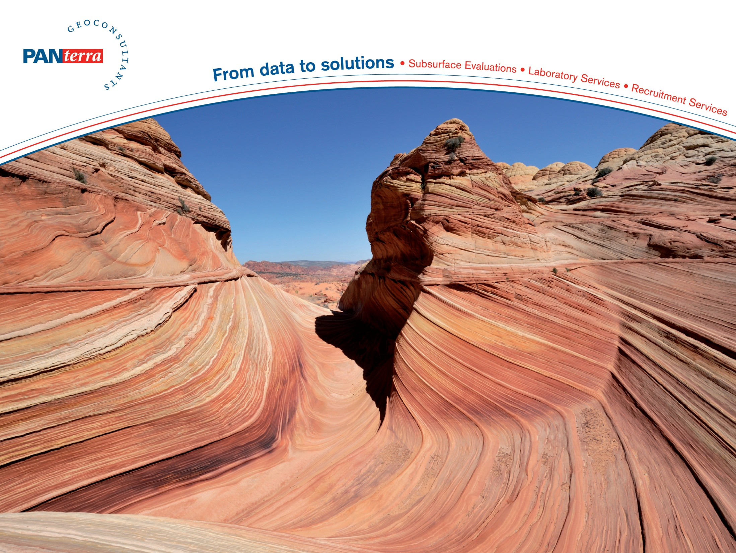
DAP Symposium Delft 2015
Geological aspects of geothermal exploration in the West Netherlands Basin.
Andrew A. van de Weerd
Yvonne A’Campo

Slide 2
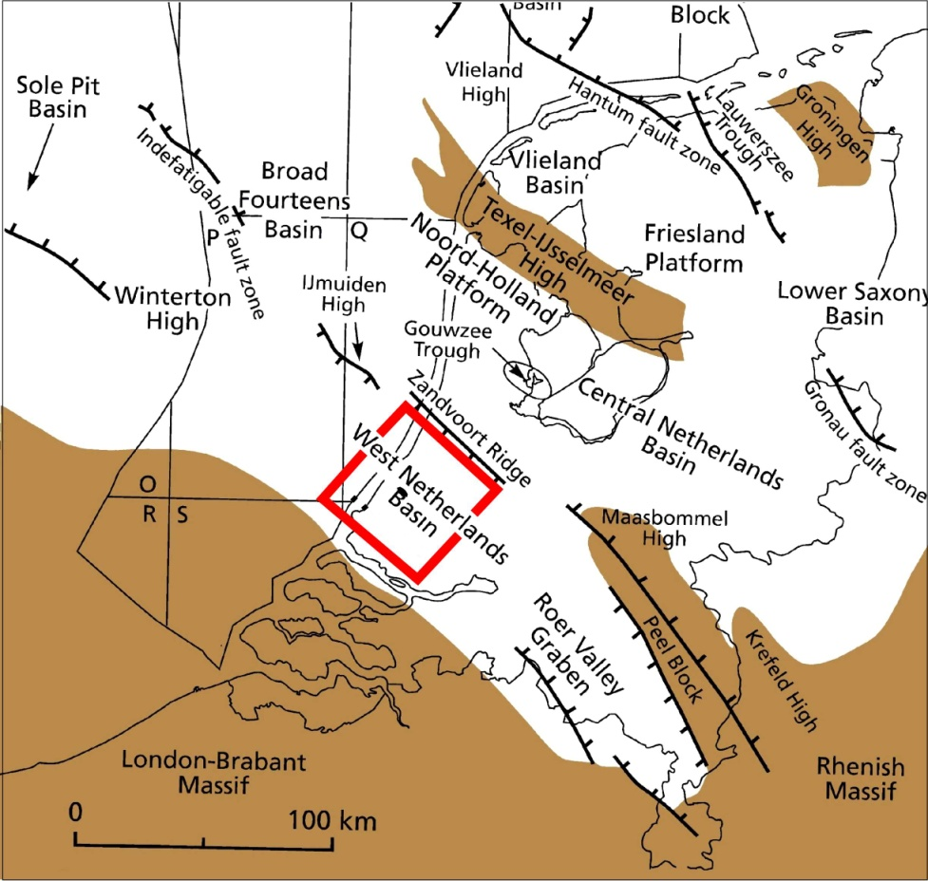
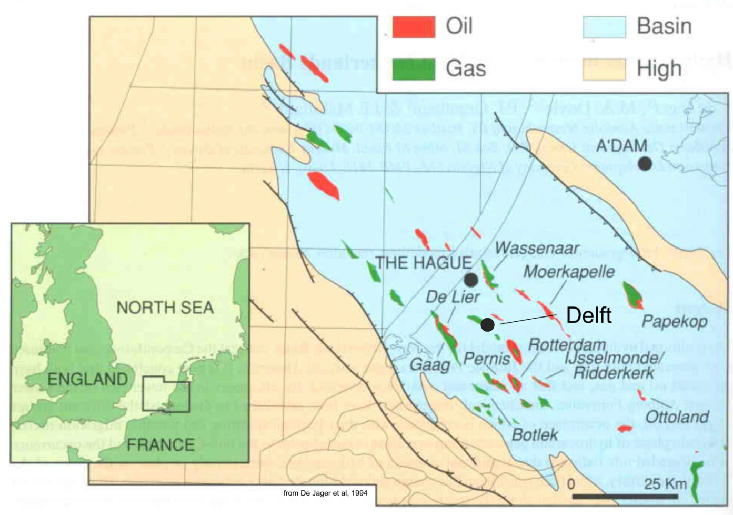
Location maps of the West Netherlands basin
Notes:
Location maps of he West Netherlands basin. Note 1) the strong NW-SE trend 2) the continuation to the offshore area and the Roer Valley Graben. 3) the oil and gas fields in green (=gas) and red ( =oil)

Slide 3
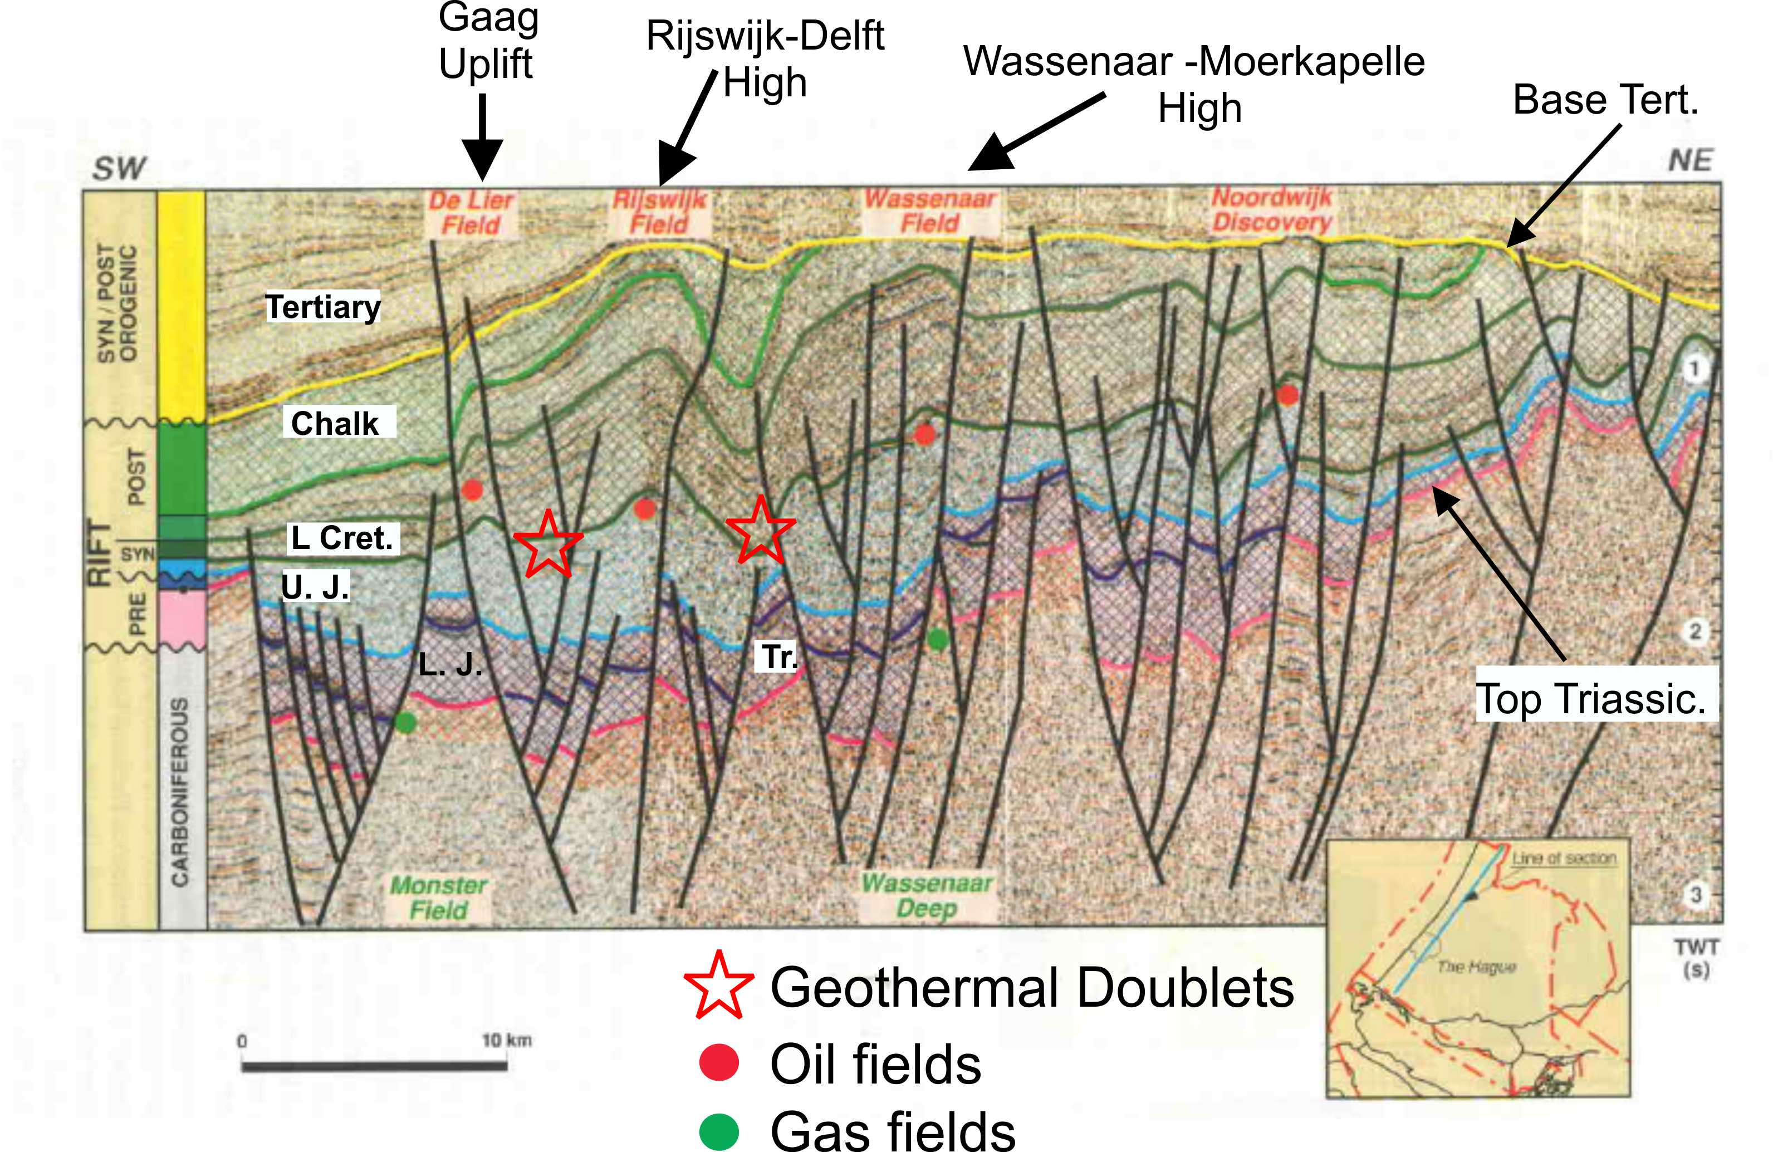
Seismic section through the basin
Notes:
Seismic section through the basin. Note 1) the small size, only some 60-70 km 2) the stratigraphy Tertiary, Upper Cretaceous Chalk, Upper Cretaceous, Lower Cretaceous, Upper Jurassic, Lower Jurassic and deeper levels. 3) the basin originated in the Upper Jurassic with strong subsidence along NW-SE oriented faults which is the tectonic grain of the basin. 4) In the late Cretaceous followed by inversion along the same tectonic grain. 5) note these late Cretaceous inversion structures with have oil and gas fields in the Triassic and in the Lower Cretaceous Sans

Slide 4
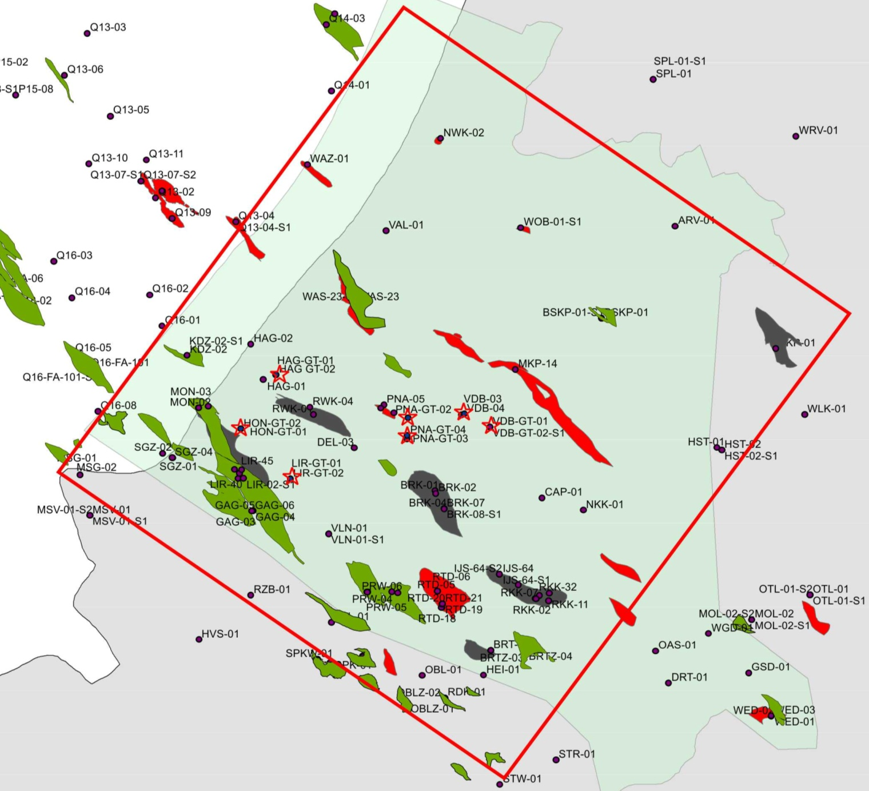
Oil and gas fields in the WNB
High trends
Oil fields
Doublets
Gas fields
Abandoned
oil fields
Notes:
Map showing the oil and gas fields in the NW-SE oriented inversion structures. Gas fields (green) in the Triassic and in the Lower Cretaceous, oil fields in the Lower Cretaceous. Note the stars with are drilled doublets. The northern part of the basin has few wells for petroleum geological reasons.

Slide 5
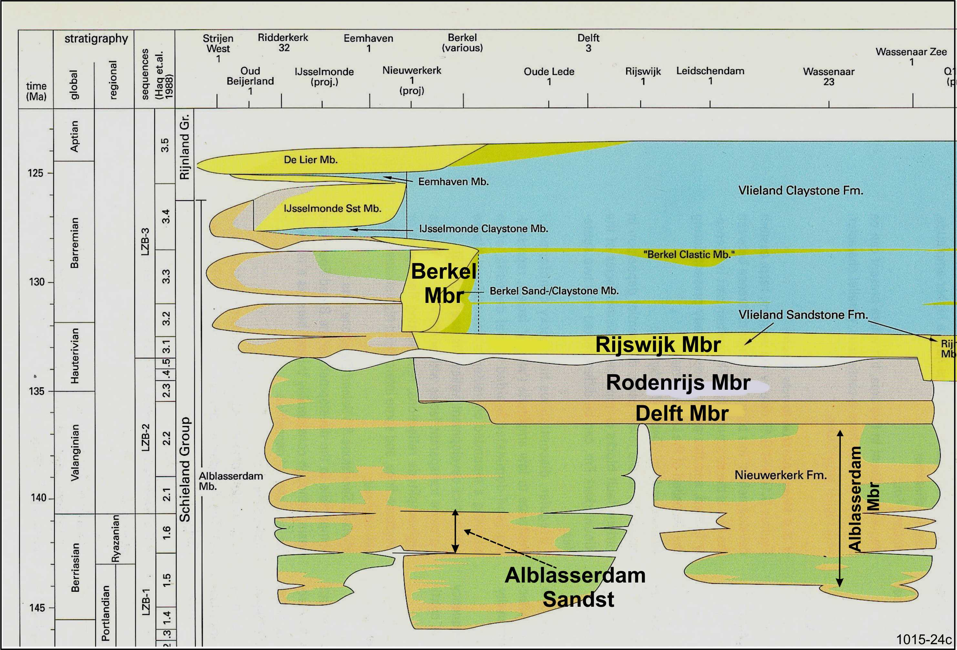
Stratigraphic Section Upper Jurassic-Lower Cretaceous
Notes:
Stratigraphic Section of the Upper Jurassic-Lower Cretaceous.
Sands are in yellow.
The stars indicate potential and drilled geothermal reservoirs.
The lower part of th section is non-marine (Alblasserdam, Delft, Rodenrijs).
The upper part is marine ( Vlieland) with the coastal sandstone members (Rijswijk, Berkel and others) in yellow.

Slide 6
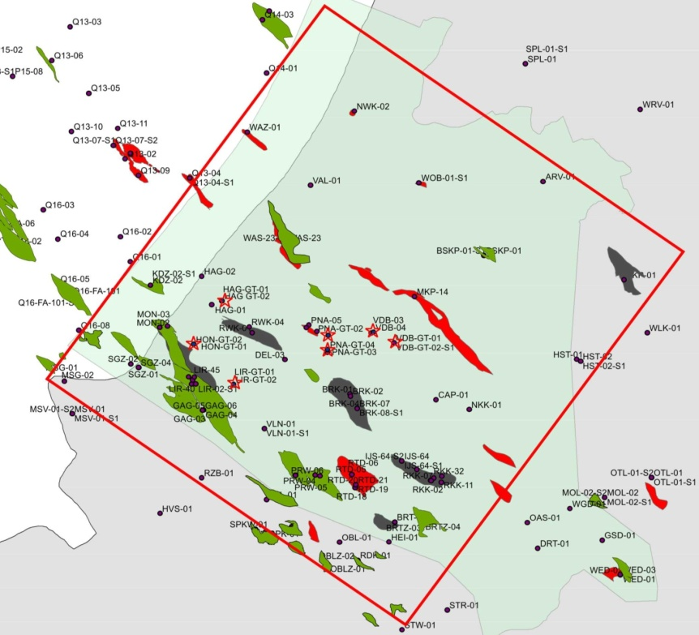

Examples from the “Westland” area
Southern Margin of the West Netherlands Basin
Notes:
I am going to show you examples from two areas: The Westland area in the south and the delft-Pijnakker area in the central part of the basin. The distance between the areas is some 10-20 km.

Slide 7
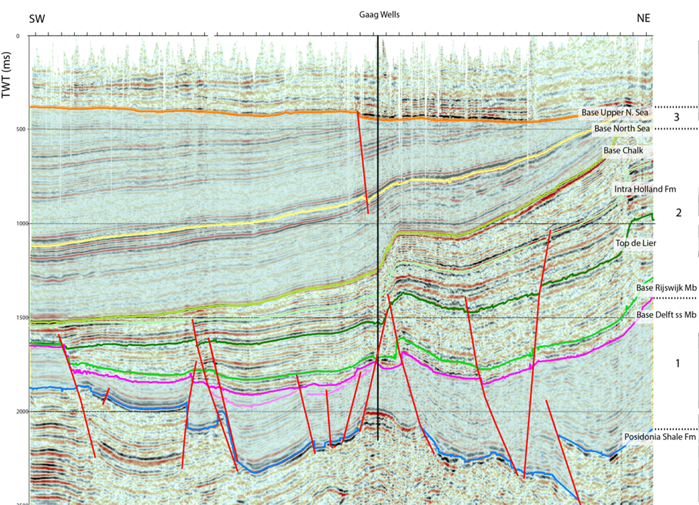
Southern
Basin Margin
Delft-Rijswijk
High
Gaag Uplift
with Triassic gas fields
Notes:
SW-NE oriented seismic line through the Westland area. The basin margin is to the south. The Delft Rijswijk High is the right. In between is the Gaag uplift with Triassic gas fields and Cretaceous oil and gas fields (now depleted) in the inversion anticline. The star indicates the presence of the working geothermal doublets in the Delft Mbr.

Slide 8
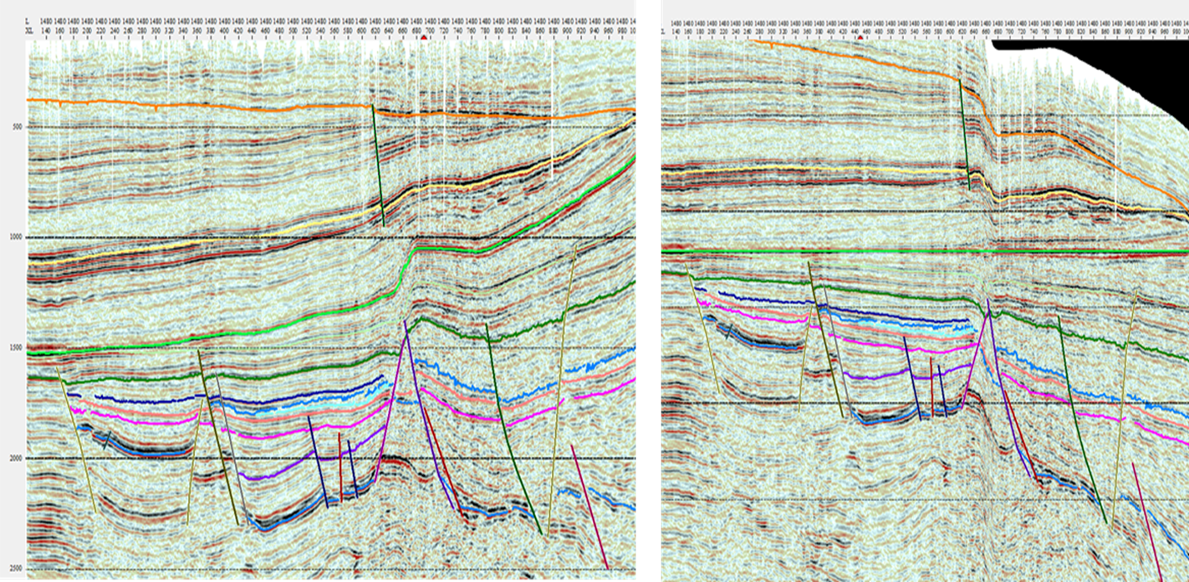
Flattened on Base Chalk = effect of inversion removed
Seismic section in TWT
1 Sec
Base Chalk
Top De Lier
Base Chalk
Delft
2 Sec
Gaag
Uplift
Pos
Gaag
Uplift
Pos
Notes:
Left is the original seismic section, to the right a flattened section, flattened horizon is the base of the Upper Cretaceous Chalk. The flattening removes the effect of the Late Cretaceous inversion and shows the pre-Inversion structure of the basin
Note:
The interpeted horion: Lower Jurassic Posidonia, the near Delft horizon, near Rijswijk horiozn, Top de Lier horizon, base Chalk horizon .
The Posidonia is the source rocjk for the oil and gas in the Cretecous
The Gaag High must originated prior to the Late Cretaceous inversion. Thus there was an inversion phase in the Early Crtecoues
The thickening of the section towards the centre of the basin (toward the NE)
The inversion anticline that formed as a result of late Cretaceous inversion

Slide 9
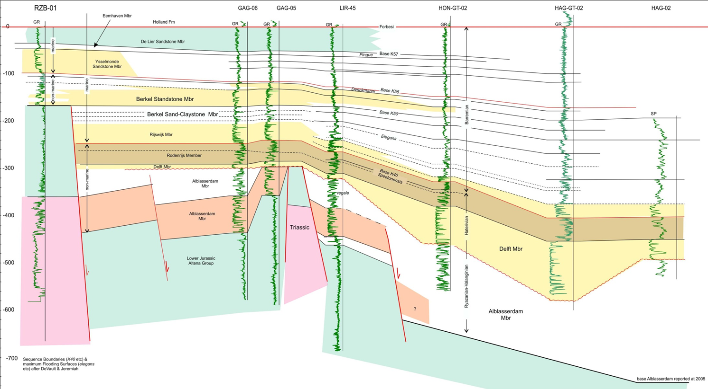
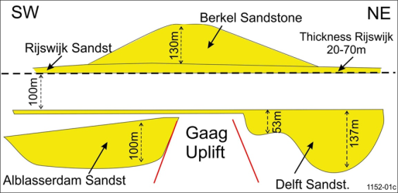
South
Well Section Westland area (GR logs)
North
Datum = top De Lier
Rijswijk-Berkel Combined
300 m
Lower
Jurassic
Delft
Triassic
Gaag Uplift
Alblasserdam Sandst
Notes:
This is a well section through the Westland area showing the three geothermal reservoirs (stars) . Note:
The Gaag uplift, the basin margin
The three reservoirs with the schematic section lower right corner
The de Lier Sandstone = marine and low permeability

Slide 10

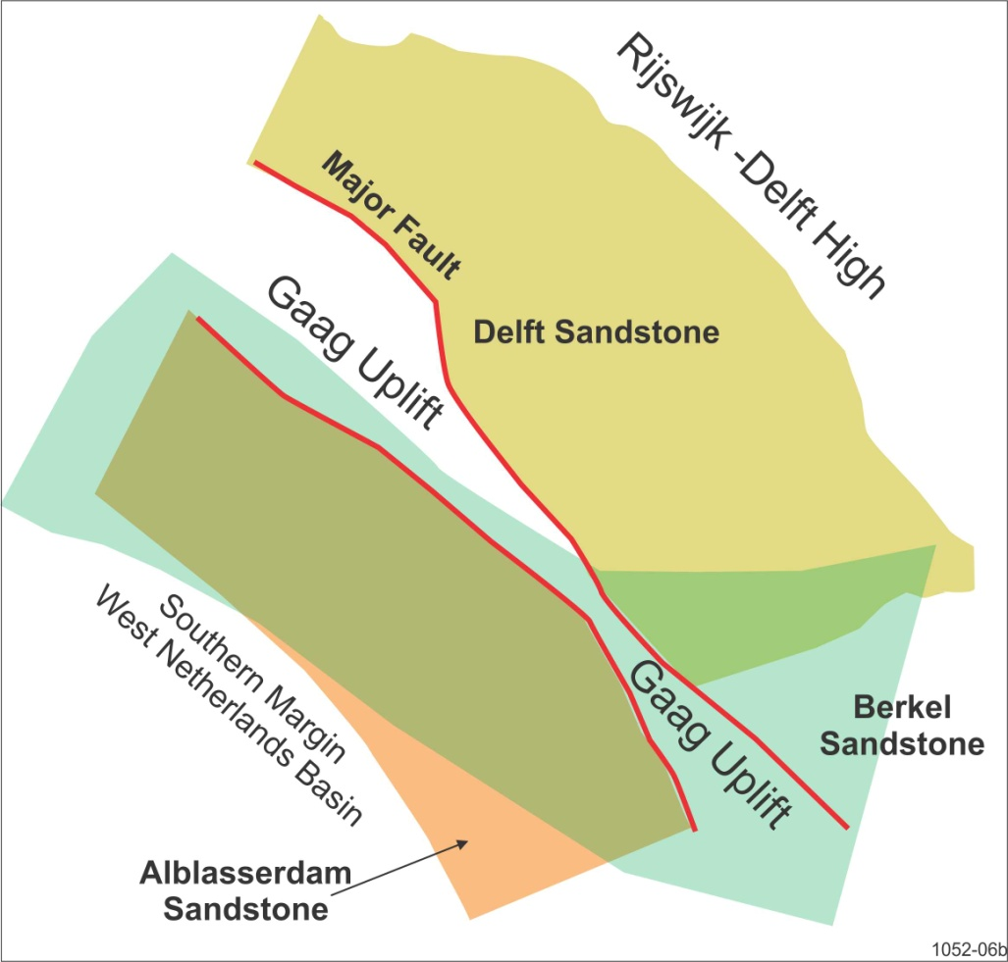
Three reservoirs in the Westland area and schematic distribution
Notes:
Schematic section showing the three geothermal reservoirs and in a schematic way their distribution
Note:
the Gaag uplift
The Delft sandstone to the NE
The Alblasserdam sandstone to the SW
The Berkel sandstone crossing the gaag uplift

Slide 11
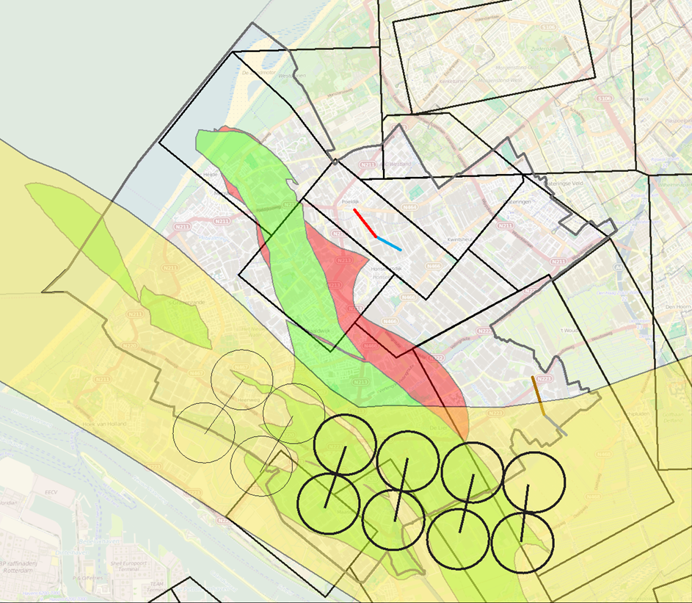

Potential Doublets in the Rijswijk-Berkel reservoir of the Westland Area
Notes:
Potential Doublets in the Rijswijk-Berkel reservoir of the Westland Area. This reservoir has not yet been tested in this area.
Note:
There is potential for some 4 doublets and possibly 2 more toward the west, if reservoir quality does allow this.
the Gaag uplift
The sand is a coast-near deposit, foreshore beach possible offshore bar.
It is thin and shaley toward the basin center

Slide 12
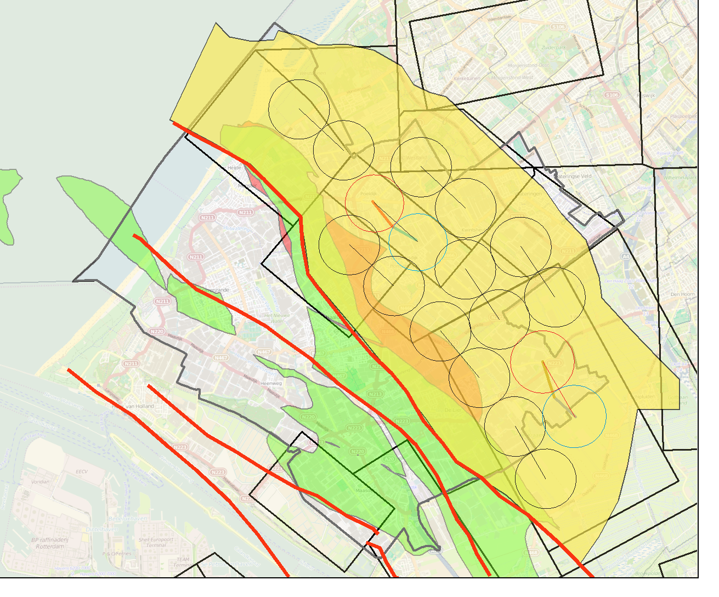
Potential for Doublets in the Delft Sandstone in the Westland Area
Honselersdijk Doublet
De Lier Doublet
Gaag uplift
Notes:
Potential for Doublets in the Delft Sandstone in the Westland Area
Note:
At present two doublet have been drilled and are in operation (in colour)
Neglecting concession boundaries there is room for 9 doublets, possibly more close to the faults of the Gaag high, or toward the Rijswijk-Delft High, but that requires detailed geological research.
For optimal planning of doublets PanTerra recommends to construct a dynamic reservoir model of the area, to

Slide 13
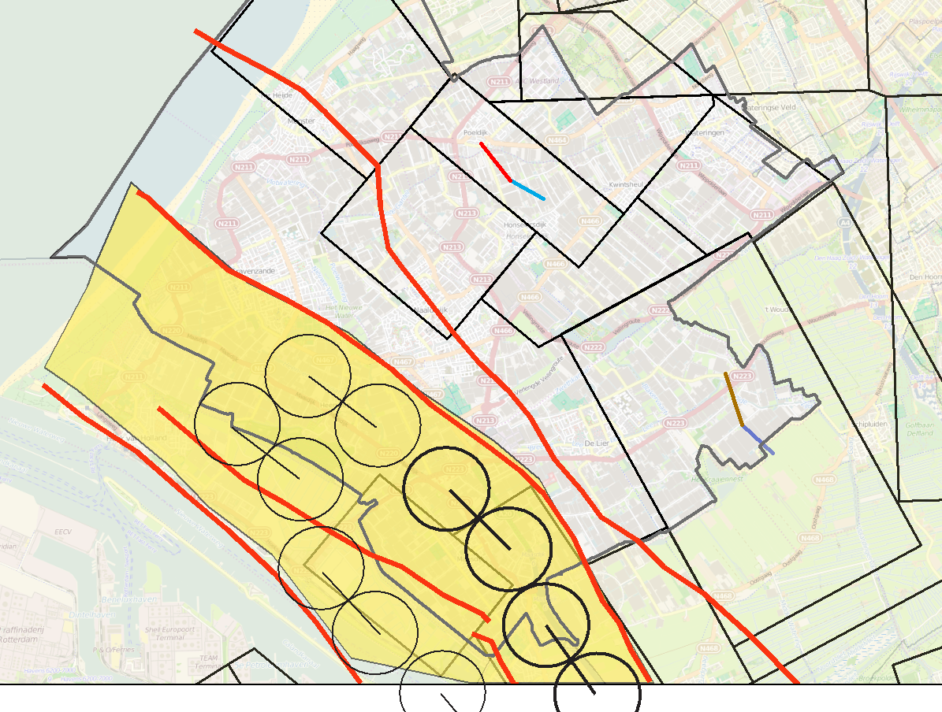
Potential for Doublets in the Alblasserdam Sandstone in the Westland Area
Gaag uplift
Gaag uplift
Notes:
Potential for Doublets in the Alblasserdam Sandstone in the Westland Area
Note:
This reservoir is untested
There is potential for some 4-5 doublets

Slide 14
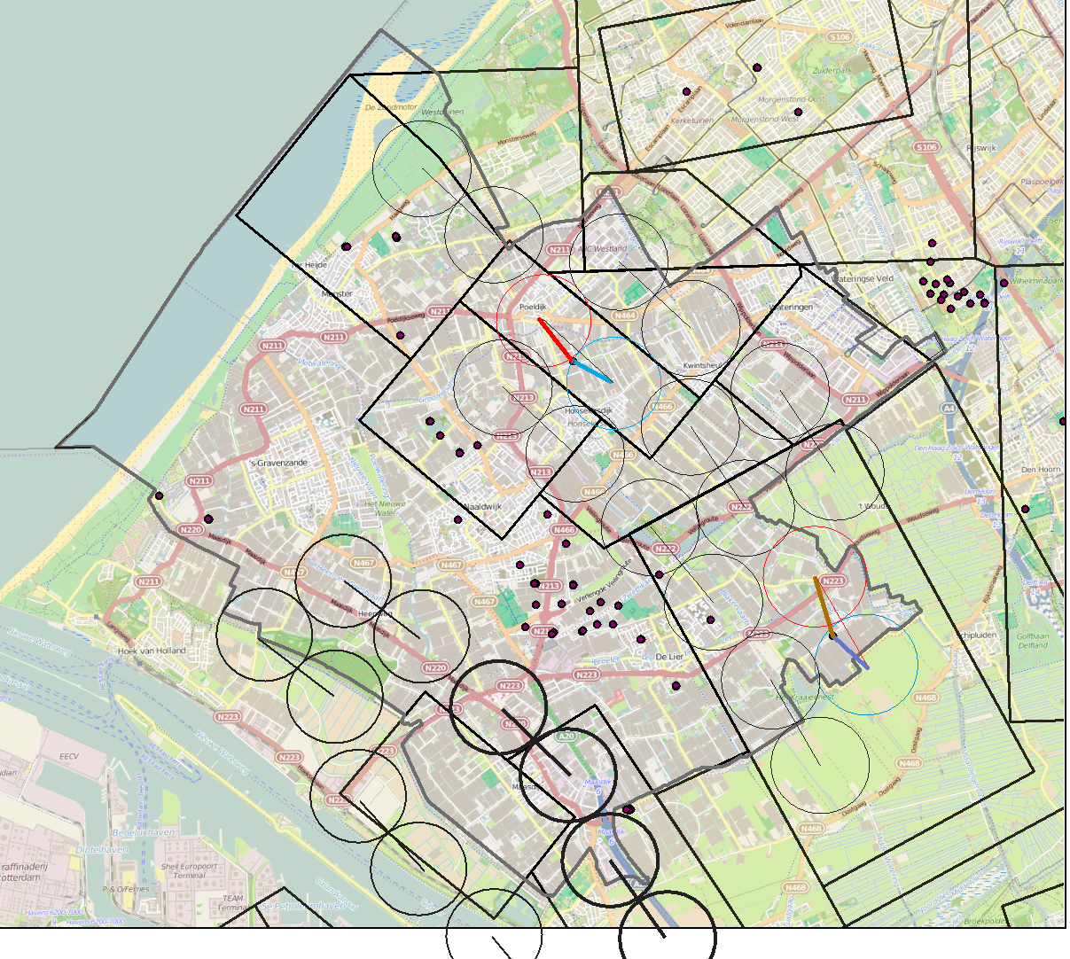
Map with doublets of two reservoir units over map showing greenhouse complexes
The Hague
Rijswijk
Delft
Rotterdam
Harbour
Notes:
The green house areas in Westland (solid colors in grey-ish)
In total there is probably potential for some twenty doublets, this a fairly quick estimated based on a wells distance of 1500 m.
It is not yet know if this is an optimal distance for a full and efficient use of the existing reservoirs.
Perhaps distance can be smaller and more doublets may be placed.
In addition ,further detailed studies are needed to decide if additional doublets may be placed near faults and towards the Rijswijk-Delft high.

Slide 15
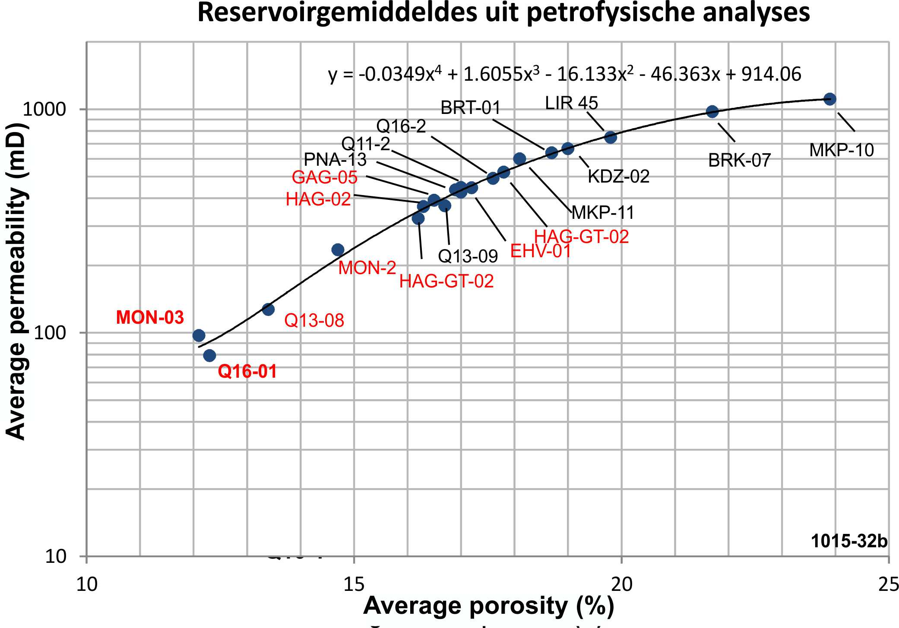
Reservoir Characteristics Delft Mbr. Westland area:
Comparison of pre-drill estimate with post-drill testing
Reservoir averages from petrophysical analyses
Notes:
Pre-drill reservoir characteristics are evaluated from petrophysical analyses of the basin.
The procedures is as follows:
This graph the plots averages for the Delft Mbr in 19 wells in the basin. The red values are questionable and should be removed for several reasons such as not from the Delft Mbr. or absence of a reliable porosity log
From measured core-plugs a porosity-permeability relation is established for the reservoir unit (Delft)
Porosity will established from wireline logs over the reservoir
Using the porosity-permeability relation the porosity curve for each well is transformed in a permeability curve.
Average porosity and permeability for the reservoir established and plotted and this is plotted on a graph.

Slide 16
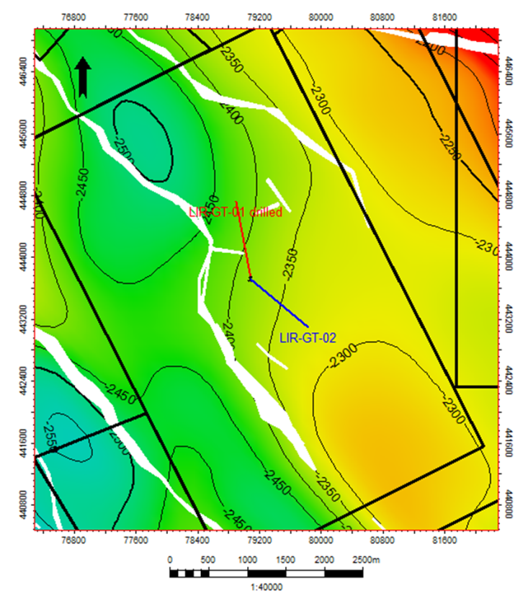
Test results of the Delft Mbr in HON-GT-01 and LIR-GT-01 :
HON-GT-01:
Reservoir perm: 1000mD (pre-drill estimate 150-400 mD)
LIR-GT-01 & 02:
Reservoir perm 1000mD, (pre-drill estimate 170-500-920 mD)
Presence of parallel flow barriers (faults) at 750 & 1250 m
Water Temperature 90 C
Thickness reservoir = 70 m, N/G = 0.5
Wells diameter in aquifer 8.5 inch
Flow rates up to 350 m3/hour with pump pressure of 55 bar (after clean-up)
Depth map De Lier Doublet with faults from seismic

Slide 17
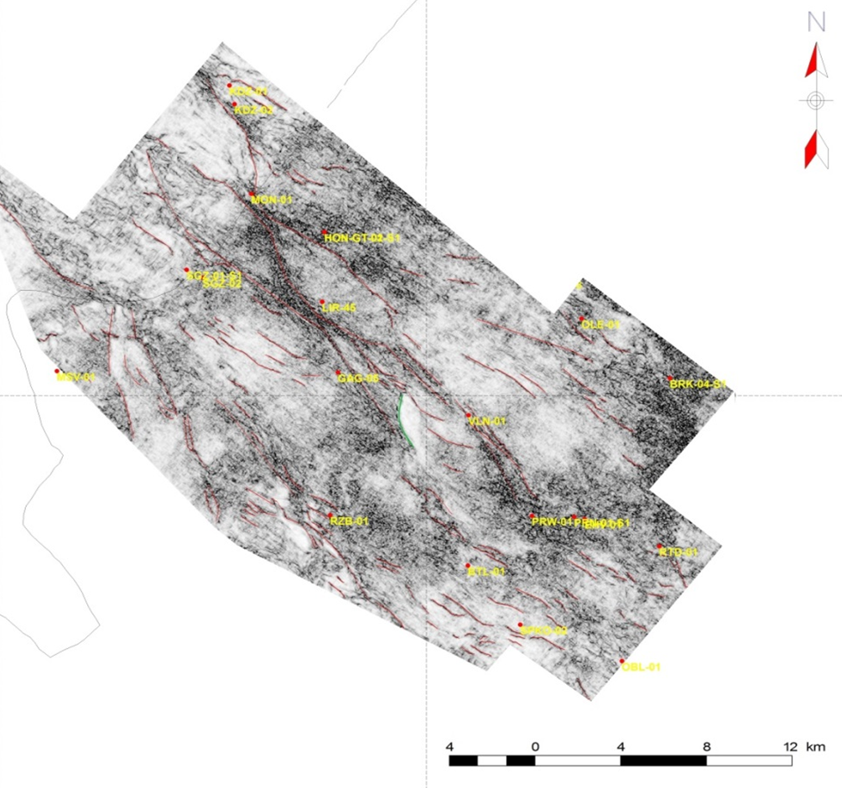
Tectonic Analysis
HON doublet
LIR doublet
Fault pattern on a similarity attribute map
Notes:
This is an attribute maps showing similarity or rather dissimilarity. It is good in detecting faults here enhance with a red line. Faults that are interpreted as continuous are according to these maps in fact in most cases different parallel strands that are somewhat dislocated.

Slide 18
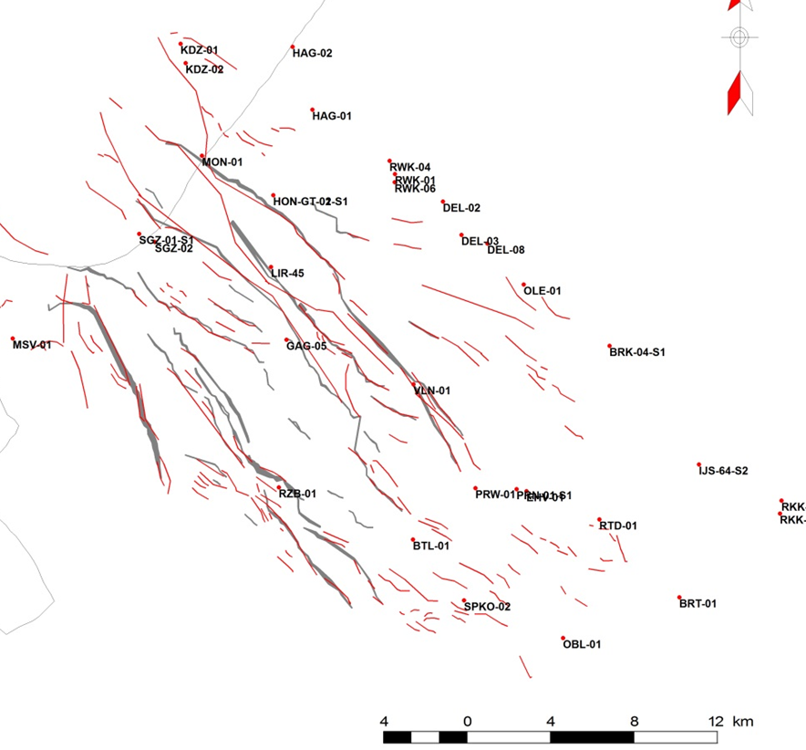
Fault pattern without the map
HON
Gaag uplift
LIR
Rijswijk-Delft High
Gaag uplift
South margin of the basin
Notes:
This is the fault pattern without the underlying similarity map. Such maps help to place the two wells of adoublet to be parallel with the tectonic grain ( or tectonic trend trend) and avoiding faults between the two wells of a doublet.

Slide 19
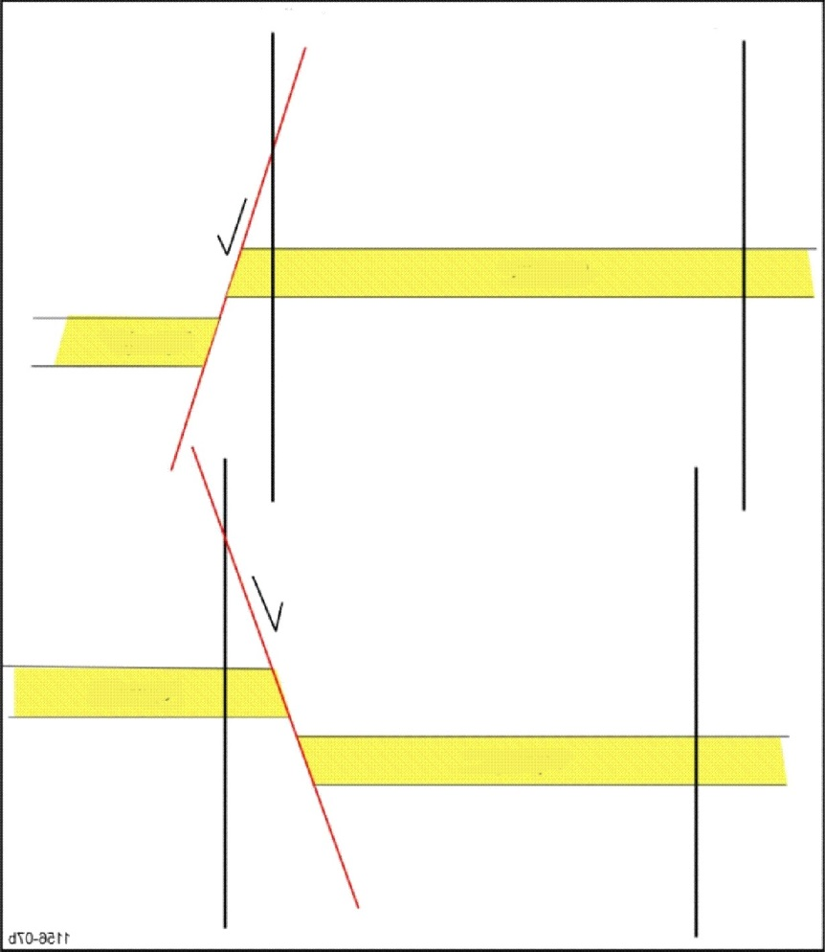
Presence of fault: 25 m missing section in left well
25 m missing section
Rijswijk Mbr
Notes:
In this case the 25 meter offset cannot be seen on the seismic, seismic is not good enough here. We assume the fault is a normal fault with a direction parallel to the structural trend of the basin. In this case it was not a problem because the wells are aligned parallel to the structural trend

Slide 20
Conclusions from the Westland Area
There are three potential geothermal reservoirs.
Two geothermal doublets drilled in the Delft Sandstone.
The other two reservoirs remain undrilled.
Post-drill testing has revealed that the permeability of the Delft reservoir exceeds the pre-drill estimates.
There is potential for at least 20 doublets in the area.
Detailed geological analyses are needed for a good placement of the injector and producer.
Well designed and executed test are needed to establish the potential of the reservoir and helps the planning of following wells and further reduce the geological uncertainty.

Slide 21

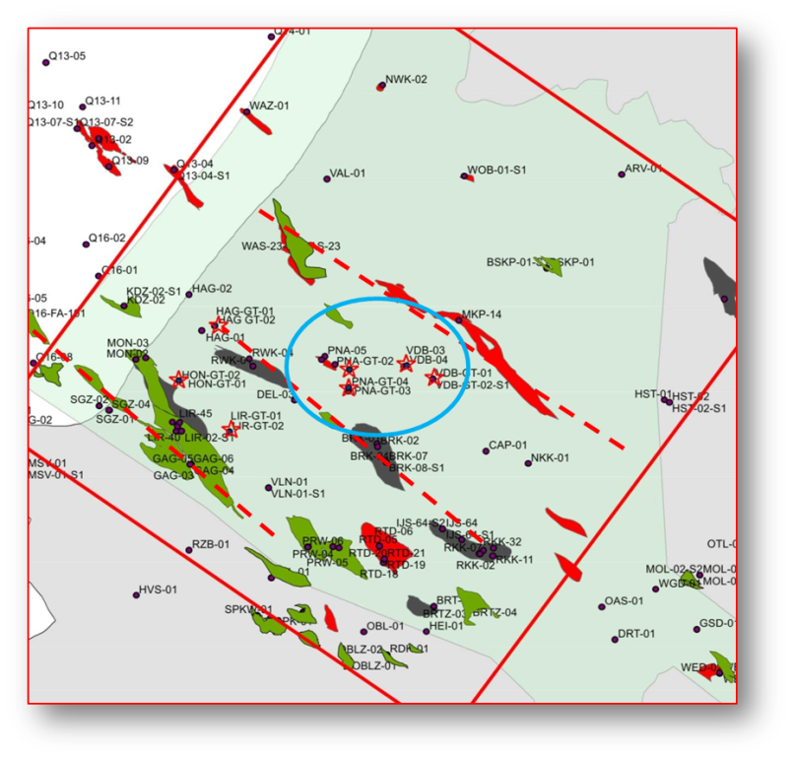
Examples from the Delft-Pijnakker area
Central Part of the West Netherlands Basin

Slide 22
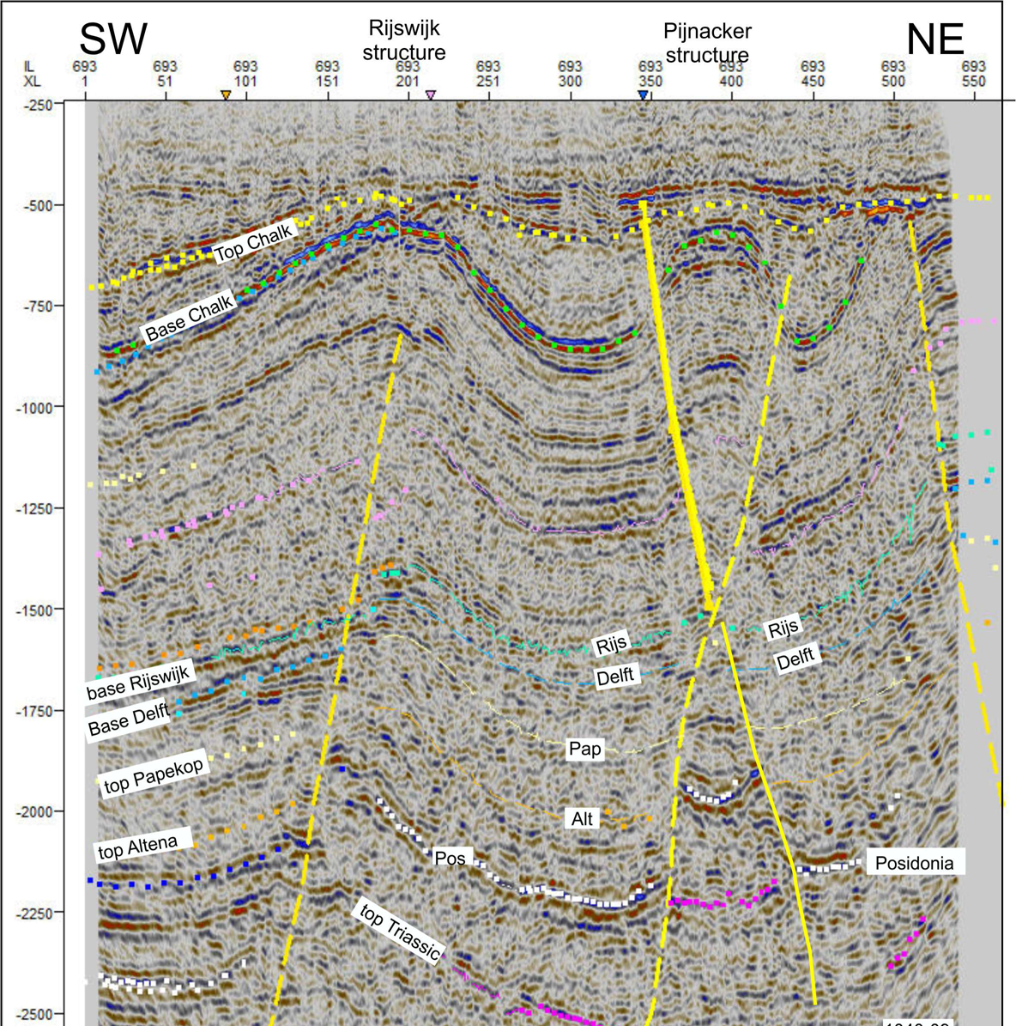
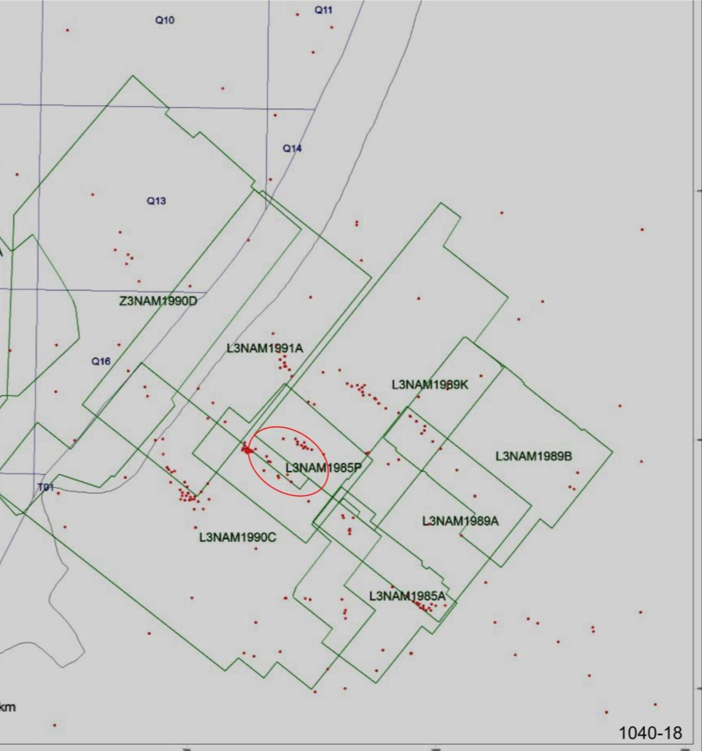
DAP project seismic line

Slide 23
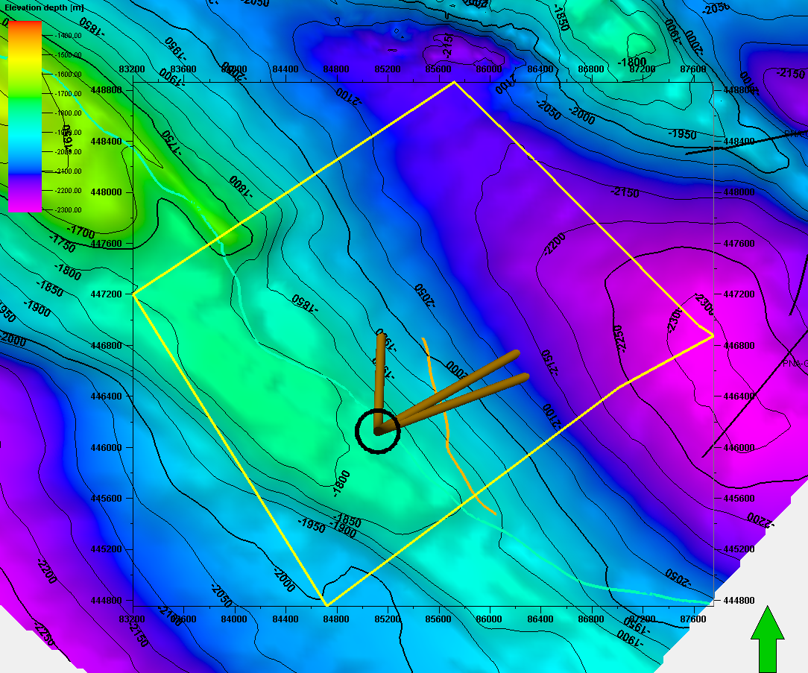
Top Delft Mbr Depth Map for DAP proposals
PNA doublets
Proposed injector
Proposed producers
Notes:
Map shpwing the Delft high , where we are sitting ( or standing)

Slide 24
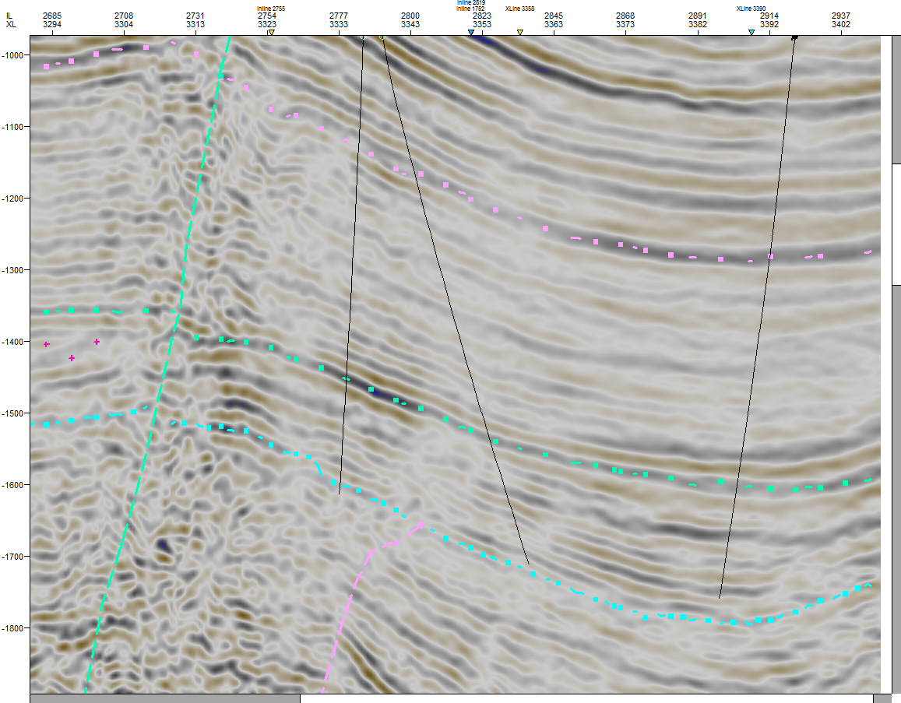
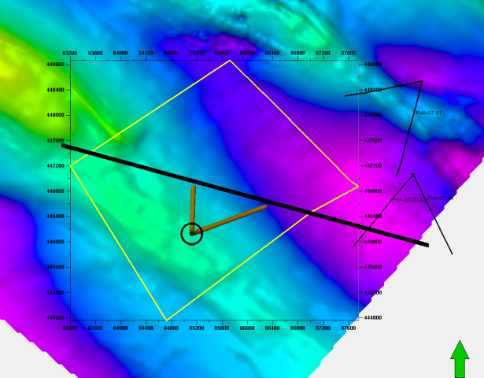
Seismic line showing both wells at reservoir level
Near top De Lier
Near Base Rijswijk
injector
producer
PNA-GT-03-S2 (projected)
Near base Delft
Subtle Unconf.
Notes:
This sesimic is from a reprocessed volume. It shows the producer and the injector and absence of faukts between the two wells. Note the subtle unconformity, better visible in the next slide.

Slide 25
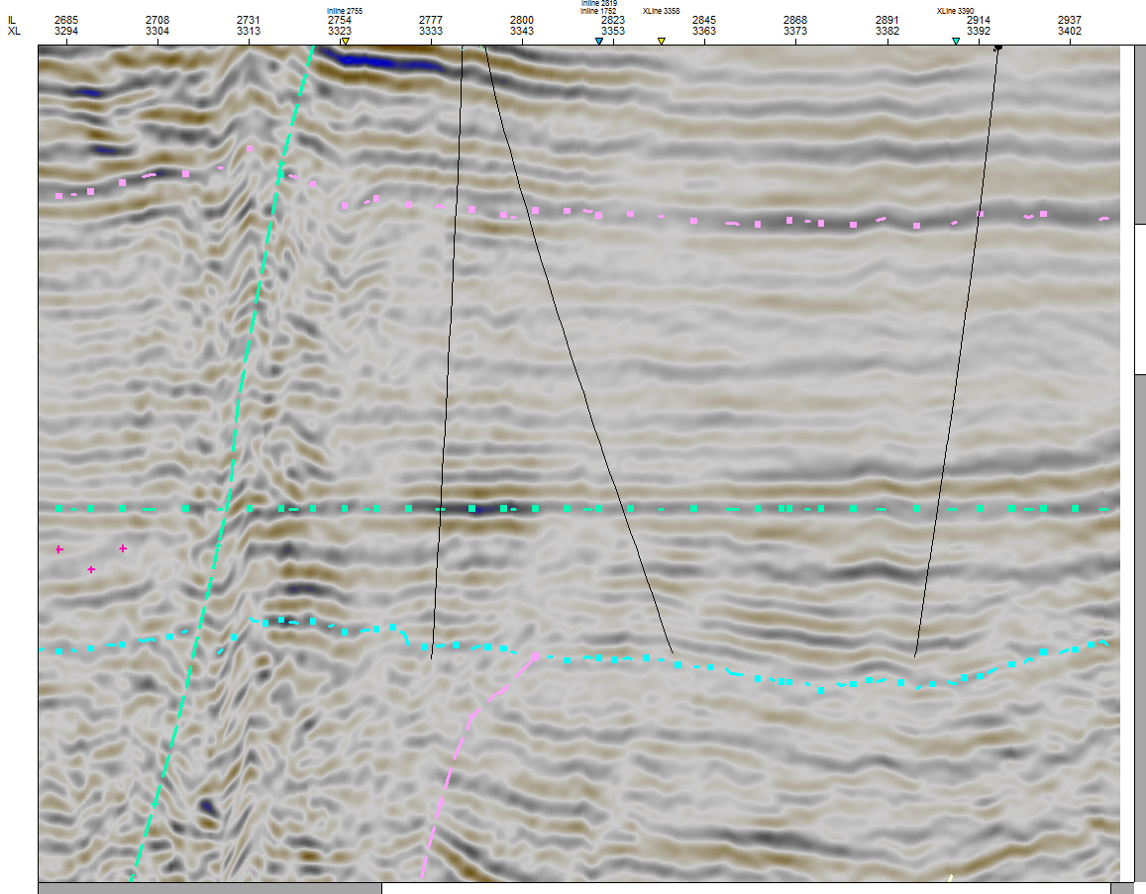
Flattened Seismic line showing both wells at reservoir level
Near Top De Lier
injector
producer
PNA-GT-03-S2 (projected)
Near Base Rijswijk
Near Base Delft
Subtle Unconformity
Notes:
This section is flattened on the Base Rijswijk horizon. It shows several features.
Note the thickening of the section below the Rijswijk and thinning in the Delft High, showing that the structures were active during deposition. Note that theunconformity is slightly better expressed with reflector being cutoff

Slide 26
Well section in the Delft-Pijnakker area (GR logs)
PNA-GT
3-4
VDB-GT-
3-4
VDB-GT
1-2
1.7 km
Oil well
Oil well
200m
Berkel
Rijswijk
Rijswijk-Berkel
@ 1625 m depth
2300 m
depth
Delft Reservoir
@ 1775 m depth
Notes:
Stratigraphy in the Delft Area, section flattened on the Rijswijk Sandstone

Slide 27
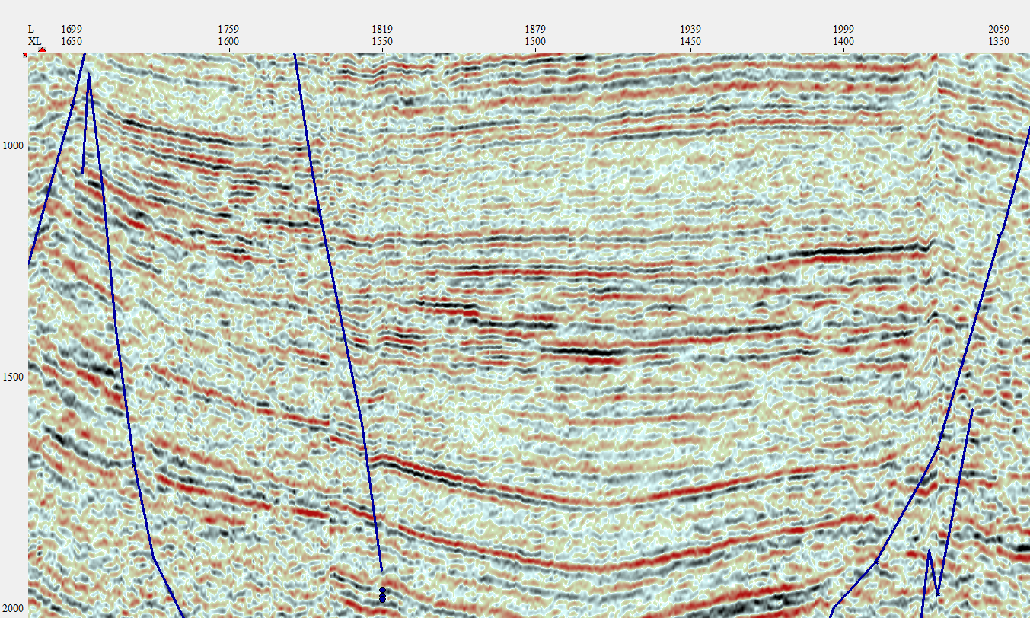
Berkel Sandstone pinch-out on flattened seismic section
Berkel Sandstone
Pinchout

Slide 28
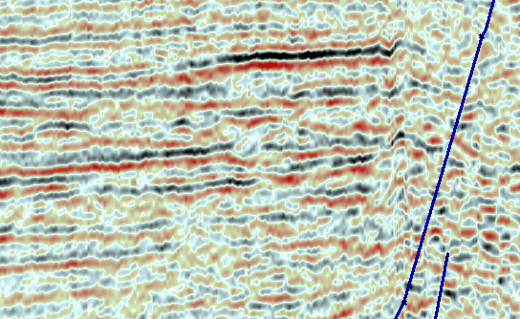
Detail of the Berkel Sandstone pinch-out
VDB-GT-03 & 4
VDB-GT-01 & 2
170 msec

Slide 29
Reservoir characteristics Delft-Pijnakker area
There are no good designed tests for the four doublets and permeabilities could not be calculated by our specialist
Delft Mbr Reservoir Characteristics
Permeability: probably in the 300-400 mD range
Thickness: 60-90 m
N/G: approx. 0.8
Flow rates in the order of 125 -160 m3/h @ 50 -60 bar pump pressures
Rijswijk-Berkel reservoir characteristics
Permeability: probably in the 300-400 mD range
Thickness: 85-90 m
N/G: 0.8
Flow rates in the order of 150 m3/h @ 50 bar pump pressures
Notes:
Good test results not available despite presence of four drilled doublets.

Slide 30
Post-drill Testing Geothermal Reservoirs
Geothermal operators had little interest in running wireline logs. In most cases only the GR is available from LWD. Two of the early geothermal wells do not have a GR log, making it impossible to establish the precise reservoir thickness. Similarly, post-drill tests were not properly designed and executed.
Well tests should be designed and executed in such a way that a kh (transmissibility) of the reservoir can be established. In addition, an interference test of the producer and injector should be executed.
PanTerra was responsible for he test design of the latest doublet in the basin (De Lier) and a reliable reservoir permeability was established. In addition, distance to barriers (= faults) and (probable) anisotropy of the reservoir was established.

Slide 31
Conclusions Delft-Pijnakker area
Two reservoirs: Delft and Berkel Sandstones
Four Doublets have been drilled, three are in the Delft Mbr
Data collection of these early doublets less systematic and less complete
Delft Mbr has lower permeabilities than in the Westland area
Compared to the Westland the tectonism is more complex & intense
PanTerra has not yet established the total potential of the Delft-Pijnakker area, but PanTerra has done research and designed three more doublets.

Slide 32
Thank you

