Slide 1
District heating around Paris
Guarantee policy
Christian BOISSAVY
Geothermal French Association for Professionals

Slide 2
The abundance of various geothermal resources

Slide 3
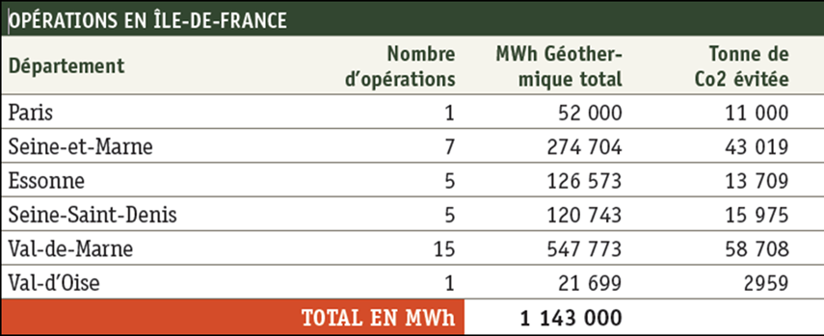
63 Existing geothermal DH systems in France (2012)
More than 75% of the total geothermal production is located in the Ile de France region and specifically in Val de Marne Département.
End of 2015, 8 additional DH should be operational, leading to 46 doublets operated in Ile de France at more than 500 MW installed

Slide 4
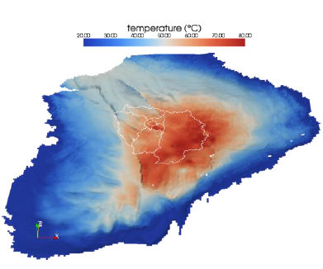
The favourable geological conditions in the Paris basin

Slide 5
Dogger map dated 1976
Exploration oil and gas wells
Iso-depth top Dogger
Expected productive zone for the reservoir

Slide 6
Milestones of Dogger exploitation in the Paris basin
1960’s-Pre-oil shock: First attempt (abandoned and second attempt was successful
1973-1978-Post first oil shock: Four completed doublets and enforcement of the legal framework
1979-1986-Post second oil shock: 51 completed doublets with over 90% of success ratio, first well damage symptoms
Late 1980’s-Early exploitation stages: Corrosion/scaling damages and equipment failure (submersible pumps and others)
1990’s-Technological and managerial maturation: technical improvements, with R&D stimuli, debt renegotiation, abandonment of 20 non economic and severely damaged doublets
2008-2015- Restart of the geothermal business: ADEME geothermal fund support, private investment, new doublets with upgraded production

Slide 7
Typical geothermal doublet scheme in Ile de France

Slide 8
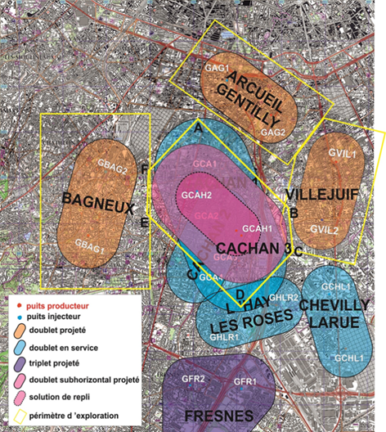
Concentration in Val de Marne has to be carefully managed

Slide 9
Development issues and gained experience The thermal breakthrough

Slide 10
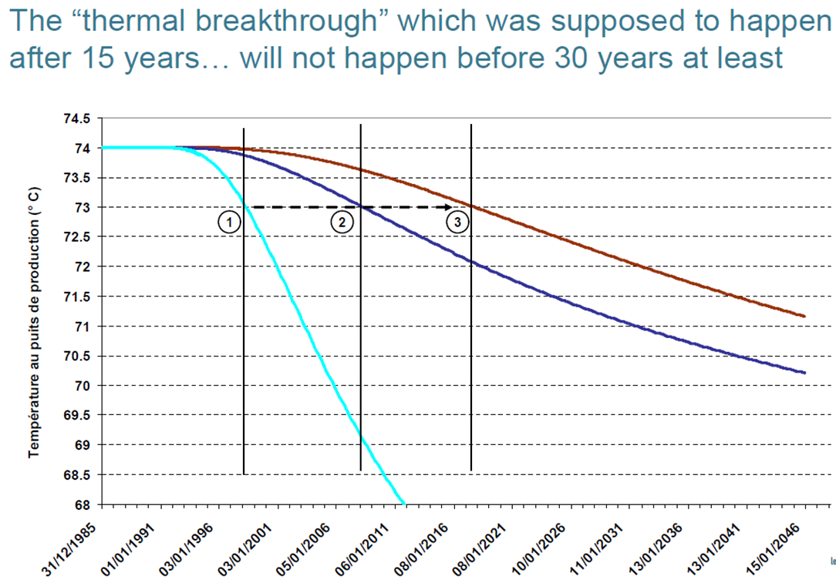
Development issues and gained experience

Slide 11
Development issues and gained experience

Slide 12
Development issues and gained experience The ageing of wells is the true limitation of the operations realized in the 1980s

Slide 13
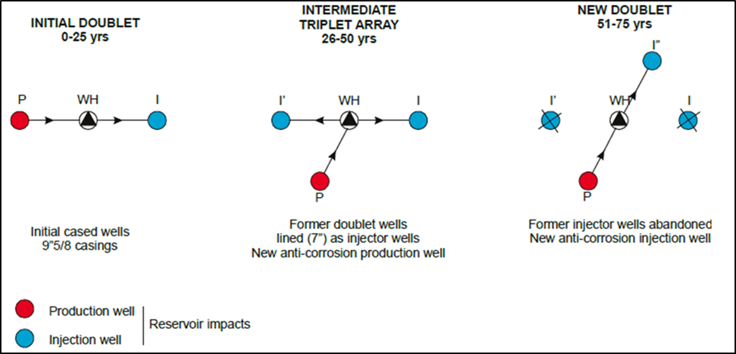
Development issues and gained experience New schemes to revamp the old doublets

Slide 14
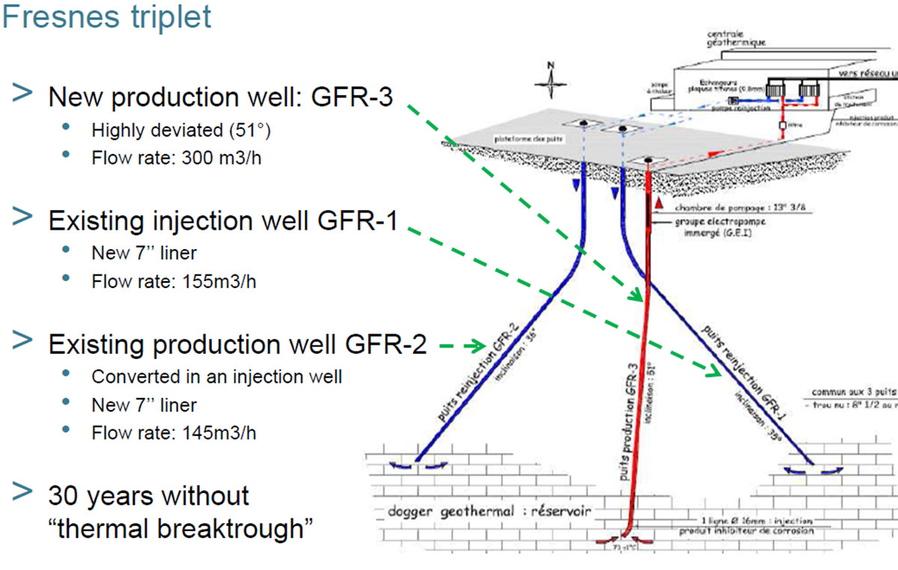
Development issues and gained experience

Slide 15
Development issues and gained experience

Slide 16
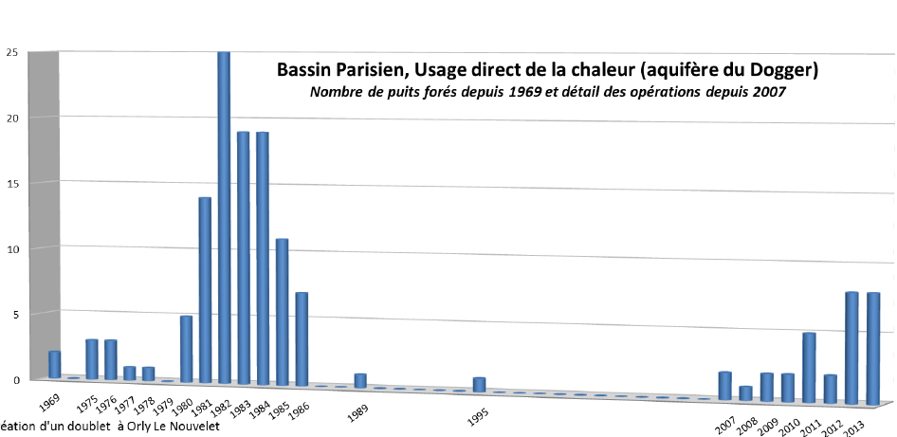

Slide 17
New plants and remediation of old doublets

Slide 18
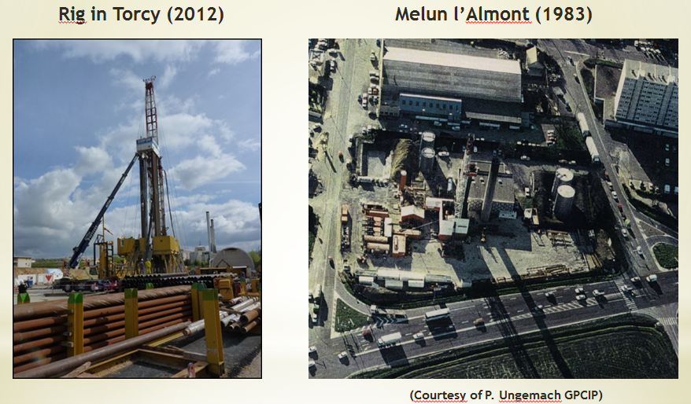

Slide 19
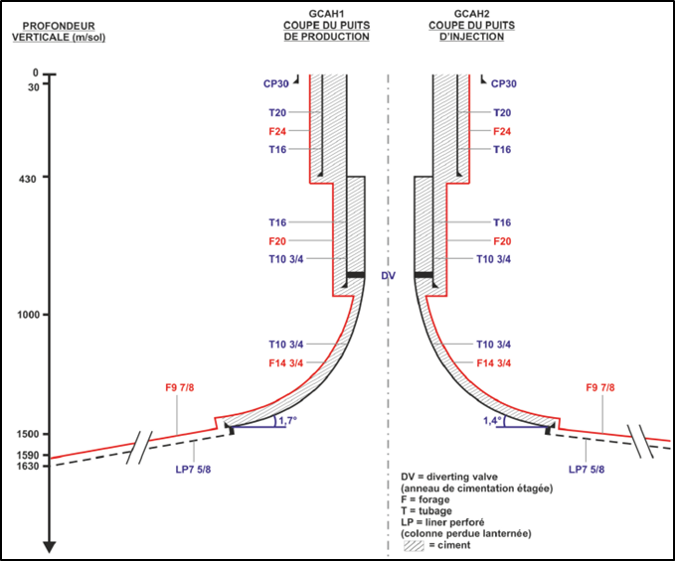
New technologies to be utilised in Cachan
A new doublet will be drilled sub-horizontally in the reservoir allowing a significant increase in the production flow-rate or giving the possibility to exploit the reservoir even if the permeability is low. (expected flowrate at 450m3/h)
(Courtesy of GPC IP)

Slide 20
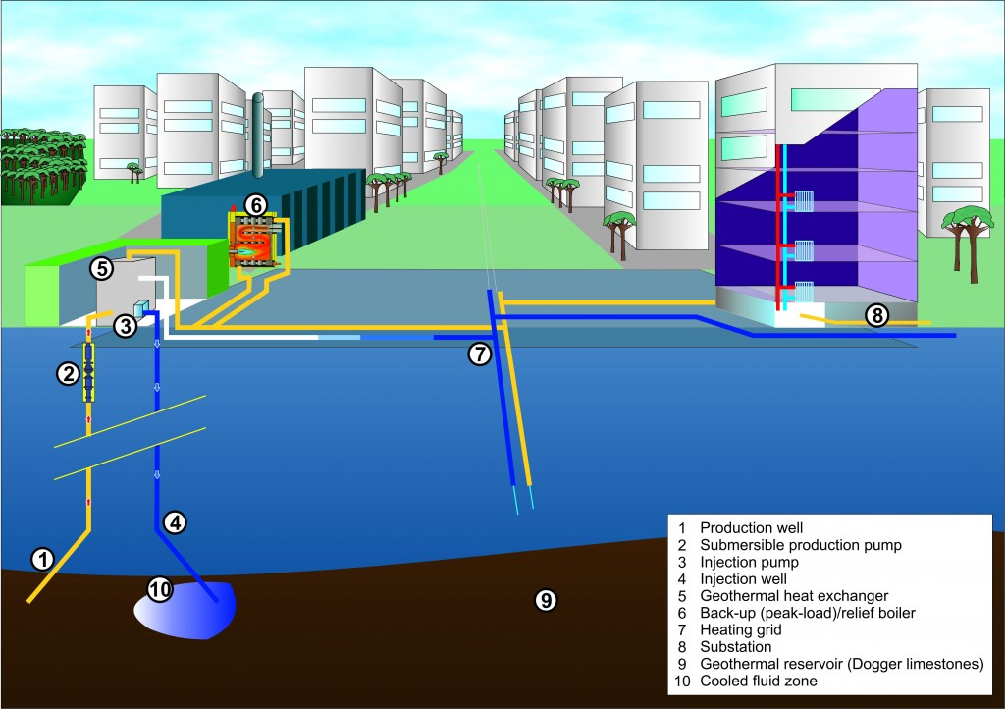
More than 400 MW th installed for direct uses GeoDH systems
Mature technologies adapted from oil and gas business; doublets or triplets in between 5 to 15 MWth using big power heat pump to valorize the geothermal water before injection. DH connecting 20000 to 30000 inhabitants with existing network revamped or new network fitting with low temperature exploitations.

Slide 21
The key for success in Paris has been the risk mitigation system put in place by ADEME

Slide 22
The Short Term Risk: insurance principles

Slide 23
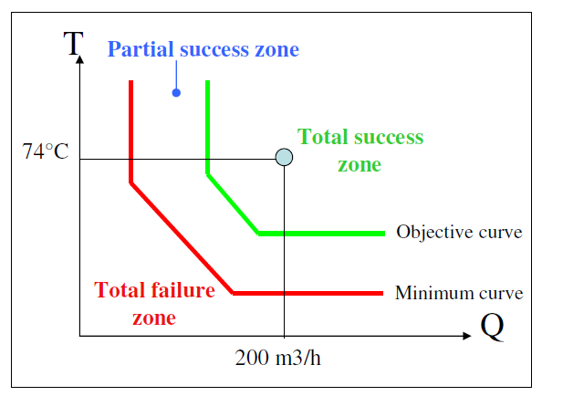
The Short Term Risk: insurance principles

Slide 24
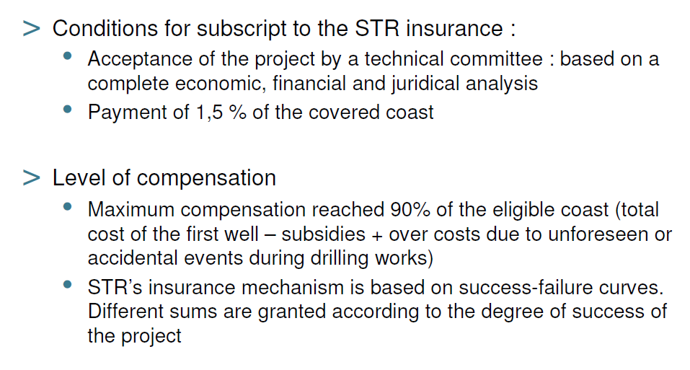
The Short Term Risk: insurance principles
Payment of 3 to 5% of the covered cost ( for a Dogger doublet of 11 M€ the insurance cost is only around 350K€)

Slide 25
The Long Term Risk: insurance principles

Slide 26
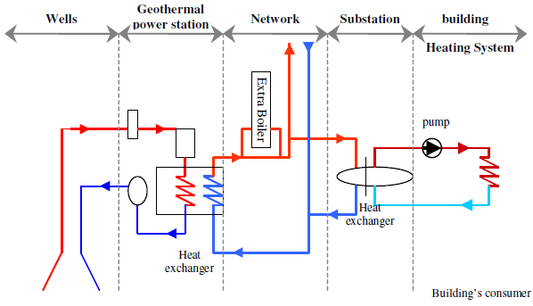
The Long Term Risk: insurance principles The contract duration is 15 years
LTR covers :
The wells, materials and specific equipment such as anti corrosion devices
The geothermal loop
The quality of the geothermal resource (clearly established at the origin)

Slide 27
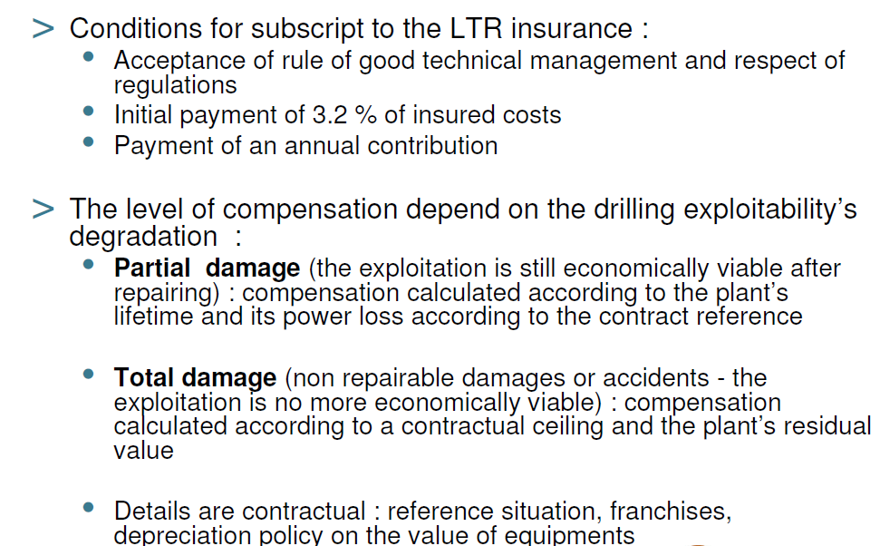
The Long Term Risk: insurance principles
The contractor has subscribed the Short Term Risk insurance
The annual fee for a Dogger doublet is between 10 to 15 K€
Average of 10 to 15 K€

Slide 28
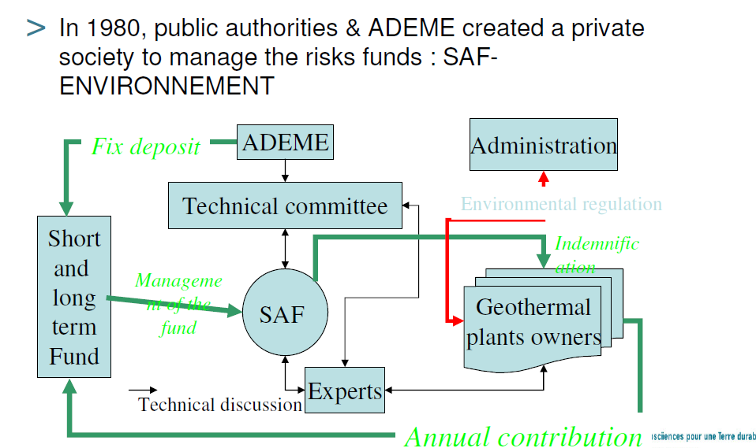
Creation of the fund in 1980 by ADEME and public authorities. The fund is managed by a private company owned by the Caisse des dépôts et Consignations.

Slide 29
Management of the Fund

Slide 30
The recapitulative result of the fund after 34 years
Income
- Subsidies ADEME and Miniostry of Industry: 17,5 M€
- Amounts paid by consumers: 14,2 M€
- Financial products: 8,5 M€
Expenses
- Amounts paid to contractors: 21 M€
- Provisions: 0,5 M€
- Management and expertise: 6,5 M€

Slide 31
Thanks for your attention
www.afpg.asso.fr

