Slide 1
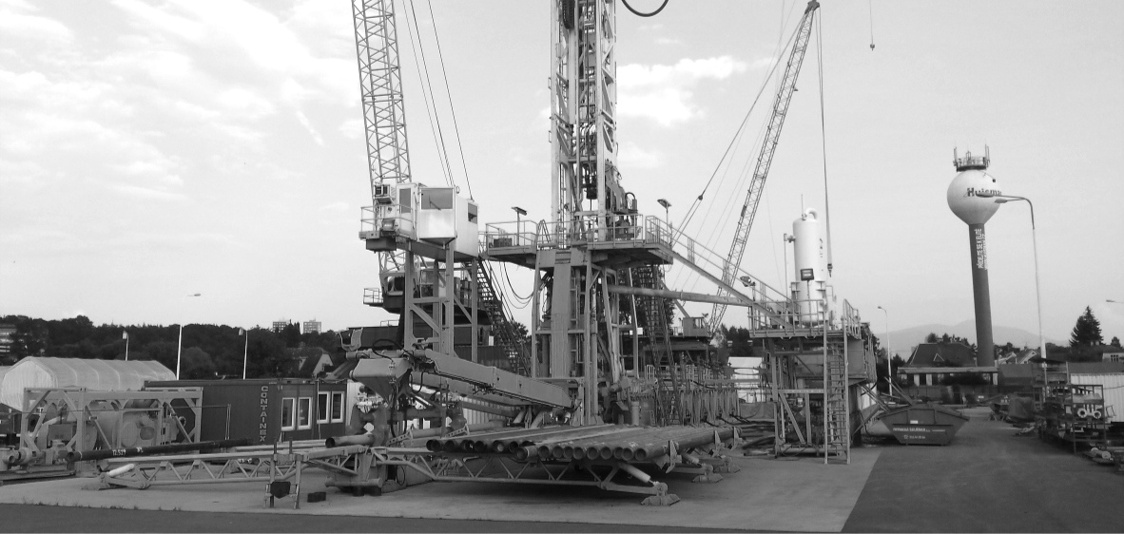
Innovations in drilling
DAP 2015
Maarten middelburg (HWT & WEP)
February 25, 2015
Delft
Notes:
Thank you Professor Bruhn for your introduction and a thank you to DAP for allowing me to speak here today about our ideas to improve the drilling process.
Huisman Well Technology (HWT) is a joint venture between Well Engineering Partners and Huisman Equipment and combines the expertise and understanding of the drilling process with a highly skilled and innovative equipment manufacturer for the drilling and offshore industry. Together these companies share a vision of improving the drilling process.
In the current drilling climate and especially geothermal drilling, the total well cost (and residual risk) can make or break a project.
Huisman Well Technology works on solutions to increase the efficiency of the complete drilling process. We are looking at solutions for both downhole and surface equipment .
Today I would like to share some of our ideas and show you where we are heading.
But let’s first have a quick look at where we are coming from and where we are today.

Slide 2
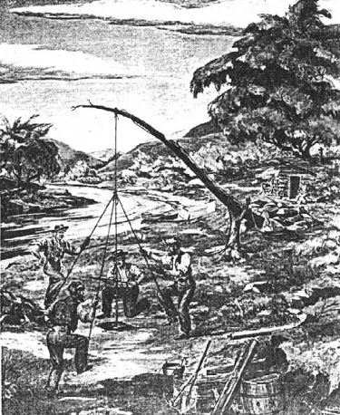
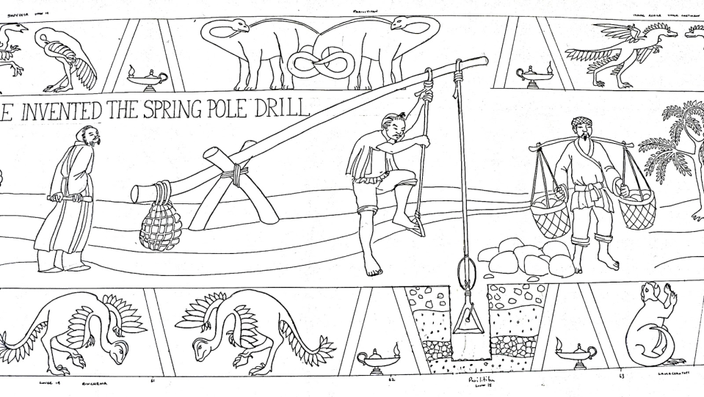
History of drilling
Spring Pole drilling, 1000 B.C.
Ruffner Brothers 1806-1808
Notes:
Drilling technology, although advanced today, is still based on old principles.
Ancient Chinese used an early form of cable tool drilling to drill for salt.
They actually produced gas that they transported through bamboo tubes. They burned it to boil and evaporate the brine and to make salt.
Some 3000 years later the Ruffner brothers used the same principle for their salt mining process on the banks of the Kanahwa river in West Virginia.
The petroleumhistory.org website praises them for being “the inventive pioneers of drilling in North America”
I guess their motto was something like: If it ain’t broke don’t fix it…”
A killer for Innovations

Slide 3
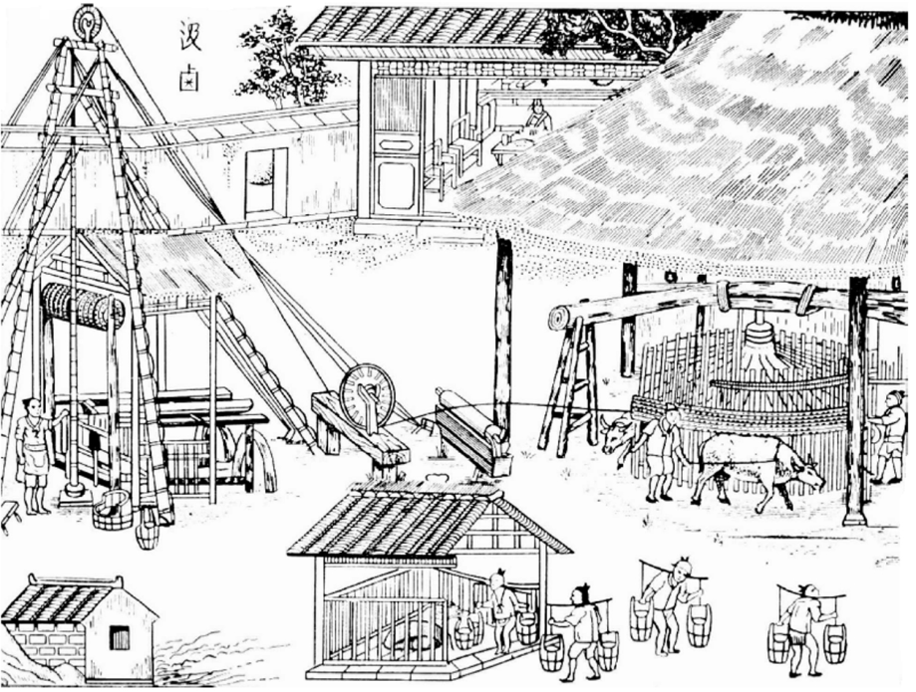
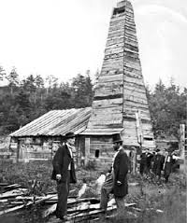
History of drilling
China, Sichuan Province, 200BC
Colonel Drake, Titusville PA,1859
Notes:
Rotary drilling technology was also used in early China and in Egypt.
In the early 1500s even Leonardo da Vinci created a design for a rotary drill
It closely resembled the rotary drilling methods employed today, although these ancient versions were driven by people and later mules; the “modern” versions in the 19th century and early 20th used steam engines to drive the rig. Nowadays they are replaced by Diesel power or where possible straight from the power grid.
The concept of rotary drilling has evolved and grown over time and despite the early Chinese know how, it was Colonel Drake’s rig in Titusville, Pennsylvania, that marked the launch of a worldwide industry.
Over a century later we are still using the same basic technology and try to make it more efficient and safe.
But in many parts of the world not even that is true.

Slide 4
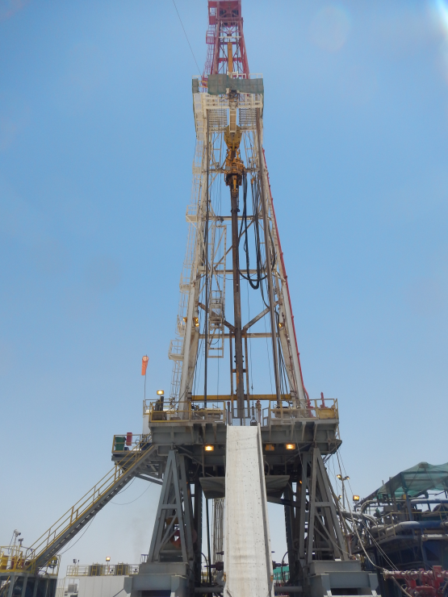
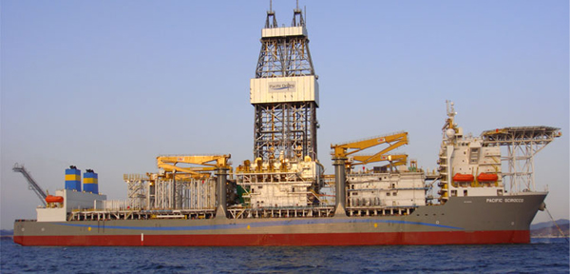
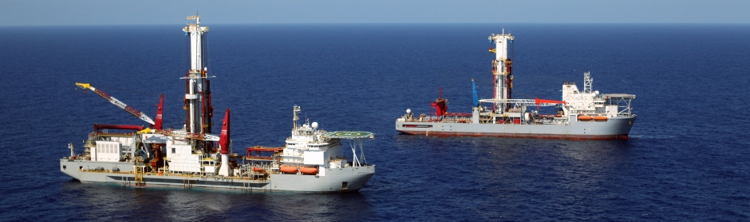
Evolution
Notes:
But in all fairness, we did make quite some progress: We are developing smarter systems and tools, we manage to drill deeper, at more remote locations and keep moving towards more automation.
The industry however is rather conservative and slow in adopting new technology. >>> The previous examples show that we sat on the same technology for about 2000 years. (so much for progress!)
And despite the technological advance, we are still at risk of any unplanned or uncontrolled events

Slide 5
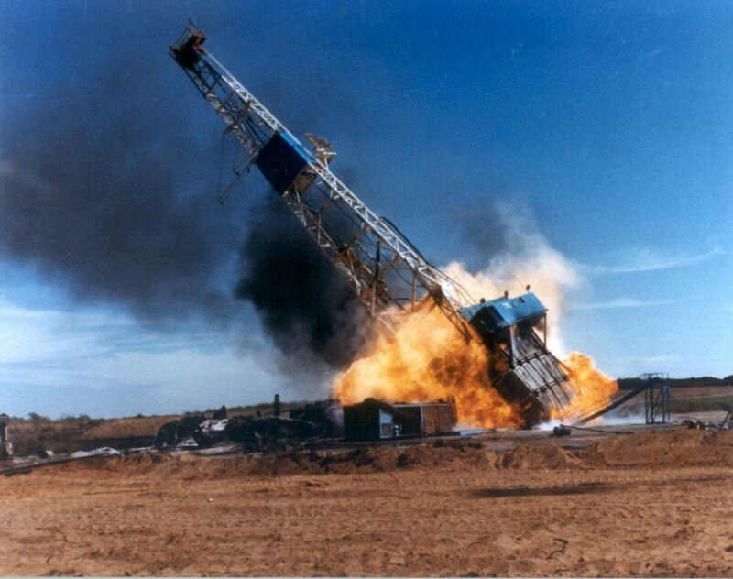
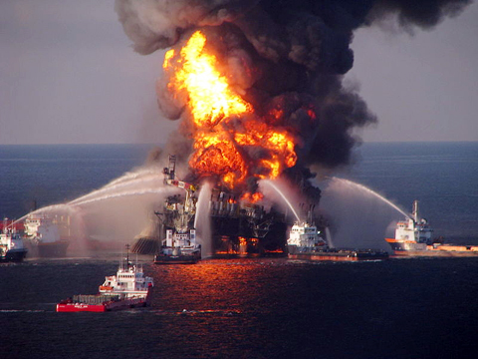
Better Control of process needed
Reduce Risk
Notes:
We still need a better control of the entire process : we plan for the worst and hope for the best ...
These pictures are dramatic and luckily do not occur everyday, but when it does, impact is huge and headlines are made.
These examples are offcourse the worst cases, but in drilling there is always some risk on a daily basis: mudlosses, hole stability issues, stuck pipe, failing to get your casing down.
It will always result in lost time and potentially lost equipment.... or worse.
We believe that a lot of this non-productive time can be avoided by applying different technology. If you can reduce risk you will reduce your total well cost.
Savings are not always in drilling faster: you don’t have to beat the curve, as long as you do not overrun the curve ( I am referring to the time-depth curve that we typically use to track performance)
>> avoid problems and half of the battle is won ( the other half is reducing flat times between sections )

Slide 6
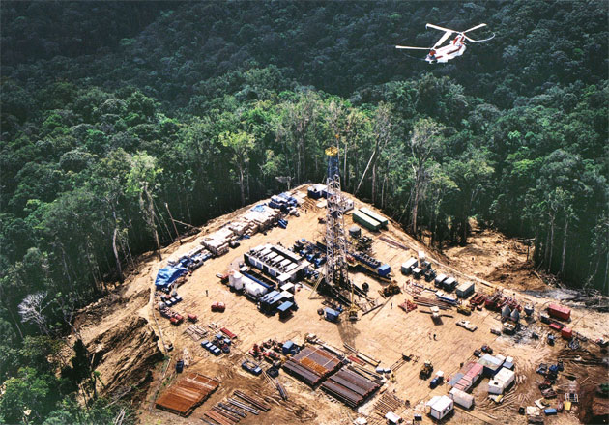
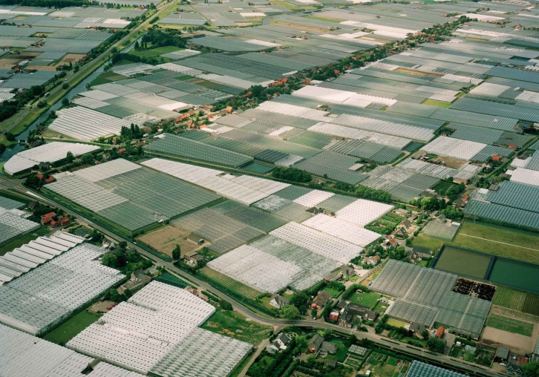
simpler operations
Notes:
WE NEED SIMPLER OPERATIONS
We are drilling in remote locations, where smaller, more efficient rigs result in less transport movements of equipment, people, fuel.
Or closer to home, where space is limited and smaller footprints are required. We are operating in densely populated areas, and need to make our operations in general less intrusive , in this case less is more
Huisman Well Technology aims to simplify operations, and operate with less equipment, less people at lower cost
Smaller rigs lead to a smaller footprint
And lead to smaller locations,
Lower construction costs
Lower mobilization rates
Lower rig rates
Lower fuel consumption

Slide 7
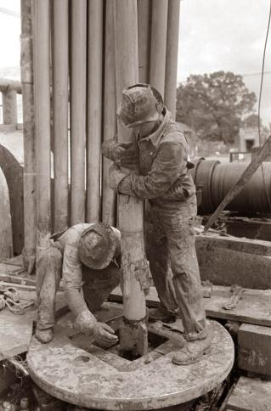
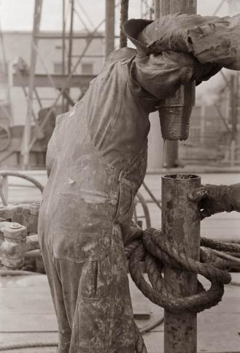
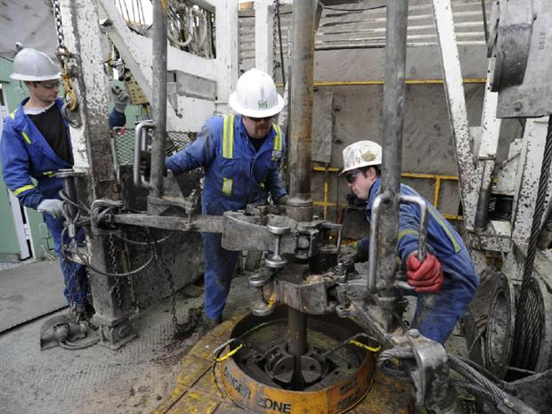
Automation
1950’s ?
today
Notes:
WE NEED FURTHER AUTOMATION
FOR HEALTH & SAFETY & PREDICTABLE QUALITY
People still work in one of the most dangerous workplaces.
Where things go right a 1000 times, but can go wrong the #1001st
Automation means les human interaction and creates a safer work environment.
Less personnel on the rig means less exposure and less cost
We are looking to automate and integrate services on the rig where the rig crew can be operator of the equipment.
These services are now typically third party hired services:
Directional Drilling (ECI/RSS),
Tubular running (casing running crews),
and Drilling Fluids (MPD sysytem)

Slide 8
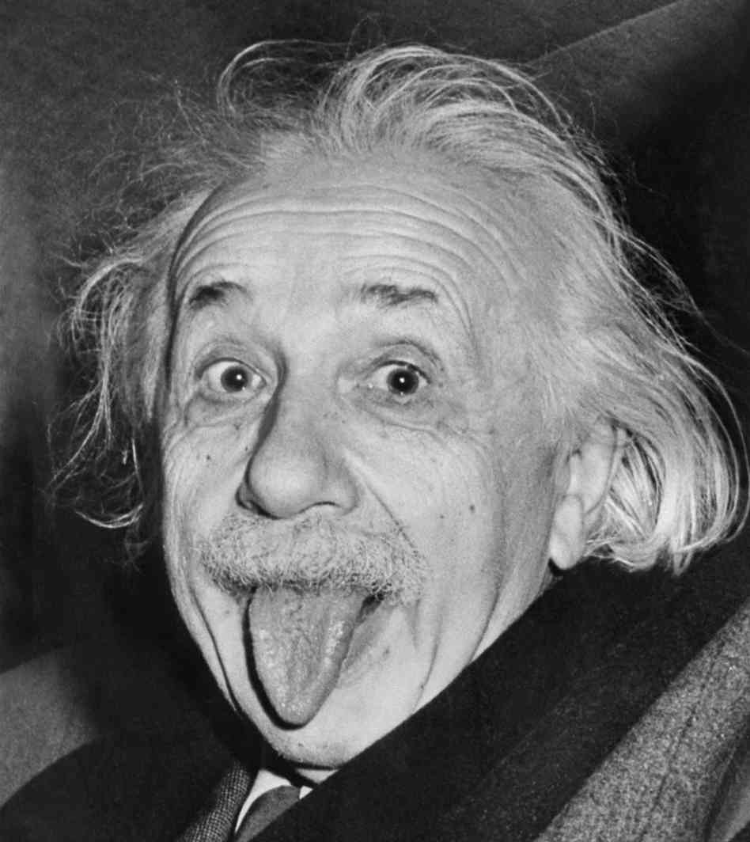
INNOVATION
"Any intelligent fool can make things bigger, more complex, and more violent. It takes a touch of genius -- and a lot of courage -- to move in the opposite direction.“
EINSTEIN
Notes:
Einstein already told us to think differently
I am not claiming geniality, but we look at the process as a whole:
The goal is drilling to a certain depth; safely and as quick as possible.
The total cost of a well is made up of various components: rig and rig equipment, safety equipment, risk mitigation and all kinds of third party services and external experts.
We are actually looking to make things smaller, less complex >> here too, less is more

Slide 9
Efficiency up, cost down
Well Construction Cost plus Cost of Risk show stopper for many Geothermal projects
Need for:
  Higher operating efficiency
  Reduce risk
  Smaller and cheaper rigs
  Safer and less human interaction
  Wells with a longer life and less maintenance
0
Depth
1000
2000
3000
Time/Days
Notes:
We aim to Increase process efficiency, minimise equipment handling, reduce non-productive time.
We have developed the Enhanced casing installation system (a level 3 casing while drilling system)
We are developing an Automated Rotary Steerable System
and a Managed Pressure Drilling system
We aim to minimise the rig size, components and services to reduce daily operating cost
HOW?
By reducing the hookload requirements as we apply composite casing instead of steel.
By applying casing drilling technology and reduce handling and trips, reduce pump requirements, and in general reduce energy consumption.
And by applying managed pressure drilling to further reduce the system requirements and drilling risk.
Reducing and eliminating components, systems and services, will lead to the ultimate goal of rig-less drilling and drill wells from a regular autocrane instead of heavy drilling rigs, while still being able to drill the same type of wells safely but at a fraction of the cost.
The time depth graph aims to show the effect of NPT between sections: reducing the flat times is much more efficient than trying to drill faster. If we take the blue line as benchmark, often the red dotted line becomes the actual, because of say one or two extra reaming trips. The green line represents ECI drilling that eliminates pipe trips.

Slide 10
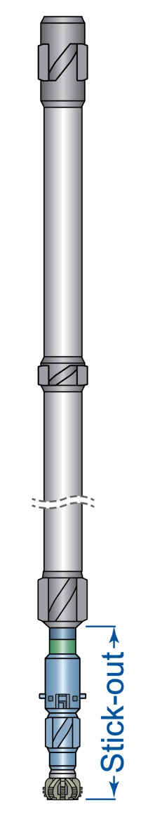
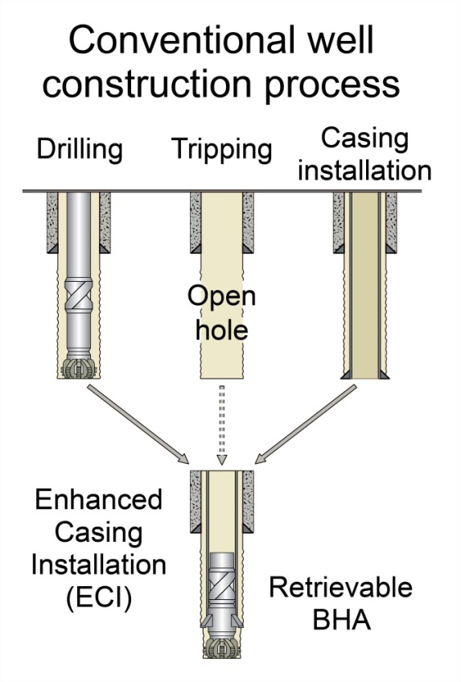
ECI - Enhanced Casing Installation
Retrievable & Directional casing drill system
Well stabilized
Minimal stick-out (<1m) even with M/LWD in BHA
Cable, drill pipe, pressure retrievable
Equipment inside casing i.e. low lost-in-hole risk & minimum wear; composite casing shoetrack allows logging through casing.
Operated by rig crew (no external DD service)
Notes:
The ECI system is a level 3 casing while drilling system, which means that it uses a retrievable BHA that locks in a profile at the bottom of a casing string.
The main components are a bit, an underreamer and a lock down device.
It can be run in combination with any motor or Rotary steerable system and regular MWD & LWD tools.
Motor and tools will remain inside the casing (so they are well protected) with only a short stick-out of bit and reamer; this gives a well stabilized assembly for efficient drilling.
The hole is being cased while it is drilled and the bit and BHA can be retrieved when TD is reached, or whenever there is a need to make changes to the assembly. The BHA can be retrieved to surface very fast by a cable or even pumped up >> So no pipe tripping!
When integrated in the rig system (by preference on Huisman’s own rigs) the rig crews can operate the system, eliminating the need for external Directional Drilling Services and Tubular running services.

Slide 11
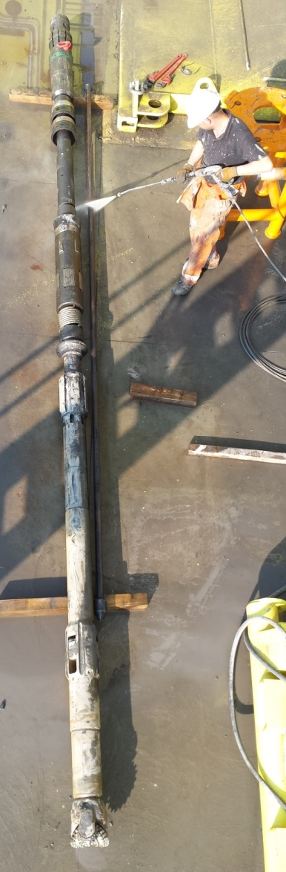
ECI Advantages
Fast tripping for BHA changes (cable or pressure assisted): Less handling increases personnel safety, saves time, reduces energy consumption and reduces rig footprints.
Drill pipe vs ECI drilling: smaller and near flush annulus:
  Increased drilling efficiency: better hole cleaning, simpler mud system, lower mud weight, less losses, less reservoir damage, better cement jobs, dynamic kill method in case of influx.
  Less drill string failures and inspections needed
Casing sits directly in place after drilling:
  Less open hole time, less hole quality problems, smaller hole being drilled, lean casing profile, immediate contingency sidetracking.
Notes:
ADVANTAGES of ECI are
Fast tripping for BHA changes (cable or pressure assisted):
Less handling: increases personnel safety and saves time,
A casing drive and power slips eliminate the need for Tubular running services and crew
Compared to drilling with drill pipe, ECI provides a smaller annulus:
which leads to better hole cleaning, less hydraulic requirements, a simpler mud system and better cement jobs
ECI requires lower mud weight (as it requires no trip margin), so we reduce the chances for losses and create less reservoir damage.
The biggest advantage: the casing sits directly in place after drilling: the hole is being cased off as it is drilled!!
Less open hole time in general means less hole quality problems (or at least the negative effects of it) > in conventional drilling we are spending a lot of time reaming and conditioning the hole, and how often did you not get the casing at the required depth?
Casing while drilling can help to solve this.
In general ECI helps to reduce NON PRODUCTIVE TIME,
by saving on handling and tripping
and by avoiding potential problems

Slide 12
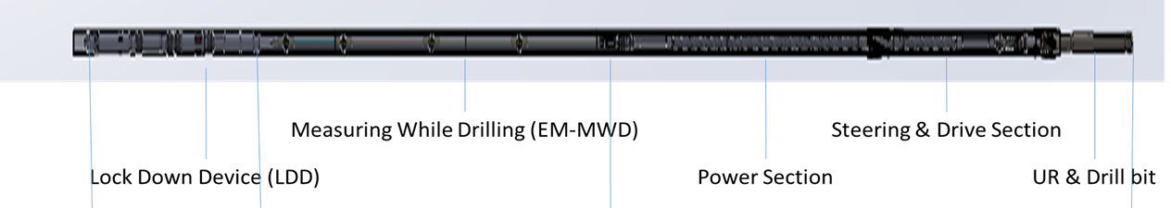
ECI/RSS - Rotary Steerable System
Development of a cost efficient RSS
Drill vertical to horizontal section with the same casing size
Point the bit technology -> precise steering, also in soft soils
Continous controlled from surface without down linking
Controls integrated in rig so operated by rig, crew or remote:
  no need for 3rd party directional drillers or steering tools required
Only standard MWD electronics are used downhole
DLS capability upto 5 degree/30m
Equipment sits inside casing so small stick-out (<1m) and well protected
DAP 2015
FeBRUAry 25, 2015
Notes:
We are currently developing an automated rotary steerable system to work with the ECI system.
It will be a point the bit system for accurate steering, even in soft soils
Capable of drilling a curve or dogleg severity of upto 5 degrees per 30meters or 100 foot.
It will be controlled from surface by the Driller so there is no need for directional drillers.
And the biggest advantage of a rotary steerable system over motor drilling is improved penetration rates and better hole quality.

Slide 13
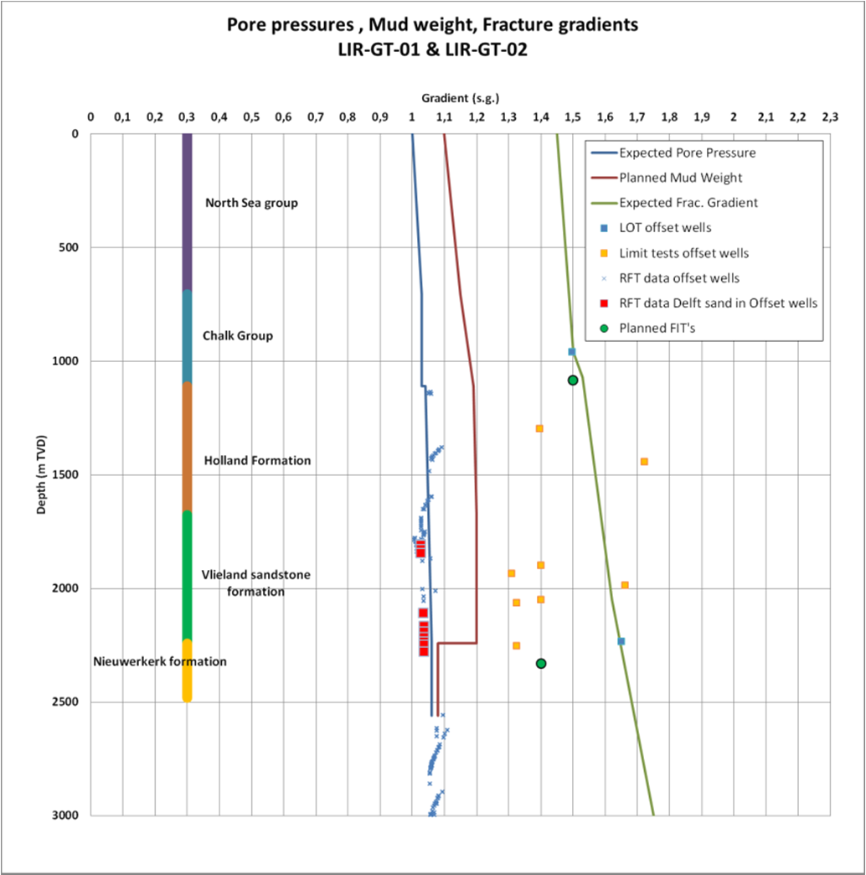
MPD - Managed pressure drilling
MPD - Managed pressure drilling system
Control annular pressure close to balance with formation pressure
Maintain pressure control at all times (also in narrow pressure window)
Control ECD effect
MPD Advantages
Faster penetration rates
Improved wellbore integrity
Reduced fluid loss and reservoir influx
Avoid reservoir damage
Notes:
Managed pressure drilling is drilling overbalanced while maintaining constant bottomhole pressure using a combination of mud density, equivalent circulating density, and backpressure. Pressure balance is maintained in a closed-loop fluid system and the back pressure is applied through a pressure control device or choke.
MPD reduces several drilling problems that lead to non productive time like mud losses, well bore stability issues, and so on.
At the same time MPD increases safety of drilling operations as one can quickly respond to variations in formation pressure, by applying more or less back pressure.

Slide 14

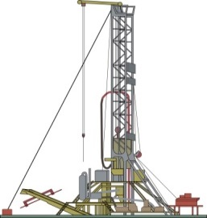
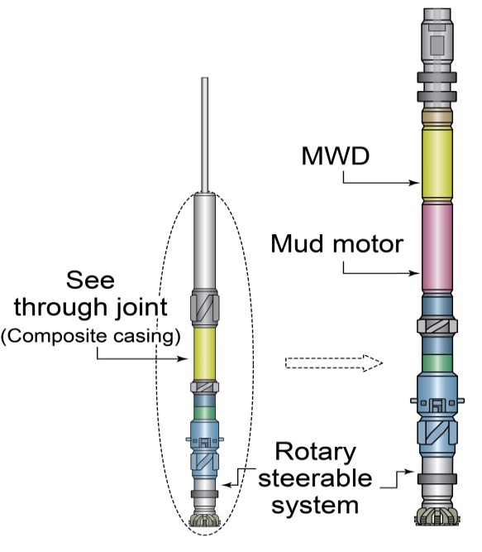
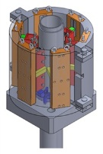
Simplify drilling process
Increase Process Efficiency:
  ECI
  Automated Rotary Steerable
  Integrated Continuous MPD
Reduce rig (size) requirements (reduce dayrate)
  Reduce hookload >> composite casing
  Reduce footprint
  Reduce pump capacity (ECI)
  Reduce Energy requirements
  Reduce specialist services (and personnel)
    directional drilling (rig crew operates ECI)
    TRS (rig equiped with casing drive, power slips, torque m/u software)
  Eliminate topdrive
Casing
drive
Winch
Torque
arrester
Notes:
IN SUMMARY:
Huisman well technology aims to simplify the drilling process:
By increasing the efficiency:
In application of ECI
An automated Rotary Steerable System
And Integrated Continuous MPD
By reducing rig requirements, size and equipment we aim to reduce the overall day to day operating cost.
And ultimately our goal is to drill the same type of wells as we drill today but with a crane instead of a heavy drilling rig;
safely, at a fraction of the cost of today, and with more control.

Slide 15
Roadmap for Geothermal
Everyone wants innovations but nobody wants to be the first (serial no.1 syndrome) >> Will DAP be first?
HWT developments will lead to cost efficient drilling, but this will not happen overnight and we welcome operators to explore the possibilities with us.
Implement new technology and start realise savings.
0
Depth
1000
2000
3000
Time/Days
Notes:
In the current climate I would say: Never waist a good crisis,
So if you are a geothermal operator or planning to be, please come and talk with us and hopefully we can start realising savings in well construction cost together.
I have shown the typical time-depth curve before, and I thought it would be appropriate to end with it as well, because if we want to bring geothermal energy further and realise more projects, we need to keep shifting that line!
Thank you for your attention!

Slide 16
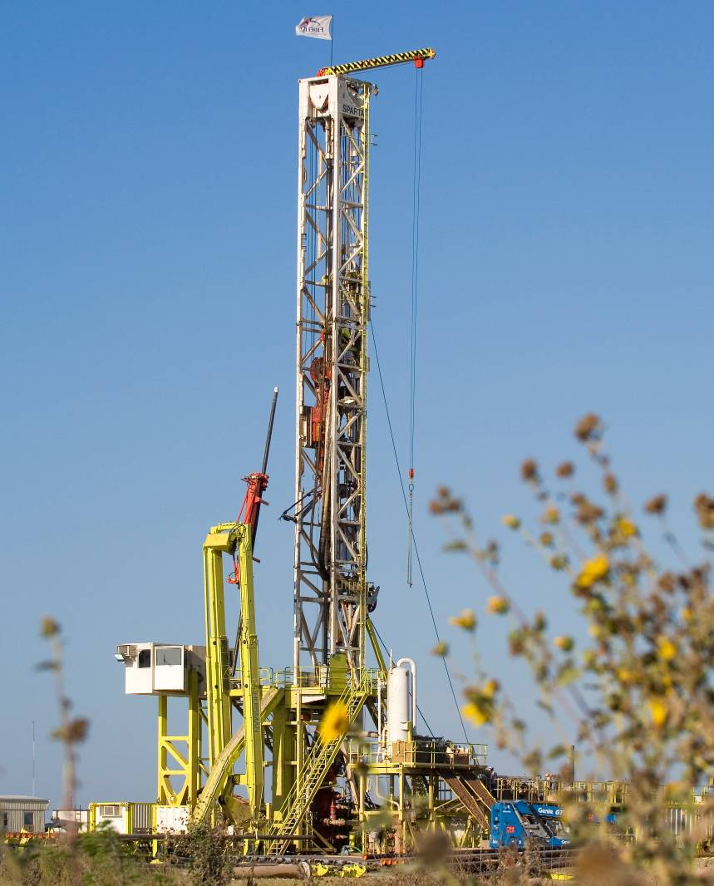
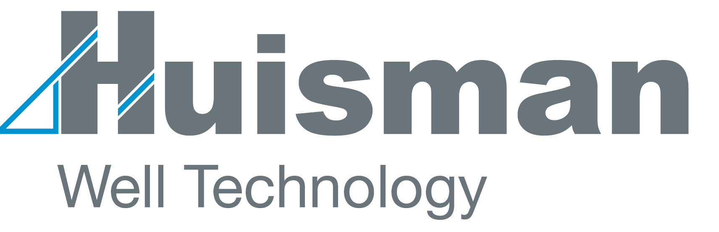
www.huismanwelltech.com
info@huismanwelltech.com

