Slide 1
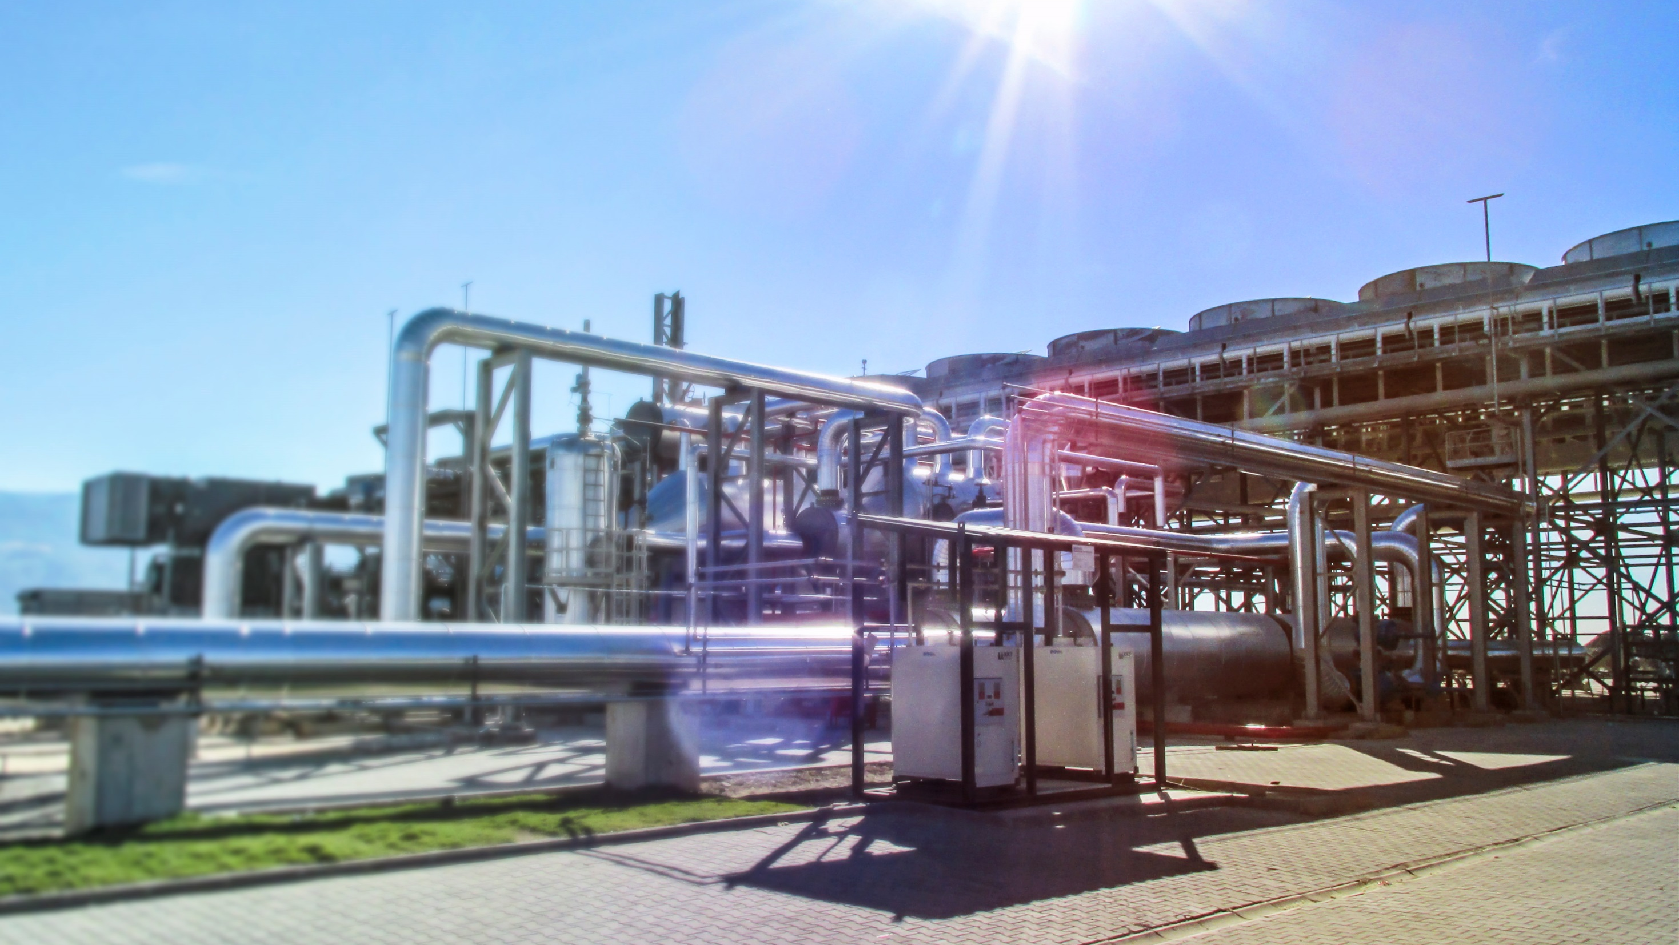
Geothermal district heating coupled with an ORC plant
Prof Dr Pall Valdimarsson
Atlas Copco Geothermal Competence Center and Reykjavik University

Slide 3

1. atlas copco
Facts in Brief
Established | 1873 in Stockholm, Sweden
Four focused business areas | Compressor Technique Industrial Technique Mining and Rock Excavation Technique Construction Technique
Global presence | Customers in more than 180 countries
Employees | 40 200 in 90 countries
Annual revenues 2013 | BSEK 84 (BEUR 9.7)
Notes:
3. Facts in brief
Atlas Copco is a 141-year-old company. We are well-known for our professional leaders, our high ethical standards and business practices, and for our great products and service.
We are more than 40 000 employees in 90 countries. In 2013 revenues reached 84 billion Swedish kronor and the operating margin was 20.3%.

Slide 4
Conclusion
Geothermal district heating is different from fuel heated district heating
Geothermal power production is base load (maximum power all the time)
District heating has an outdoor temperature governed duration curve
District heating has always preference to generation of electricity (blood vs money)
The exergy available from the wells is finite and constant
The exergy used by the district heating system cannot be converted to electrical power
=> the exergy consumption of the district heating has to be minimized
=> it is important that the connection between power plant and district heating does not waste exergy
Home sweet home – a few words on the Icelandic experience

Slide 5
Don’t forget
Iceland was a poor third world country 60 years ago
Direct use of geothermal heat is one of the major factors in our transition to the 20th century!

Slide 6
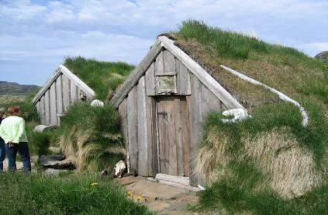
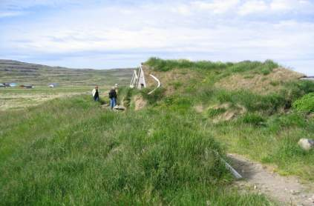
Icelandic farmstead, 1920?...

Slide 7
Geothermal utilization
Production of electrical power
  Steam cycles
  Binary cycles
Direct use
  District heating
  Agriculture
  Aquaculture
A chain from well to the final product
  Process
  Component
  Value
  Energy
  Exergy
All elements in this chain are equally important, from the geothermal well over to the building radiators, and they all have to be designed with utmost care
  -- and that includes the building system and its radiators!!

Slide 8
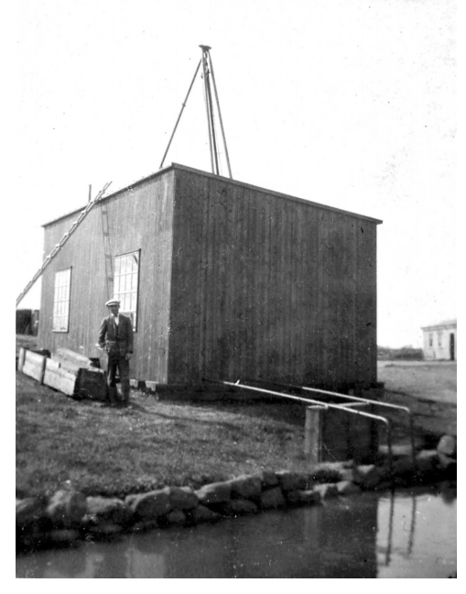
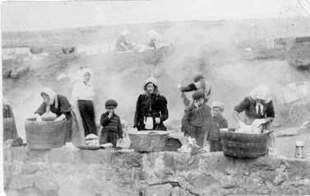
Reykjavik 1920

Slide 9
District heating
Heat extracted in order to supply heat to a district heating system from a power plant will reduce its power generation ability
Geothermal district heating is heating around 90% of all buildings in Iceland
These systems are efficient, and over 80 years of operating experience have given a large knowledge base on the operation and economics on such systems
Most of the Icelandic geothermal fields used for district heating have a temperature around 80°C
Standard system supply temperature is 80°C, constant regardless of the load
Load variations are accounted for by variation in the system flow
Rather generous pipe diameters, resulting in high temperature loss during low load.

Slide 10
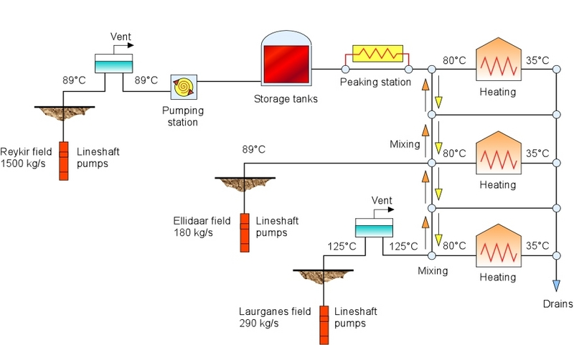
Reykjavik d/h before 1990
http://IGA (www.geothermal-energy.org): What is geothermal_energy?

Slide 11
Reservoir temperature
 | °C |  |  | °C
Orkuveita Reykjavíkur | 92,9 |  | Orkuveita Húsavíkur | 118
Höfuðborgarsvæði | 94,5 |  | Skagafjarðarveitur | 71,2
Hitaveita Rangæinga | 72,9 |  | Hitaveita Bláskógabyggðar | 103,9
Grímsnesveita | 78,6 |  | Hitaveita Seltjarnarness | 109
Hitaveita Þorlákshafnar | 106,7 |  | RARIK | 76,1
Hlíðaveita | 96,7 |  | Hitaveita Dalabyggðar | 83
Hitaveita Stykkishólms | 87 |  | Hitaveita Blönduóss | 75,2
Bifröst / Norðurárdalsveita | 72,1 |  | Hitaveita Siglufjarðar | 73
Ölfusveita | 116,3 |  | Hitaveita Flúða | 106
Hitaveita Skorradals | 90 |  | Hitaveita GOGG | 80,3
Austurveita | 82,1 |  | Hitaveita Dalvíkur | 65,5
Munaðarnesveita | 86,5 |  | Hitaveita Egilsstaða og Fella | 75,5
Hvammsvíkurveita | 85 |  | Hitaveita Húnaþings Vestra | 95,2
Norðurorka | 83 |  | Hitaveita Öxarfjarðarhéraðs | 114
Hitaveita Ólafsfjarðar | 61,2 |  | Hitaveita Fjarðabyggðar | 80,8
Hitaveita Hríseyjar | 79,2 |  | Orkubú Vestfjarða | 64,5
Hitaveita Akureyrar | 88,1 |  | Hitaveita Reykhóla | 96
Hitaveita Svalbarðsströnd | 46,8 |  | Hitaveita Suðureyrar | 64,5
Reykjaveita, Fnjóskadal | 90,2 |  | Hitaveita Brautarholts | 71
Hitav. Akraness og Borgarfj. | 96,1 |  | Hitaveita Drangsness | 61

Slide 12
Size and start of utilization
 | MW today | Start of utilization |  |  | MW today | Start of utilization
Höfuðborg/ Hitav. Rvíkur | 885 | 1930 |  | Selfossveitur | 42 | 1948
Hitaveita Hveragerðis | 25 | 1947 |  | Hitaveita Laugaráss | 14 | 1923
Hitaveita Rangæinga | 21 | 1982 |  | Reykholt | 12 | 1928
Grímsnesveita | 16 | 1975 |  | Laugarvatn | 6 | 1928
Hitaveita Þorlákshafnar | 14 | 1979 |  | Hitaveita Seltjarnarness | 27 | 1971
Hlíðaveita | 10 | 1988 |  | Hitaveita Blönduóss | 9 | 1977
Hitaveita Stykkishólms | 9 | 1998 |  | Hitaveita Siglufjarðar | 6 | 1975
Bifröst / Norðurárdalsveita | 5 | 1992 |  | Hitaveita Dalabyggðar | 4 | 1999
Hitaveita Skorradals | 4 | 1996 |  | Hitaveita Flúða | 19 | 1929
Austurveita | 3 | 1988 |  | Hitaveita GOGG2 | 15 | 1992
Munaðarnesveita | 3 | 2005 |  | Hitaveita Dalvíkur | 15 | 1969
Hitaveita Suðurnesja | 159 | 1974 |  | Hitaveita Egilsstaða og Fella | 12 | 1979
Hitaveita Akureyrar | 82 | 1977 |  | Hitaveita Húnaþings Vestra | 7 | 1933
Hitaveita Ólafsfjarðar | 10 | 1944 |  | Hitaveita Reykjahlíðar | 7 | 1971
Reykjaveita í Fnjóskadal | 5 | 1982 |  | Hitaveita Öxarfjarðarhéraðs | 6 | 1994
Hitaveita Hríseyjar | 2 | 1973 |  | Hitaveita Fjarðabyggðar | 6 | 2005
Svalbarðsströnd/Svalbarðseyri | 1 | 1979 |  | Hitaveita Suðureyrar | 3 | 1977
Hitaveita Akraness og Borgarfj. | 78 | 1981 |  | Hitaveita Reykhóla | 1 | 1954
Orkuveita Húsavíkur | 52 | 1970 |  | Hitaveita Brautarholts | 1 | 1950
Hitaveita Sauðárkróks | 23 | 1953 |  | Hitaveita Drangsness | 1 | 1999
Hitaveita Hjaltadals | 9 | 1980 |  | Hitaveita Mosfellsbæjar | 0,5 | 1929

Slide 13
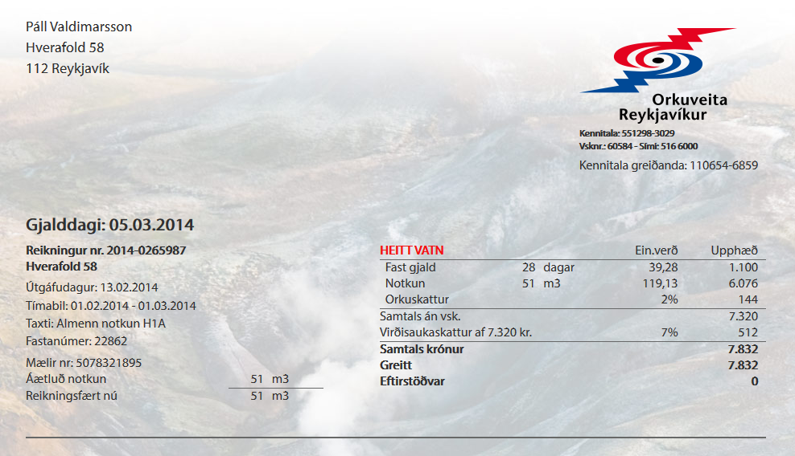
Cost for the client
A m³ water has 1000*4,186*(75-35)/3600 kWh = 46,5 kWh
51 m³ have 51*46,5 = 2371,5 kWh
7832/2371,5 = 3,30 kr/kWh = 0,0213 €/kWh
0,767 €/m³
€50,32
Morning newspaper is 4.680,- kr/month (€30,13 per month)
Television 2 (Videorental with home delivery) is 6.990,- kr/month.

Slide 14
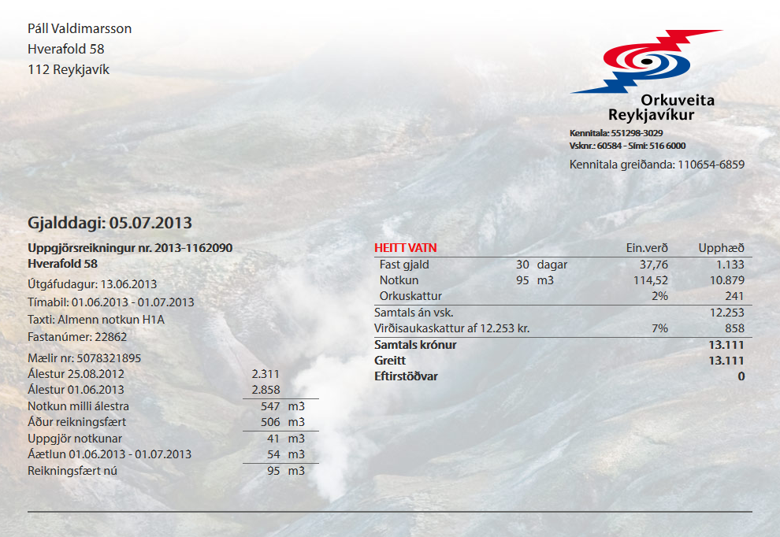
Meter reading and estimation

Slide 15
Fixed/energy cost
The cost of energy is high in the fossil fuel fired system compared to the capital cost
The reverse is true in the geothermal system.
  The energy consumption is critical to the economy of the fossil fired system
  The capital cost (maximum power) is critical for the economy of the geothermal system.
The analysis of high load conditions is critical for the geothermal system.

Slide 16
District heating load
Minimum power
  During the summer the system has to be able to supply sufficient water to enable the preparation of the hot domestic tap water.
The maximum power
  Chosen so that the estimated indoor temperature at the worst placed consumer does not fall below a certain minimum during the lifetime of the district heating system
Minimum indoor temperature
  A common practice is to use 16°C.
  To establish this criterion, the worst cold spell to be expected during the lifetime of the system has to be defined
  The minimum indoor temperature for that cold spell has to be calculated

Slide 17
Climate

Slide 18
Relative heat load

Slide 19
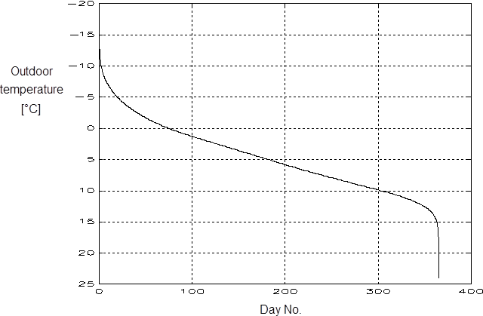
Outdoor temperature duration
Cost is proportional to the maximum
Heat load
Investment cost
Income is proportional to the area below the curve

Slide 20
The building heating problem
Indoor temperature 20°C
Q_{loss}
T_{supply}
Q_{water}
Q_{radiator}
T_{return}

Slide 21
The power plant
Heat input
Power plant
Electricity output
Heat output
Heat rejected
Cooling fluid input
Cooling fluid output

Slide 22
The system

Slide 23
Pipe cooling
L
D
dx

Slide 24
Transmission effectiveness
The ratio of the temperature drop of the water to the difference between inlet temperature and the ground temperature.
The effectiveness is zero, when the outlet temperature equals the ground temperature, and one, if there is no temperature drop.
The transmission effectiveness at design condition τ₀ is the used as a reference
The following relation for the transmission effectiveness and the consumer heat exchanger inlet temperature is used:

Slide 25
The building heating problem
Indoor temperature 20°C
Q_{loss}
T_{supply}
Q_{water}
Q_{radiator}
T_{return}

Slide 26
Building
The relative heat loss from the buildings can be calculated as:

Slide 27
A radiator
Supply pipe
Thermal radiation
Air velocity due to natural convection
Return pipe
Insulation
Building structure

Slide 28
Radiator, water side
The relative heat removed from the radiator water can be calculated as:

Slide 29
Radiator, air side
The relative heat transferred from the radiator surface to the indoor air is calculated as:

Slide 30
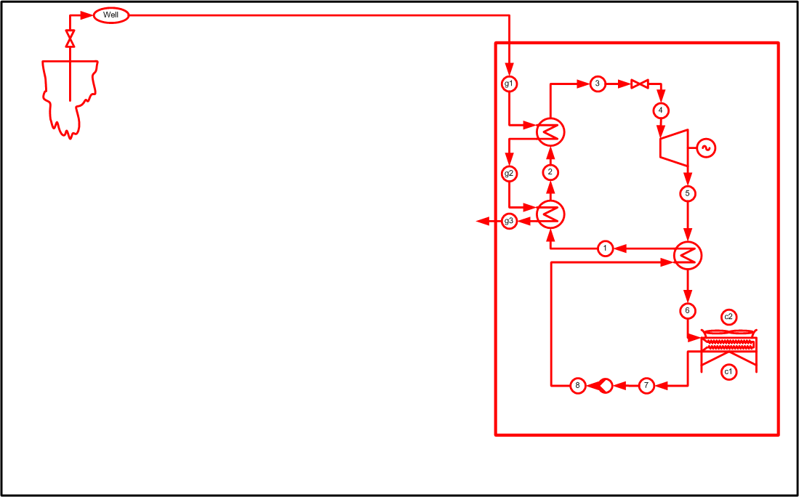
ORC cycle

Slide 31
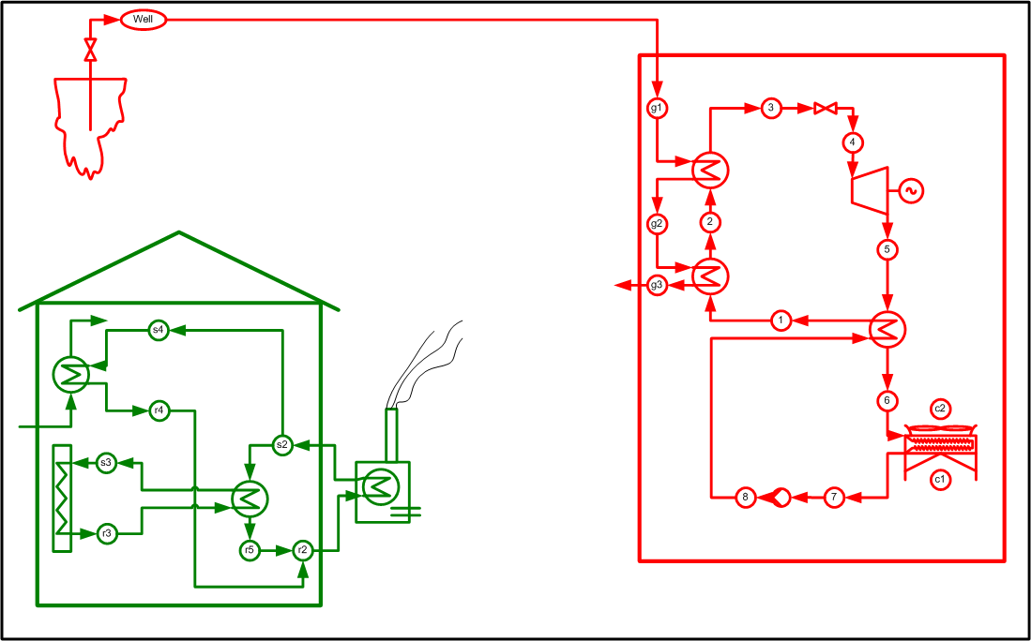
Building heating system

Slide 32
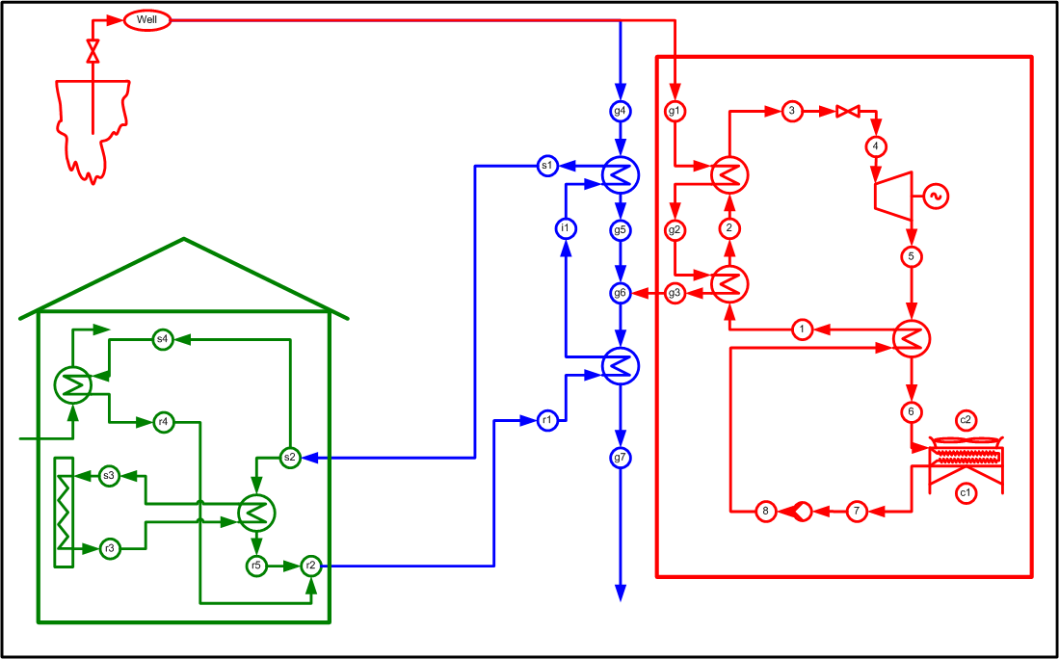
Geothermal Co-Generation

Slide 33
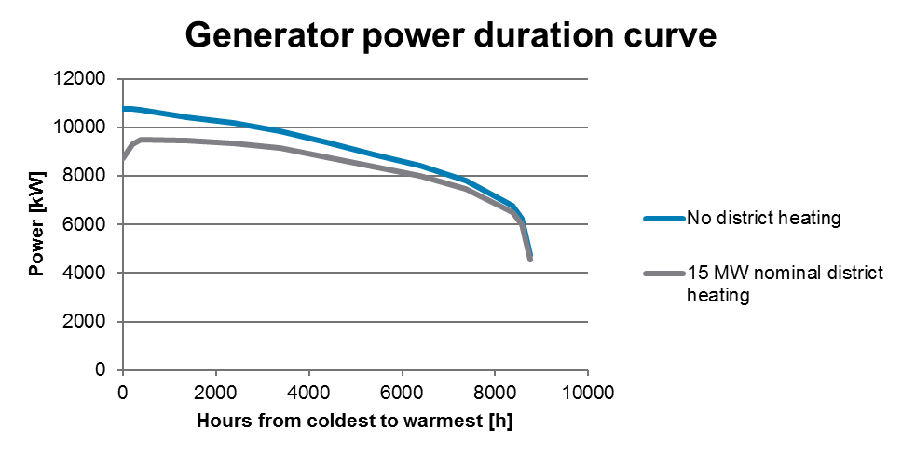
The area between the curves represents the reduction of electrical energy production because of the district heating operation

Slide 34
Geothermal flow to power plant
Geothermal fluid available for production of electricity
Geothermal fluid required for district heating operation

Slide 35
Variable turbine efficiency
The Atlas Copco radial turbine has high isentropic efficency throughout the whole year despite large changes of operating conditions

Slide 36
Average day

Slide 37
Summer day

Slide 38
Winter day

Slide 39
Temperature duration curves
District heating supply
Building supply
Plant intermediate temperature
Building return
District heating return

Slide 40
Heat duty duration curves
District heating load
Preheater load
Radiator load
Tap water load
Afterheater load
Return system loss
Supply system loss

