Slide 1
Well stimulation in Geothermal projects
Gerrit Nitters
NPCI/IF Technology

Slide 2
Introduction
What is well stimulation?
Methods
  Acid treatments
  Acoustic stimulation
  Hydraulic stimulation
Application
Geothermal well configurations
  Doublets, Triplets
  Soultz
Conclusions

Slide 3
WELL STIMULATION
What is well stimulation?
  Any activity that enhances productivity of a well by affecting the near well bore area
    Matrix treatments – restore natural productivity
    Hydraulic fracturing – enhance natural productivity
    Perforation?
    Etc?
What is it not?
  Reservoir enhancement like steam drive or water flooding
  Removal of scale, wax, etc. from the tubing
Notes:
Most people are probably aware of the term Well Stimulation, but it may mean different things to different people. This just to define what most people consider as well stimulation. In essence Stimulation is about making sure that the near wellbore area is not the bottleneck for production. So, it addresses all methods that enhance the productivity by affecting the near wellbore area. I.e. just in and outside the perforation area. So it is not about steam drive or waterflooding which influences the reservoir. Likewise it is also not concerned with removal of wax ,asphalt, scale, etc. from the tubing.

Slide 4
Production & Skin: Semi-Steady State
Production
(zero skin = 100%)‏
Skin
Flow Efficiency (FE or WIQI)‏
>5
< 50%
formation damage caused by poorly designed drill-in/completion fluids
2
80%
optimized drill-in & completion fluids
damage removal & cleanup
Production increase after treatment
0
100%
sandstone acid treatment
-2
140%
carbonate acid treatment
frac & pack
-4
250%
fracture stimulation
Notes:
To assess the impact of damage on well productivity in vertical wells, we can relate the skin factor S, to the ratio of the damaged to undamaged well production rates Qactual/Qideal , which is referred to as Flow Efficiency (FE) or Well Inflow Quality Indicator (WIQI).
Flow efficiency is related to the skin factor by the semi-steady state equation. For a range of typical values of the drainage radius, re, between 200 and 400 m, ln(re/rw) – 0.75 can be approximated by 7. This approximation results from the behaviour of the natural log function. An approximate expression for flow efficiency in terms of skin, can thus be written as shown in the slide

Slide 5
Causes of Damage
Drilling, completion and workover operations
  Filtercake on the wall of the wellbore
  Invasion of drilling fluid filtrate
  Polymers or fluid loss material used
Produced or injected fluids
  Changes in produced fluid
    Scale
Injected fluids during special activities
    Sandcontrol
    Acid, solvent, etc.
Production chemicals used
  Scale inhibitor, production corrosion inhibitor, etc.

Slide 6
Productivity enhancement techniques
Chemical Methods – Remove (formation) damage
  Matrix acidizing
  Acid washes
  Chemical flushes with surfactants, solvents, mutual solvents, etc.
  Microbial stimulation
Mechanical Methods – Improve inflow area
  Hydraulic fracturing – from frac&packs to massive hydraulic fracturing
  Explosive fracturing including the use of propellants, "Radialfrac"
  Acoustic stimulation
  Re- and additional perforating
Combined Mechanical/Chemical Methods
  Acid-fracturing including propped acid fracturing,
  Closed Fracture Acidising (CFA)‏
Thermal Methods – Heavy oil
  Steam soak
  In-situ heat generation
  Electrical heating
Notes:
Following the definition of the term Well Stimulation these are the most common stimulation methods. As indicated this course will concentrate on the Chemical Methods.

Slide 7
Acidizing
Removal of near well bore impairment
Scale
Screen plugging

Slide 8
History
Acidising treatments
1895 First acid job
  Successful HCl treatments by the Ohio Oil company
  Corrosion problems
1932 HCl with arsenic corrosion inhibitor
1933 first HF treatment in sandstone
  disappointing due to formation plugging – precipitates
1940 First HF/HCl treatment
1950/60’s Numerous treatments
  Additives to combat shortcomings
  Better theoretical understanding
1970’s Alternative HF/HCl systems
  Fluoboric acid
  Self Generating mud acids, etc
1980’s Diversion and placement techniques
  Foams
  Coiled tubing
1990’s Computerised design and execution support
Picture
Acidizing in early days

Slide 9
Acidizing 2000’s
Pictures

Slide 10
Acoustic cleaning
Movie

Slide 11
Acoustic well stimulation
Damage removal
  Fines in near wellbore
  Drilling Filter-cake
  (In)organic deposits
Screen cleaning
picture
Possible configuration
Acoustic energy transmitter
Coiled tubing

Slide 12
Pulse Power is Real Power!!!!!!
Movie
100000⁺ Hz
Compressed energy
Electric current 50 HZ

Slide 13
Scale removal by pulse power technology
Before treatment
After treatment
Pictures

Slide 14
Hydraulic fracturing development options

Slide 15
IT’S ALL ABOUT IMPROVING THE INFLOW
Optimum connection between reservoir and well
Notes:
Candidate selection for matrix stimulation is based on finding wells with impaired productivity and diagnosing the cause of the impairment. Failure of a well to obtain economic objectives alone is not evidence of formation impairment. Failure to achieve economic objectives may be the result of limitations of the reservoir (e.g. pressure, permeability) or wellbore (e.g. artificial lift, inadequate tubing size either by sub-optimal design or by scale growth inside the tubing).
Matrix stimulation cannot solve such problems. Candidate selection therefore requires an accurate assessment of the current productivity of the well and what the well can produce without impairment. The ratio between these two is sometimes referred to as WIQI; Well Inflow Quality Indicator. We will come back in more detail on this topic.

Slide 16
First Hydraulic Fracture Treatment - 1947
Picture
Notes:
Also fraccing in its early days was in essence not more than a pump truck hooked up to the well. This picture was taken in 1947 on a well site in Hugoton, Kansas, USA. The pump truck could probably only deliver about 400HHP.

Slide 17
Nowadays
Picture
Me
Notes:
A far cry from what stimulation is now. This is what a big fracjob job actually looks like these days. This is a propped fracture in the Middle East; note the proppant silo and the large number of pumps; a total of 22000 HHP was available.. And one third is not on the picture. There were eight more fluid tanks. The well head itself is to the right of the photo and so is the control room.

Slide 18
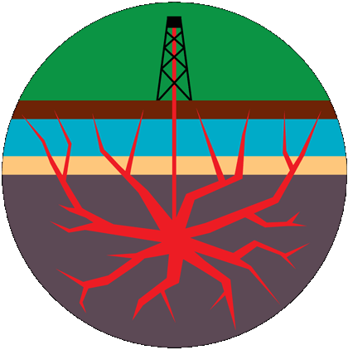
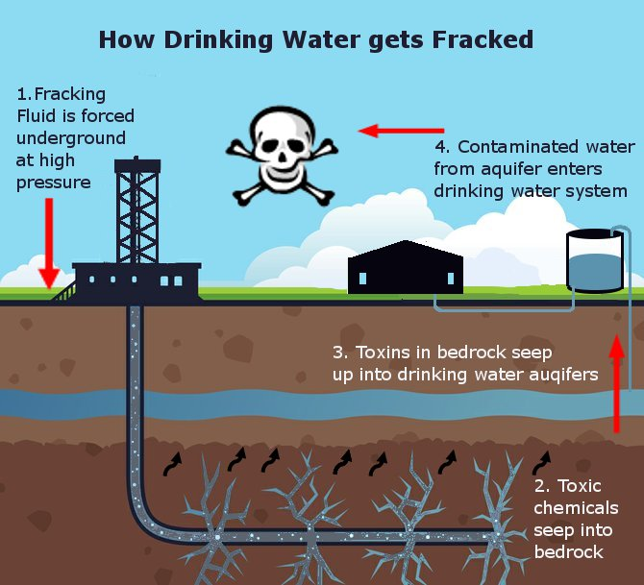
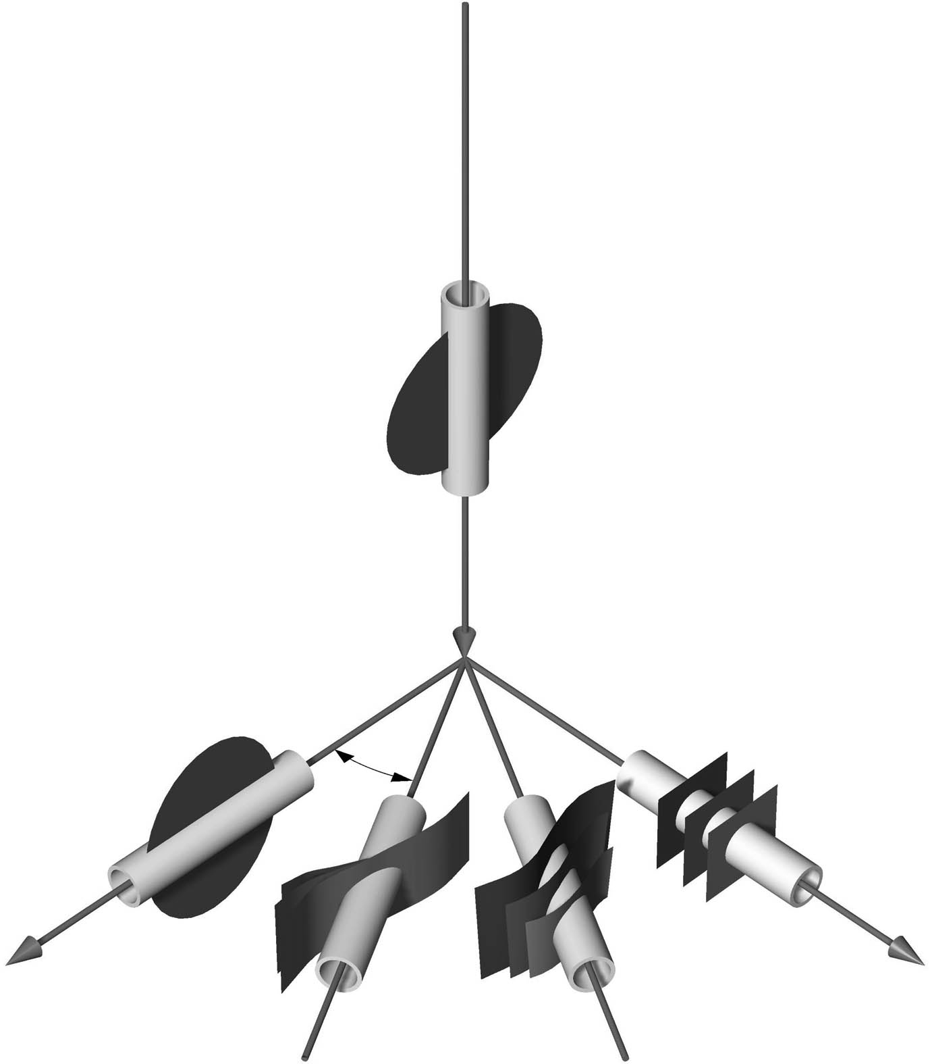
Fractures come in all shapes and sizes
But not this
Or this
σ_{v} = σ1
σ_{Hmax} = σ2
σ_{Hmin} = σ3
Notes:
Since its inception, hydraulic fracturing has developed from a simple, low-volume, low-rate fracture stimulation method to a highly engineered, complex procedure that is used for many purposes. Fracturing treatments typically have varied in size from the small (e.g. 20-50 m3 ) Skin frac treatments, to the deeply penetrating massive hydraulic fracturing (MHF) treatments, of more than1 million gal (4000m3 ) fracturing fluid and 3 million lbs. (1.4 million kg) of propping agent to multiple fracture treatments using many thousands of m3 of liquids in shale gas developments. Hydraulic fracturing is currently the only known process that allows the development of such shale gas reservoirs. Next to this MHF treatments still play a significant role in developing otherwise uneconomical tight gas reservoirs.

Slide 19
Why fracturing?
Well inflow equation:
Fracturing affects:
The skin factor S;
  A highly conductive fracture by-passing the skin (Skinfrac or Frac & Pack)
The formation capacity Kh;
  More formation height may be connected with the wellbore, showing up as an increase in Kh
The ratio re/rw;
  Increased effective well bore radius, i.e. r_{w} is replaced by L_{f} /2 (half the length of the fracture)
it can provide sand control!

Slide 20
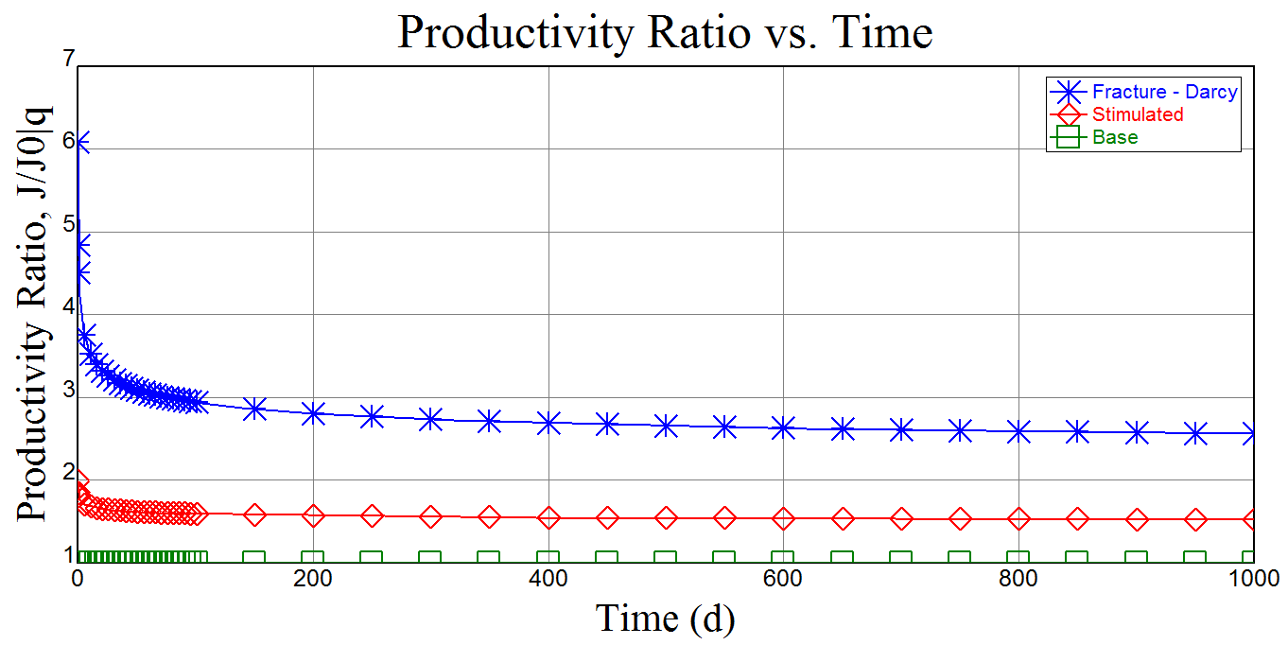
Productivity improvement
For the injection well it means higher injection rates without increasing the surface pressure

Slide 21
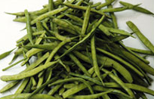




Frac fluids
      Main Components: Water and sand
      Additives:
      Guar Gum
            http://www.guargum.co.in/
        Borate; crosslinker to create higher viscosity
        Acetate and carbonate salts; pH buffers
        Persulfates and enzymes ; to break down viscosity after the treatment
        Citrus extracts to enhance flowback (Orange oil)
        Bactericide to prevent fluids from premature bacterial breakdown
      All materials are classified as WGK 1 (Germany)
      100% green materials e.g CleanStim (Halliburton) OpenFrac (SLB)
Notes:
This table shows that while there are a variety of different additives used in fracturing fluids, these additives are items that people encounter in their daily lives. Because the make-up of each fracturing fluid varies to meet specific needs for a well, it is not possible to provide a single amount or volume present in each additive. However, based on the volume of water that is used in making a fracturing fluid, the concentration of these additives is diluted considerably when considered on an overall volumetric basis. Service companies are also working to develop even more environmentally friendly fluids, including the use of hydrochloric acids which more easily break down into simple salts.

Slide 22
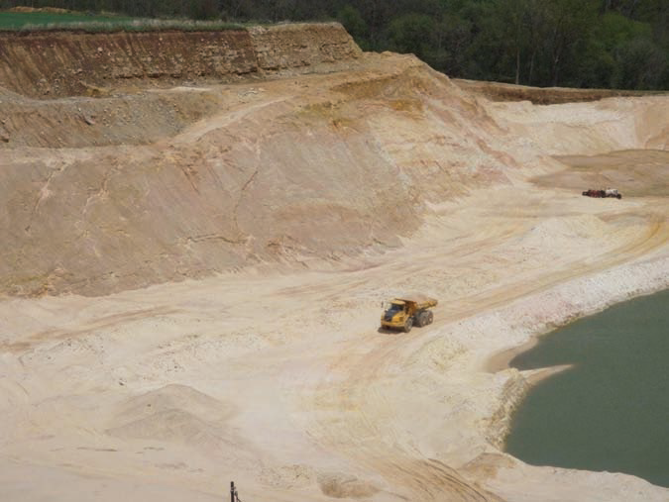
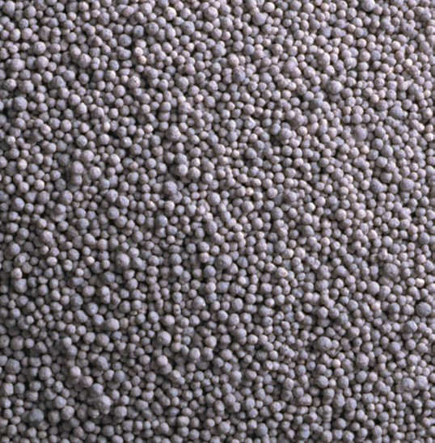
Proppants
Sand
Sintered Bauxite
Ceramics

Slide 23
Type of Fracturing treatments
Skin Frac
Frac & Pack
Massive Hydraulic Frac
Multiple vertical fracs
Multiple horizontal hole fracs
Shale gas frac
Coal Bed Methane frac
Acid frac

Slide 24
Where is fracturing applied?
Sandstones
  High permeability
  Low permeability
Carbonates
  Limestones
  Dolomites
Shales
  Extremely low permeability
Coal
  Coal bed methane
Geothermal
Notes:
Lithology, porosity and permeability are primary inputs for designing matrix acidizing treatments, but also for hydraulic fracturing treatments. Permeability is a measure of the ease with which fluids can flow through a formation. The S.I. permeability unit is m2, but the customary oilfield unit is the millidarcy (md.). For sandstones the shaliness is important as it controls the permeability, but also several rock mechanical parameters such as Youngs modulus, that will influence fracture growth. Carbonates dissolve in hydrochloric acid, and are therefor easy to clean with some acid. Also a special hydraulic fracturing technique can be applied: acid fracturing. With this techniques hydrochloric acid will create open channels deep into the formation after hydraulically fracturing it first.
Shales are the flavour of the year at the moment. Shale gas reservoirs can only be developed using multiple horizontal well bores and multiple hydraulic fracturing treatments creating a huge inflow area.
For coal bed methane reservoirs similar technology is required. Coal beds are very low permeability, like shales, and gas production will rely on natural fractures present in the coal beds. Also coal beds are usually saturated with water, which needs to be pumped off prior to producing gas from it.
Geothermal energy is an odd-ball with a bright future. Watch that space! Drilling two parallel horizontal wells in low permeability rock (Dry Rock) and connecting them with hydraulic fractures will produce a subsurface radiator that produces heat instead of oil or gas. Similarly a so-called “doublet” in the aquifer of a good permeability formation can serve to produce significant quantities of heat.

Slide 25
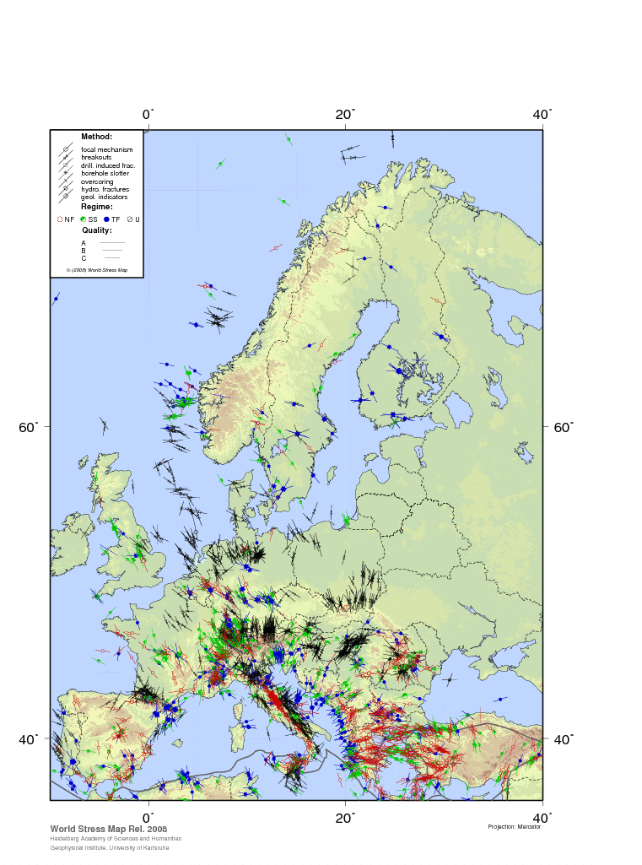
Maximum Horizontal Stress Orientation Europe
DIRECTION OF FRACTURES
=

Slide 26
Cost of an Hydraulic Fracturing Treatment
 |  | Frac Length (m)
 | 20 | 40 | 60 | 80
Fracfluid | 1000 bbl | 3000 bbl | 6000 bbl | 8000 bbl
Proppant | 20000 lbs | 60000 lbs | 120000 lbs | 200000 lbs
 |  | Frac Length (m)
 | 20 | 40 | 60 | 80
Fixed costs | 100000 | 100000 | 100000 | 100000
Fracfluid | 1000 | 3000 | 6000 | 10000
Proppant | 40000 $ | 120000 $ | 200000 $ | 300000 $
Chemicals | 10000 $ | 30000 $ | 50000 $ | 80000 $
Pump charges | 10000 $ | 30000 $ | 60000 $ | 100000 $
TOTAL | 161000 $ | 283000 $ | 416000 $ | 590000 $
Notes:
Depending on the reservoir’s in-situ stress profile along the well bore, a fracture will grow away from the well bore in a more or less rectangular shape if it is contained between an overlaying and an under laying formation with a higher horizontal stress, or it will grow away from the well bore in a radial, penny, shape in case there are no confining boundaries present. Off course any shape in between is also possible depending the in-situ stress profile.
As it is the length of the fracture that determines the productivity improvement, the volume of fluids and proppant pumped into the fracture (and therefore the costs) to create this length will depend on the ultimate shape of the fracture. Sophisticated fracture simulators are available to calculate the fluid and proppant volume required to generate a certain fracture length, but simple back of the envelope type of calculation as we will see further in this course will give us the early insight we need to select candidates and do the economic optimisations.

Slide 27
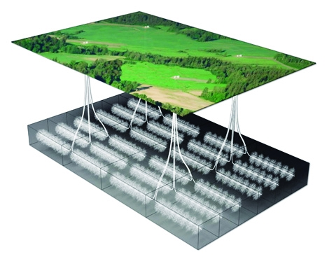
TO massive multi fracs in Shalegas
From small Frac & Packs in high permeability sandstones
Notes:
In recent years, hydraulic fracturing technology has made the next step in facilitating the unlocking the enormous gas reserves in shales. In the USA, the Barnett shale and the Marcellus shale development completely changed the American Energy outlook and might make the country independent of imports.
Key to the shale gas development is the drilling of many multi-lateral horizontal holes, each thousands of meters long, and subsequently placing 20 - 30 proppant filled hydraulic fractures in each lateral with the aid of complicated isolation techniques

Slide 28
Pictures
Notes:
This picture shows an outcrop of the Eagle Ford Shale in South Texas. There are several things to note in this very productive source rock:
There is an extreme amount of vertical heterogeneity with layers ranging from fractions of an inch to a few inches thick. Changes in TOC, Mineralogy and Mechanical Properties occur continuously over the net height of the reservoir.
Horizontally the reservoir is much more consistent with changes occurring over several hundreds of feet
At the base of this outcrop you can see a gray section that has a higher organic content

Slide 29
Earthquakes
Fracs have triggered minor earthquakes, up to 3 on the Richter scale
Only in techtonically active areas
Large scale injections

Slide 30
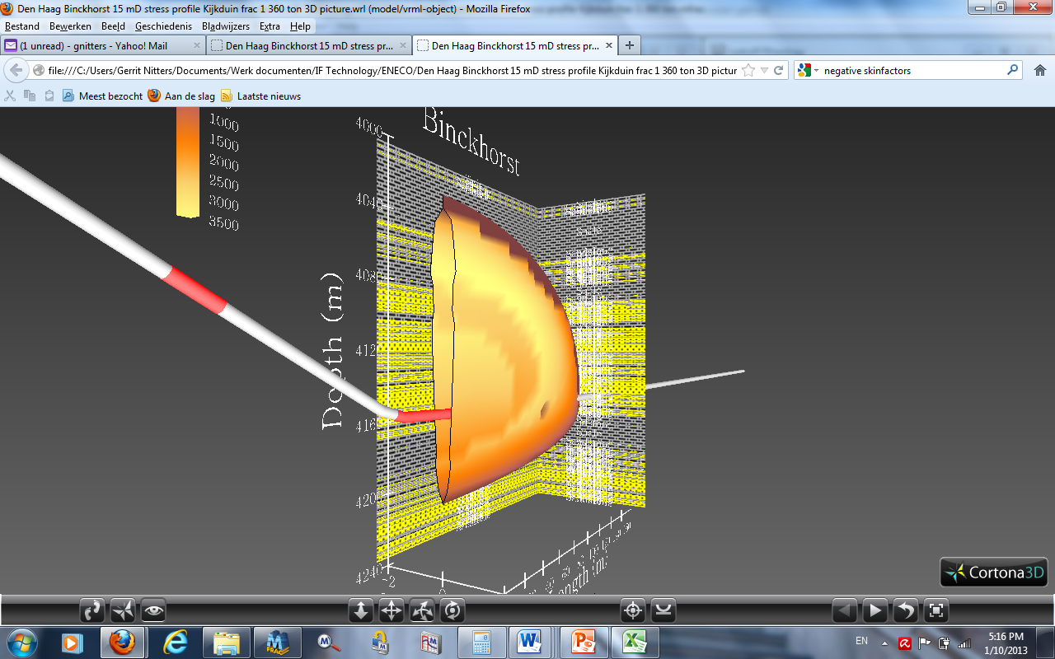
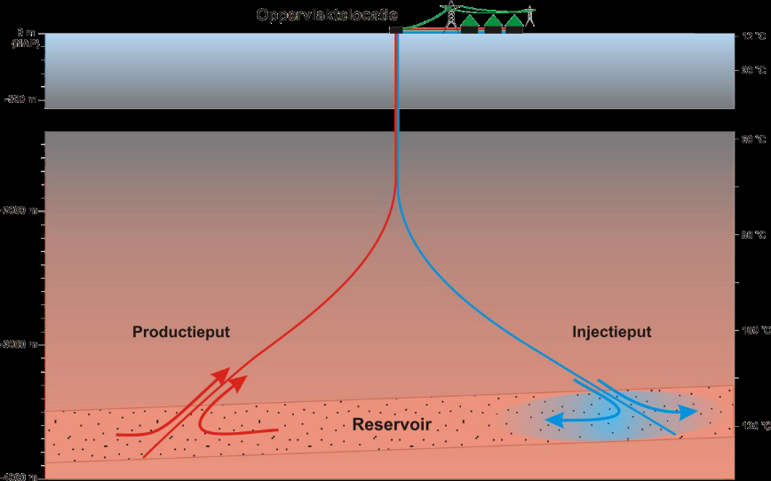


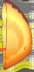
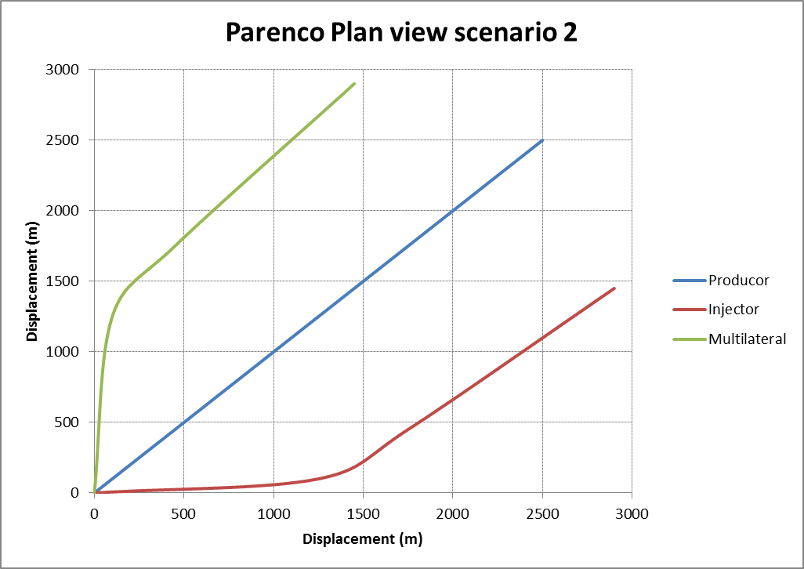
Doublets, Triplets
SoDM rule does in general not apply for dedicated fracture treatments

Slide 31
Soultz EGS project
Issues
  Scaling
  Seismic events
  Radioactivity

Slide 32
Soultz stimulations 1991 - 2007
Creation of the 2 well system GPK1/GPK2 at 3600 m (1991 – 1998)
Creation of the 3 well system GPK2/GPK3/GPK4 at 5000 m (1999 – 2007)
Deepening of GPK1 at 3600 m and stimulation
Deepening of GPK2 at 5080 m and stimulation
Drilling of GPK2 at 3880 m and stimulation
Drilling of GPK3 at 5100 m and stimulation
Circulation test between the 2 wells GPK1/GPK2 (4 months)
Drilling of GPK4 at 5270 m and stimulation
Circulation test between 3 wells (5 months)
Complementary chemical stimulations

Slide 33
Hydraulic stimulation
Pressue fall-off suggest fracture closure at ~ 7 MPa

Slide 34
summary
Well stimulation includes a number of techniques to improve the productivity or injectivity of a well. It is applied on a regular basis in the oil and gas industry. The technology is also applicable to geothermal wells.
Scaling – Acid treatments
Plugged screens – Acid treatments and acoustic methods
  needs further development
Increase “natural” capacity – hydraulic fracturing
Thank you for your attention

Slide 35
Reference
Soultz
Main achievements from the multi-well EGS Soultz project during geothermal exploitation from 2010 and 2012
Albert Genter¹, Nicolas Cuenot¹, Bernd Melchert², Wilfried Moeckes¹, Guillaume Ravier³, Bernard Sanjuan⁴, Raphaël Sanjuan^{1,} ⁵, Julia Scheiber1, Eva Schill¹, Jean Schmittbuhl⁶
1 GEIE Exploitation Minière de la Chaleur, Kutzenhausen, France
2 BGR, Hannover, Germany
3 ES-Géothermie, Haguenau, France
4 BRGM, Orléans, France
5 INP ENSIACET, Toulouse, France
6 EOST, Strasbourg, France

