Slide 1
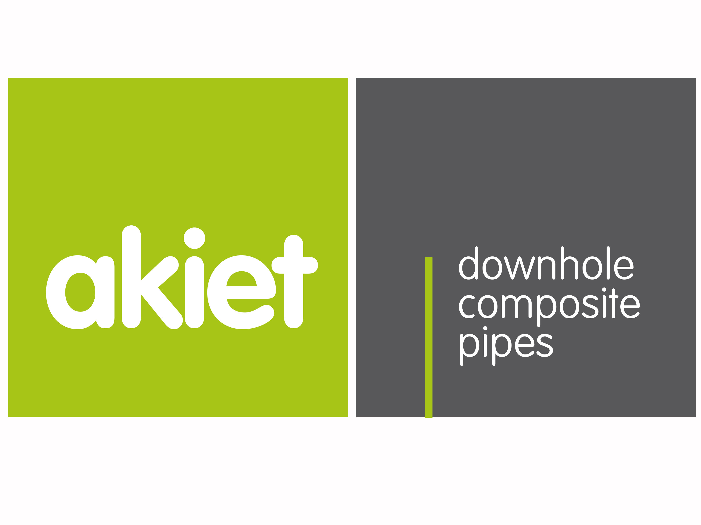
DAP Symposium 2015
Rob Selles, CEO

Slide 2
Introduction
Akiet BV was formed after completion of a private equity funding round of Acquit Business Development BV (ABD)
Founders of ABD were Tom Bakker, Dick Swart and Willem de Jong who are also founding fathers of DAP (WEP & IDN Concepts)
ABD exists to pursue the vision of:
  Drilling to 3000m+ from a parking lot
    to significantly reduce the surface impact and capital expenditure of geothermal doublets
ABD started developing High Strength Composite Casing in 2006 and Akiet now is ready to supply!
downhole
composite
pipes

Slide 3
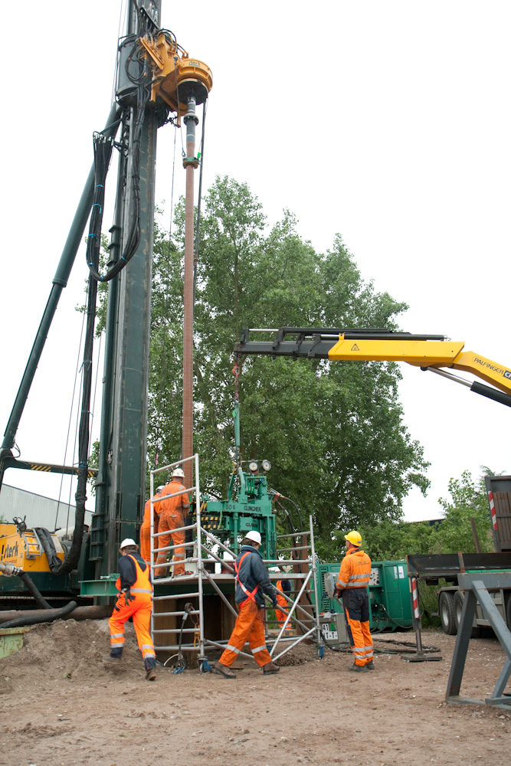
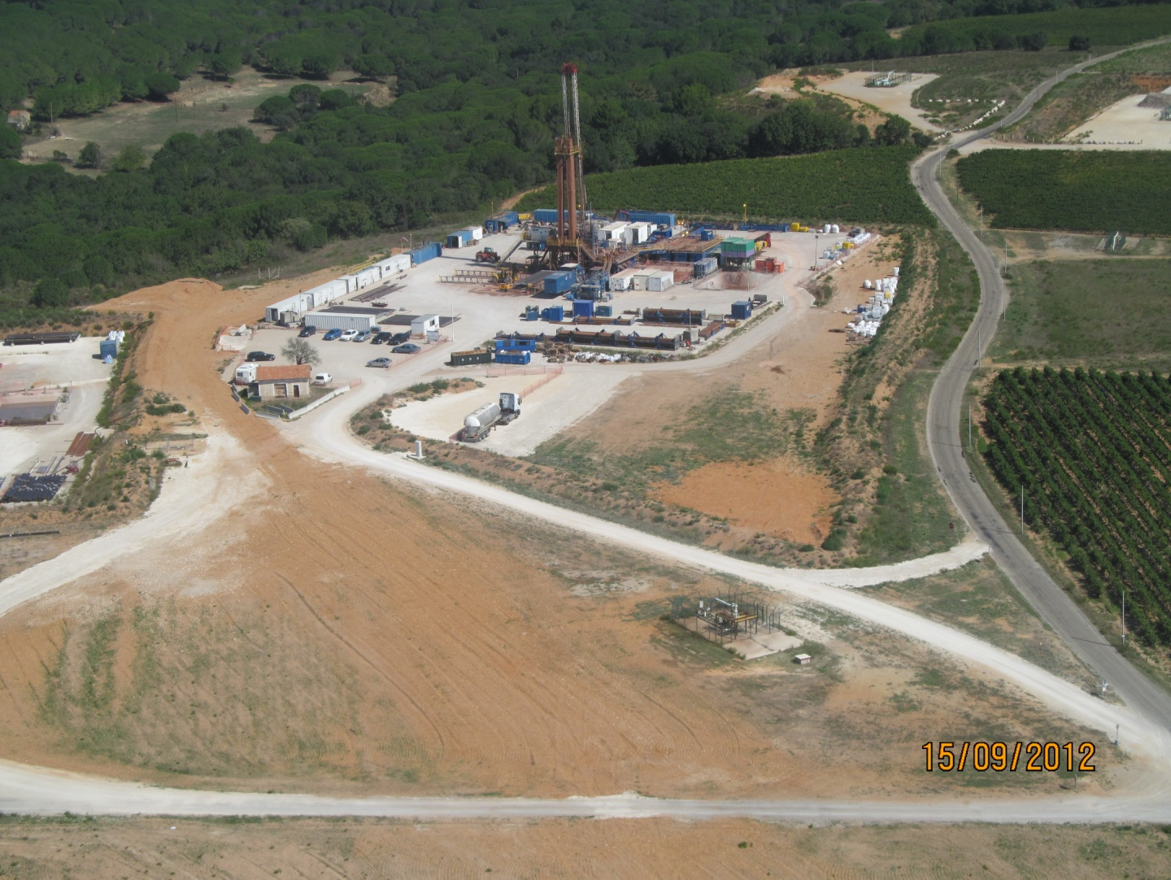
Enhanced Composite Casing Installation (ECCI)
Maximum load for 1000m well with 9-5/8” casing:
Material | Specific Weight | Buoyancy in mud | Hook load (tons)
Steel casing | 70 kg/m | 0,85 | 60
5” drill pipe | 29 kg/m | 0,85 | 25
HSCC / ECCI | 20 kg/m | 0,45 | 9
Conventional rig
Super single rig
Super HSCC/ECCI rig

Slide 4
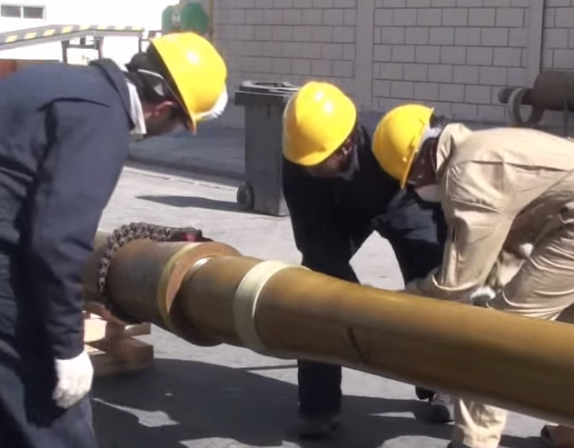
Composite Technology
GRE composite consists of glass fibers in an epoxy matrix
With traditional GRE pipes, fibers, drenched in epoxy, are wound around a mandrel. Disadvantages include:
  Fibers under an angle with main forces => requires thicker walls
  Air inclusions giving weak spots under high pressures
  Uneven surfaces => vulnerable to handling damage and weak spots
Traditional GRE threaded couplings are thick and relatively weak

Slide 5
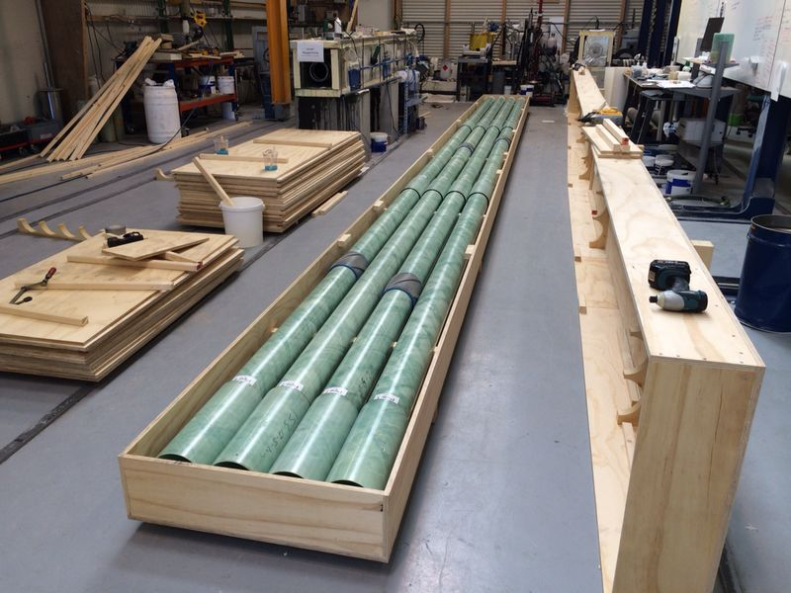
Rotary Casting Technology
Fabrics are wound around a mandrel
The mandrel is placed inside a rotary mould
The mould is spun at high rpm
Centrifugal forces position the fabrics tightly against inside of mould
Resin is injected and driven into the fiber structure pushing out all voids
After curing the pipe is removed from the mould
Glued couplings are slender and strong

Slide 6
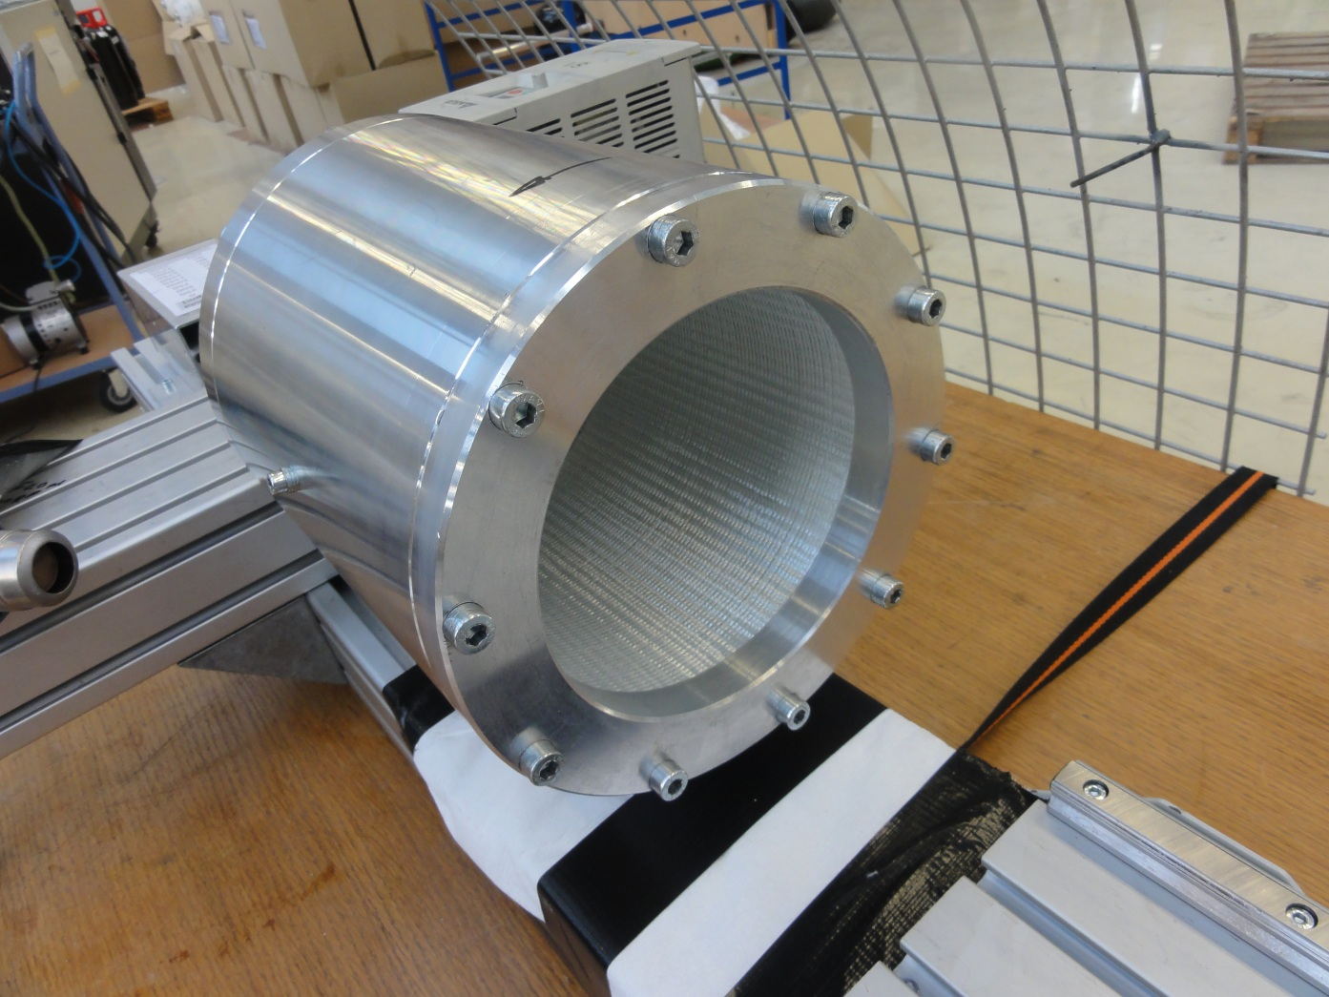
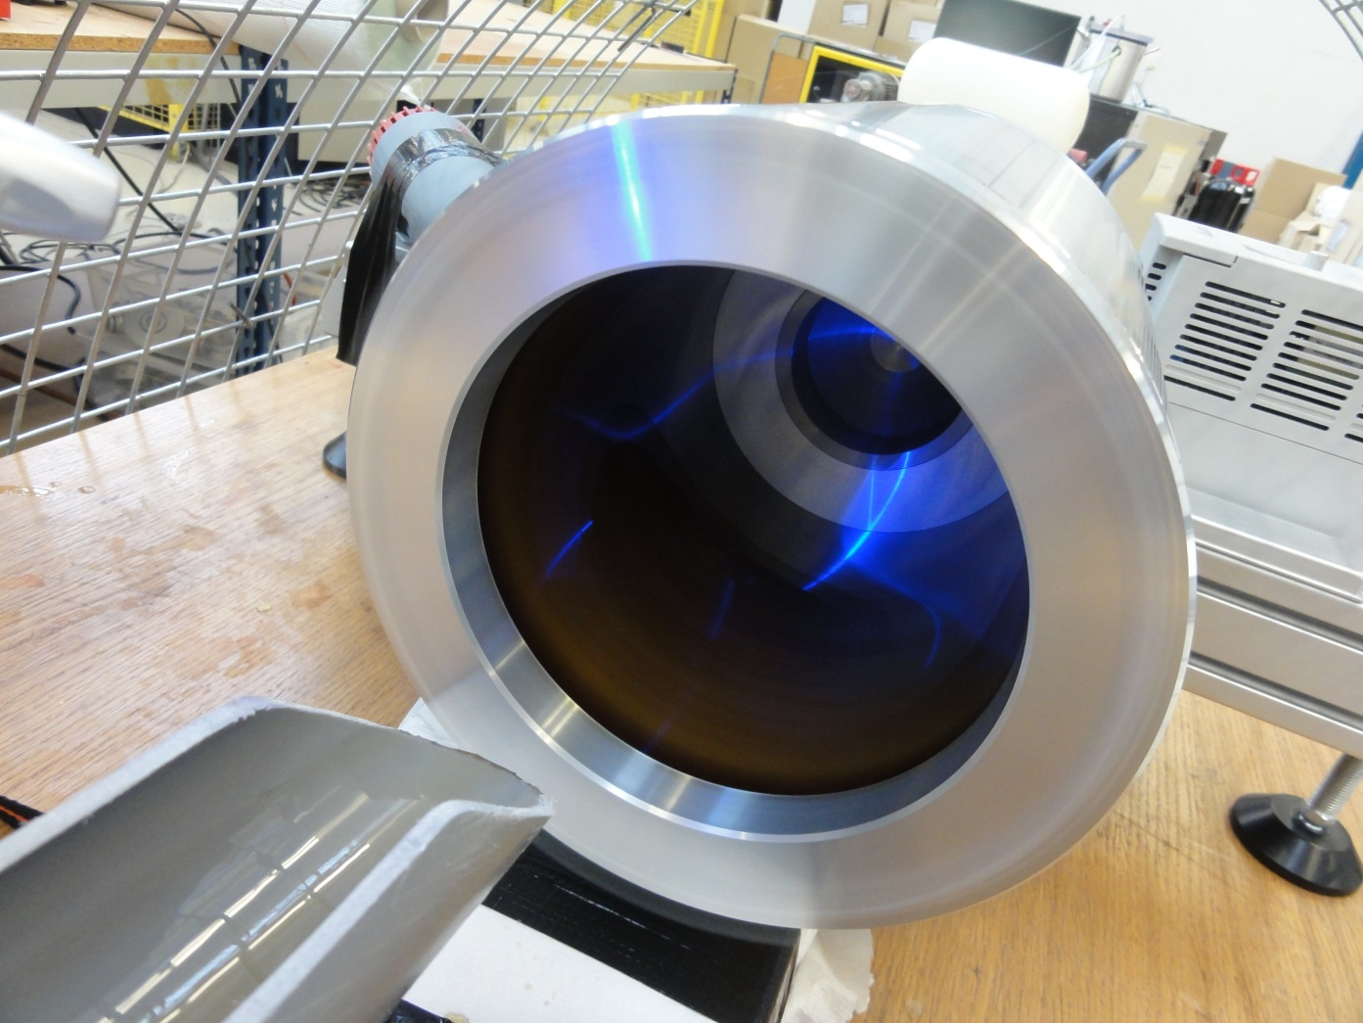
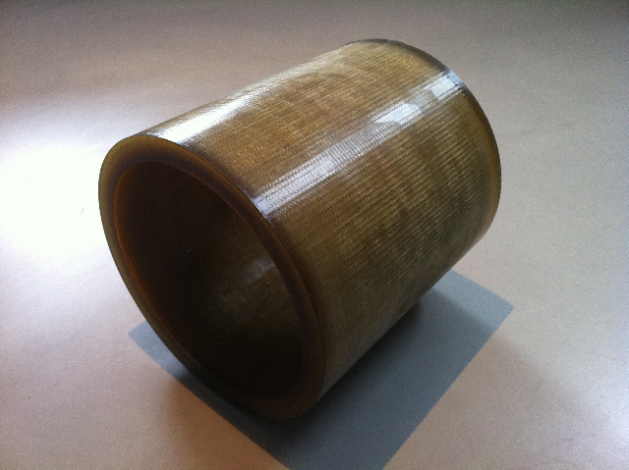
The long road to success
Rotational casting pipes with glued composite couplings
  Fibers run in direction of largest forces
  Thin walls
  Small off-set on couplings
  Smooth surfaces
Tested on 20cm machine proving concept
Production tested on 2 meter machine trying different materials and epoxy
Production proven on 4 meter 7” machine
First orders expedited and successfully installed

Slide 7
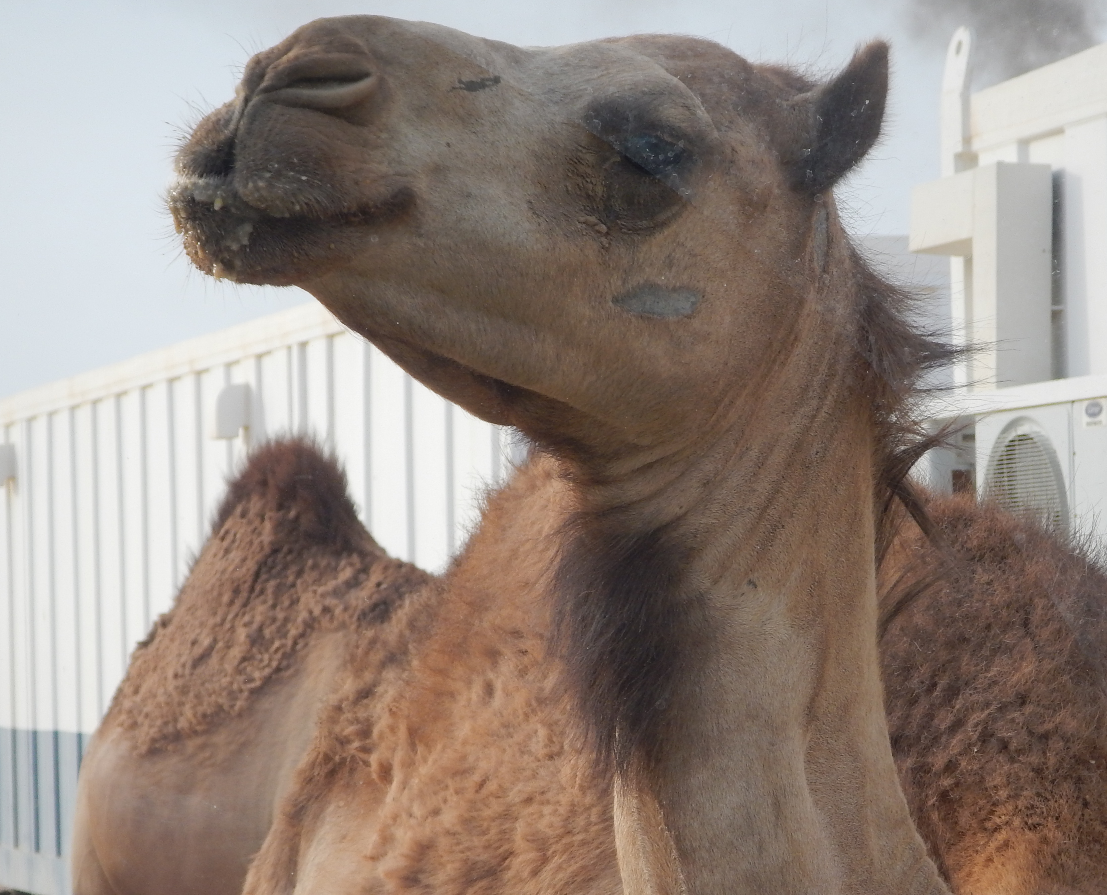
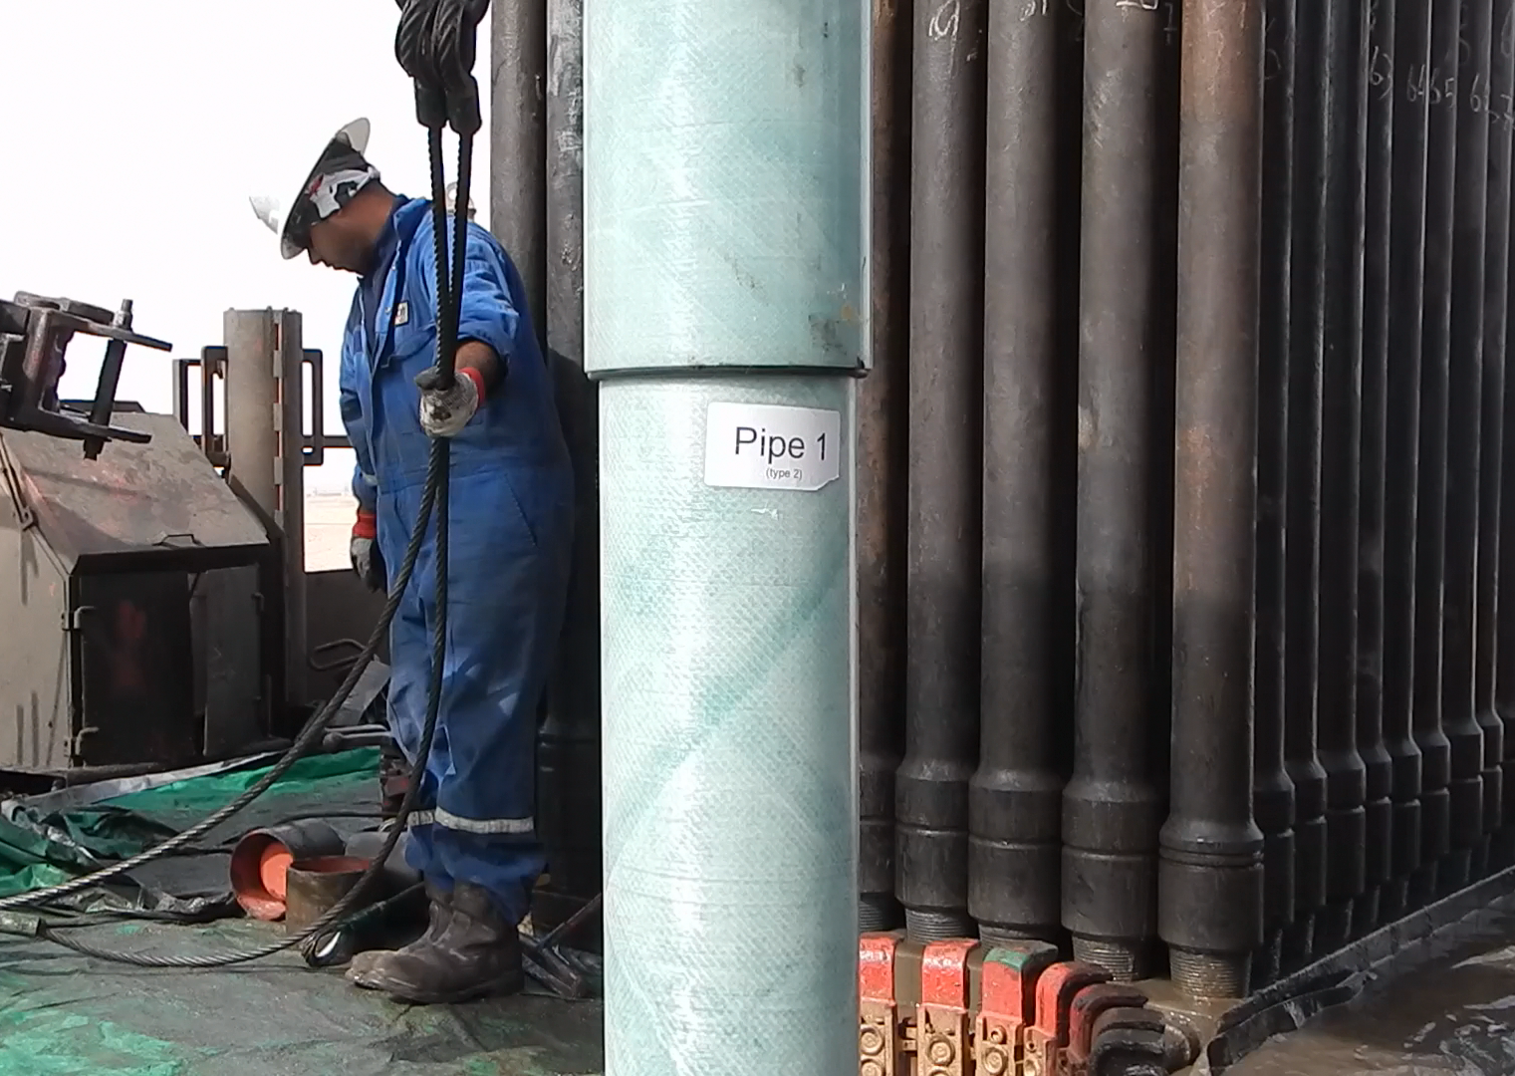
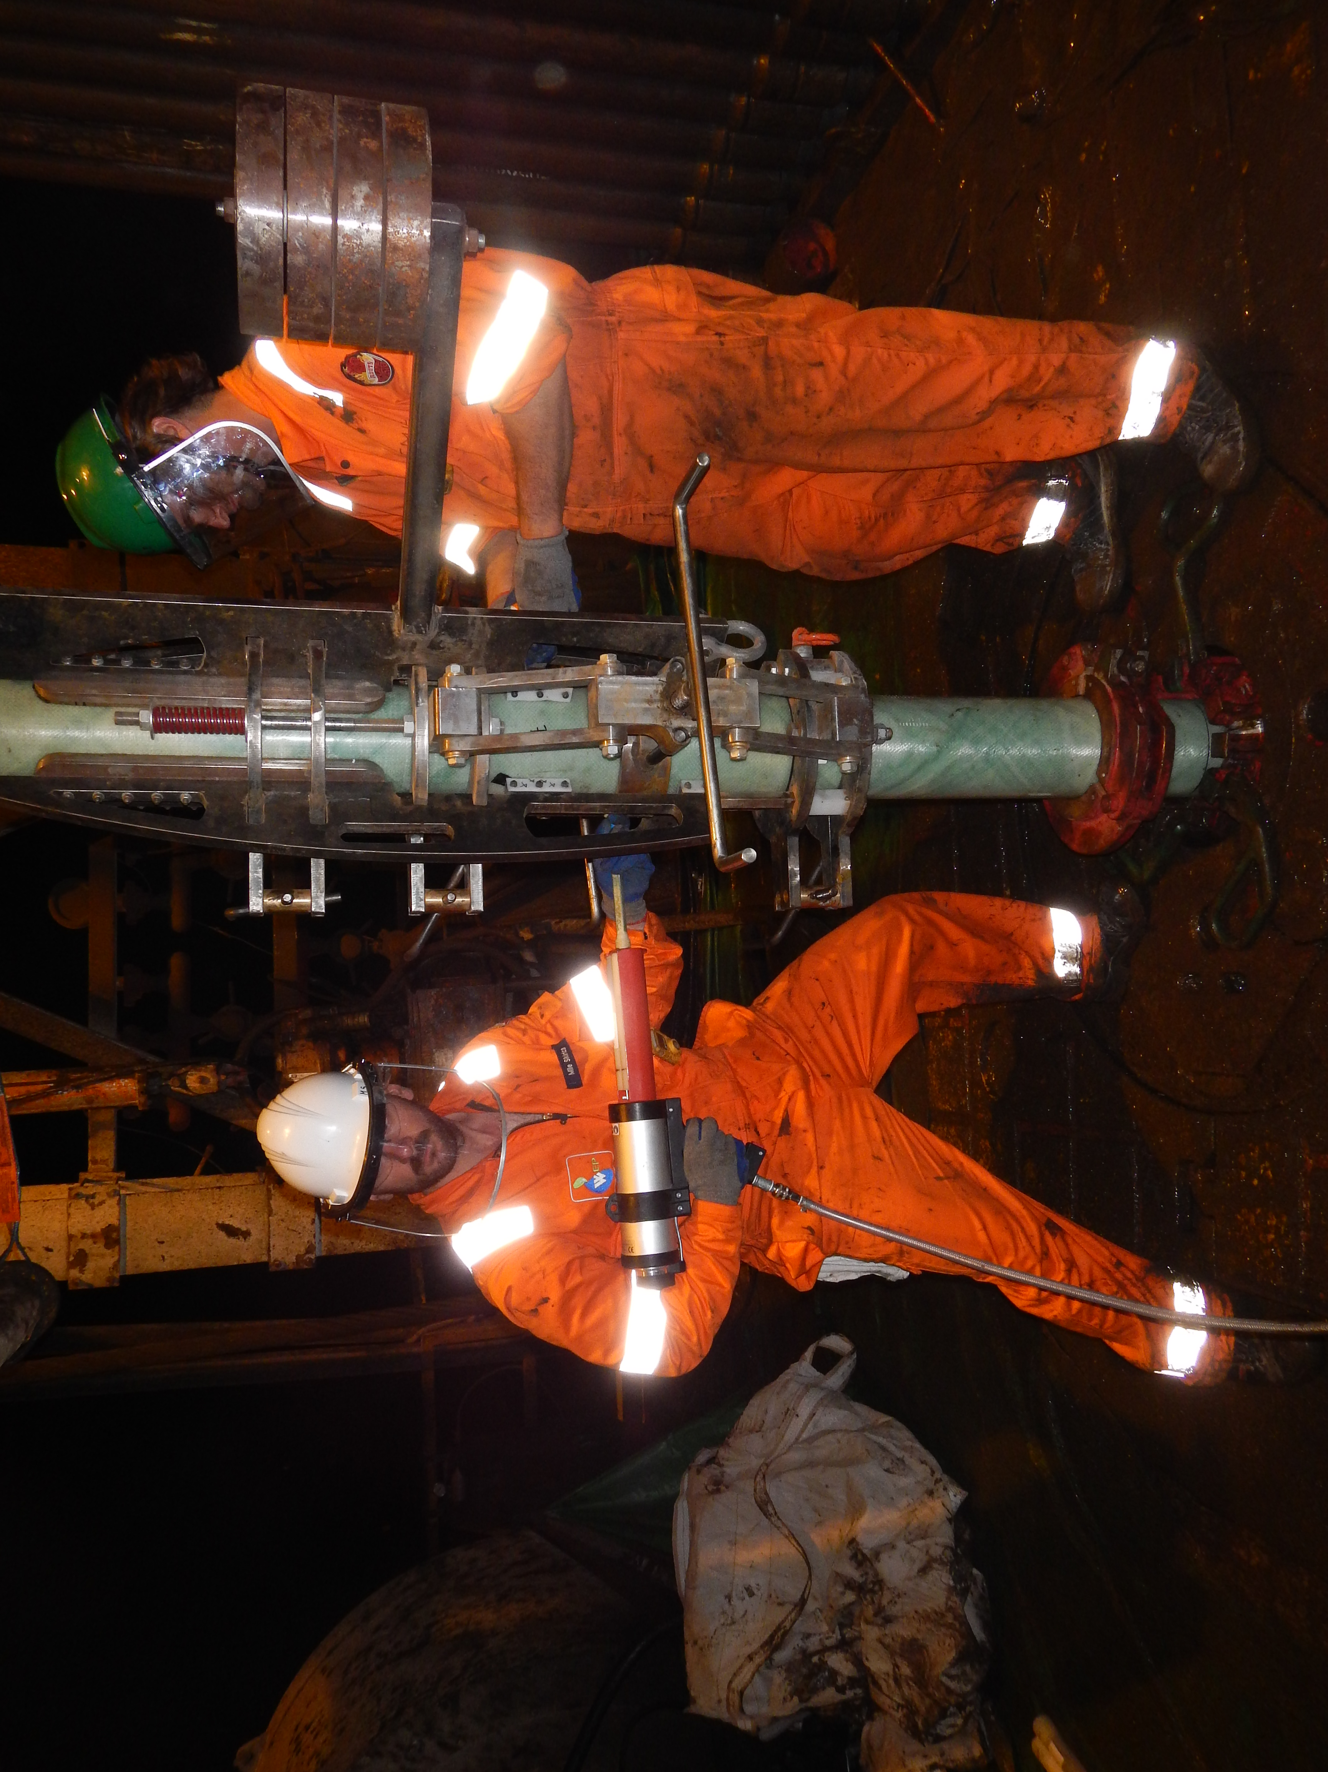
World record @5000 meters vertical depth

Slide 8
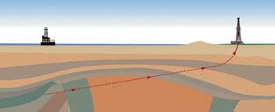
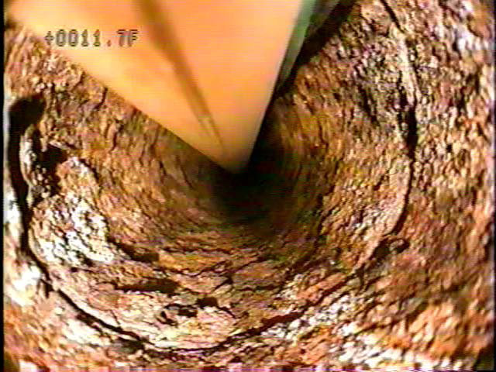
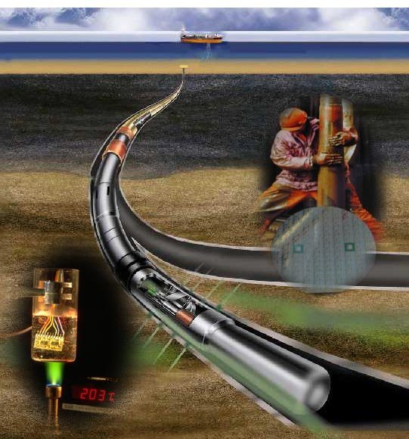
In search of larger markets
Light weight:
Extended Reach Drilling
Small hook load
Helicopter supplied sites
Eliminate corrosion problems
Corrossive formations
Water injection wells
Disposal wells
Enable “See-through-logging” (STL™)

Slide 9
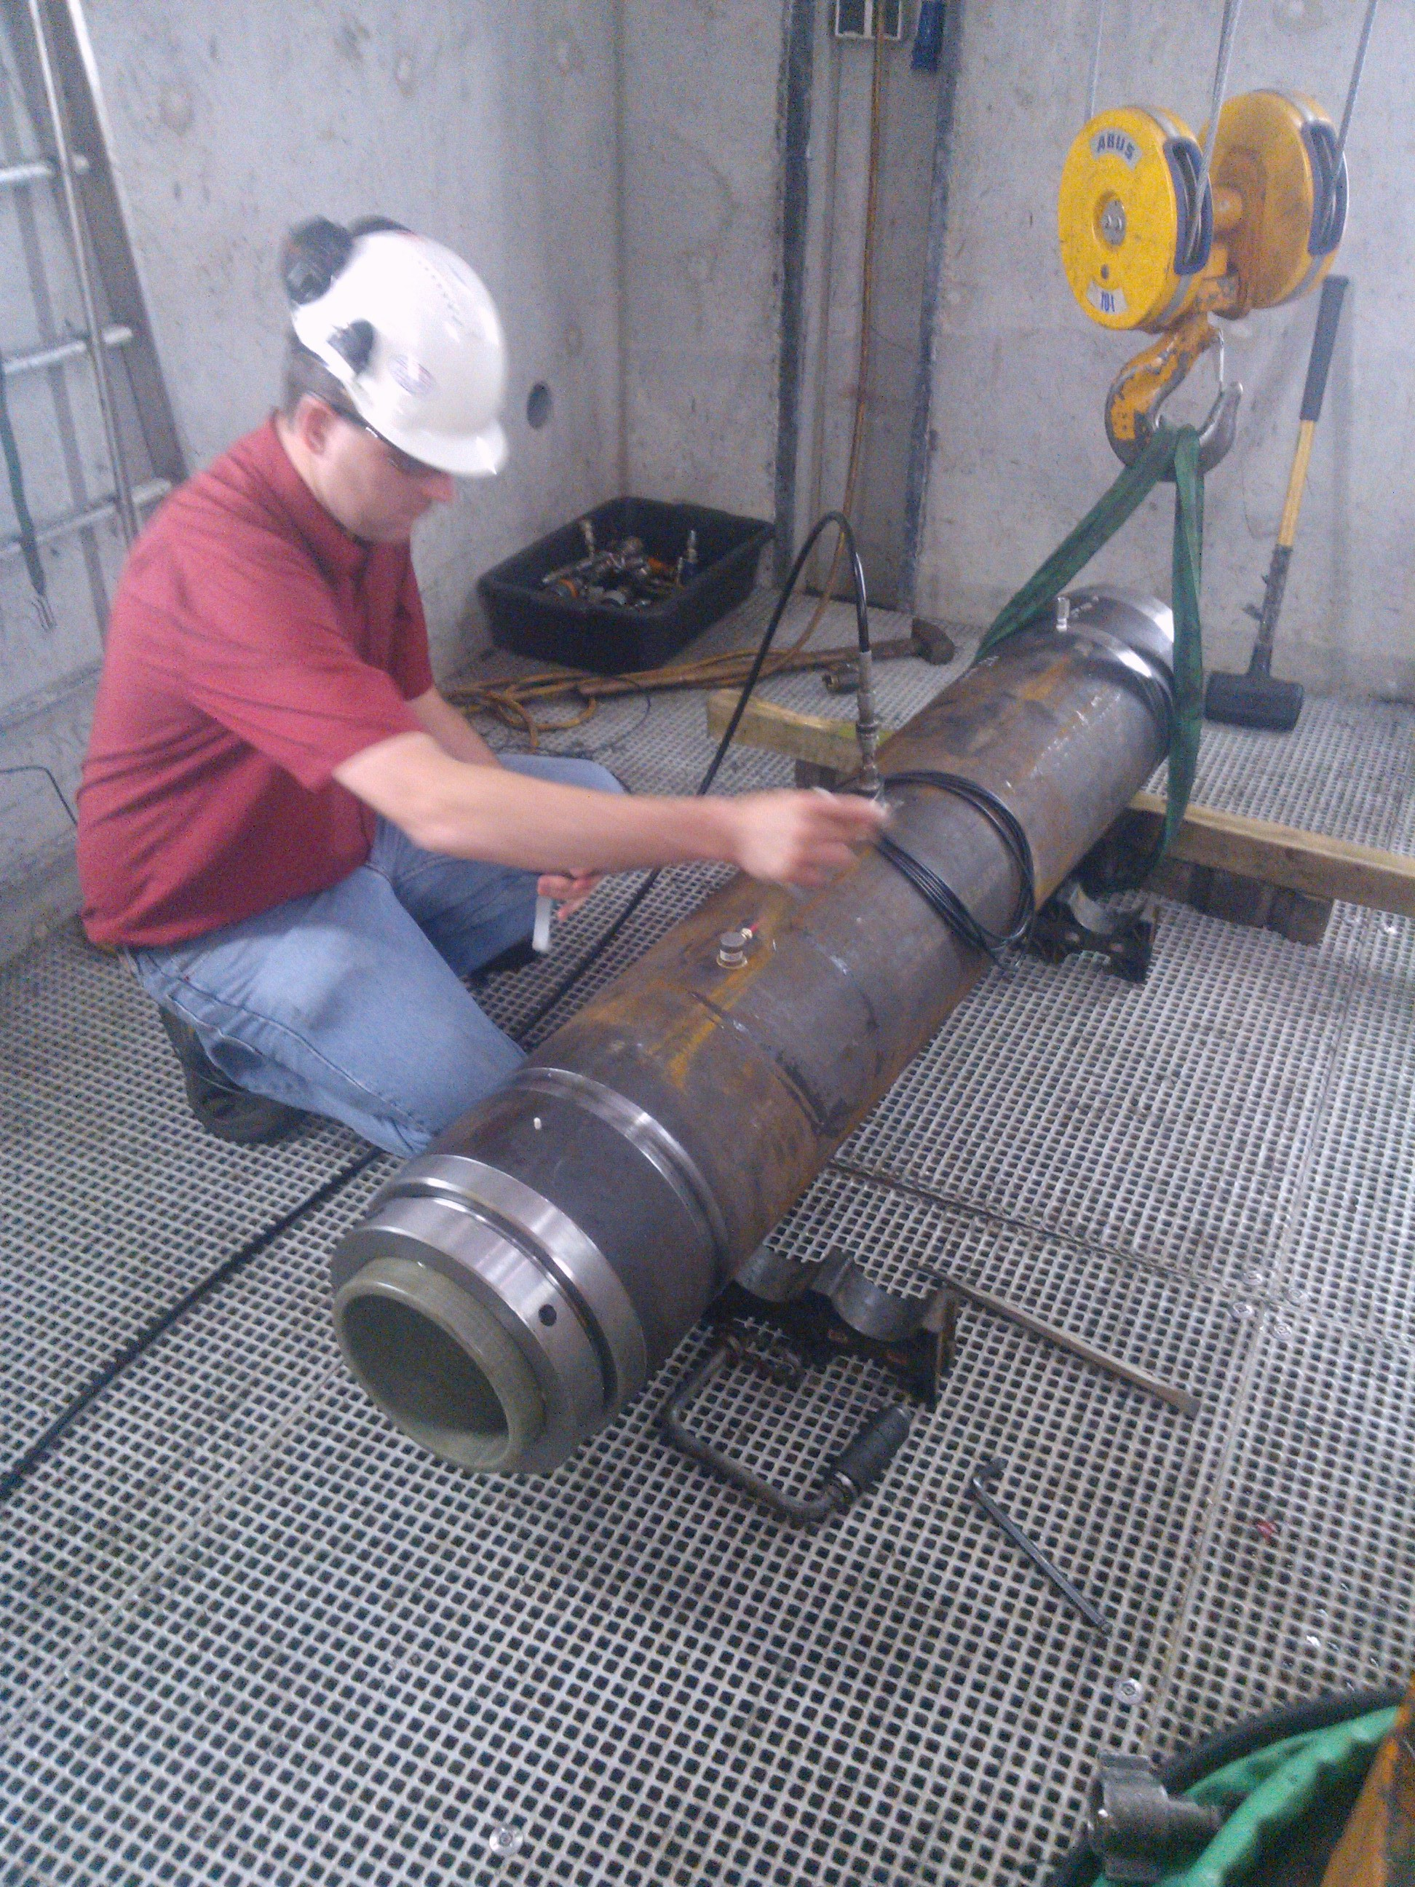
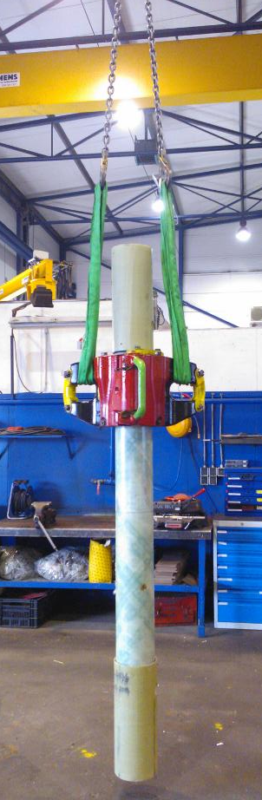
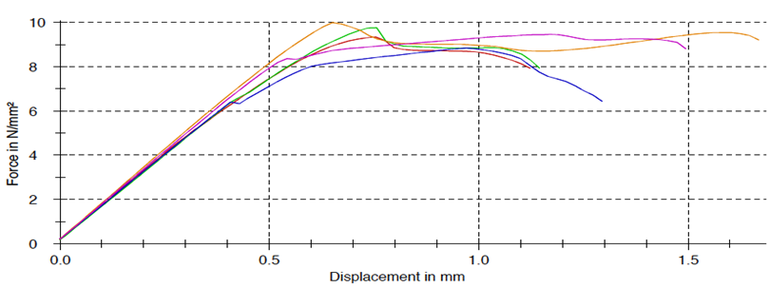
Extensive testing showed reliability and consistency
Tests performed to demonstrate:
Capability to handle required loads
Reliability / durability
Handling / robustness
Logging responses

Slide 10
Test results
Pipe system can handle loads with sufficient safety margin
Cement bonding can be logged
Pipe is transparent for the requested measurements i.e. magnetic and acoustic logging
Current temperatures up to 105’C. Route to higher temperatures identified
Sufficient data collected to prepare detailed casing installation program
7” HSCC system (pipe & connection) | test result | unit
Burst | 275 | bar
Collapse | 207 | bar
Tension | 1250 | kN
Compression | 588 | kN
Torsion (limited by test set-up) | 16.3 | kNm

Slide 11
Geothermal Doublet Research Program (Research, Development & Education , “3 O”)
Enhanced Composite Casing Installation (ECCI) technology (casing while drilling)
Fundamental understanding of the loading conditions, the material properties, and the dynamic behaviour of the equipment involved.
Cooperation with the faculties
    Aerospace Engineering (composite materials, non destructive testing),
    3me (engineering mechanics, robotics, systems and control, materials)
    Civil Engineering and Geosciences (geoscience aspects)
BSc and MSc internship and graduation opportunities:

Slide 12
Further research subjects
Improved heat resistance of composites
Improved wear, impact and creep-resistance of composites
Dynamic characterization of composite materials in drilling operations
Innovative full composite connection technology
New metal-composite-integration technology
Composite cased well abandonment
Non-Destructive Testing

Slide 13
Phasing to full roll-out
1000 meter HSCC geothermal system. Traditional equipment
2600-3000 meter geothermal system. Light weight drill rig. DAP Objectives
1000 meter geothermal system. Crane based
3000meter crane based geothermal system.
All technology proven and applied

Slide 14
Close to commercialisation
Within the next 12 months Akiet will have:
proven technology
tested systems
manufacturing capability
Achieved by working with strategic partners,
…..to enable geothermal system operators to reduce the total cost of drilling by 20%, with less operational cost than a traditional system

Slide 15

With thanks to:

Slide 16
Rob Selles, CEO
rob@acquit-bv.nl
+31 83795187

