Slide 1
Integration of binary power plants at geothermal low temperature sites
Stephanie Frick
GFZ National Research Centre for Geosciences in Germany
International Centre for Geothermal Research (ICGR)
DAP Symposium Delft
February 25th 2015

Slide 2
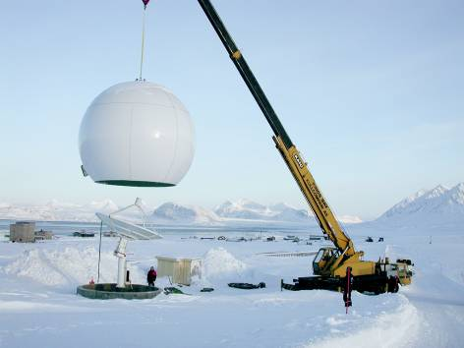
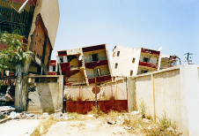
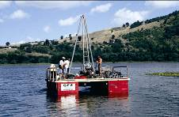
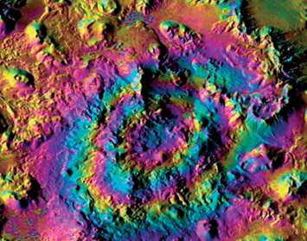
Research Profile of GFZ
Earth System Analysis / Departments
Geodesy & Remote Sensing
Physics of the Earth
Geodynamics and Geomaterials
Chemistry and Material Cycles
Earth Surface Processes
Earth System Management / Geoengineering Centres
Centre for CO₂ Storage (CGS)
International Centre for Geothermal Research (ICGR)
Centre for Early Warning
Centre for Geoinformation Technology (CeGIT)
Centre for Geoecological Research (CGR)
Earth System Monitoring / Scientific Infrastructures
MESI (Modular Earth Science Infrastructure)
Observatories (plate boundary, global change, TERENO)
Global networks (e.g. GEOFON)
Scientific Drilling
International Centre for Geothermal Research (ICGR)
Helmholtz Centre Potsdam German Research Centre for Geosciences
Notes:
15.12.08 Abstimmungsgespräch BGR
2
Das Forschungsprofil des GFZ versucht, mit seinem umfassenden Ansatz der Komplexität des Systems Erde gerecht zu werden.
In allen diesen Forschungsbereichen finden sich energierelevante Themen. Wir bearbeiten konventionelle und nichtkonventionelle fossile Brennstoffe; wir untersuchen deren geologische Entstehungsbedingungen ebenso wie die mögliche geologische Speicherung des Abfallgases CO2. Wir untersuchen die Bildung von methanhydraten im Labor ebenso wie in der Natur.
Und wir kümmern uns um die nachhaltige Energieversorgung durch Erdwärme nicht nur zum Heizen, sondern auch zur Stromversorgung.
D1 Der Schwerpunkt unserer Arbeit ist, die Figur und Rotation der Erde, ihre Orientierung im Raum, ihre Oberfläche und ihr Gravitationsfeld in allen Einzelheiten zu vermessen.
D2 Dabei haben wir nicht nur die Vorgänge im Erdinnern, sondern auch das Magnetfeld der Erde im Blick. (Magnetfeld, Vulkanismus, Erdbeben, Seismologie, geodynamische modellierung
D3 wie dort die Bewegungen im Inneren unseres Planeten ablaufen, sei es die langsame Drift der Lithosphärenplatten oder die äußerst schnellen Vorgänge in einem Erdbebenherd. Gleichzeitig vollziehen wir in Laborversuchen im Detail nach, was im Gestein geschieht, wenn es beispielsweise in einem Erdbeben bricht, in die Tiefen des Erdmantels taucht oder als Magma schmilzt.
D4 Transport von Materie und Energie, Stoffeigenschaften und die Transportprozesse von Geomaterialien zu erforschen und zu verstehen. Dabei befassen wir uns auch mit den Wechselwirkungen zwischen Geo-, Bio-, Hydro- und Atmosphäre.
D5 Natürliche Variationen und menschliche Eingriffe in die Landschaft und Stoffkreisläufe führen zu Veränderungen an der Haut der Erde und koppeln sich zurück auf das Gesamtsystem. Verknappung nutzbarer Böden, Landschafts- und Klimawandel wirken sich direkt auf den menschlichen Lebensraum aus. Die Messung und Modellierung dieser Vorgänge und Wechselwirkungen auf aktuellen und geologischen Zeitskalen sind der Schwerpunkt der Forschungsarbeiten in unserem Department.

Slide 3
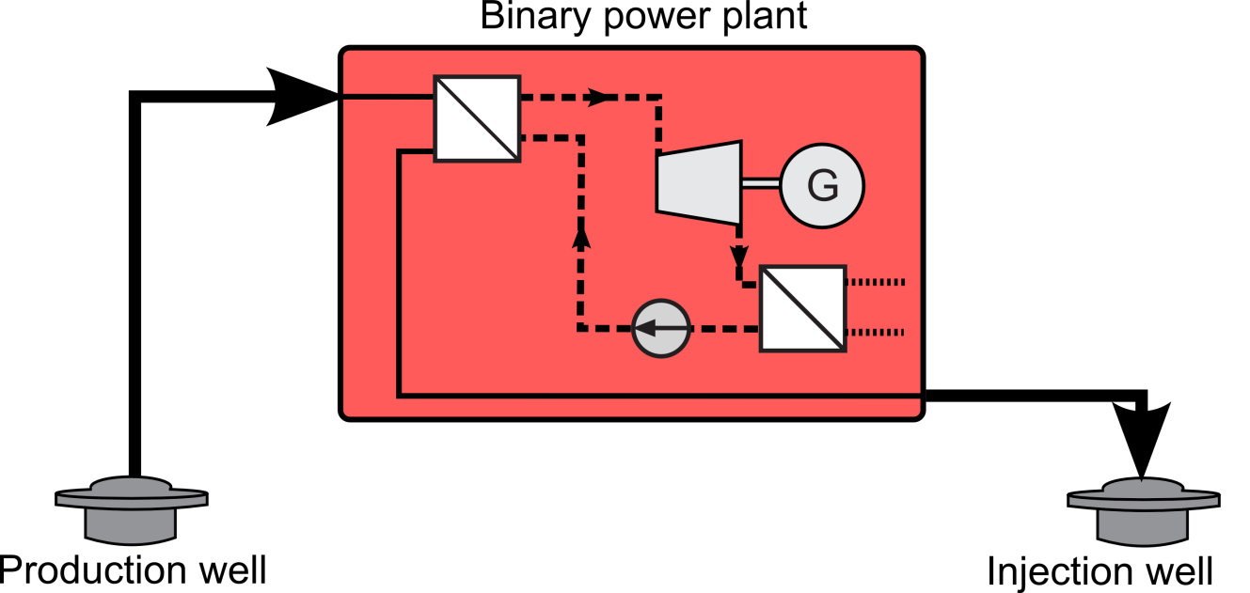
Cogeneration of electricity and heat at geothermal low temperature sites?
Combined heat and power (CHP)
→ simultaneous generation of electricity and heat in the same plant
Electricity
Heat

Slide 4
Cogeneration of electricity and heat at geothermal low temperature sites?
Combined heat and power (CHP)
→ simultaneous generation of electricity and heat in the same plant
Electricity
Heat
30...50°C .
85…95% of Q_{in}
(~5…30MW_{th}/doublet)
100...150°C

Slide 5
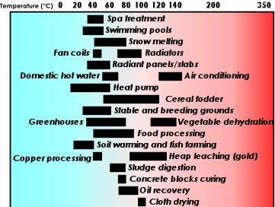
Cogeneration of electricity and heat at geothermal low temperature sites?
Combined heat and power (CHP)
→ simultaneous generation of electricity and heat in the same plant
Electricity
Heat
30...50°C .
85…95% of Q_{in}
(~5…30MW_{th}/doublet)
100...150°C
Lindal-Diagram
Source: http://www.geothermal-energy.org/314,what_is_geothermal_energy.html

Slide 6
Cogeneration of electricity and heat at geothermal low temperature sites?
Combined heat and power (CHP)
→ simultaneous generation of electricity and heat in the same plant
→ No typical application for geothermal low temperature sites
Electricity
Heat
30...50°C .
85…95% of Q_{in}
(~5…30MW_{th}/doublet)
100...150°C

Slide 7
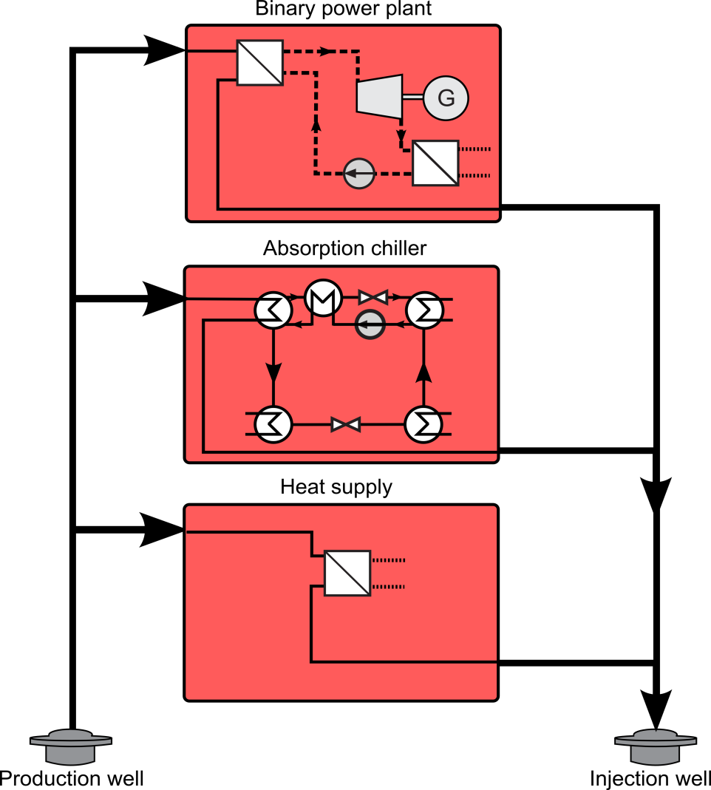
Cogeneration of electricity and heat at geothermal low temperature sites?
Serial and/or parallel coupling of electricity and heat supply
Plant concept depending on
  Reservoir characteristics
  e.g. available temperature,
  reservoir productivity / pumping effort
  Geothermal fluid composition
  e.g. temperature limit for geothermal
  fluid use (scaling),
  fluid-material-interactions (corrosion)
  Heat demand characteristics
  e.g. maximum load, base load,
  temperature level
Electricity
Heat
’Chill‘

Slide 8
Cogeneration of electricity and heat at geothermal low temperature sites?
Serial and/or parallel coupling of electricity and heat supply
Plant concept depending on
  Reservoir characteristics
  e.g. available temperature,
  reservoir productivity / pumping effort
  Geothermal fluid composition
  e.g. temperature limit for geothermal
  fluid use (scaling),
  fluid-material-interactions (corrosion)
  Heat demand characteristics
  e.g. maximum load, base load,
  temperature level
  But don’t forget about the cooling
  of the binary power plant!
Waste heat
Electricity
Heat
’Chill‘

Slide 9
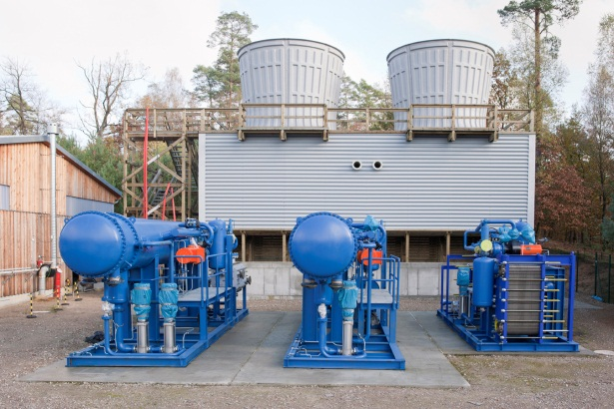
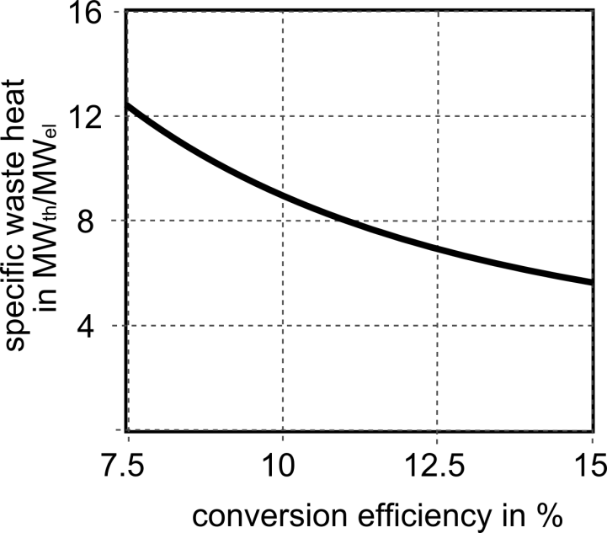
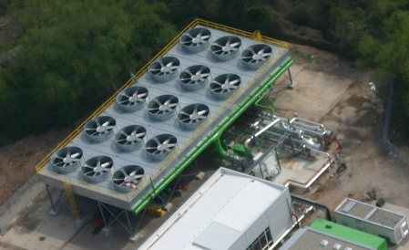
Cooling of low temperature power plants
Large amounts of waste heat → cooling system = largest component
Wet cooling tower
3stage-ORC
ORC-Plants Groß Schönebeck Source: GFZ
Air-cooled
condenser
1stage-ORC
ORC-Plant Landau Source: geox

Slide 10
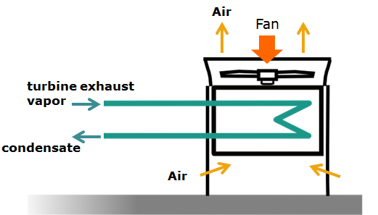
Cooling system basics
Air-cooled
condenser
Theoretical minimum temperature for condensation:
dry air temperature T_{air}
Real plant:
T_{cond}=T_{air} + ΔT_{ITD}

Slide 11
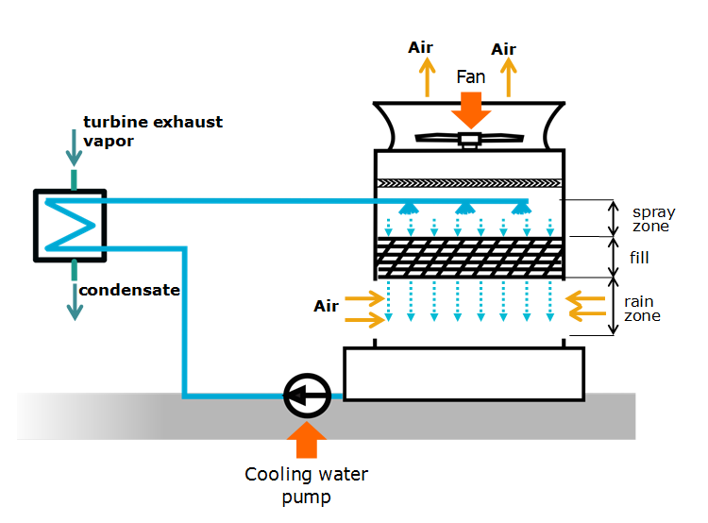
Cooling system basics
Wet cooling tower
Theoretical minimum temperature for condensation:
wet bulb temperature T_{WB}
Real plant:
T_{cond}=T_{WB} + ΔT_{approach}+ ΔT_{CW}+ ΔT_{PP}
Air-cooled
condenser
Theoretical minimum temperature for condensation:
dry air temperature T_{air}
Real plant:
T_{cond}=T_{air} + ΔT_{ITD}

Slide 12
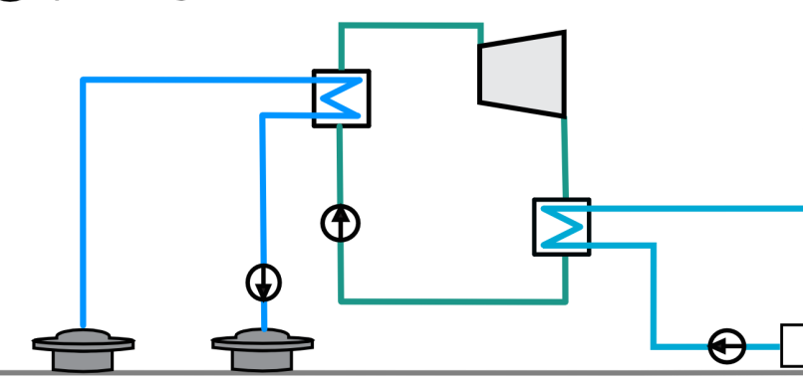
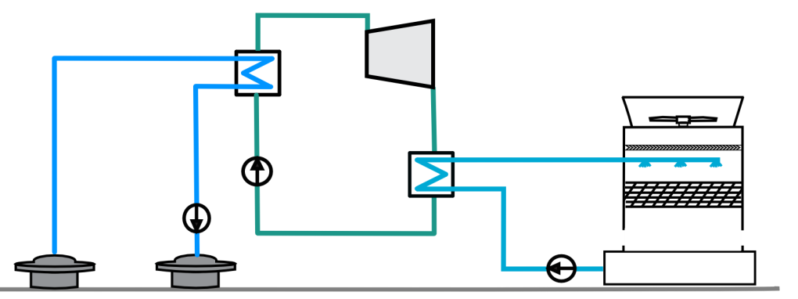
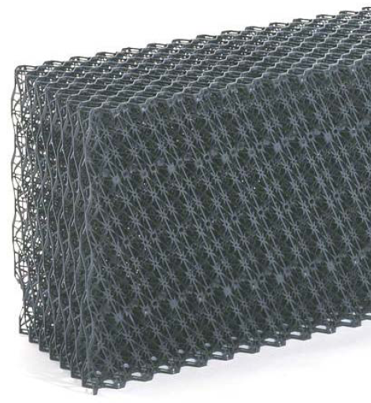
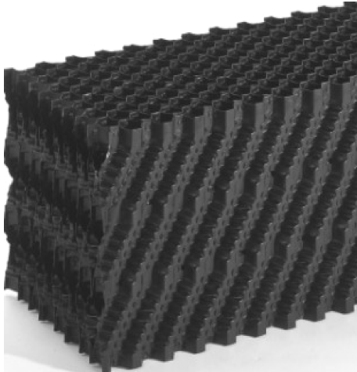

Cooling of low temperature power plants
Type of cooling system & cooling system design → site conditions
→ cooling water availability & cooling water quality
Wet cooling tower
→ 0.3…1 kg/s per MW_{th waste} _{heat}
← disposal of elutriation water
Once-through cooling
→ 10…50 kg/s per MW_{th waste heat}
river
Air-cooled condenser
→ 0 kg/s per MW_{th} _{waste} _{heat}
Trickle grid
(source: GEA)
Film fill
(source: GEA)

Slide 13
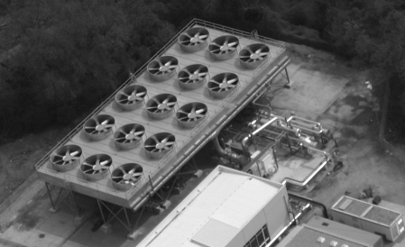
Cooling of low temperature power plants
Type of cooling system & cooling system design → site conditions
→ cooling water availability & cooling water quality
→ space available
Once-through cooling
→ no special requirement
Wet cooling tower
→ 8…15 m² per MW_{th waste heat}
river
Air-cooled condenser
→ 20…50 m² per MW_{th waste heat}
air flow area

Slide 14
Cooling of low temperature power plants
Type of cooling system & cooling system design → site conditions
→ cooling water availability & cooling water quality
→ space available and/or project budget
Example ORCs with air-cooled condenser
Example ORCs with wet cooling tower
ORC1: Brine 150°C & 30 kg/s, working fluid n-butane
ORC2: Brine 120°C & 60 kg/s, working fluid isobutane

Slide 15
Cooling of low temperature power plants
Type of cooling system & cooling system design → site conditions
→ cooling water availability & cooling water quality
→ space available and/or project budget
Example ORCs with air-cooled condenser → 20…50 m² per MW_{th}
Example ORCs with wet cooling tower → 8…15 m² per MW_{th}
ORC1: Brine 150°C & 30 kg/s, working fluid n-butane
ORC2: Brine 120°C & 60 kg/s, working fluid isobutane

Slide 16
Cooling of low temperature power plants
Auxiliary power for fans and cooling water pumps need to be considered
→ gross power and auxiliary power demand _{ꜛ} with _{ꜜ} condensation temp.
→ optimum condensation temperature
ORC with air-cooled condenser
ORC with wet cooling tower

Slide 17
Cooling of low temperature power plants
Auxiliary power for fans and cooling water pumps need to be considered
→ gross power and auxiliary power demand _{ꜛ} with _{ꜜ} condensation temp.
→ optimum condensation temperature → optimum ITD / approach
Initial temperature difference ITD = T_{cond} - T_{air}
Approach to wet bulb temp.
Approach = T_{cold water} – T_{WB}
ORC with air-cooled condenser
ORC with wet cooling tower

Slide 18
Cooling of low temperature power plants
Auxiliary power for fans and cooling water pumps need to be considered
→ gross power and auxiliary power demand _{ꜛ} with _{ꜜ} condensation temp.
→ optimum condensation temperature → optimum ITD / approach
→ optimum ITD / approach depends on air flow area (8…13 kW_{el}/MW_{th WH})
Initial temperature difference ITD = T_{cond} - T_{air}
Approach to wet bulb temp.
Approach = T_{cold water} – T_{WB}

Slide 19
Summary
Serial and/or parallel coupling of electricity and heat supply most typical for geothermal low temperature sites
Plant concept for cogeneration depending on
> Reservoir characteristics & geothermal fluid composition
> Heat demand characteristics
Large amounts of waste heat → cooling system = largest component
Typical cooling systems: air-cooled condensers & cooling towers
Type of cooling system & cooling system design
→ cooling water availability & cooling water quality
→ space available and/or project budget
→ optimum ITD / approach depending on air flow area
→ Design of cooling system should be integrated as early as possible in the plant design process (→ influence on working fluid selection, heat exchanger dimensioning, turbine design…)

Slide 20
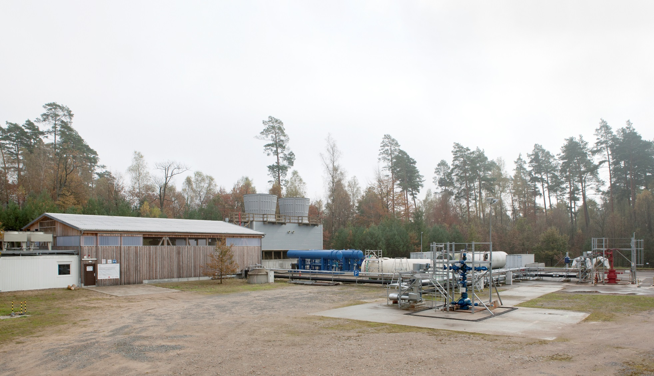
Thank you very much for your attention!

Slide 21
Cooling of low temperature power plants
Auxiliary power for fans and cooling water pumps need to be considered
→ gross power and auxiliary power demand _{ꜛ} with _{ꜜ} condensation temp.
→ optimum condensation temperature → optimum ITD / approach
Approach to wet bulb temp.
Approach = T_{cold water} – T_{WB}
ORC with wet cooling tower

