Slide 1
Geothermal Project “ECOGI“ in Rittershoffen, France
Clément Baujard
Reservoir Engineer, ES-Geothermie

Slide 2
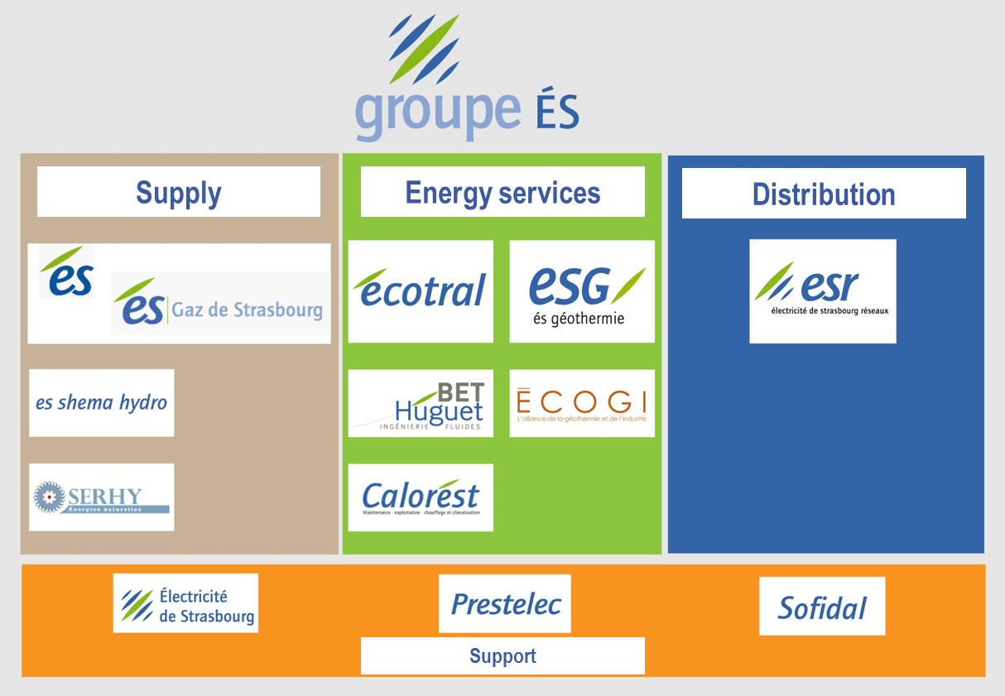
ES Group: main activities
ES Group belongs to EDF at 88%
Staff 1200, 2014 turnover 945 M€
1st energy supplier in Alsace (Eastern France)
ES Géothermie (ESG), 100% subsidiary ES

Slide 3
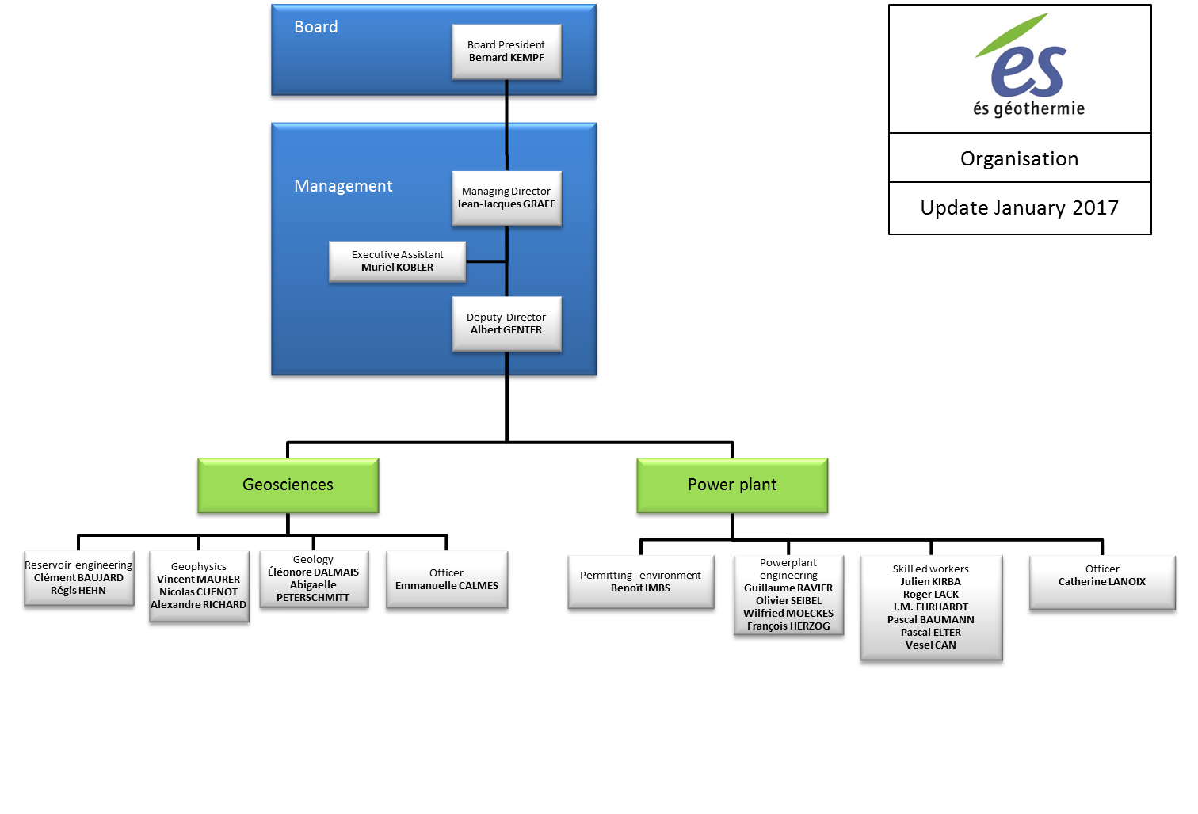
ES-Geothermie: who are we?
SME
23 employees
Turnover : 2Mio €

Slide 4
ES-Geothermie: what do we do?
General contracting for deep geothermal projects, from exploration to power plant commissioning - Permitting, Feasibility studies, Design and detailed planning, tendering process and specifications, selection of subcontractors, management, coordination and works supervision, reporting (…)
Power Plant operation - Soultz-sous-forêts and Rittershoffen
Consulting activities and services - Planning and interpretation of well logs, Reservoir engineering and development strategy, Platform design and realization, Pump and power plant design, Interpretation of geophysical data, 3D geological modelling, Well targeting and trajectory, Real-time seismic monitoring, Design, planning, realization and interpretation of pumping tests, Handling of natural radioactivity issues, Database handling for well data, Communication (…)
Hardware - Seismic Monitoring stations, Tubes/Connections/Production test wellhead assembly and lines, PTQ Sensors for surface monitoring and acquisition module, Secured data servers, Pumps, tanks, separators, (…)
Software - SLB Petrel, Wellcad, Autocad, Seiscomp, AQTESolv, Surfer, Matlab, (…)
Research activities - Chair in Strasbourg University, H2020 projects (…)

Slide 5
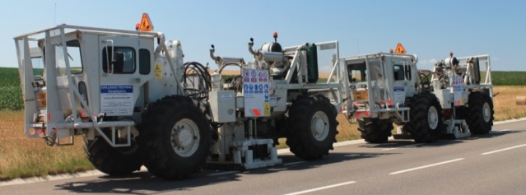
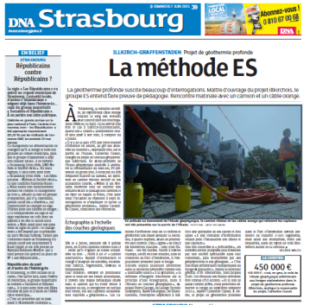
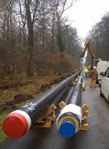
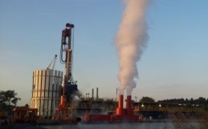
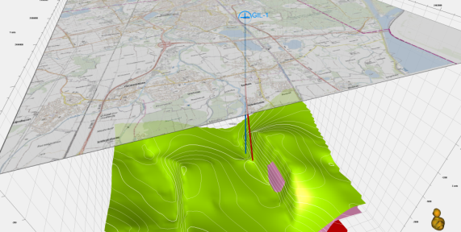
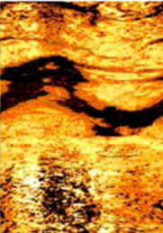
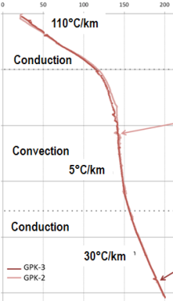
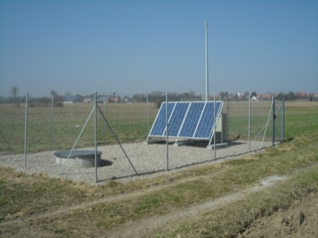
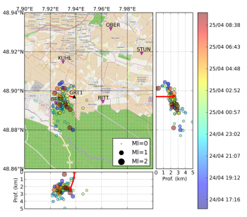
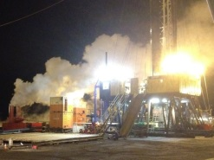
ES-Geothermie consulting and services
Seismic exploration
EGS Services
Environment
& Acceptability
Surface facilities
2D geology & 3D model
Reservoir logging
& testing
Sismological station network
Induced microseismic monitoring

Slide 6
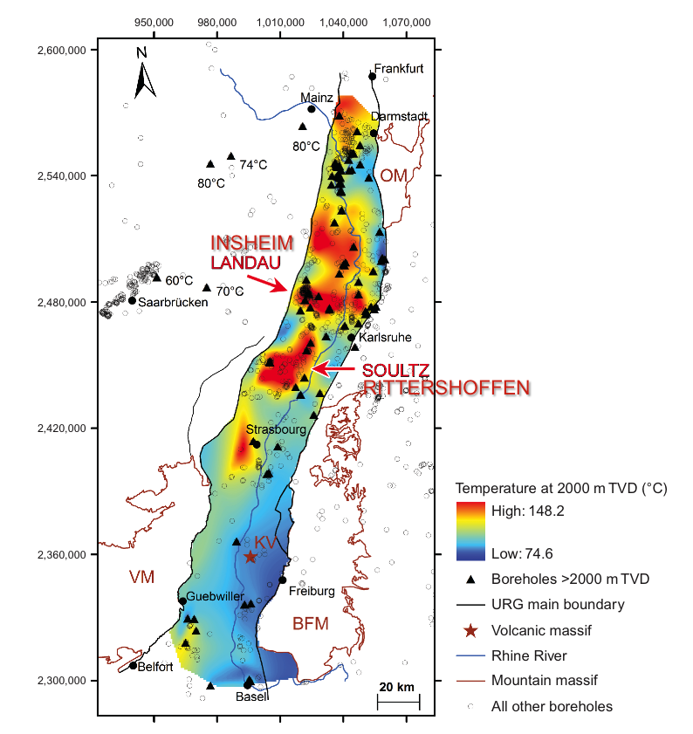
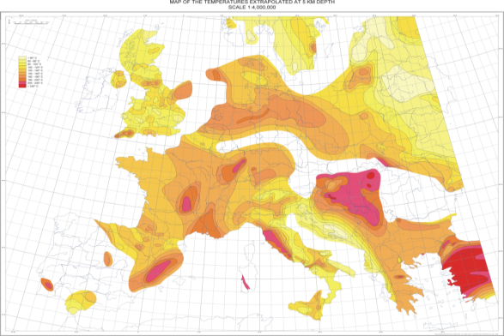
Alsace (« Elzass ») Geothermal context
Temperature data from Liag
Hurtig et al, 1992
Several large-scale thermal anomalies in Europe
Tertiary grabens (Upper Rhine Valley) with many geothermal projects
Temperature range > 150°C

Slide 7
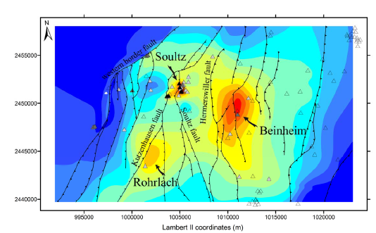
Soultz / Rittershoffen temperature anomaly
Stockstadt
Temperature distribution within the URG at 1500 m depth (LIAG)
Wattenheim
Speyer
Landau
Soultz
ECOGI
Strasbourg
Sélestat
Fault map and temperature field
between Soultz and Rittershoffen
Baillieux, 2012

Slide 8
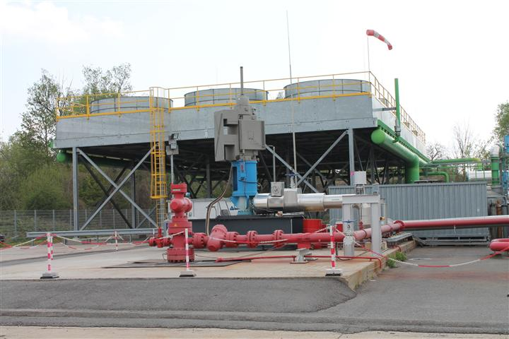
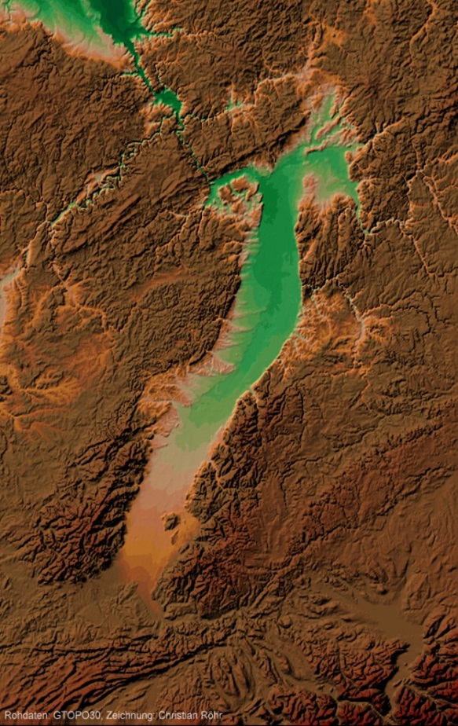
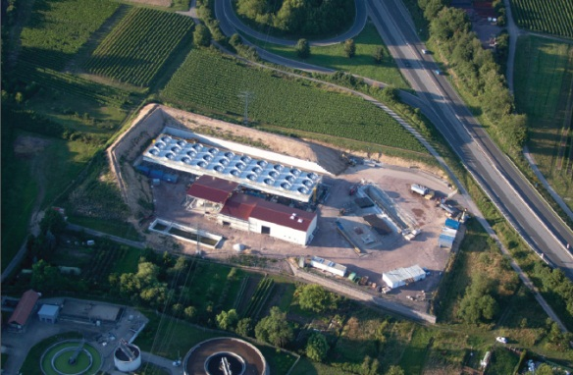
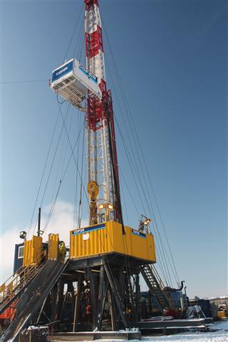
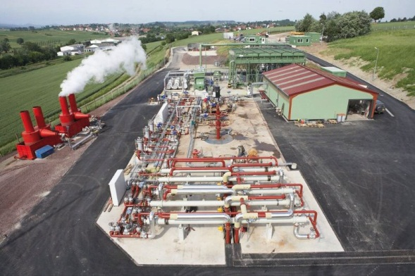
Geothermal exploitation in URG
Bruchsal
Landau
Combined Heat & Power plant
3MWe+ district heating
Landau
Insheim 4.8MWe
Insheim
Soultz
Rittershoffen
Soultz 2.2MWe
Rittershoffen

Slide 9
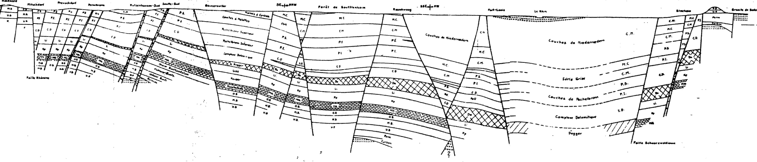
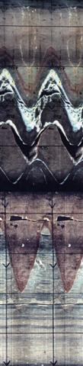

Upper Rhine Graben cross-section
Soultz
Rittershoffen
Rhine
Top basement
1400 m
Top basement
2200 m
Top basement
> 5500 m
Soultz :
fractured
sandstone

Slide 10
Hydro-thermal conceptual model
Rittershoffen
Pechelbronn
Rhin
Baden-Baden
Soultz
NW
SE
°C
0
10
2
4
225
6
0
10
20
30
40
50
60
70
km
From Le Carlier et al., 1994

Slide 11



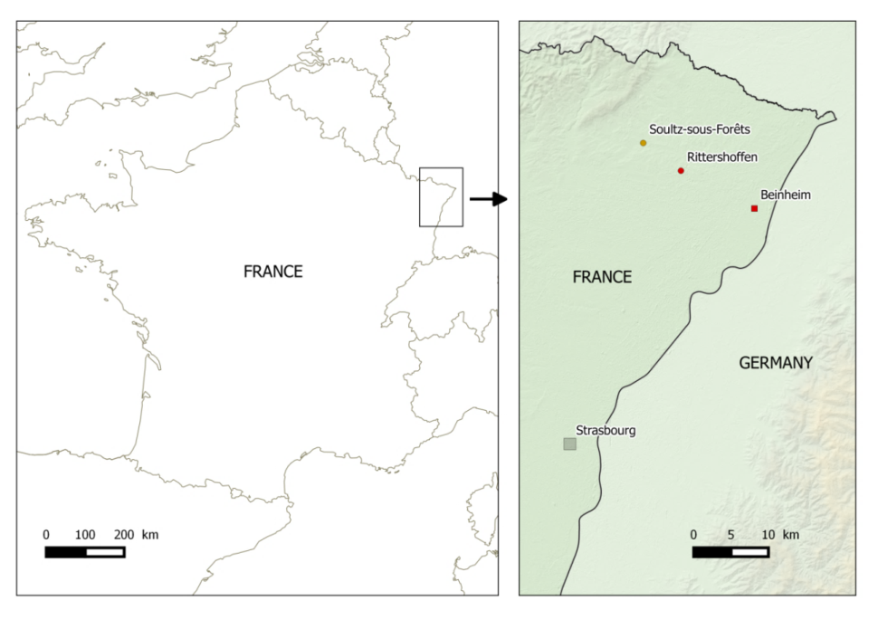
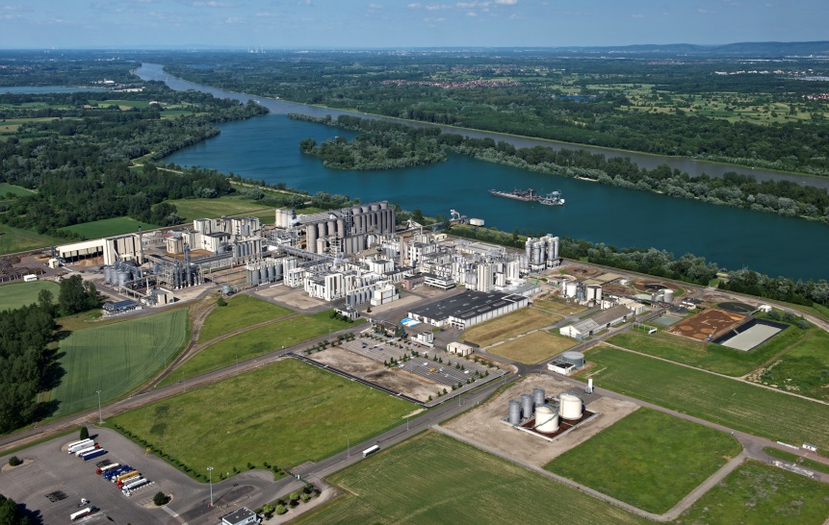
ECOGI Project: overview
ECOGI: Exploitation de la Chaleur d’Origine Géothermale pour l’Industrie
Located in Rittershoffen, France
Joint venture: ES (40%), Roquette Frères (40%), Caisses dépôts (20%)
55 M€ total investment
25 M€ French incentive from Fonds Chaleur
Beinheim Biorefinery
Geothermal project: 25MWth over 100MWth
Notes:
Fabrice Gourdellier

Slide 12
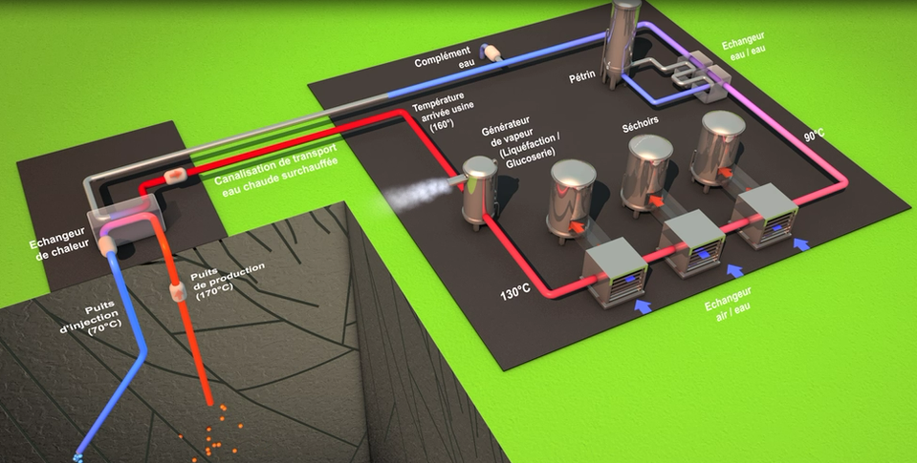
ECOGI Project: overview
Construction of a geothermal station (Rittershoffen), a heat transport and exploitation loop destined to supply overheated hot water to the industrial facility of Roquette Frères in Beinheim

Slide 13
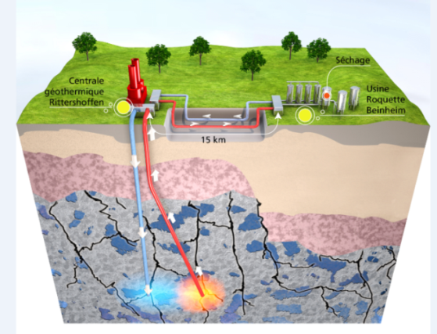
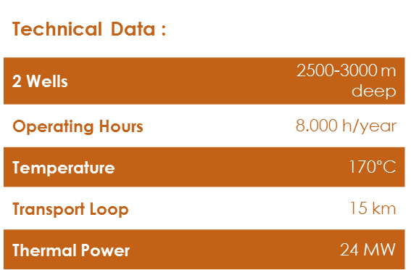
ECOGI Project: main technical phases
2011 |  | 2012 |  | 2013 |  | 2014 |  | 2015 |  | 2016
ECOGI
JV creation
 | Drilling
 | Platform construction
 |  |  | GRT1
 |  |  | Drilling and well development
 |  |  |  |  | Seismic
 |  |  |  |  | Survey
 |  |  |  |  |  | GRT2
 |  |  |  |  |  | Drilling and tracer tests
 |  |  |  |  |  |  |  | Surface loop
 |  |  |  |  |  |  |  | Thermal plant
 |  |  |  |  |  |  |  | Thermal loop
 |  |  |  |  |  |  |  | Bio-reffinery
 |  |  |  |  |  |  |  |  |  | ECOGI
 |  |  |  |  |  |  |  |  |  | Commissioning
© ECOGI

Slide 14
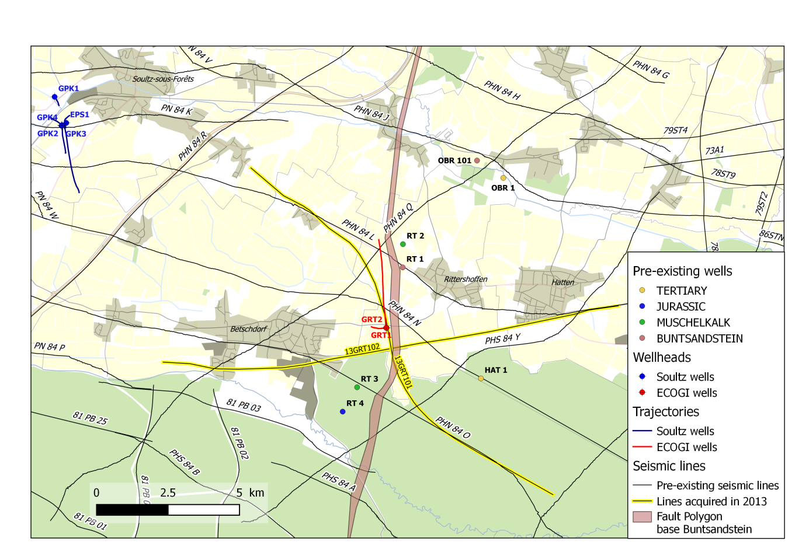
Geothermal and geological context
Offset wells
Oil exploration wells from the 80’s
Soultz-sous-Forêts geothermal wells
Seismic data
Vintage seismic lines from the 80’s
2 seismic profiles in the framework of the project
-> Thermal anomaly
-> Regional fault zone

Slide 15
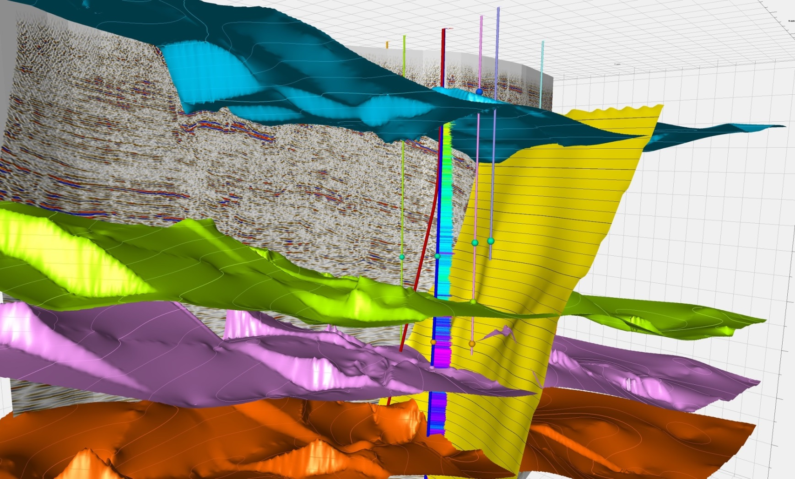
Well targets
Both wells target the fault zone in the basement
GRT-1 (vertical): 2600m MD
GRT-2 (deviated): 3200m MD

Slide 16
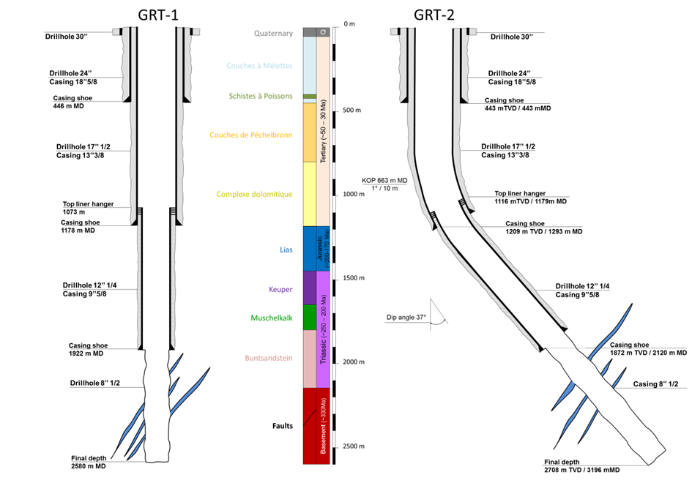
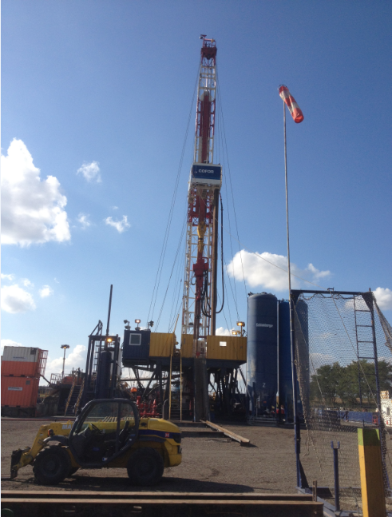
GRT-1: drilling and completion
Rig: Cofor Entrepose drilling MAS 8000
Drilled in 2012
Duration: 3 months

Slide 17
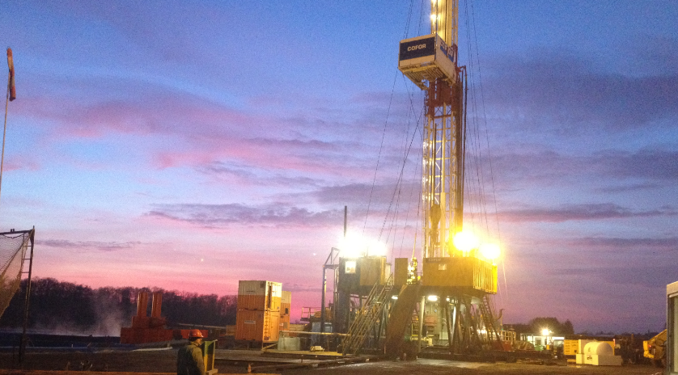
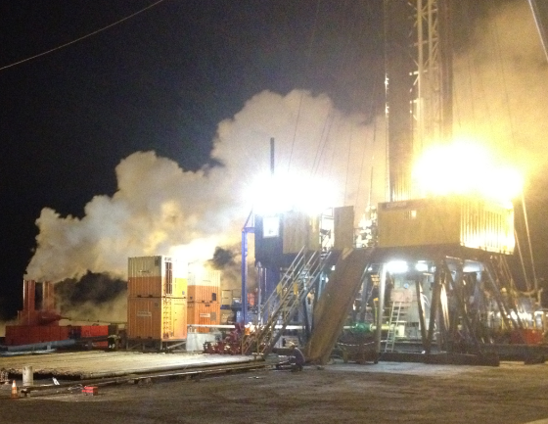
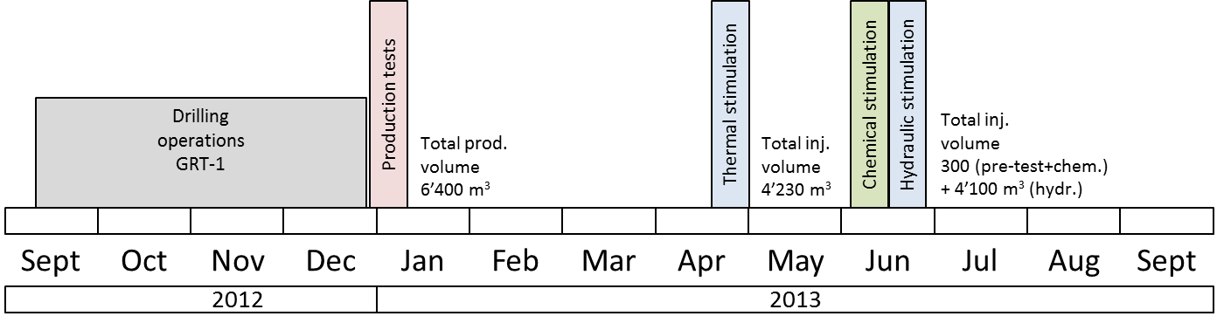
GRT-1 Well testing and development strategy
Well testing GRT-1
Low initial productivity (< 0,5L/s/bar), high skin (20)
Low initial injectivity
Economic threshold not reached
GRT-1 Well development
Thermal stimulation
Chemical stimulation
Hydraulic stimulation

Slide 18
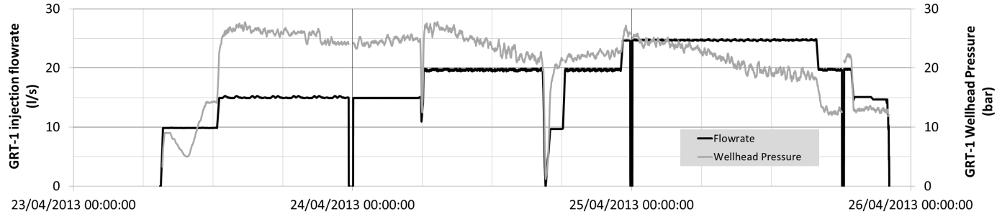
GRT-1 Thermal stimulation
Low rate and low pressure cold water injection during 3 days
Objective: cool-down the rock matrix and increase natural fractures aperture
Results:
Injectivity increase (1,5x)
low seismological activity

Slide 19
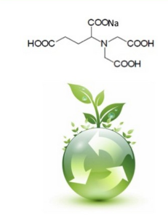
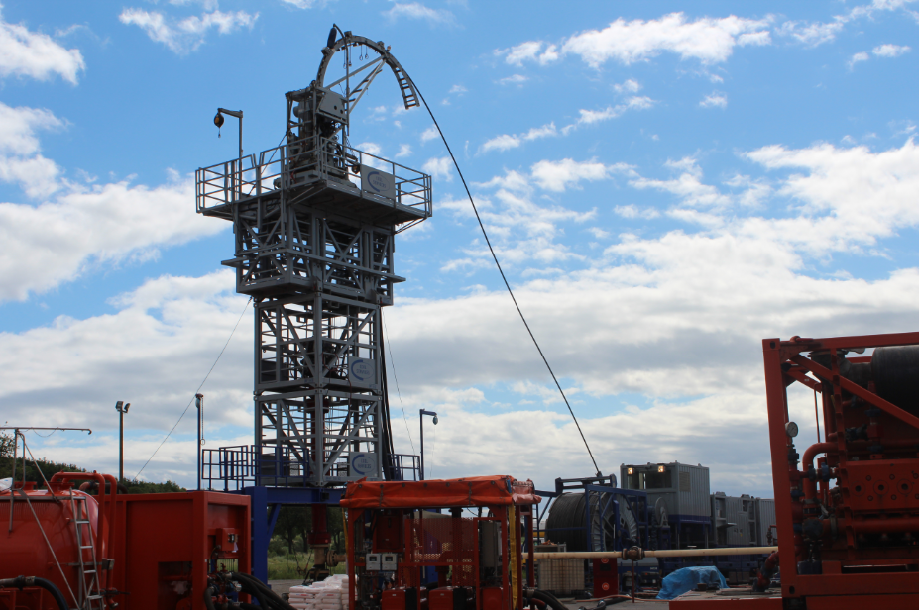
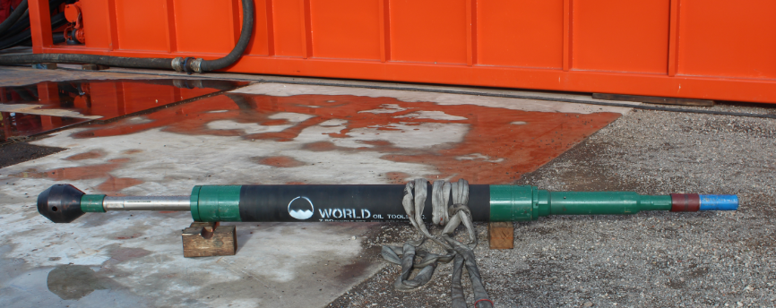
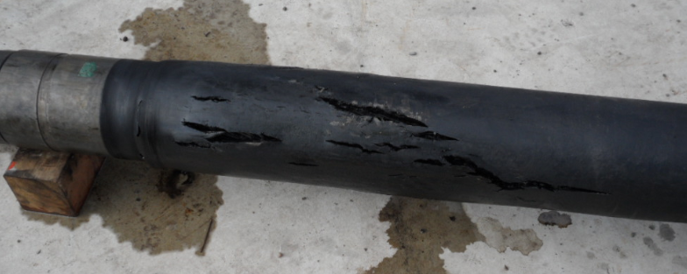
GRT-1 Chemical stimulation
Specially designed green acids were injected (glutamate based)
Focused, low volume injections using coiled tubing and OH-packers (3 intervals selected based on cutting and wellbore imaging data)
Objective: clean fracture fillings
Results: Injectivity increase (1,5x)

Slide 20
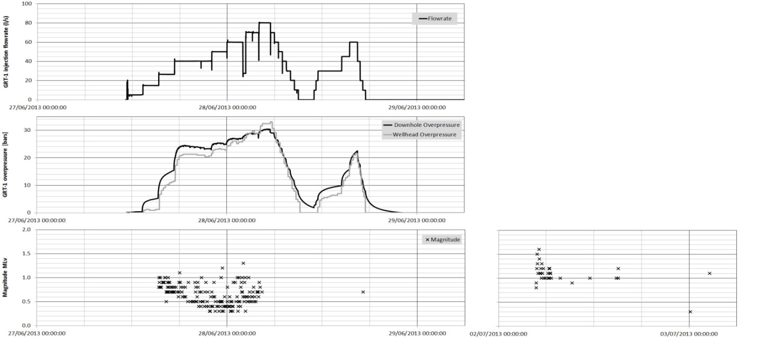
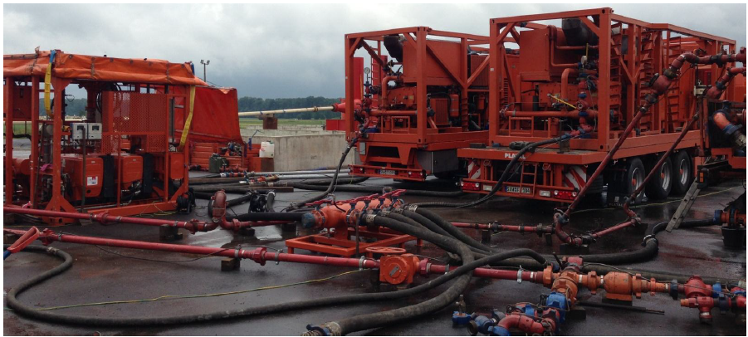
GRT-1 Hydraulic stimulation
High rate water injection
Step-rate injections
Real-time seismological monitoring
Objective: increase reservoir permeability using hydro-shear processes
Results: Injectivity increase (2x)

Slide 21
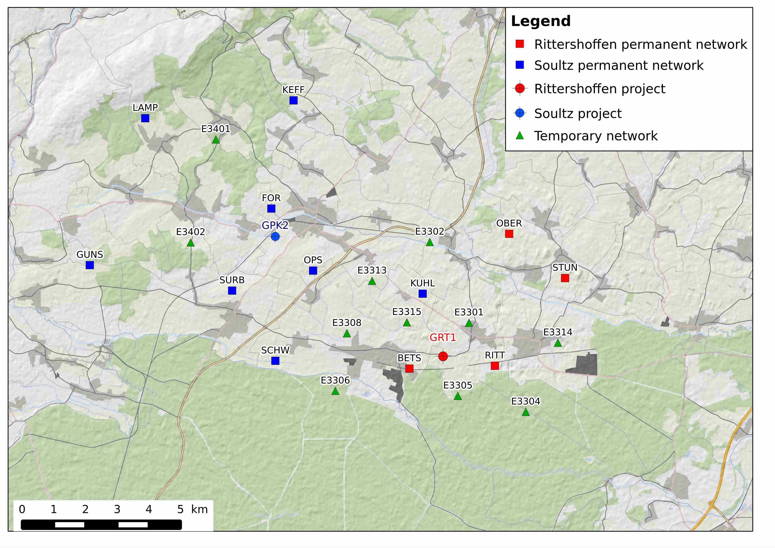
Seismic monitoring network

Slide 22
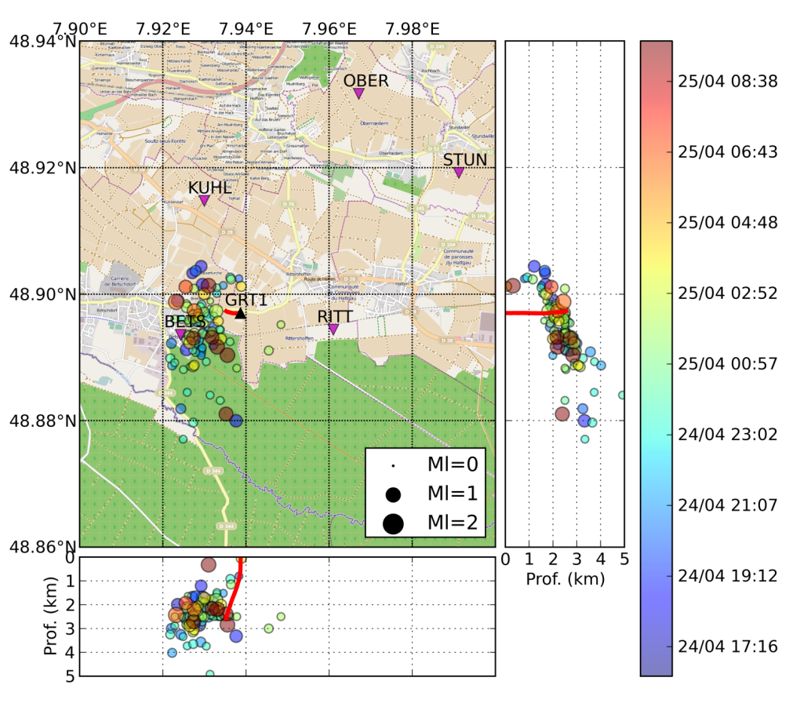
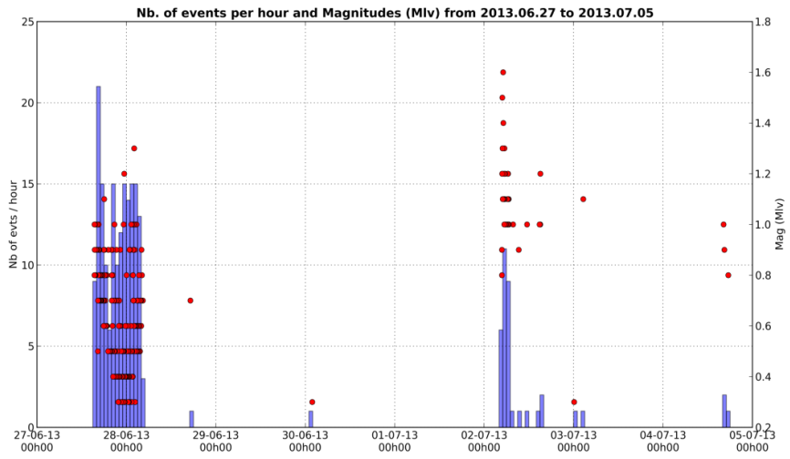
Induced seismicity during GRT-1 hydraulic stimulation
Real-time location
More than 300 events automatically picked and located
Max magnitude 1,6 Ml
  Maurer et al 2016
Critical threshold (Ml 1,7) never reached

Slide 23
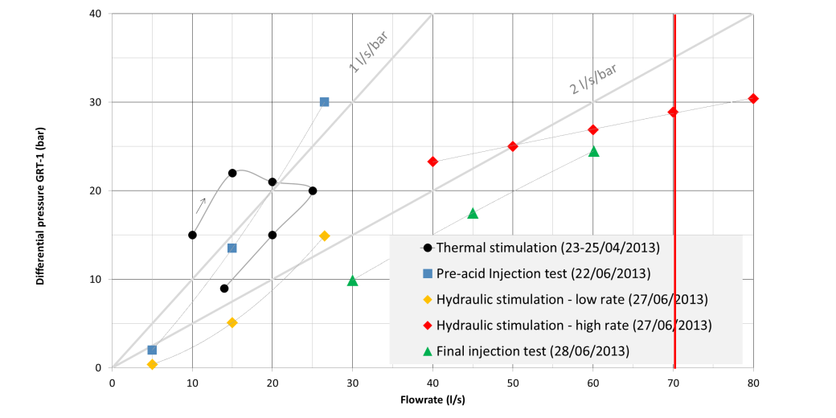
GRT-1 well development results
GRT-1 Injectivity x 5
Decision to drill GRT-2

Slide 24

Exploration (2D seismic) after GRT-1
2x 2D seismic lines were shot after drilling GRT-1
1 VSP
Objective: secure GRT-2 target

Slide 25
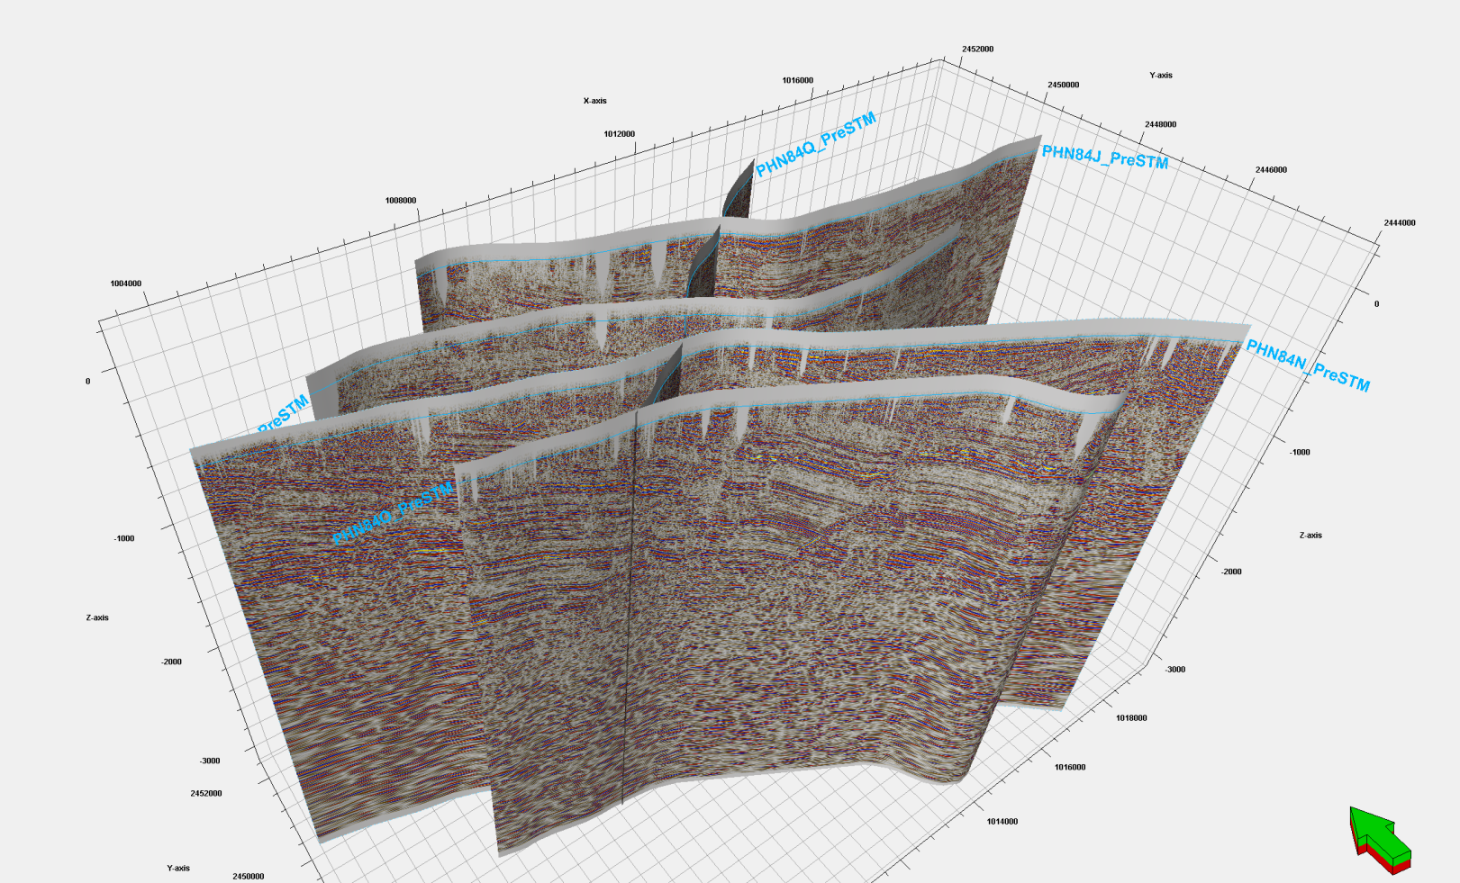
2D Seismic profiles [time]

Slide 26
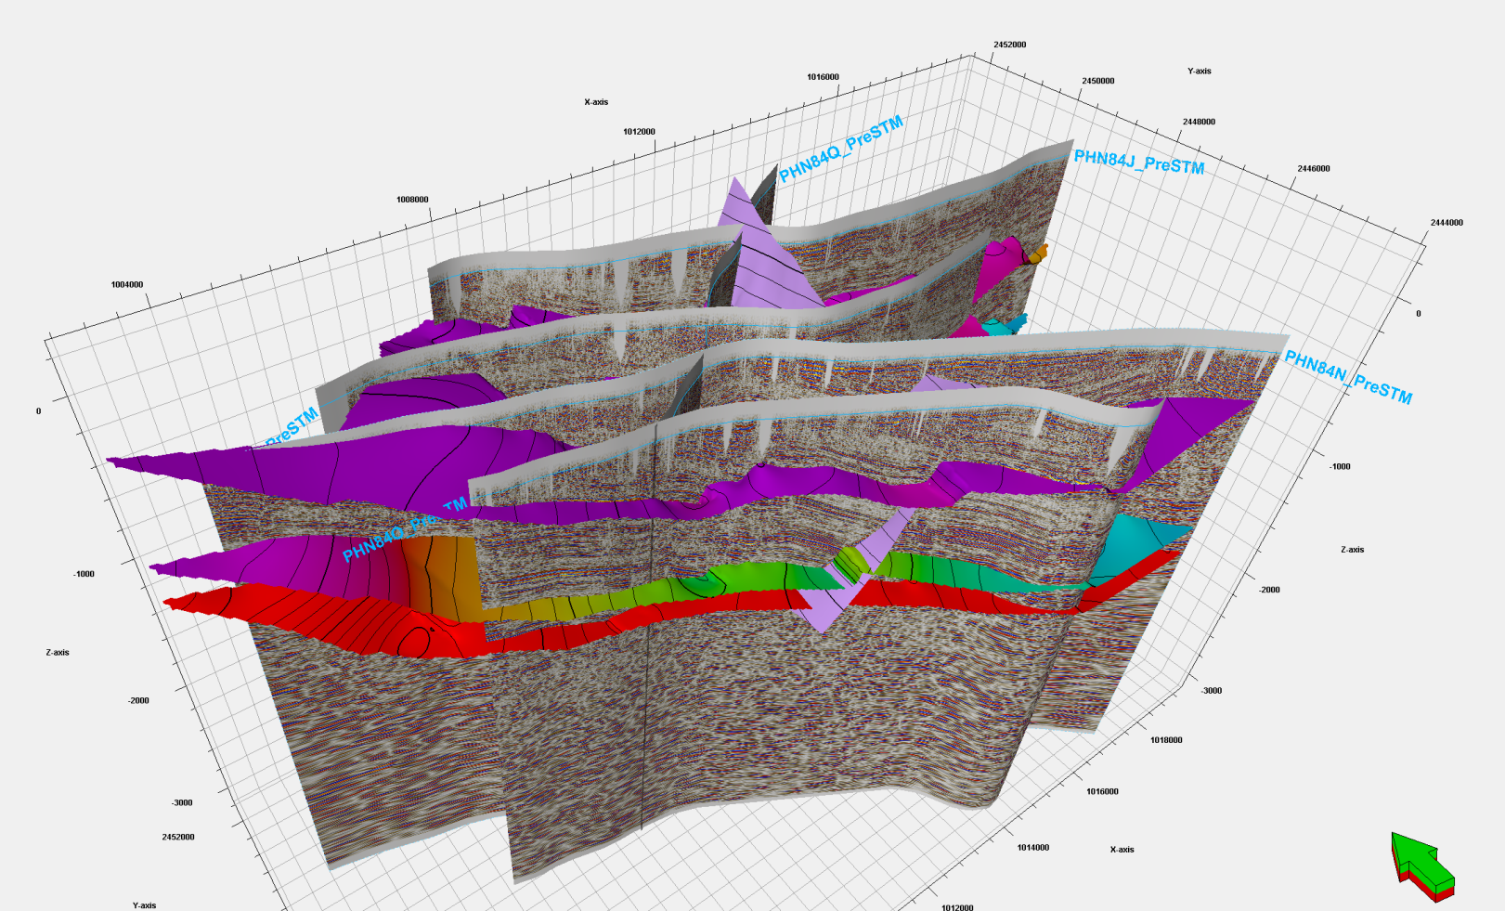
2D seismic profiles interpretation [time]

Slide 27
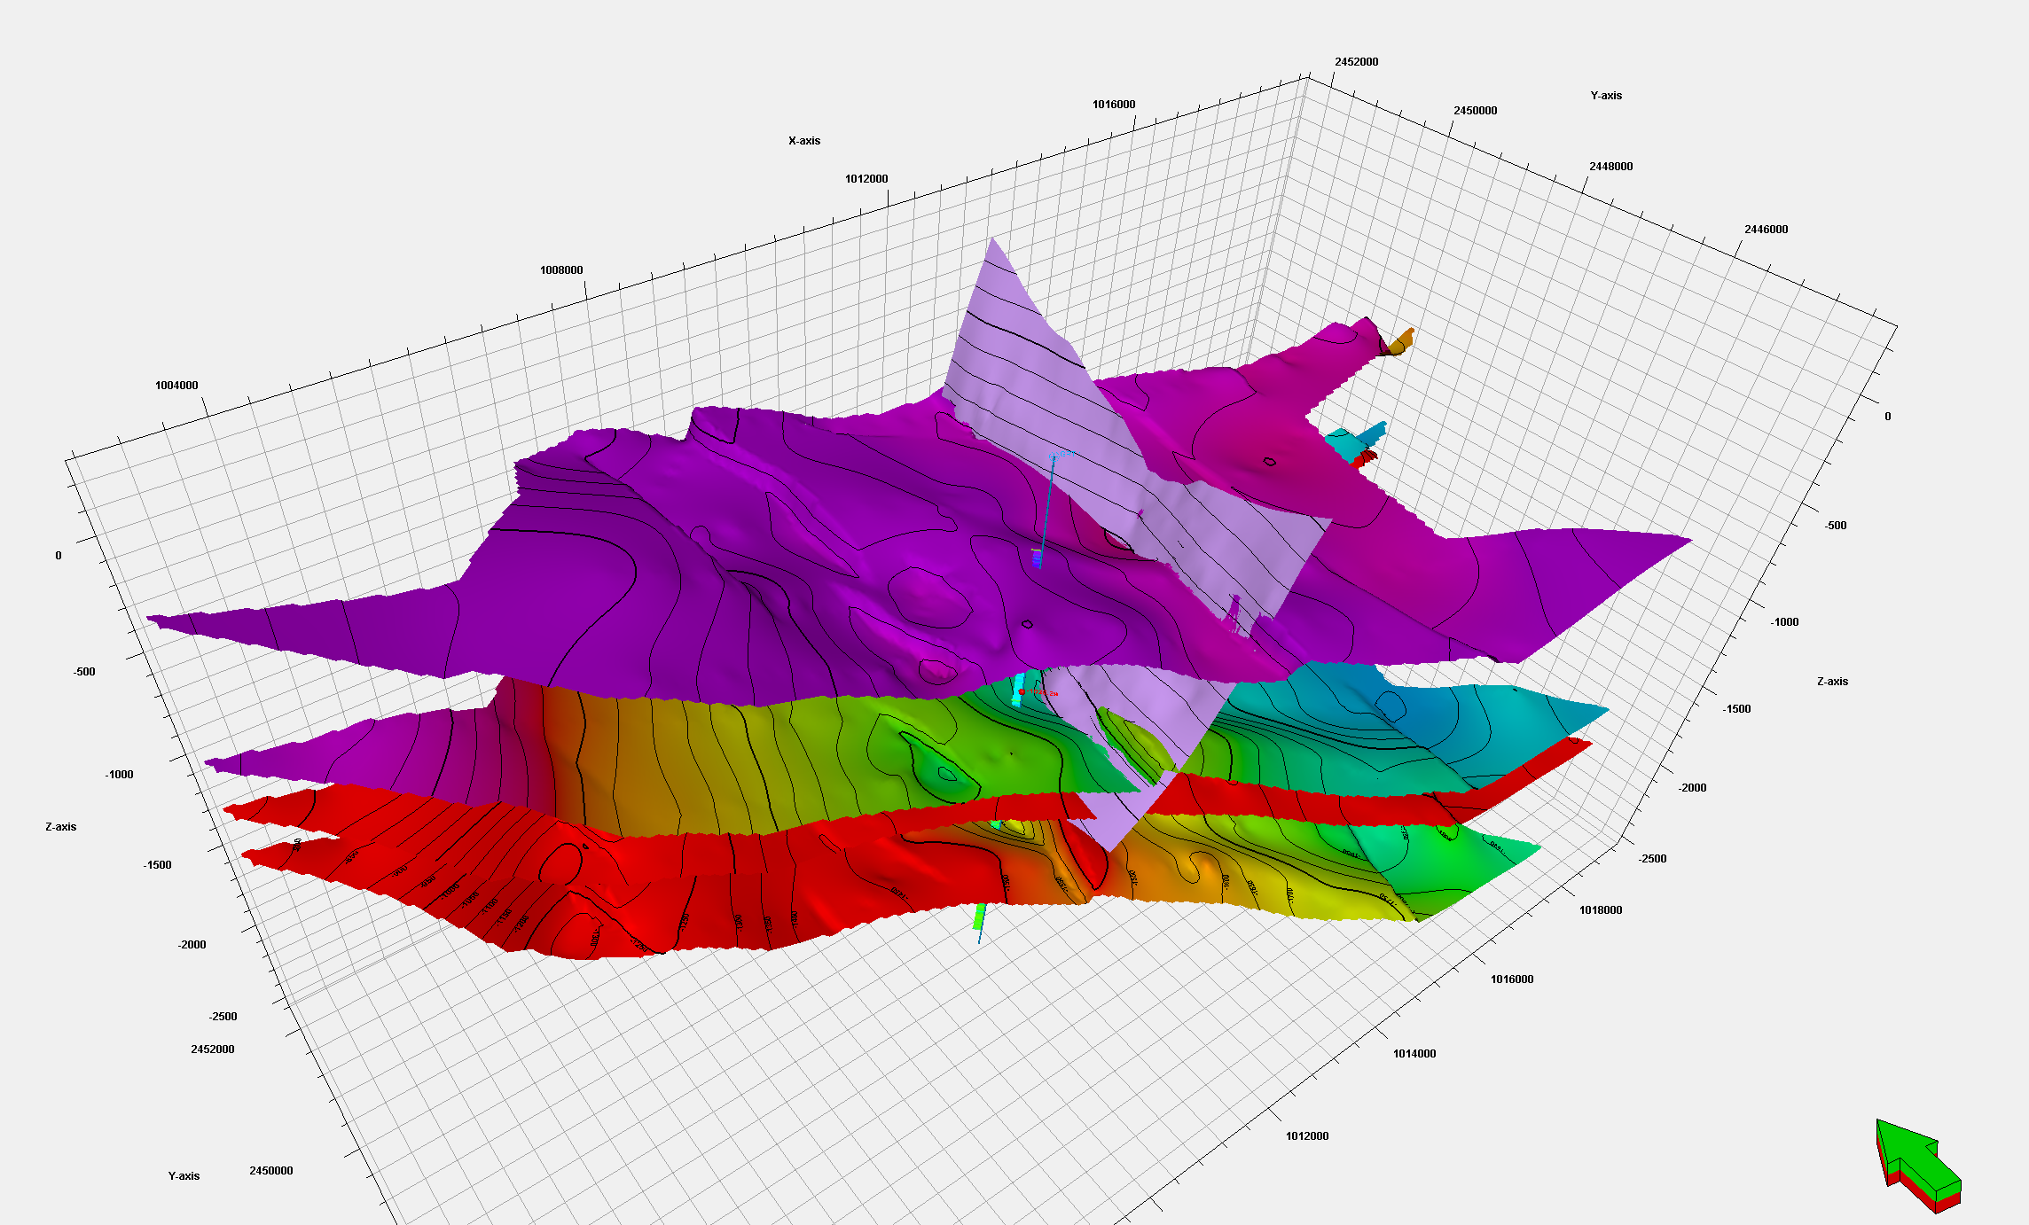
Interpretation + GRT-1 [time + z]

Slide 28
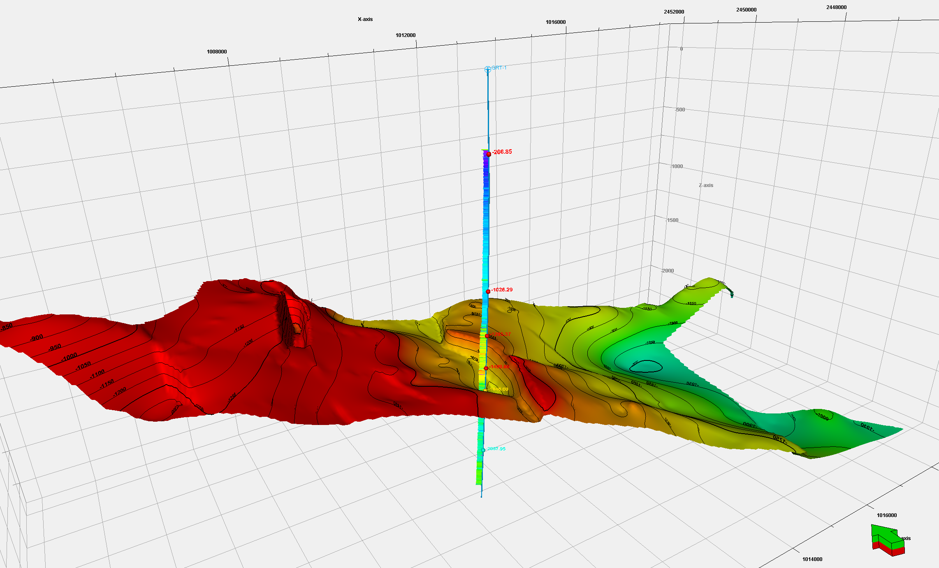
Interpretation + GRT-1 [time + z]]

Slide 29
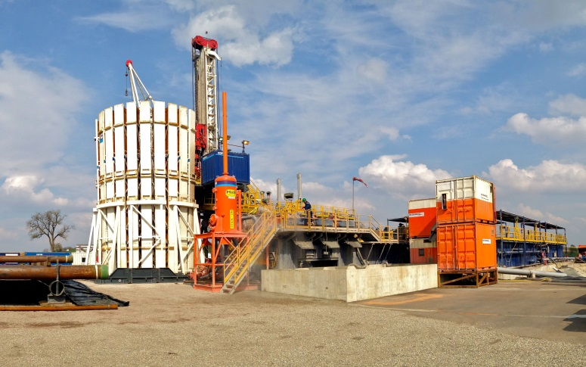

GRT-2: drilling and completion
Rig Cofor HH300
Drilled in 2014
Duration: 3,5 months

Slide 30



GRT-2 well testing
GRT-2
High productivity
Low skin
No well development

Slide 31


GRT-2 Well testing
GRT-1 – GRT-2
Interference test: pressure front in 30mn
Tracer test: breakthrough in 14 days

Slide 32
Temperature
GRT-1
GRT-2

Slide 33
Temperature

Slide 34

Heat delivery loop
15 km between Rittershoffen (drilling site) and Beinheim (bio-refinery)
- 1 natural site (Natura 2000),
- 1 train line,
- 1 motorway,
- 6 primary roads,
- 2 rivers
- 7 gas transport lines
- 1 pipeline

Slide 35




Heat delivery loop
Way to:
double enveloppe
Heat losses < 4°C/15km
Way back:
simple enveloppe
Heat losses 1,5 °C/15 km
35

Slide 36




Heat delivery loop construction

Slide 37




Heat delivery loop construction

Slide 38

The heat plant in Rittershoffen
Architect’s views

Slide 39

The heat plant in Rittershoffen
Real picture

Slide 40


Experience after 1 year production
Low induced seismicity : 365 induced mEQ detected between April 2016 and march 2017 (max Mlv = 1,4)
GRT-1 injectivity increased drastically

Slide 41

Lessons learned
Exploration data is extremely important (GRT-1 / GRT-2)
For the wells
  Drill two deviated wells with limited inclination (<35°)
  Use standard casing (20’’ and no 18’’5/8)
At a reservoir scale
  Faults are flow zone in the Rhine Graben
  Convection between to Muschelkalk and weathered granite
  In-fault convection ?
Great injectivity increase of GRT-1 with no fracturation

Slide 42



Acknowlegements and related publications
Acknowlegements:
  EU project « DESTRESS » (grant agreement No. 691728)
  ADEME Project « EGS ALSACE »
Related Publication
  EGC 2016
    Sosio et al., Integrated Geological, Fluid Flow and Geomechanical Model of a Geothermal Field, Session Exploration T1b
    Hemlich et al., Geodetic measurements for geothermal sites monitoring at Soultz-sous-Forêts and Rittershoffen deep geothermal sites, Session T5b
    Ravier et al., Towards a comprehensive environmental monitoring of a geothermal power plant in the Rhine graben, session T5b
    Maurer et al., Ground vibrations caused by geothermal drilling operations: a case study from the Rittershoffen EGS project (Alsace, France), session T5b
    Vidal et al., Natural fractures and permeability at the geothermal site Rittershoffen, France, Session S6b
    Hehn et al., Stress field rotation in the EGS well GRT-1 (Rittershoffen, France), Session S6b
    + Posters Maurer et al., Richard et al., …
  Stanford 2017, Meyer et al., “Analysis and numerical modelling of pressure drops observed during hydraulic stimulation of GRT-1 geothermal well (Rittershoffen, France)”
  Baujard et al., Geothermics, 2016, “Hydrothermal Characterization of wells GRT-1 and GRT-2 in Rittershoffen, France: Implications on the Understanding of Natural Flow Systems in the Rhine Graben”

