Slide 1
Upscaling and professionalizing geothermal energy
DAP congress
12-03-2019
Saskia Hagedoorn

Slide 2
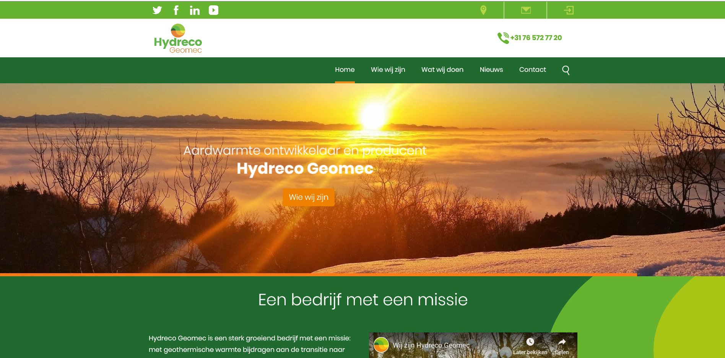
Company profile
Long term involved operator i.c.w. financial participation in projects
Geothermal energy is corebusiness
Project development, realisation and production
Knowledge in-house (22 professionals)
Operator / shareholder Delft geothermal project

Slide 3
Prepare for take off ….

Slide 4
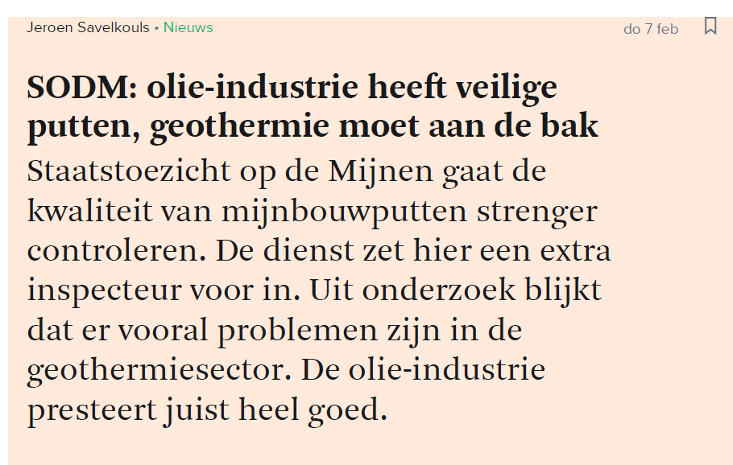
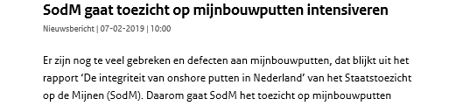
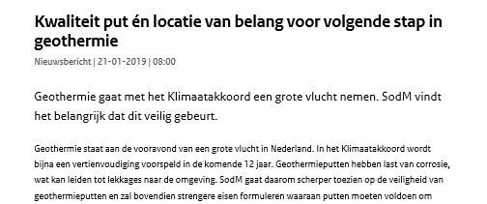
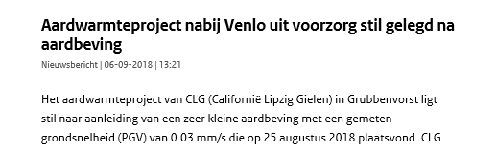
Meanwhile there are concerns ….

Slide 5
Sector / operator responsibilities
Safe projects, healthy working environment
Maximal care for the (drinking water) environment
Sound knowledge of the applicable laws and regulations
Effective management system (well / asset integrity)
Qualified personnel
Good communication, dialogue with the community
License to operate

Slide 6
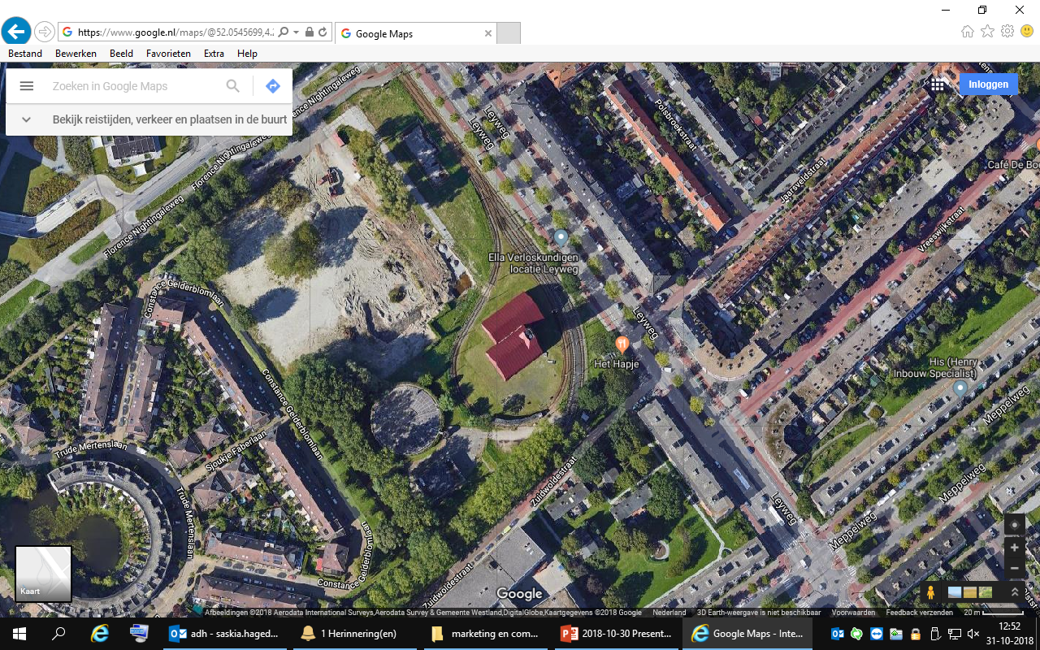
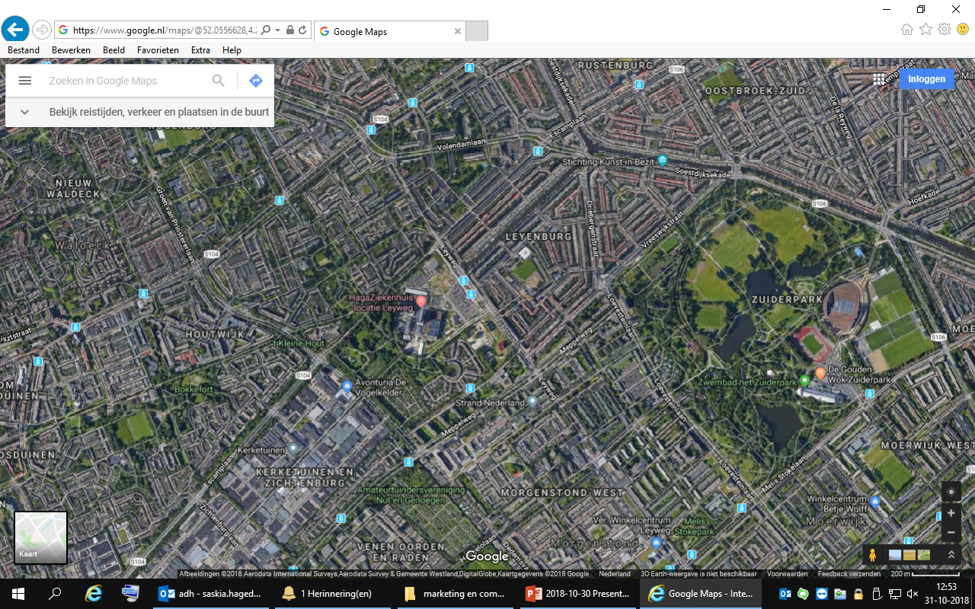
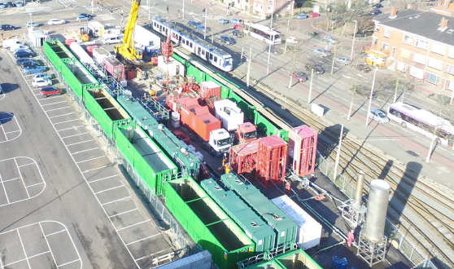
Geothermal in an urban environment, the Hague

Slide 7
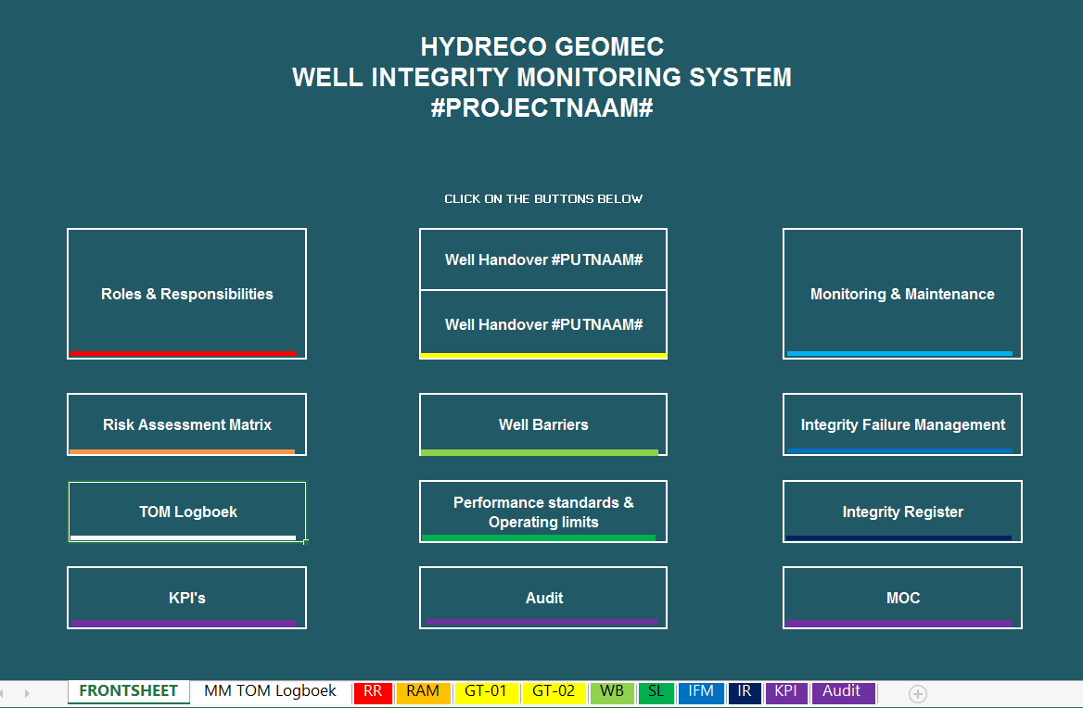
Major steps behind the screens
QHSEP management system
Standards
Stakeholder and communication protocol
Many studies and innovations
Guideline Geothermal energy in Brabant
Next generation well design
….

Slide 8
Will geothermal energy play a significant role in the energy transition ??
Can the geothermal sector make the step towards maturity in the next years ?
YES !!
Working on it every day (and night …)

Slide 9
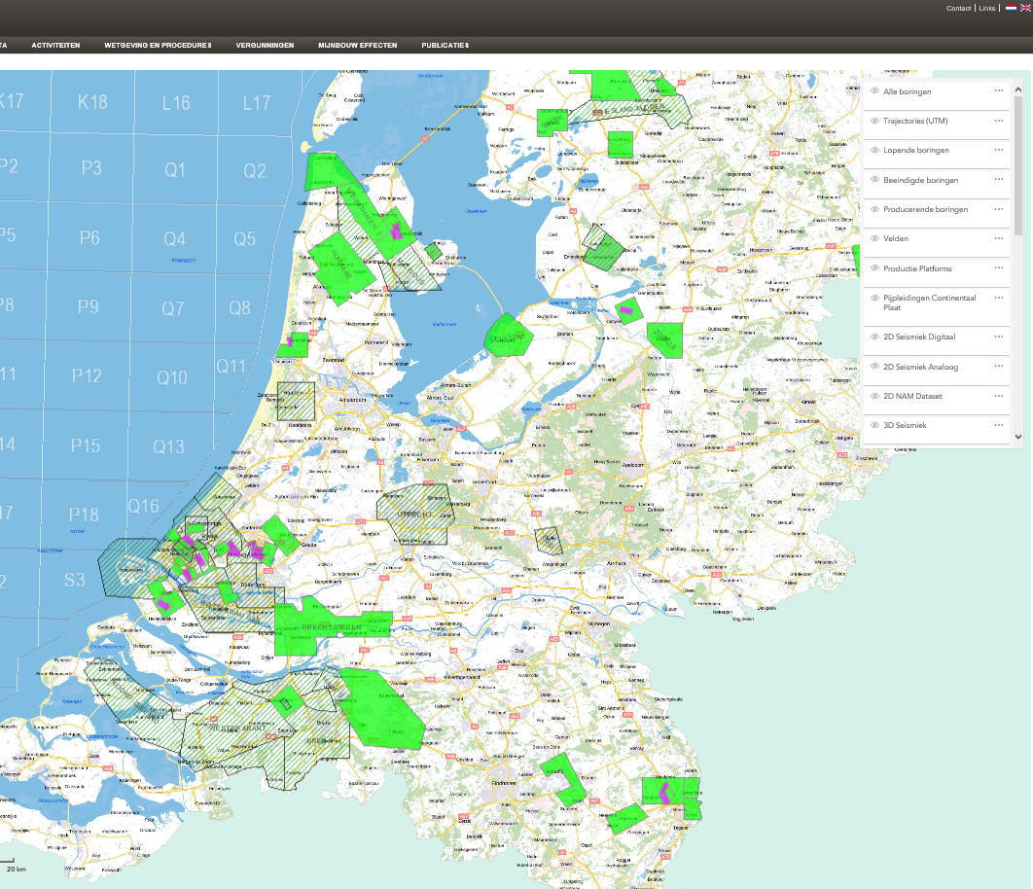
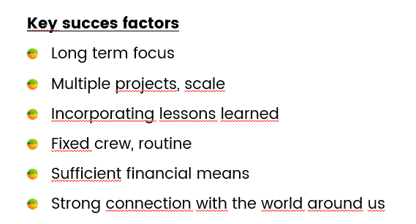
10-18
Potential for repetition
5-7
3-5
5-12
5-8
5-15

Slide 10
Thank you

