Slide 1
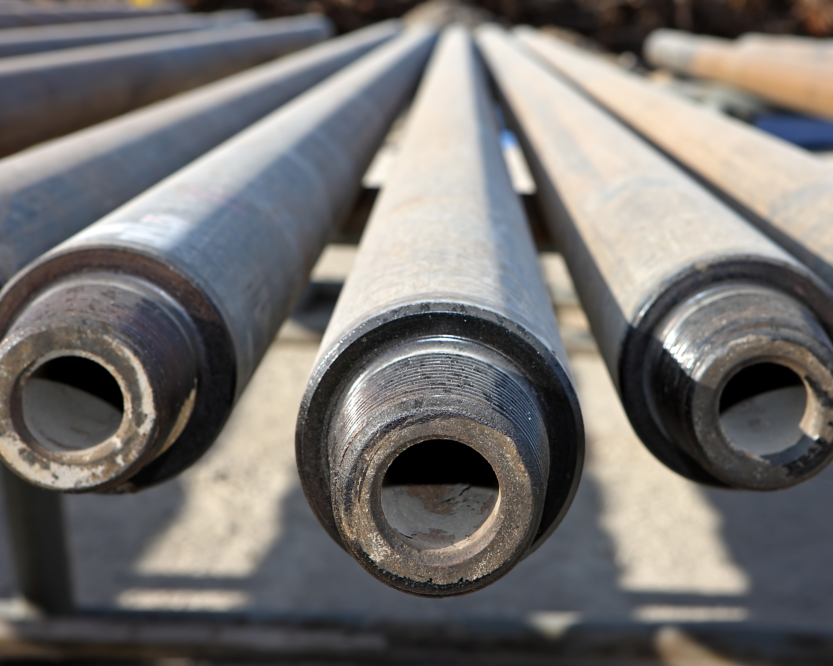








Material Challenges for High Temperature Geothermal Wells
H2020 Project Geowell
Innovative materials and designs for long-life high-temperature geothermal wells
Frank Vercauteren, Penny Pipilikaki, Jens Wollenweber

Slide 2
high temperature geothermal wells
Why improvements needed but worthwhile
High Potential for production of electricity
Lower ecological foot print compared to oil &gas based technology
Main barriers:
    High initial capital cost
    Resource development risk e.g.
        Failure of drilling wells
        Significant depth requirements
        Insufficient productivity and accessibility of reservoirs
Various challenges material related

Slide 3
IDDP-2 (Iceland Deep Drilling Project)
IDDP-2 well was completed on the 25th of January 2017
  4,659 meters depth.
  Bottom hole T = 427°C, with fluid pressure of 340 bars (supercritical state)
  Drill cores were retrieved, and the rocks appear to be permeable at depth.

Slide 4
Identified and selected challenges (1)
Large stresses on the casing during cooling and heating of well
        How reduce axial expansion forces?
        How reduce pressure exerted by water present in cement sheet?
Little known about cement behaviour at high temperature geothermal conditions
        Can Portland cement be used under these conditions?
High temperature and aggressive environment attacking casing material
        What is yield stress of used metals at high temperatures?
        How corrosion resistance can be improved at limited costs?

Slide 5
Identified and selected challenges (2)
Use of composite casings for increased temperatures
Monitoring:
Little known about temperature and mechanical forces in geothermal well
      Use of distributed sensing
Need for improved risk analysis.
Supported by mechanical and chemical modelling

Slide 6
GEOWELL Consortium
 | Partner | Partner’s name | Country
1 | ISOR | Íslenskar orkurannsóknir - Iceland GeoSurvey | Iceland
2 | IRIS | International Research Institute of Stavanger AS | Norway
3 | GFZ | Helmholtz-Zentrum Potsdam Deutsches GeoForschungsZentrum | Germany
4 | TNO | Nederlandse Organisatie Voor Toegepast Natuurwetenschappelijk Onderzoek | Netherlands
5 | BRGM | Bureau de Recherches Geologiques et Minieres | France
6 | STATOIL | Statoil Petroleum AS | Norway
7 | HS ORKA | HS Orka hf. | Iceland
8 | AKIET | Akiet BV | Netherlands
Third Parties
 | SINTEF | The Foundation for Scientific and Industrial Research at the Norwegian Institute of Technology | Norway
 | EGP | Enel Green Power | Italy

Slide 7
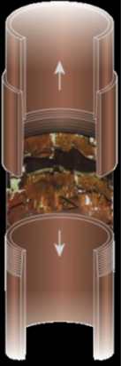
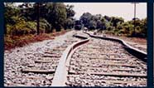
1 Large Stresses on casing (1)
Axial strains and stress
  Heating and cooling during start-up or cooling and heating for maintenance
Failed casing due to expansion and shrinking
(ISOR)
https://www.volpe.dot.gov/infrastructure-systems-and-technology/structures-and-dynamics/track-buckling-research

Slide 8
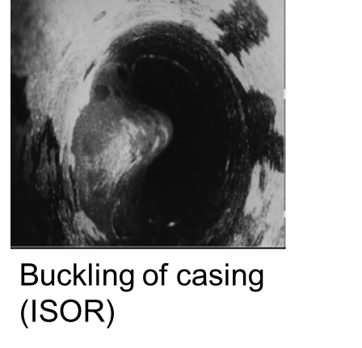
1 Large Stresses on casing (2)
Radial forces
    Mainly due to water present in the cement sheet
        Present in water pockets or in cement structure
        Between two casings water cannot escape
Combination of radial and axial forces makes that yield strength can be exceeded
Buckling of casing
(ISOR)

Slide 9
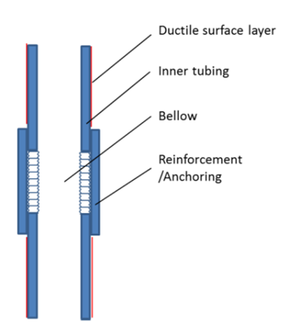
Approaches TO REDUCE STRESS ON CASING
Axial forces
  Make use of flexible coupling (development ISOR) to allow casing sections to expand into coupling (few cm /10 m)
  Develop ductile surface layer to allow sliding (TNO)
Radial forces
  Reduce pressure generated by the water present in the cement by development of improved formulations with low water content (TNO)

Slide 10
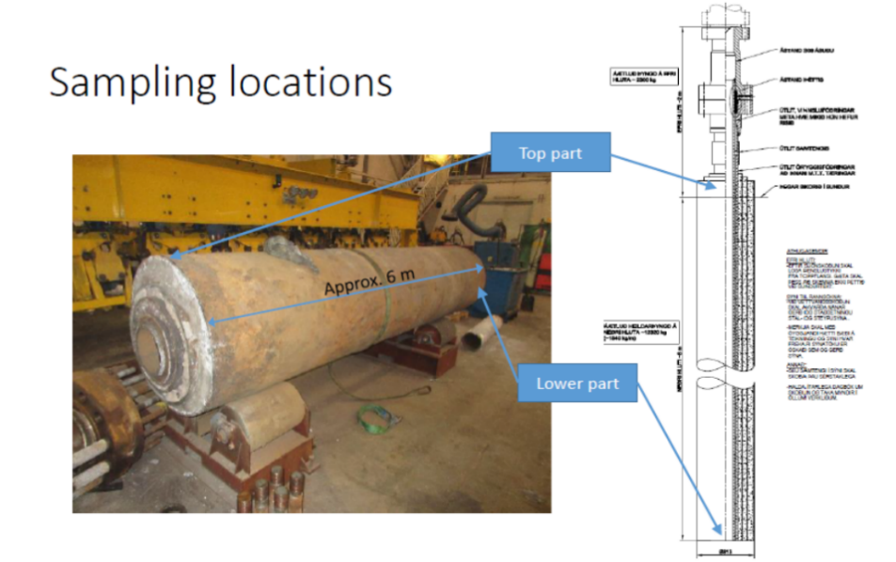
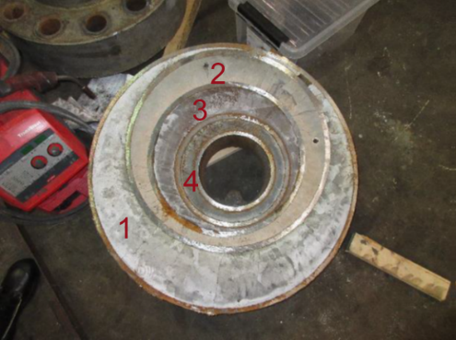
2 cement behaviour in high temperature geothermal conditions (lead: TNO)
  Can Portland cement being used for high temperature wells?
  Unique opportunity: Samples retrieved from IDDP-1 well
  Exposed to HT geothermal conditions (off and on) for 3 years
  Peak temperature 450°C
Notes:
Samples of IDDP-1 were gathered by ISOR
Temperature history:
Prolonged heating periods during 3 years. Peak temperatures up to 450°C
Samples were analyzed by TNO
mechanical tests
optical microscopy
SEM, XRD

Slide 11
Mineralogy
Mechanical properties
Closer to production casing ➔ Higher T
Observations
Mineralogy is in accordance with temperature evolution
Strength increases
Higher modulus, lower strain at break
Conclusion:
Portland cements undergo alterations
Strength is kept or increases
Lower strain at break
Mineralogy cement
S. Shaw, Hydrothermal formation of the calcium silicate hydrates, tobermorite Ca2Si6 O16 (OH) ·4H2O and xonotlite Ca6 Si6 O17 (OH)2: an in situ synchrotron study, Chemical Geology 167, 2000. 129–140

Slide 12
Outlook cement properties
Matrix with controlled exposure to different temperatures related to expected mineralogy and up to 450 °C and 300 bar
Exposure for different periods
Well defined cement samples
Study development of mineralogy
Study strength envelop trough triaxial compression measurements

Slide 13
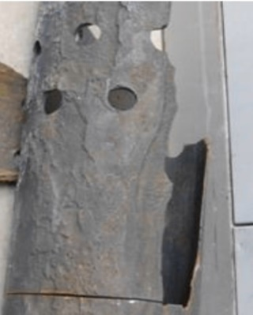
3 Use of more resistant metals
(lead: ISOR)
casing is exposed to Aggressive environments
    High temperatures (up to 450°C)
    CO₂ at high pressure
    …….
Selected Casing materials will be tested
    Various metals with good potential are selected and will be evaluated.
    Pure materials and cladded materials will be considered
    TNO contribution:
      Support in metal selection
      Determination of mechanical behaviour up to 550 °C
        ➔ yield strength (T)
Corroded casing
(ISOR)
Dedicated set-up (TNO)

Slide 14
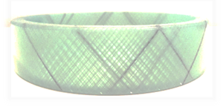
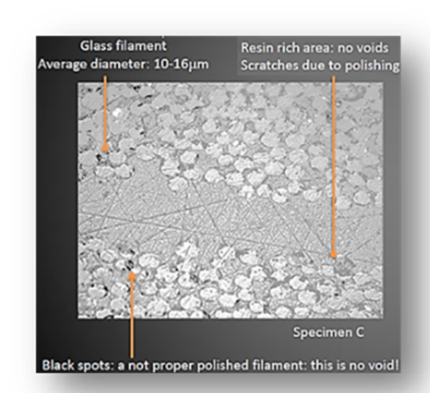
4 composite casing for (HT) geothermal
Applications (Lead: Akiet)
Advantage:
    Reduced drilling cost and land use
        Almost buoyant in drilling mud.
        Allows rig-less drilling with crane-based operations
    Corrosion resistant and less scaling
Innovations:
    Increase use temperature of composite casing from around 90 °C to ~ 170 °C
    Such development includes:
        Development dedicated connector technology
        Advanced laboratory testing at in-situ (geothermal) conditions
        TNO supports with material knowledge/analysis

Slide 15
5 Monitoring:
Real time analysis of thermal and mechanical load on casing (lead: GFZ)
  Technology used:
      Distributed temperature sensing
      Distributed strain and acoustic sensing
  Main goal:
      Gather data during cementing, production and injection
      TNO contribution: Improved sensitivity of interrogator
  Status:
      Distributed sensing glass fibre successfully installed geothermal well
      Data gathered during cementing

Slide 16
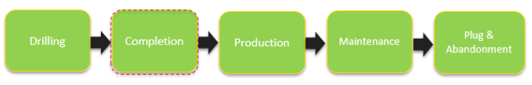
6 dedicated risk analysis of well integrity - Goal: Raise standard
No dedicated standards in place
Starting point regulation for oil & gas wells e.g.
    NORSOK D-010
    “Principles for barrier management in the petroleum industry” from the Petroleum Safety Authority of Norway
Risks are different e.g. there may be no natural gas or oil around.
Concentrate on completion and aspects dealt within Geowell

Slide 17
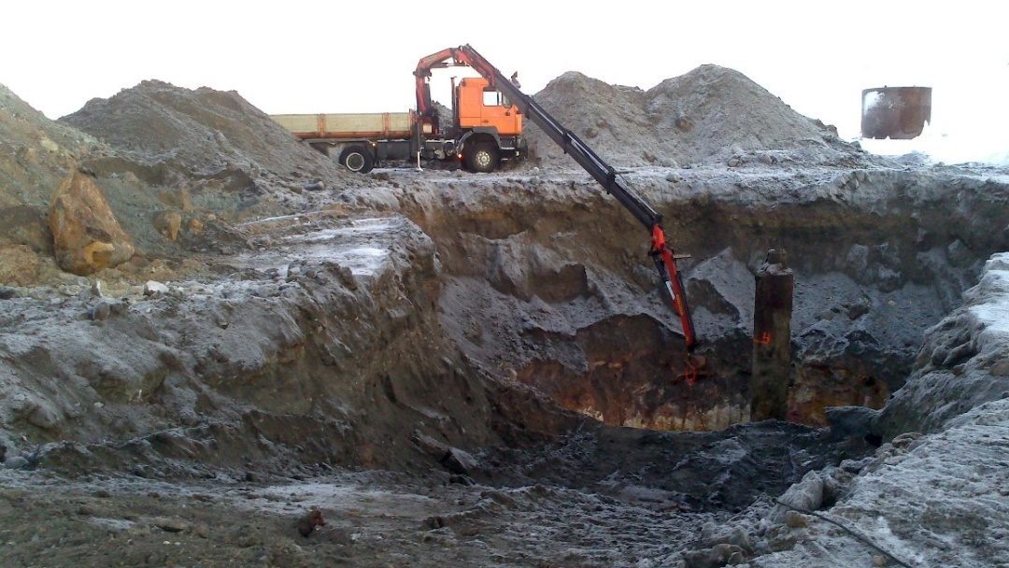
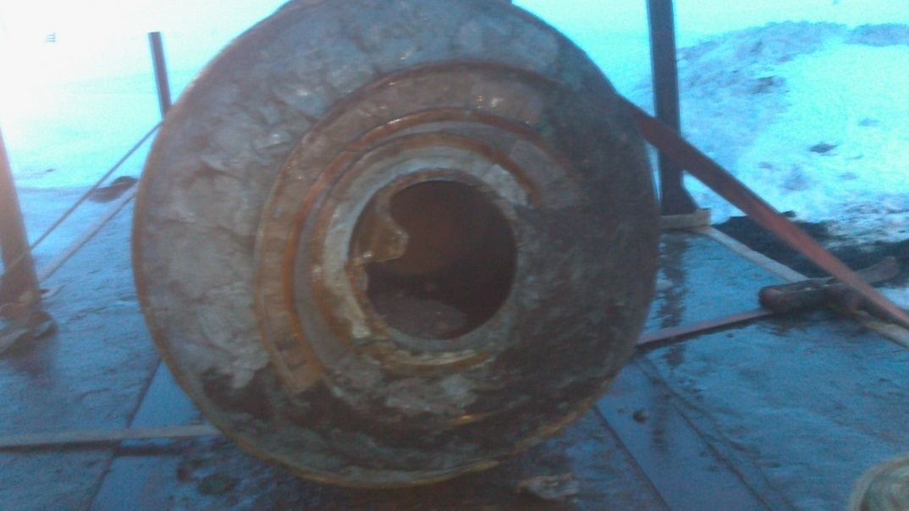
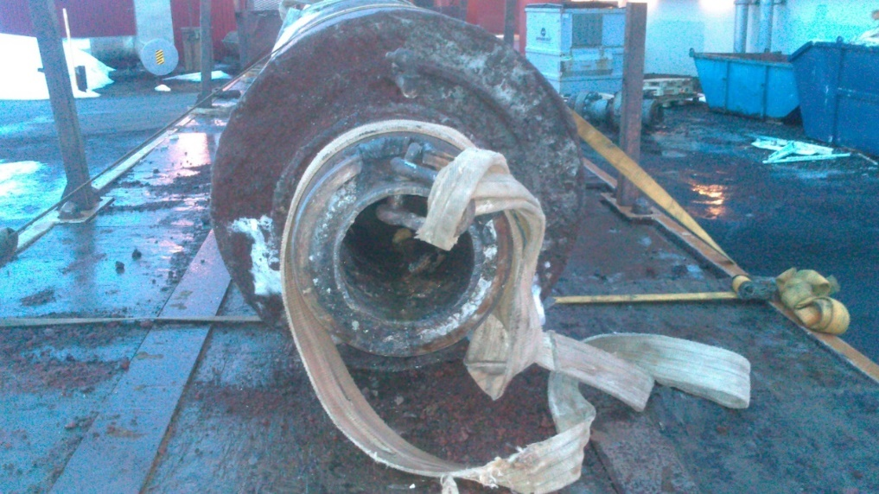

Thank you for your attention
Inspection of 6 m casing & cement from IDDP-1 well (provided by HS-ORKA and ISOR)
http://www.geowell-h2020.eu/

