Slide 1
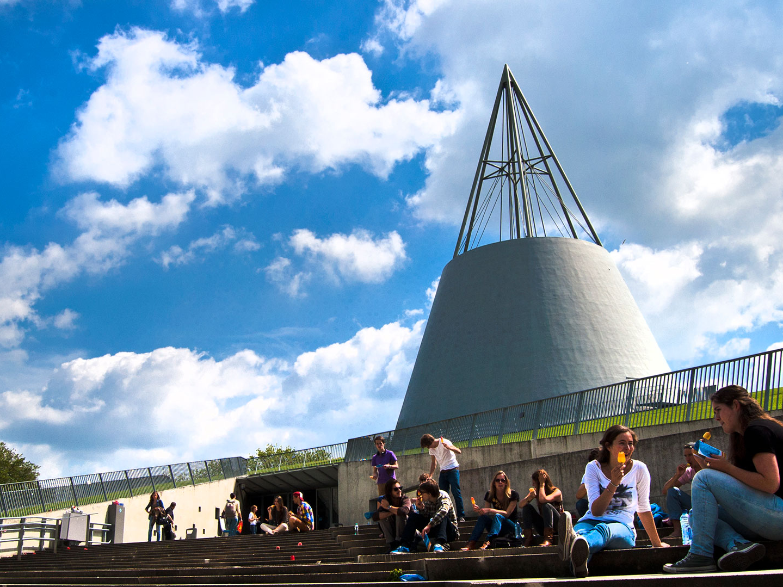
DAP 2019 Integrating cities with geothermal energy
Case study on financing
Rabobank
Ivan Das, 12 March 2019

Slide 2
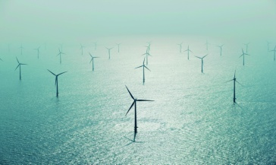
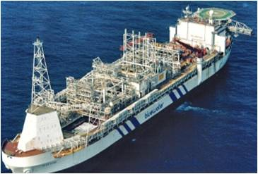
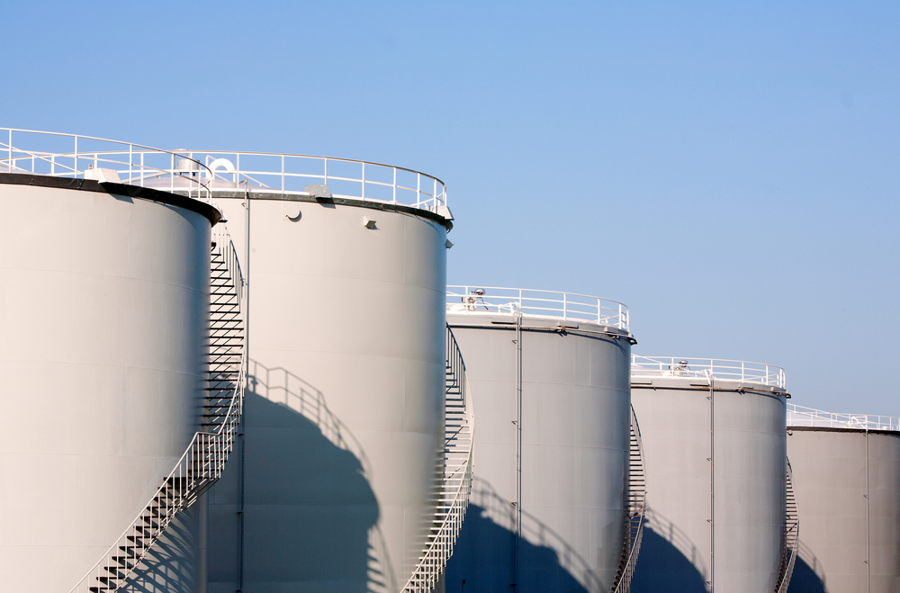
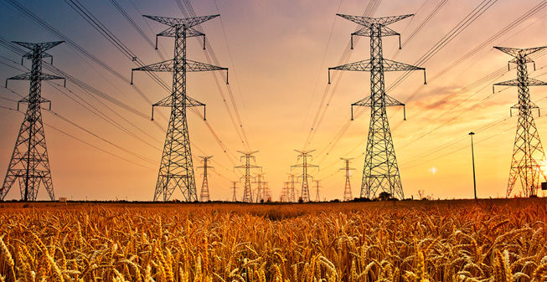
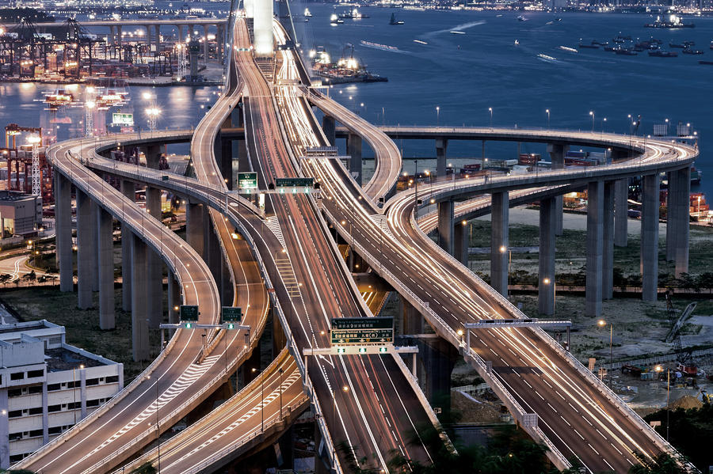
Rabobank Project Finance
Centres of competence
Who we are and what we do
Renewables |  | On- and offshore wind Solar Biomass Geothermal
Oil & gas |  | Tank storage LNG Pipelines
Offshore services |  | FPSOs Other specialised vessels
Infrastructure |  | Roads Bridges Buildings Telecom
Utilities |  | District heating Power plants
  Strong focus on (renewable) energy and infrastructure projects.
  Our portfolio currently consists of over 100 projects, EUR 4.15bn outstanding.
  The expertise of the team is in cash flow based financing with a strong limited recourse character.
  We have in-depth knowledge of the industries we serve and carefully choose the projects we opt for. Given the ‘technology heavy’ component in project financing, this understanding of the business is essential to maximizing the added value for our clients.
  Our team has a strong relationship with institutional investors active in project financing. As such, we offer the possibility to provide long-term and solid funding for projects with long tenors.
  Aside from our ‘centres of competence’, we are globally active by supporting our core Dutch clients in their international activities. As such, our international scope of business is not limited to Food & Agriculture.
Global Footprint

Slide 3
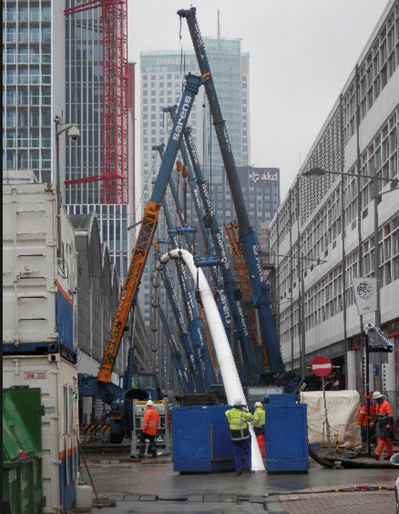
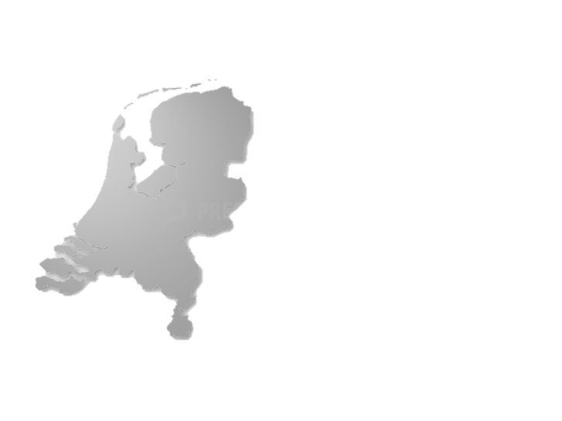
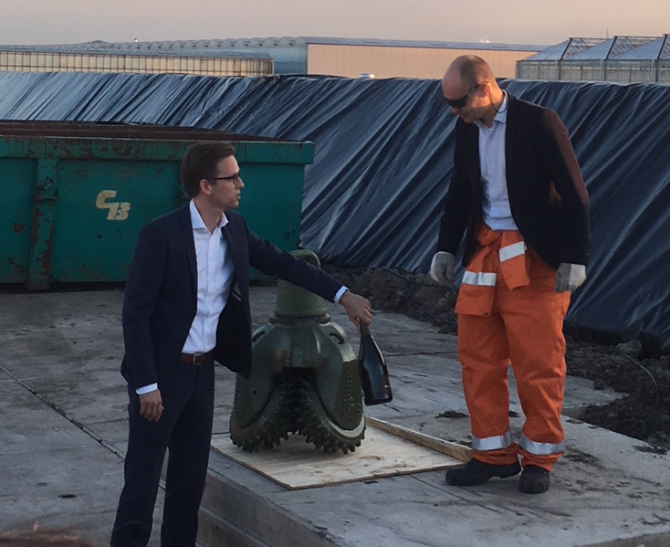
Leading player in the Netherlands, by supporting clients on important deals for them and for our country
Globaltech Offshore wind
Nordsee One Offshore wind
Zonnepark Ameland Solar
Butendiek Offshore wind
Poort van Noord N33 Motorway PPP
Meerwind Süd │ Ost Offshore wind
Q7, Prinses Amalia Offshore wind
Borkum Offshore wind
Westermeerwind Offshore wind
Merkur Offshore wind
OpenIJ Sealock Ijmuiden
Vopak Eemshaven Strategic Oil Storage
Tweede Coentunnel A10 Tunnel
ECW Geowarmte Geothermal energy
Delfluent Wastewater Treatment
NOP Agrowind Onshore wind
Poort Centraal Rijnstraat 8 PPP
Sternweg Onshore Wind
Aardwarmte Vierpolders Geothermal energy
Noaber18 N18 Motorway PPP
Gunvor Petroleum R’dam Upgrade storage & refinery
Infraspeed Highspeed infrastructure
Warmtebedrijf Rotterdam Heating network
Aardwarmte Vogelaer Geothermal energy
Gate LNG Terminal
Hartebrug II Onshore Wind
Northwind Offshore wind
Ennatuurlijk District heating
Belwind Offshore wind
C-Power I-III Offshore wind
PPP Project
Nobelwind Offshore wind
Regular Project
Windfarm
Rentel Offshore wind

Slide 4


Geothermal energy in The Netherlands
ECW Agriport 1 t/m 6
Koekoekspolder
ECW Andijk 1 t/m 4
Hoogweg
Floricultura
Duijvestijn
Haagse Aardwarmte Leyweg
Warmtebedrijf Bergschenhoek
Aardwarmte Voegelaer
Ammerlaan 1 t/m 4
Green Well Westland
Van den Bosch 3&4
Nature’s Heat
Van den Bosch 1&2
De Lier 1&2
Californie Lipzig Gielen
Trias Westland
Californie Wijnen
Vierpolders
Greenbrothers

Slide 5
Simplified overview of a project finance structure (geothermal)
Sponsors
Banks
Geology / Reservoir
SPV / Borrower
Energy off-take
Various contracts with drilling company & many other service providers
Operation & Maintenance
Insurance
Government
Permitting, SDE+
Supervision, Other

Slide 6
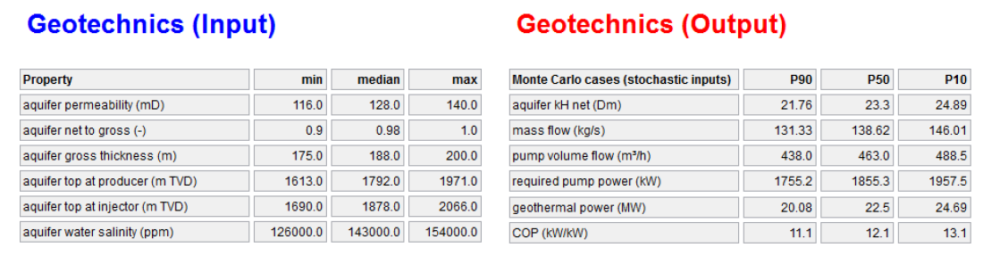
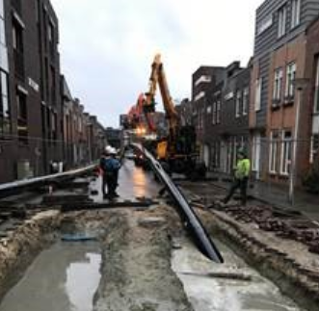
Overview of risks in (Dutch) geothermal energy
Geological (“high”)
Accurate assessment of geothermal capacity is challenging. Mitigants are the availability of geological data and assistance of specialised advisors.
  Geological reports including P50-P90 Probability scenario’s tend to vary.
  > 10% of post drill results worse than estimated P90 thermal capacity.
  Claims on RNES state insurance are uncertain → sponsors dislike 7% insurance premium for uncertainty → higher thresholds for new developments.
Technical - Construction & Operations (“low” - “high”)
  During drilling → delays, loss of equipment,/loss in hole, loss of hole, side tracks. (CAR) Insurance of subsurface works become more difficult every day which impacts appetite of investors and financiers and viability of business cases.
  “Main Contracting” does not exist in geothermal energy projects → 20 service providers are not unusual → interface risks → Project management is key.
  Construction risks mitigated by high contingency budgets putting pressure on expected IRR and appetite of investors and financiers.
  Risks turning into reality → large deviations in CAPEX/MWth, not only because of uncertain drilling expenses, also because of wide variety in heating networks.
  Operations & Maintenance are key. Operating a geothermal energy plant ≠ ‘pumping some hot water → F.e. side effects related to natural gas, oil, radioactivity, scaling, corrosion & induced seismicity may arise.
3.

Slide 7
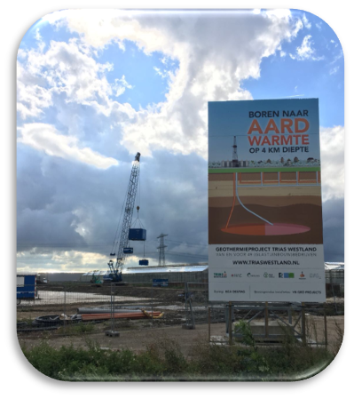
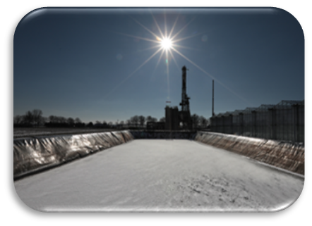
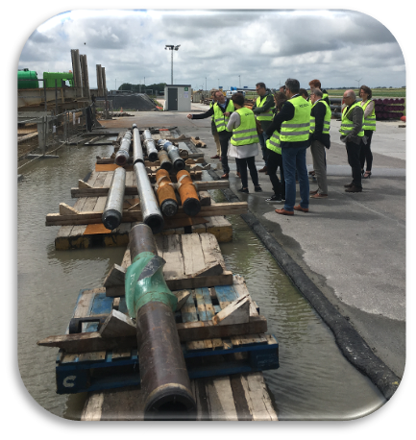
Overview of risks in (Dutch) geothermal energy
Off take (“low” – “high”)
  Heat distribution is a local play → No national grids like electicity and gas → In smaller B2B financial due diligence of every single off taker → In larger B2B and in B2C projects diversification effect become a mitigant.
  In B2B projects: 15 years off take agreements are common / all off takers provide for own back up.
  In B2C (city district heating) other risks (and mitigants!) come into play because of consumer protection laws and regulations, a.o. de (Nieuwe) Warmtewet.
Price (“low” – “medium“)
  Dutch SDE+ subsidy scheme for renewable energy is decent.
  Where off takers are also shareholders, stable cash flows can be guaranteed; in other situations possibly more challenging.
  SDE+ does not perfectly fit to city district heating.

Slide 8
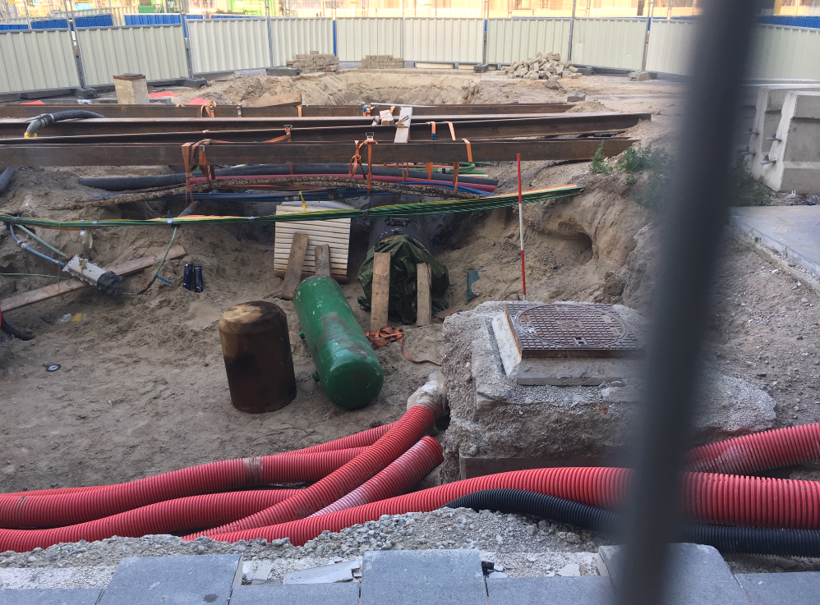
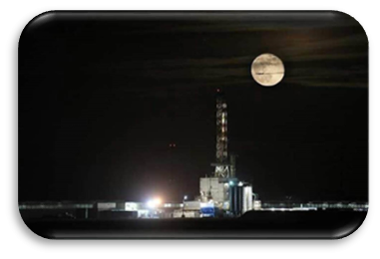
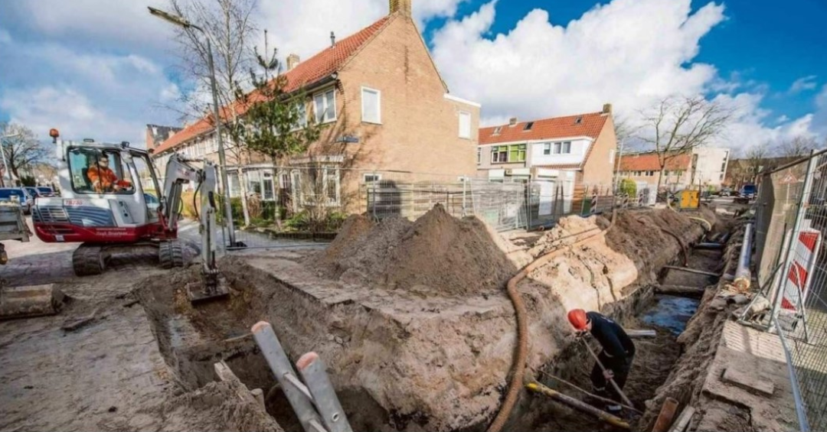
Overview of risks in (Dutch) geothermal energy
Stakeholder management (“low – high”)
  The more stakeholders the higher the risks.
  Permitting aspects more cumbersome in cities.
  Laws & regulations not yet adequately fitting for geothermal energy re. drilling, operation, induced seismicity.
  Are governmental bodies as Ministries, RVO and SODM aligned on geothermal energy?
  Social & psychological impact not to be underestimated.
  Chances of delays..

Slide 9
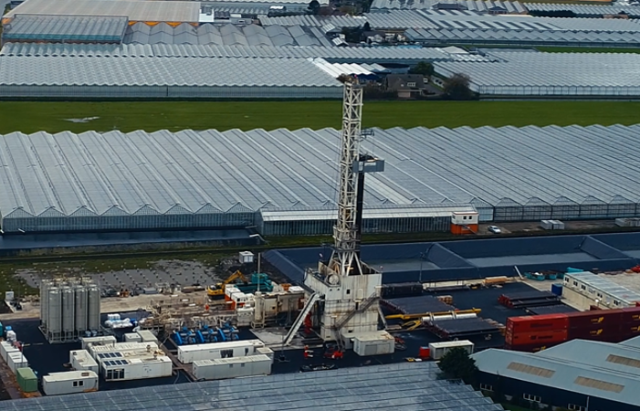
Case study: Trias Westland

Slide 10
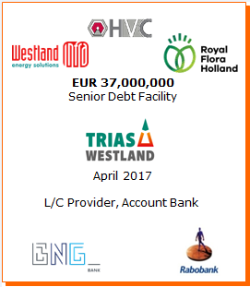
Trias Westland Geothermal Energy
Overview
About Trias Westland
Trias Westland is a company founded for the purpose of exploring and exploiting geothermal wells in the Trias earth layer at approximately 4,000 meters depth. The project consists of the drilling of deep wells, construction of above surface installations for heat exchange and a district heating network to 49 horticultural greenhouses in the municipality of Westland. Total investment amounts around EUR 55mln. Total project capacity is about 22 MW, to be completed in the spring of 2019.
Transaction Details
The technique of geothermal power in the Netherlands is to drill into the earth looking for warm water reservoirs. This warm water will then be pumped up to the surface, where it will be used to heat (green-)houses. The cooled down water will be injected back in to the subsurface reservoir. The Trias Westland project is the first to drill to the Trias earth layer at a depth of 4km (other projects go to a depth of approx. 2.3km). Geothermal energy is of vital importance for the Westland region, as the greenhouse farmers need sustainable and competitively priced energy for growing their crops.
The project is backed by HVC, Westland Infra and FloraHolland, where the first two have the municipality of Westland as their major shareholder. The offtakers of the project are horticultural companies who will use the heat for growing their crops. The growers benefit from participating in the project, as (i) the geothermal heat will be offered at a lower price than gas and (ii) the project will be handed over to the growers once the shareholders and banks have been repaid. Therefore the project returns are interesting not only for the shareholders, but certainly also for the growers.
Rabobank’s Performance
Rabobank Project Finance and BNG Bank have been involved of this project since many years. Financial close was reached in April 2017. This transaction is a nice example of Rabobank Project Finance dept. supporting CSR and innovation in our country’s important horticultural sector.
Key Terms
Sponsors
Total deal size | EUR 50mln
Senior debt | EUR 37mln
Tenor | Construction + 14 years
Capacity | ~ 22 MW

Slide 11
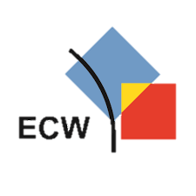
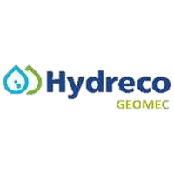
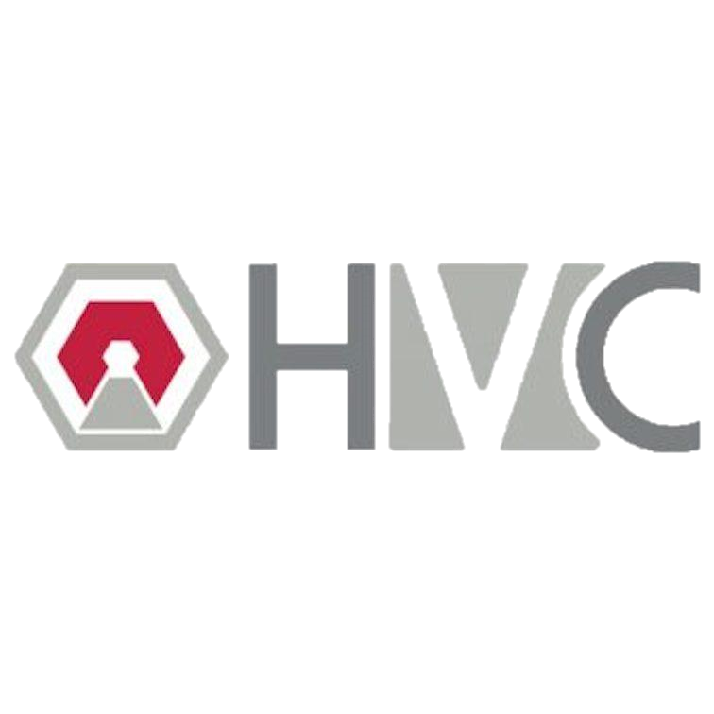
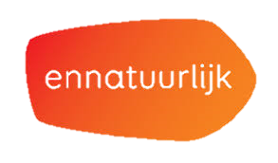
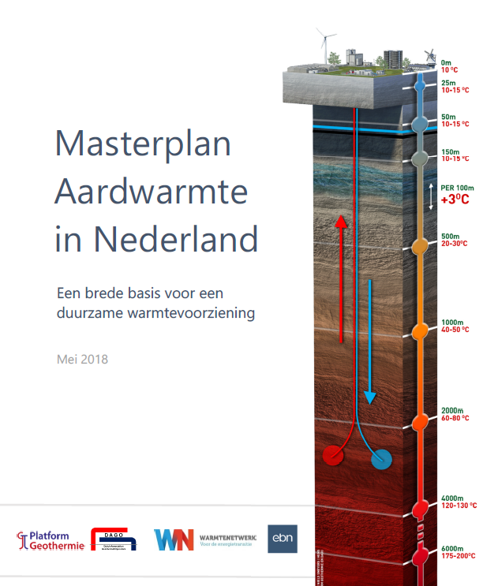


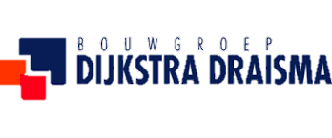

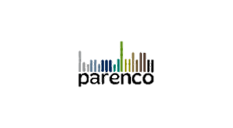
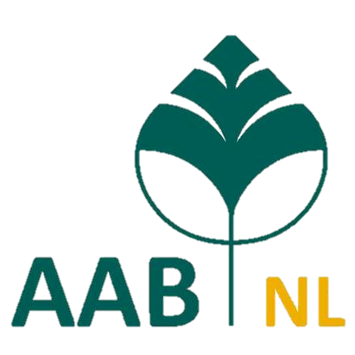

What’s next?
UDG
City district heating
“Versnelling en verbetering”
Plays
Masterplan aardwarmte
“Light” industries

Slide 12
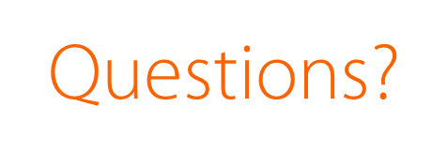
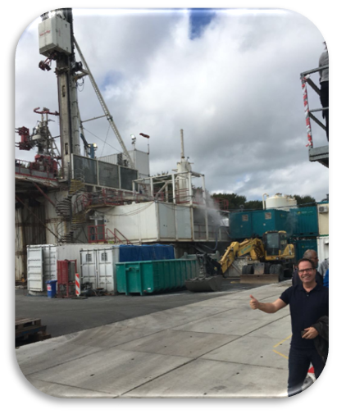

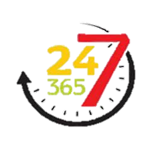

Slide 13
Important notice
This presentation has been prepared exclusively for the benefit and internal use and does not carry any right of publication or disclosure. Neither this presentation nor any of its contents may be used for any other purpose without the prior written consent of Rabobank. The information in this presentation reflects prevailing market conditions and our judgement as of this date, all of which may be subject to change. The information and opinions contained in this document have been compiled or arrived at from sources believed to be reliable, but no representation or warranty, express or implied is made as to their accuracy, completeness or correctness. Rabobank and its directors, managers, employees and agents, disclaim any and all liability for, or based on, or relating to any information contained in, or errors in or omissions from, this presentation. The information and opinions contained in this document are wholly indicative and for discussion purposes only. No rights may be derived from any potential offers, transactions, commercial ideas et cetera contained in this presentation. This presentation does not constitute an offer, advice or invitation. This document shall not form the basis of or be relied upon in connection with any contract or commitment whatsoever. This presentation, including this notice, is governed by Dutch law. Any disputes relating to this presentation shall be exclusively submitted to the competent courts in Amsterdam, The Netherlands.

