Slide 1
Luc Brugman
Investing in geothermal heat
Towards a sustainable built environment

Slide 2
HVC is a publicly owned heat company
Shareholders
46 municipalities
6 water boards
Core task
To shape and realize heat transition from a public interest perspective.
45% HVC
45% Capturam
10% RFH
100% Coöperation
(48 greenhouse companies)
Geothermal heat Project Ltd.
1st doublet (20MWth)
2nd doublet (~15MWth)
Acceleration heat transition Westland
Realising geothermal heat projects (100MWth)
Integrating residual heat (100MWth)
50% HVC
50% Capturam

Slide 3
Content
Timelapse of a geothermal heat project
Geothermal heat in the energy transition
Challenges in the built environment
Three current examples

Slide 4
Timelapse

Slide 5
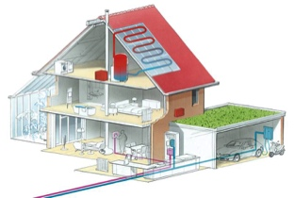
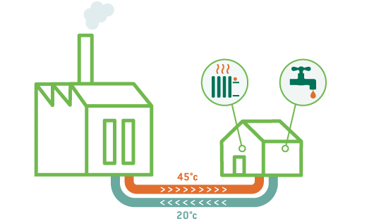
Geothermal heat in the heat transition
Long-term: all-electric as primary solution Short-term: “no regret” opportunities for collective heat
1) Green and (for now) unavoidable gas
Limited potential
Limited availability of biomass for the production of green gas
Gas remains a necessary fuel for the (high temperature) process-industry and as a back-up for district heating.
2) Collective heating systems
Direct potential
Mature technology
Existing infrastructure performs well and is under control.
Geothermal heat sources will (amongst others) further reduce the environmental impact.
3) All-electric
High expectations, but…
Innovations are necessary (electricity storage, laws and regulations, grid reinforcement, smart grids, E-heat pumps)
Generation of renewable electricity

Slide 6
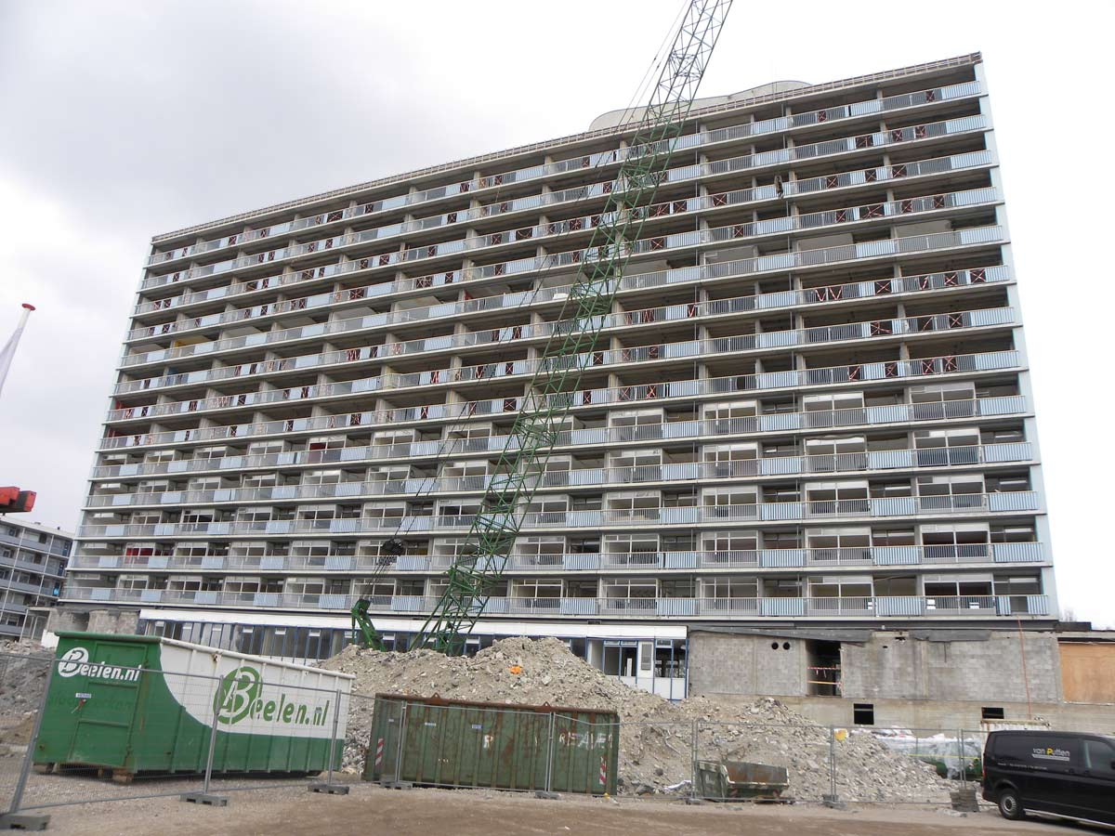
However, it all starts with the end user…
Collectives
Individuals
The transition starts with housing corporations and municipal property, and then continues to individual home owners.

Slide 7
Challenges for project development
The demand-side development is relatively unpredictable (end-user driven), while demand-side requirements are stringent in terms of:
Sustainability
Security of supply
Price
A business case for geothermal heat requires approximately 10.000 end-users. (SDE++ may lower this number to 3500-5500.)
Stringing beads is a common approach to build-up to sufficient demand, however,….
Who can give guarantees to the individual beads?
What if the well produces less than expected? What if the risks are too high?
What are the fall-back scenarios?
A long-term development strategy and a long-term heat source strategy are necessary.

Slide 8
Thinking in terms of demand and supply
Current converstations are always about district heating infrastructure, however…
infrastructure always follows the development of demand and suppply,
therefore… we should actually talk about:
How will the heat demand develop over time?
What are suitable heat sources?
Who will take system responsibility?
Heat demand
Current and future
Seasonal variation
Heat supply
Base load
Middle load
Peak load
Back-up

Slide 9
Multi-year source strategy
District heating networks can be fuelled by:
Residual heat (decreasing)
Biomass
Geothermal heat
Heat from surface water
Heat-cold storage systems
High temperature heat storage
Power to Heat
Hydrogen
Current heat sources
Future proof heat sources, when considering:
The transition towards lower supply-temperatures.
Concept development (combining technologies).
Integration into the built environment.
Innovative technologies, heat sources of the future

Slide 10
Harvesting heat: essential differences
New construction homes
Production temp. = 85 ºC
Return temp. = 45 ºC
Power = 8 MWth
3500 full load hours? = 100.800 GJ
Greenhouses
Production temp. = 85 ºC
Return temp. = 35 ºC
Power = 10 MWth
6000 full load hours = 216.000 GJ
Existing built environment
Production temp. = 85 ºC
Return temp. = 55 ºC
Power = 6MWth
3500 full load hours? = 75.600 GJ
Three examples of the same geothermal well, the same CAPEX and (nearly) the same OPEX.

Slide 11
Three current examples of projects under development

Slide 12
District heating in the Ijmond region
Activities
Development of a district heating system (>20.000 woningen)
Unique opportunities
Starting from a current geo-well
Scaling through a second well
Combining residual heat from Tata (12MWth) with geothermal heat (12MWth)
Sufficient availably supply for ~15.000-20.000 households
Geothermie
TATA

Slide 13
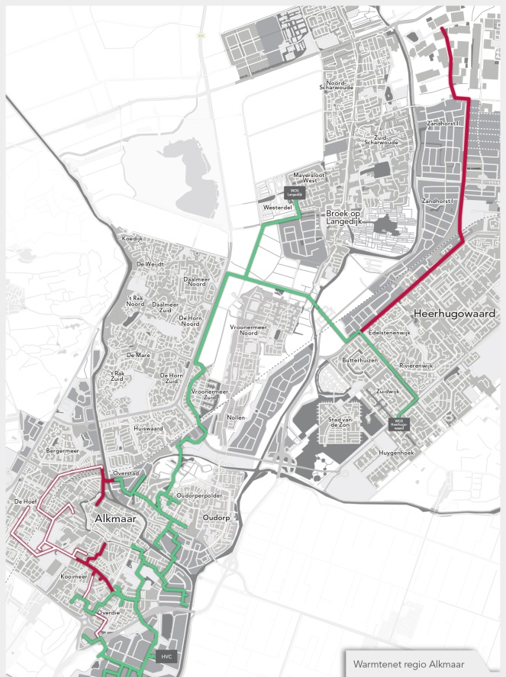
District heating in Alkmaar - Heerhugowaard
Alton
Alton activities
Back bone operational since dec. 2018
Pipeline dimensioned for geothermal heat (temperatuur 85 ºC -35 ºC)
Data exchange with the NAM
Unique opportunities
High heat demand (built enviornment and greenhouses)
Suitable location for geothermal well
High potential, good geology
Status:
Land has been purchased
Tracing permit has been obtained
SDE+ was granted

Slide 14
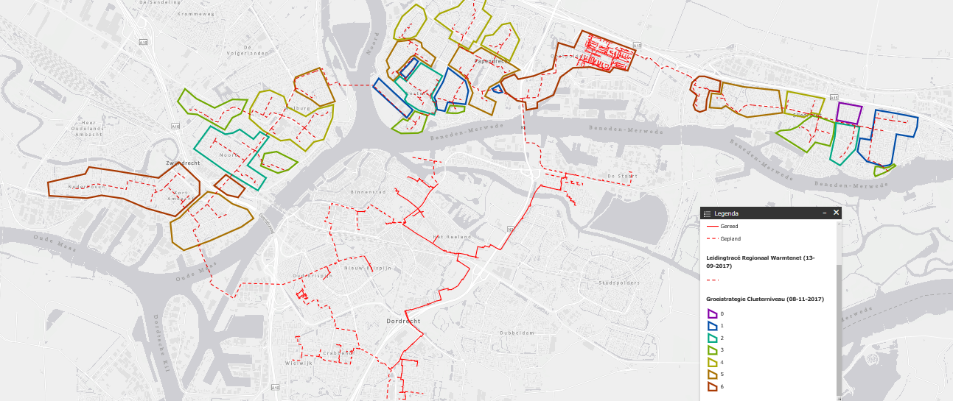
District heating Drechtsteden region

Slide 15
Example ‘Drechtsteden’
GEO
source
BC-Tablis
Activities Sliedrecht / Papendrecht
Geological research shows high potential
1200 households in Sliedrecht (2019) contracted
National subsidy granted for 600 households in Sliedrecht
Unique opportunities
Sliedrecht and Papendrecht combined show good potential for a project based on geothermal heat.

Slide 16
Finally,
Geothermal heat (co-) determines the shape and speed of the heat transition. However, geothermal heat is only a part of the system.
Moreover, geothermal heat projects face public acceptance and local participation as additional challenges.

