Slide 1
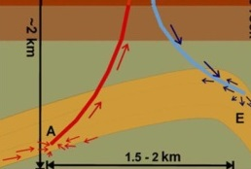
Update DAPwell: the campus geothermal well
Phil Vardon
Geoscience and Engineering
Theme leader Geothermal Energy
A hot topic for deep research

Slide 2

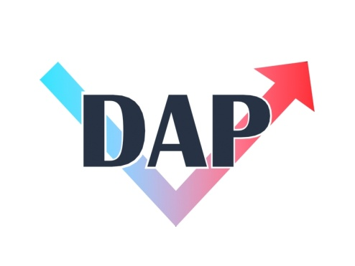


DAP(well) history
Stichting DAP:
Supports research, education, development
2007
2008
2010
2013
2018
Ongoing
cooperation
Delft Aardwarmte Project
Exploration permit
Ammerlaan and Duivestijn projects
Plans for (commerical) campus well cancelled
DAPwell:
University led well (+ partners)
Geothermal Theme Established

Slide 3
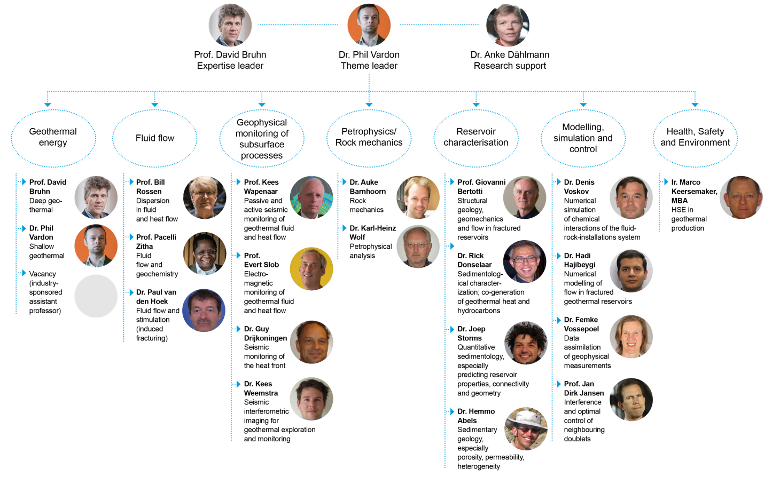
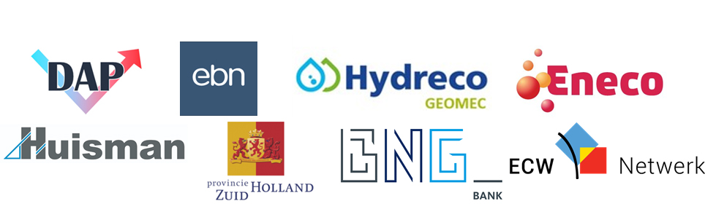
Theme in Geothermal Science and Engineering
Expanding to other departments.

Slide 4
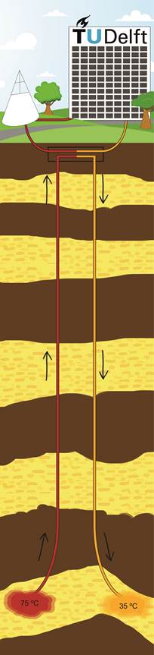
DAPwell: Living laboratory
Science: Dept. GSE
Knowledge
Operations: CRE
Heat

Slide 5
DAPwell: Living laboratory
Science: Dept. GSE
~€6m of research infrastructure planned.
Operational funding (PhD students / researchers) to be applied for.
Operations: CRE
Commercial business plan.
Phased implementation: supply heat to campus, extend heat grid, supply heat outside campus.
Company in process of being formed, with university and other partners.

Slide 6
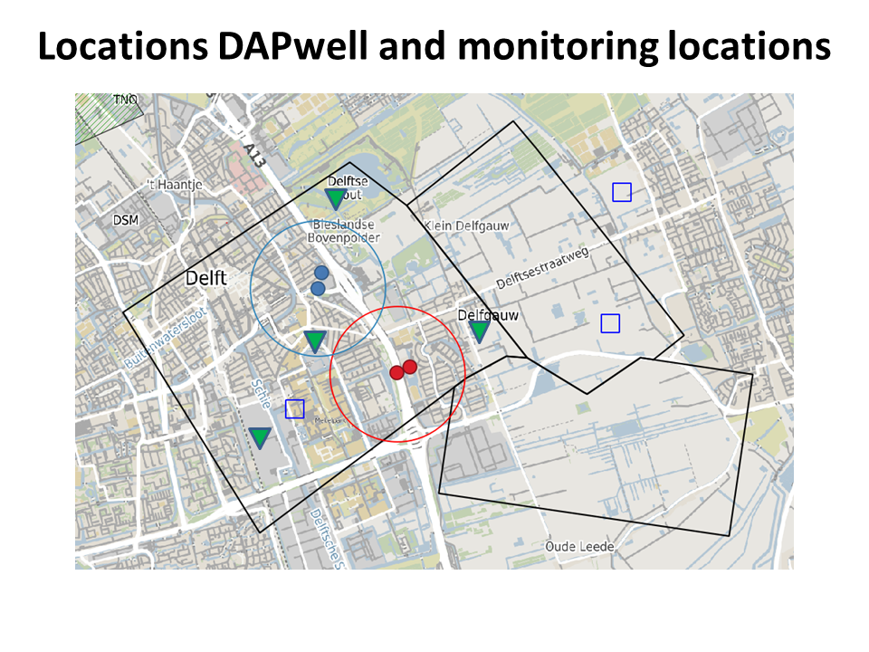
Concept well design: locations
Ground surface
~800m depth
reservoir
~2200m depth
~1400m
outstep
Locations likely to change during detailed design

Slide 7
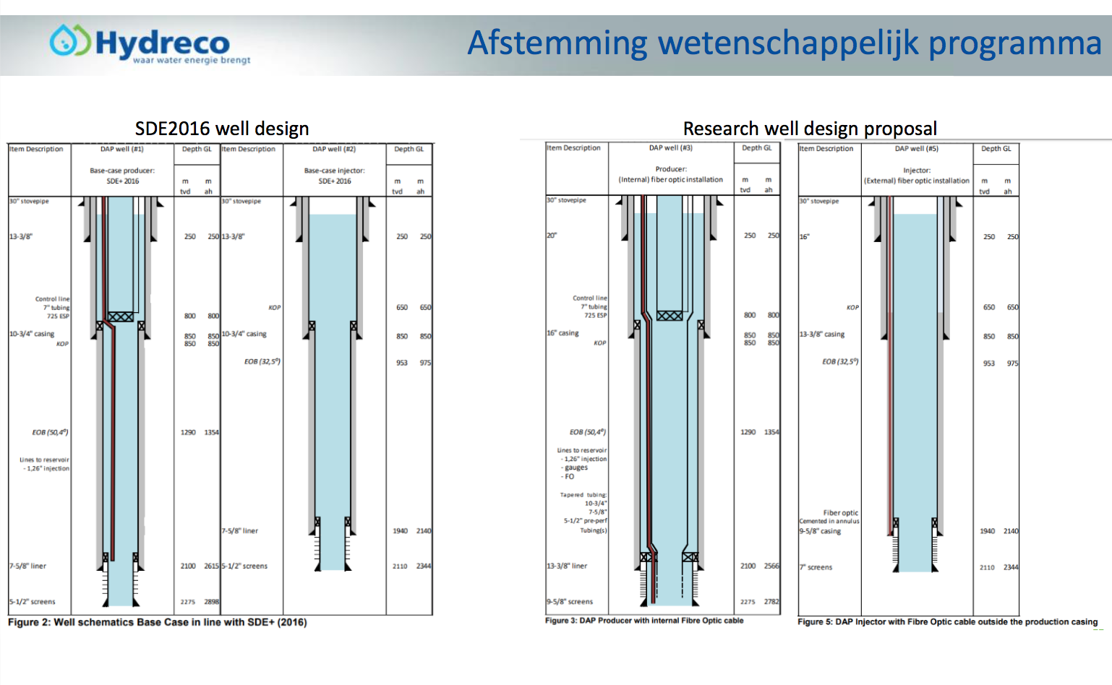

Slide 8
Decisions and project progress
July 2018: TU Delft board – decides in principle to pursue a geothermal well
Jan 2019: TU Delft, Hydreco GeoMEC and EBN signed a ‘samenwerking overeenkomst’ based on initial plans.
Detailed business plan, conceptual design, contracts, linking research and operations
March 2019: TU Delft board – proposed final decision
June 2019: TU Delft ratified decision
Permitting, detailed design and procurement
Spring 2020: Begin drilling
End 2020: Hot water production and supply

Slide 9
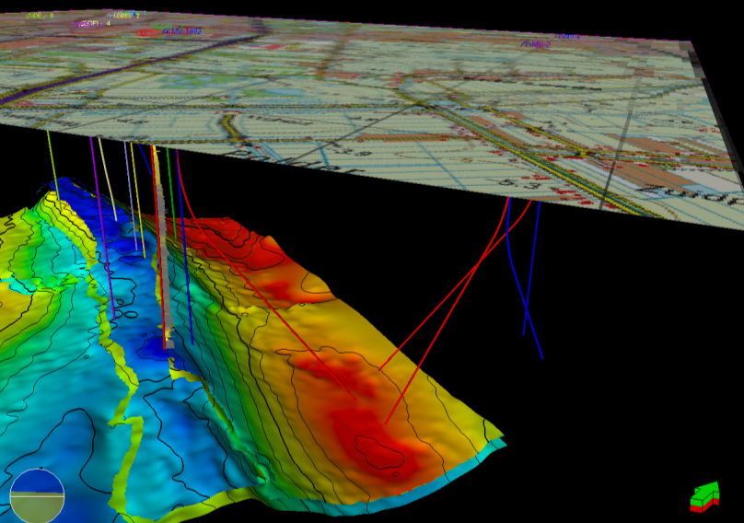

Research: DAPwell
Research topics
Prediction: models, control
Behaviour: thermo-hydraulic-chemical
Geology: cores >500m
Monitoring: geophysics, fibre optics, flow, best monitored well
Impact of activities at surface
Materials: new casing material
Integrated: to campus, urban
Image/data courtesy of Douglas Gilding / DAP / NAM
reducing uncertainties | making sustainable energy large scale
Notes:
Outcomes: reduce risk, reduce costs, via fundamental knowledge and technical developments.

Slide 10
DAPwell: science plans
Coring >500m
More knowledge of reservoir
Permeability / mechanical / thermal / chemical behaviour
Heterogeneity and uncertainty
Composition
Matching with downhole logs
More knowledge of overburden
Mechanical properties
Transport properties
Composition
Why is this important?
Reducing uncertainties leads to better business models
Reduces risks – possible to say more about induced seismicity
Match what is observed downhole with laboratory tests
Other industries / technologies also benefit

Slide 11
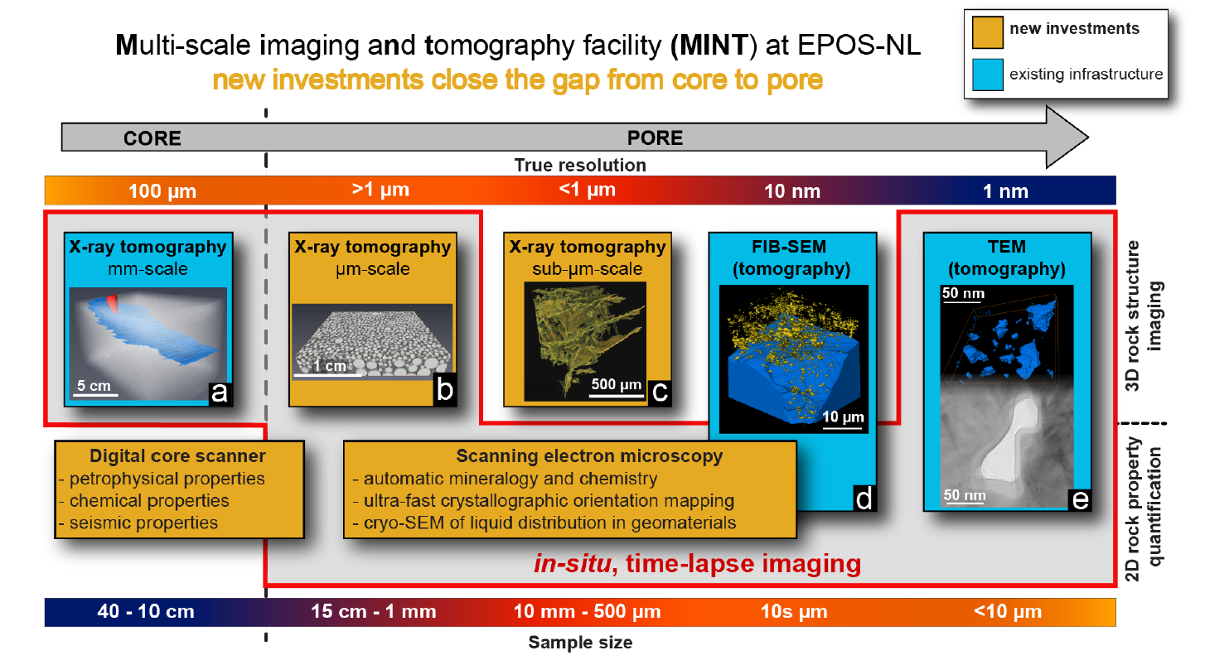
DAPwell: science plans

Slide 12
DAPwell: science plans
Monitoring
Baseline monitoring
Near surface water quality
Seismic network
Deformation
Why is this important?
The impact on the surface is a major societal concern
Good initial monitoring gives a comparison

Slide 13
DAPwell: science plans
Monitoring
Logging
Initial logging:
  Stresses (mini-frac)
  Porosity / density
  Electrical resistivity
  Gamma ray
  Etc…
Periodic logging (~every 6 months)
  Depending on casing
Why is this important?
In-situ conditions are the most realistic
Match downhole conditions to laboratory data
Investigate changes in the reservoir, e.g. clogging / scaling, fractures
Notes:
Corrosion, clogging etc…

Slide 14
DAPwell: science plans
Monitoring
Fiber optics
Producer – inside casing
  Pressure (~15 locations)
  Temperature – distributed
  Acoustic
Injector – behind casing
  Seismic
Why is this important?
Can lead to better models: better models = better predictions = lower risks
Seismic risk more defined
Investigate processes leading to changes in the reservoir, e.g. clogging / scaling

Slide 15
DAPwell: science plans
Monitoring
Electromagnetic
Electrodes on outside of casing
Why is this important?
Can lead to monitoring of hot/cold fluids
In field development ‘steering’ of fluids can be possible

Slide 16
DAPwell: science plans
Monitoring
Tracers
Producer – inside casing
Matching results from pressure sensors and geophysical methods
Study heterogeneity of flows
Why is this important?
Can lead to better models: better models = better predictions = lower risks
Investigate processes leading to changes in the reservoir, e.g. clogging / scaling

Slide 17
DAPwell: science plans
Monitoring
Fluid sampling
Periodic fluid sampling
Corrosion / clogging
Changes in fluid can indicate reservoir changes
Link with other monitoring techniques
Why is this important?
Can lead to better clogging / corrosion reduction strategies
Can lead to good fluid monitoring procedure

Slide 18
DAPwell: science plans
Composite casing
Test at real pressures and temperatures
New joints under development
Why is this important?
Lighter – cheaper installation
Corrosion resistance
‘See through’ for some monitoring

Slide 19
DAPwell: science plans
Topics under development
Monitoring for urban environments – requirements
Simulation techniques, including uncertainties and heterogeneities
Smart wells
Integration into heat networks
High temperature storage
Long term impacts on the built environment
National / international collaboration
All data will be made public
Further projects / research topics can be addressed
Access to facilities is possible
Partners are actively engaged and sought

Slide 20
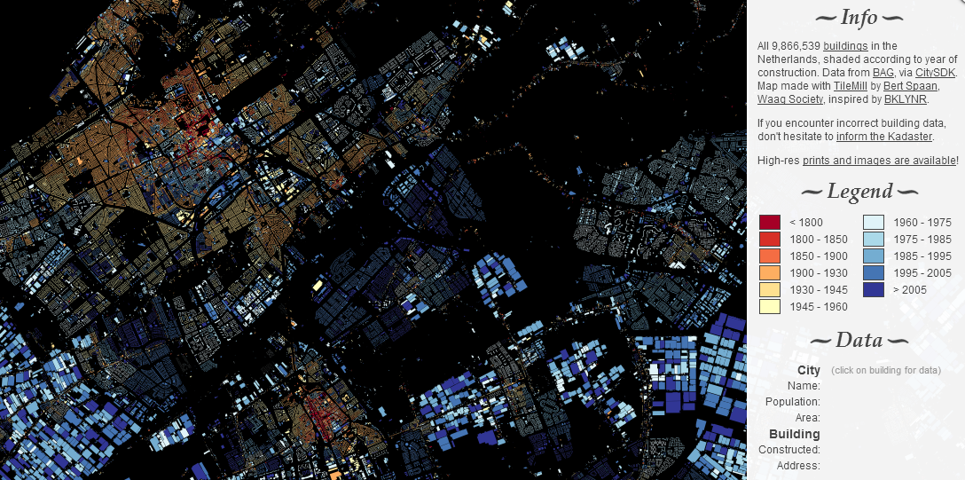
DAPwell: science plans
http://dev.citysdk.waag.org/buildings/#52.0524,4.4172,12
Notes:
Retrofitting buildings, neighbourhoods, cities is a challenge but essential

Slide 21
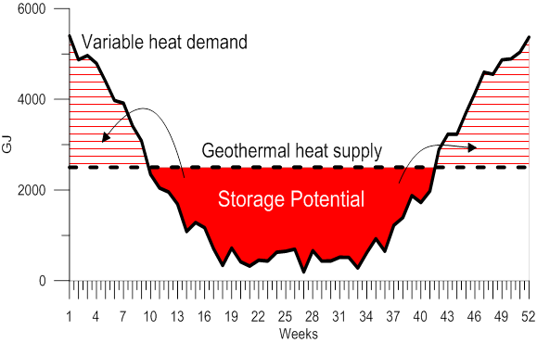
DAPwell: science plans
Bloemendaal, 2018
Notes:
Retrofitting buildings, neighbourhoods, cities is a challenge but essential

Slide 22
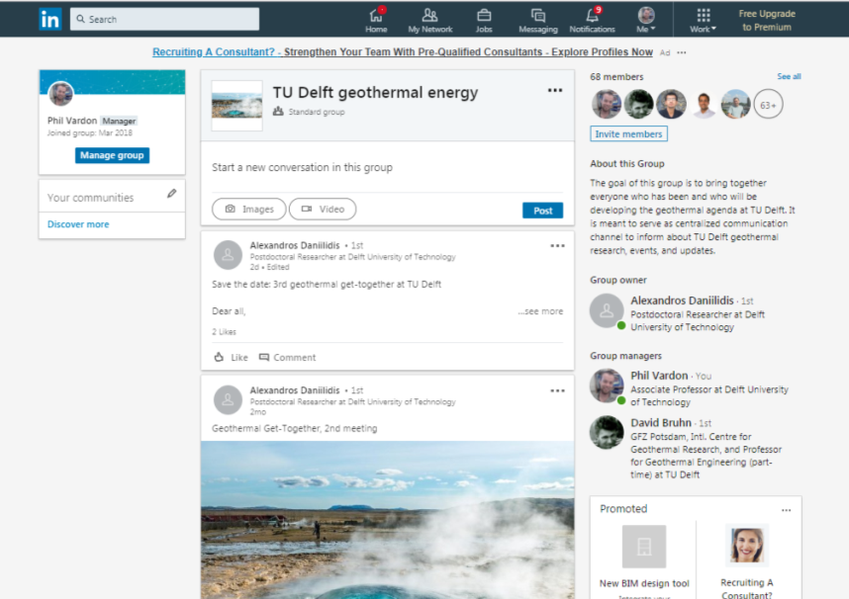
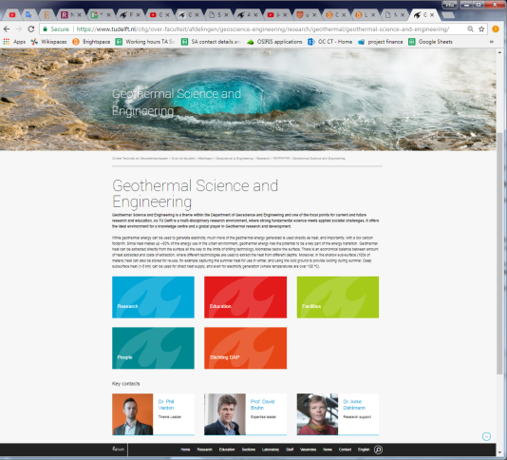
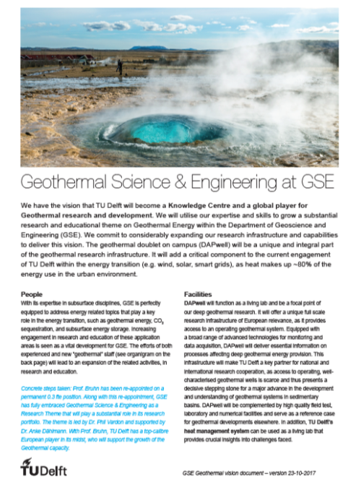
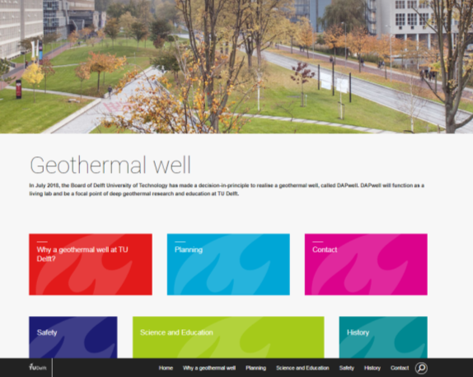
Outreach
External communication:
Notes:
GGT also

Slide 23
Outreach
Geothermal Get Together
Mix of academia, industry, government
3rd edition: November 29th
Programme:
15.30 Welcome and introduction
15:45 Frank Schoof, Chairman Stichting Platform Geothermie
16.05 Tom Bradley, Senior Geoscience Advisor, Baker Hughes
16:25 Dennis Voskov, Associate Professor TU Delft
16.45 Drinks
Next edition, provisional date: April 25th
Notes:
GGT also

Slide 24
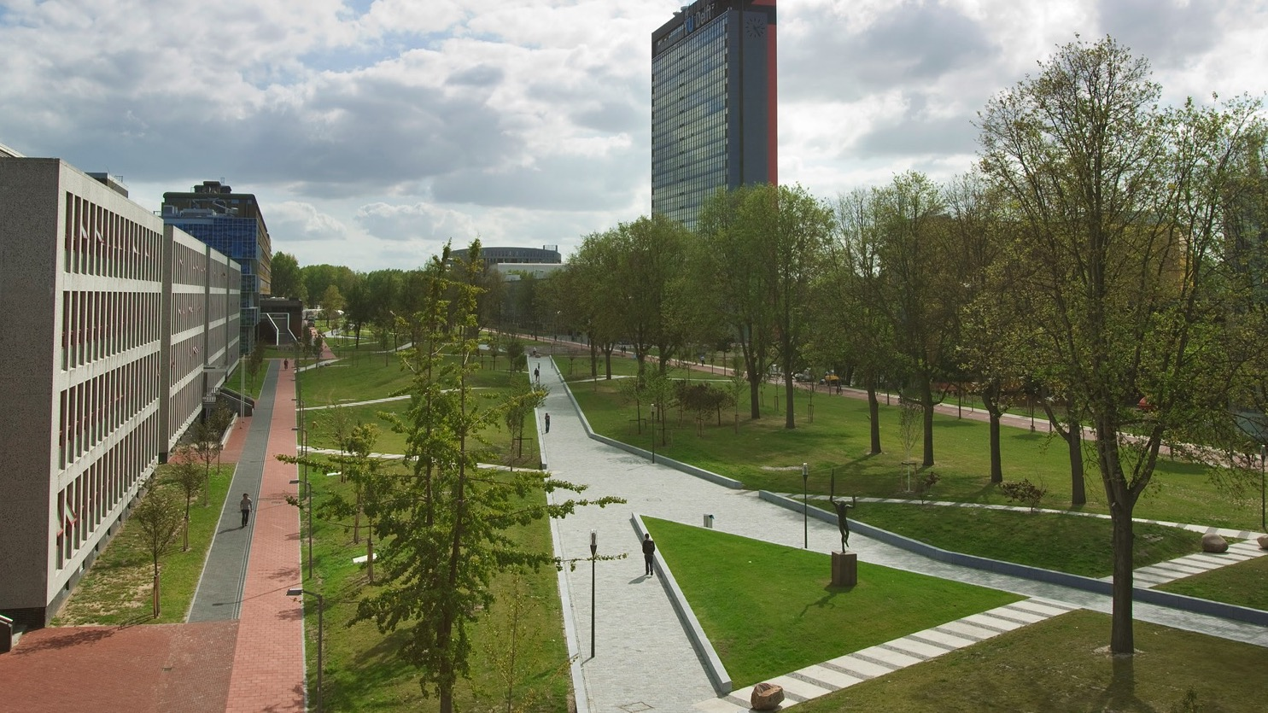
Phil Vardon
Associate Professor
Geoscience and Engineering TU Delft
T +31 (0)15 27 81456 | E P.J.Vardon@tudelft.nl | W http://www.citg.tudelft.nl/pj-vardon/
David Bruhn
TU Delft Geoscience and Engineering
Abe Steiginga
Technical Advisor Wells
Barbara Cox
Hydreco GeoMEC
+ many others
TU Delft:
CRE + finance + legal
Hydreco
EBN
All scientific members of the Geothermal Theme
Stichting DAP
Notes:
Tidy this and ask.

Slide 25
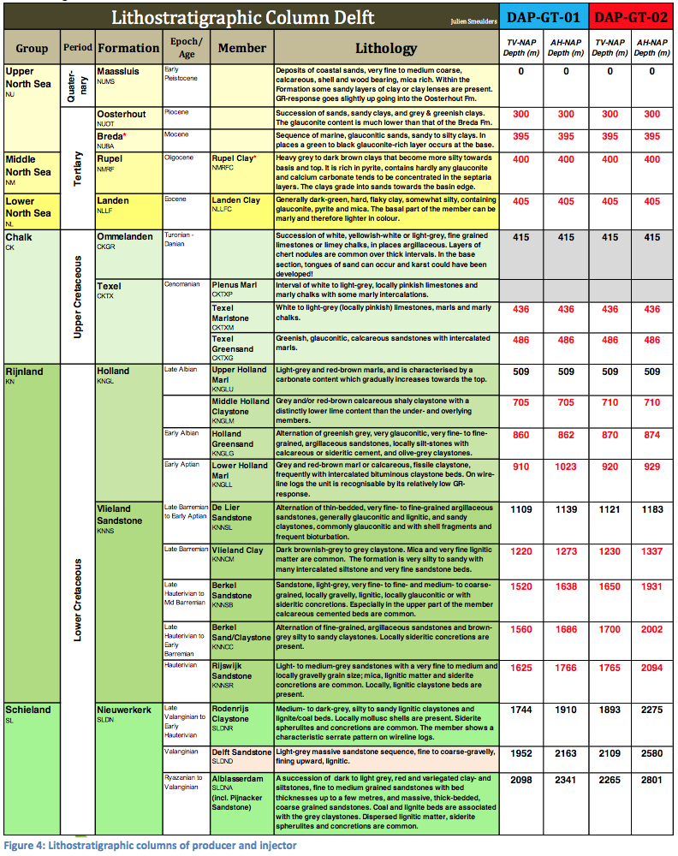
Target reservoir

