Slide 1

Heat Storage
HT Heat storage is needed, aquifers can provide the solution
ir. T.I.S. van der Woude

Slide 2
Necessity for heat storage
Notes:
60% of total energy needs in the form of heat! At the moment, most of the seasonal heat demand is provided by burning natural gas. At all levels in government and also industry, there is a growing ambition and desire to become CO2 neutral and "gas-free".
http://ec.europa.eu/eurostat

Slide 3
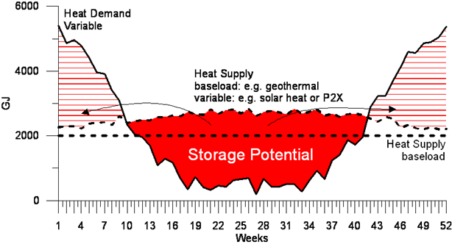
Heat is needed during winter
Notes:
Heating mainly needed 4 months of the year, Excess of generated electricity and industrial heat (during summer). This excess heat will become more as more windmills and solar parks will be build. We need to find a solution so the excess heat will not go to waste. At the moment there are large quanties of excess electricity and heat, while it cannot be stored for a long time.. When there is 4 months of heat needed, there are 8 months to fill the buffer. The only way to do that is by utilising the subsurface, shallow or deep, by the use of aquifers

Slide 4
Aquifers can provide the solution
Subsurface is a good insulator
Tertiary sand deposits (depths between 100 and 500 meters)
Applications exists for shallow and deep geothermal energy
Notes:
There is a great potential for storing excess heat in the subsurface that can be utilised in winter when demand is greatest. The idea of using the subsurface for warm and cold water storage is not new. But usually this is done until 200 meters depths. The subsurface is a great source of heat, but the subsurface is also a good insulator. In various parts of The Netherlands there are thick Tertiary sand deposits of millions year old at larger depths between 100 and 500 meters, which potential is hardly known. This is because it is of no interest for drinking water (too salty) and too shallow for oil and gas.
WKO (Warmte en Koude Opslag, i.e.: shallow warm and cold water storage) and deep geothermal energy are current applications in The Netherlands for harnessing the subsurface for its ideal isolating properties and its source of warm water.

Slide 5
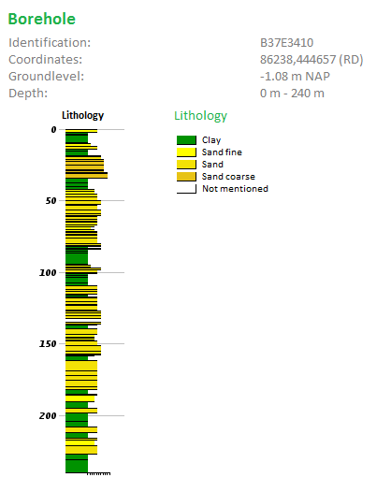
Example borehole Delft
Potential Aquifer
Potential Aquifer
Potential Aquifer
Notes:
Profile of dinoloket at Delft university
Potential aquifers between impermeable clay layers. There is a lot of potential for heat storage.
If we look at the first aquifer from 30 metres thick, if this in area of 67*67m2, you can already store 4800 GJ of heat in subsurface.

Slide 6




Application to urban areas
Hot water ←
Cold water →
Offices/shops
Heat production plant
Residence
Notes:
On the other hand there is a great potential for harnessing excess heat that is generated by industries. There are in a some urban areas heat distribution networks where industries can directly supply and distribute their heat to end users. Ideally, there should be a way to store this excess heat, which can be used in winter and be integrated into the heat distributions network.
It is customary in installation technology and also in the process industry to incorporate buffer capacities into a process. It is striking that this is not yet done on a large scale in heat networks. The advantage is that the business case can be improved. One of the reasons is that at the moment the industries can not store their excess heat and the heat is only necessary in the winter. If you store the heat in the subsurface, more houses can be connected to the heating distribution network that provides warm and cold water. Once installed the energy storage system produces no sound and uses no space which is perfect for urban areas.

Slide 7
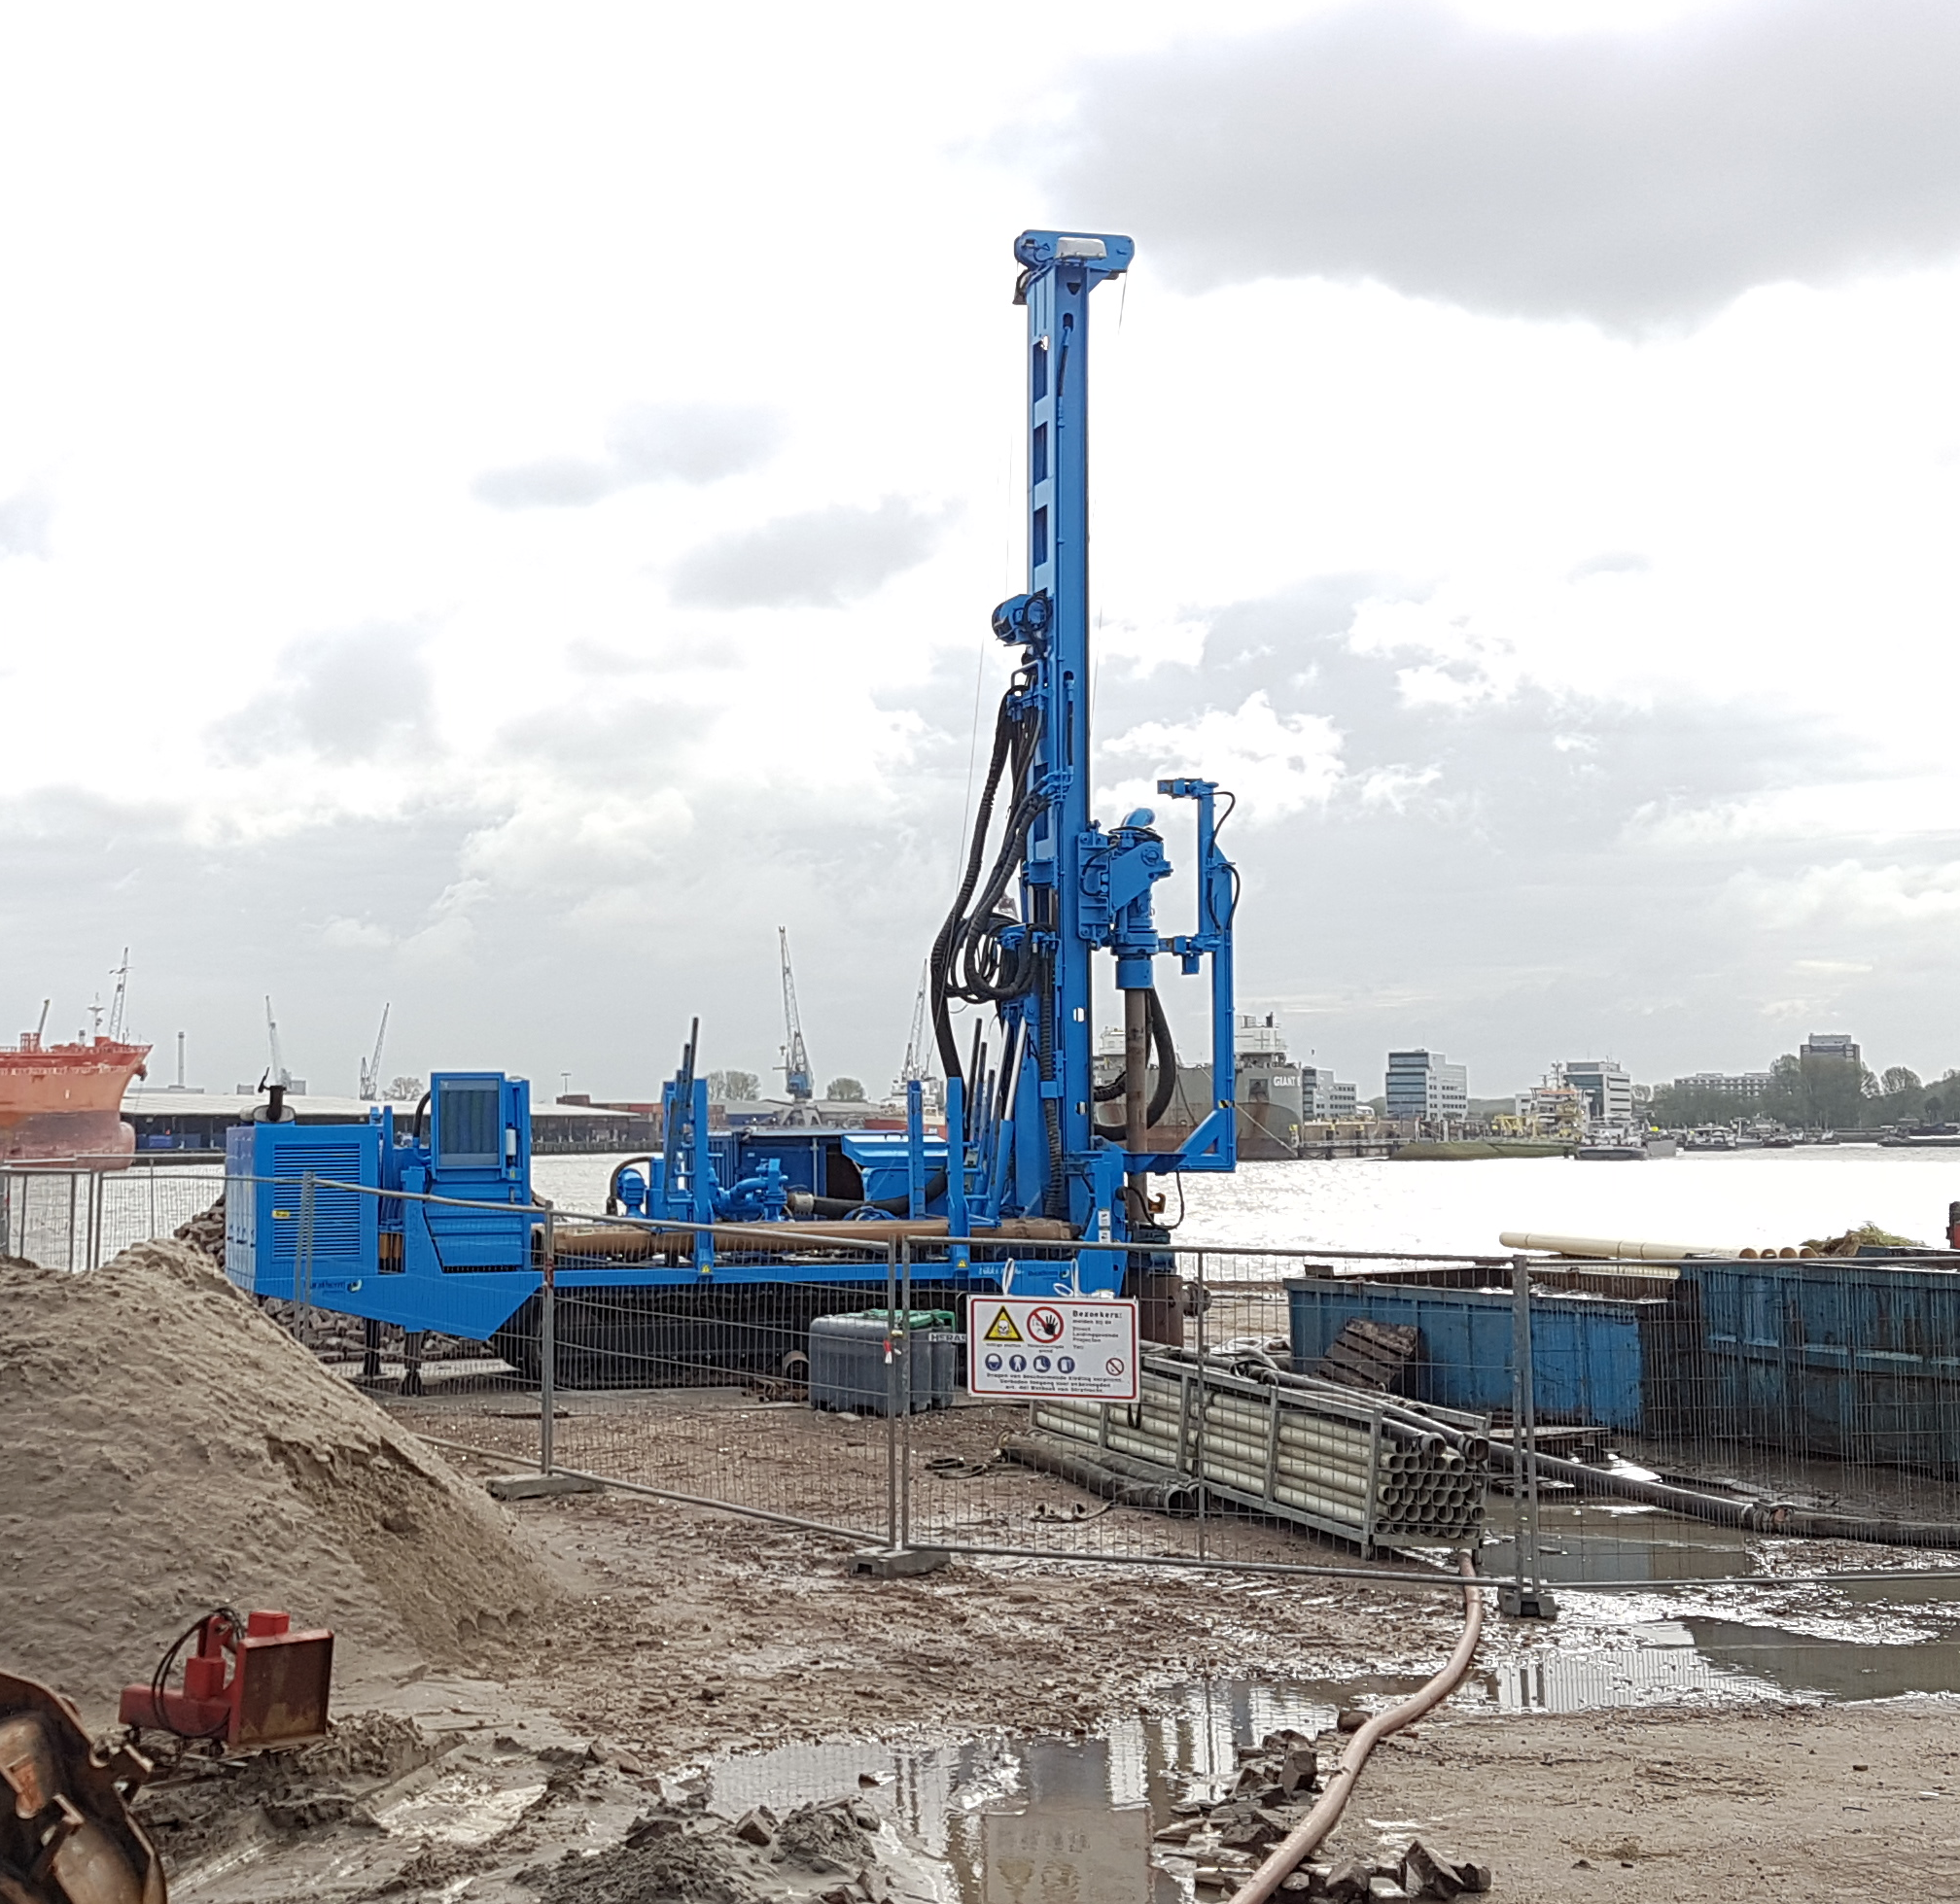


Possible solution
Hot Water Battery:
Storage of excess energy in the subsurface
Notes:
We have been working for the last year on a possible solution in cooperation with Duratherm and cohere consultant. This is the Hot Water Battery.

Slide 8
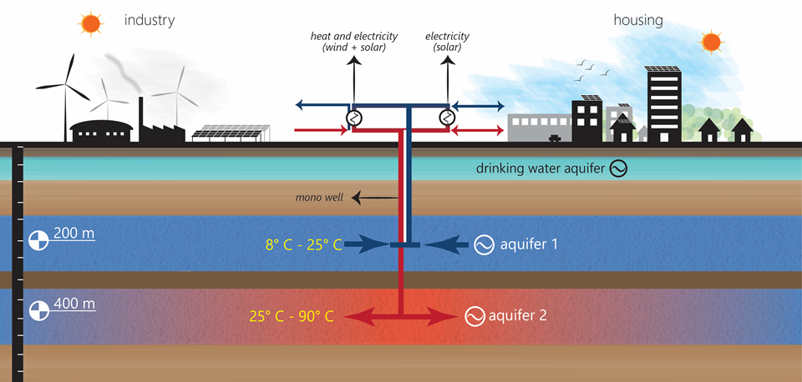
Hot Water Battery
Summer scenario
Notes:
Excess heat and electricity are converted in summer to hot water using heat pumps. The hot water is stored in a deep aquifer with a mono-well. Cool water is stored in a shallow aquifer. By storing water with different temperature at different depths, both warm and cold water can be used when needed. The advantages are that we can store higher temperatures, so this is more efficient for heating houses in winter. Because of the larger depth at which we store the warm water, there is less heat loss and no impact to drinking water. Once installed the energy storage system produces no sound and uses no space which is perfect for urban areas.

Slide 9

Hot Water Battery
Winter scenario
Notes:
It can help with the storage problem in the energy transition world.

Slide 10
Advantages of the Hot Water Battery
Storage of higher temperatures
Use of a monowell
Buffer for drinking water
4 months demand, 8 months to fill buffer
Notes:
The hot water battery is innovative, because we want to store higher temperatures than usual at these larger depths and we want to use a mono well. Furthermore, the cold aquifer provides a buffer for the drinking water. 4 months peak demand is also 8 months to partially fill buffer.
There are different possibilities and in the next presentation, more on challenges and opportunities with heat storage will be discussed.

Slide 11
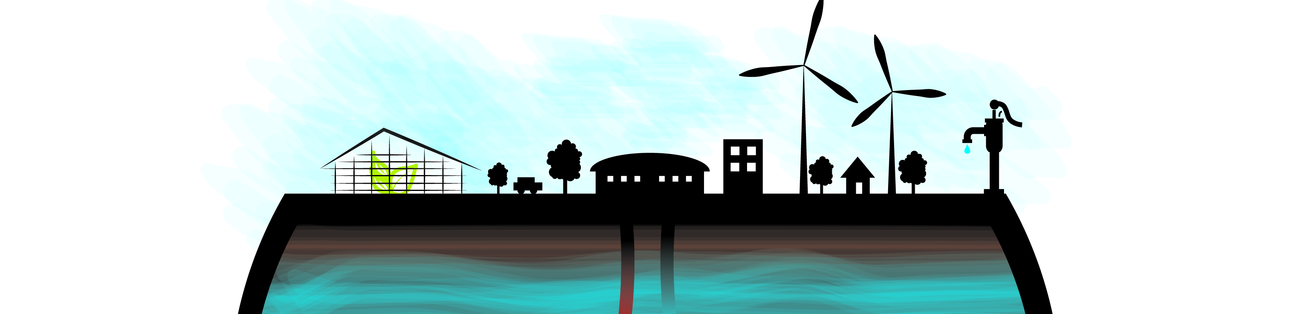
Conclusion
HT heat storage is needed
Aquifers can provide the solution
Notes:
HT heat storage is needed, now and in the future. As more energy from windmills, industries and solar energy will come available, more energy storage is needed.

Slide 12

www.witteveenbos.com

