Slide 1
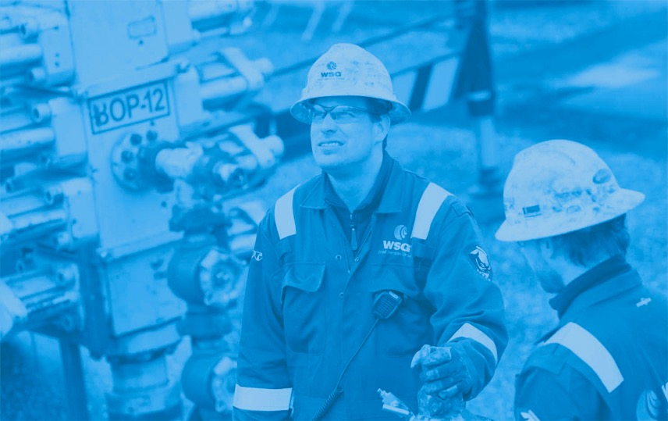


Slide 2
Contents
Introduction
Working procedure
Lateral dimensions
Acid Jetting
Operation Setup
Limitations
Statistics
Future developments

Slide 3
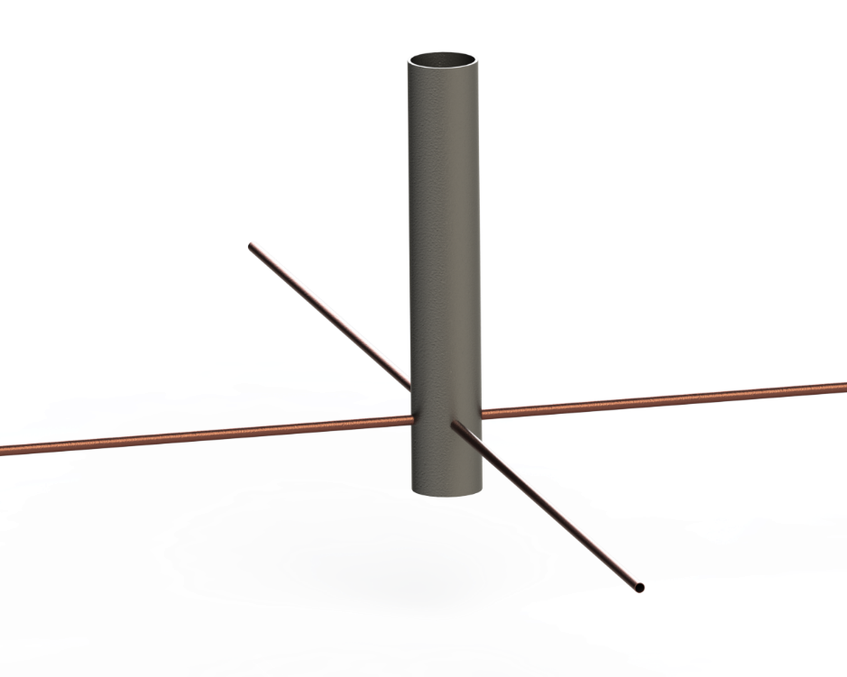
Radial Jetting - Introduction
Radial Jetting is a stimulation technique
which allows the creation of
highly conductive flow paths between reservoir and wellbore

Slide 4
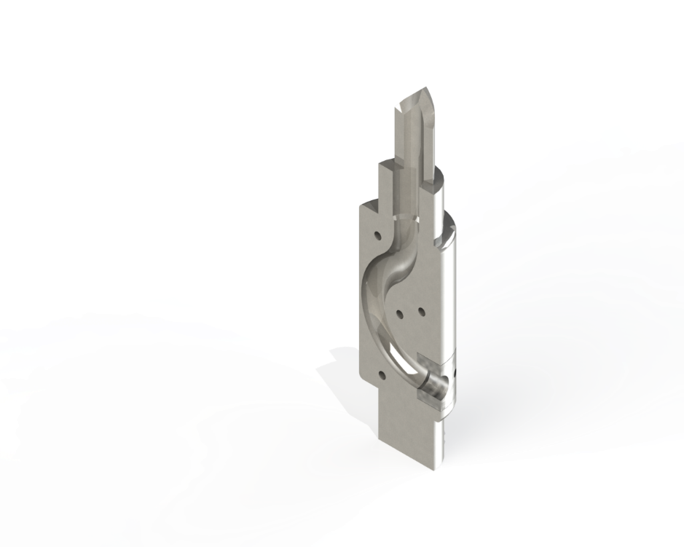
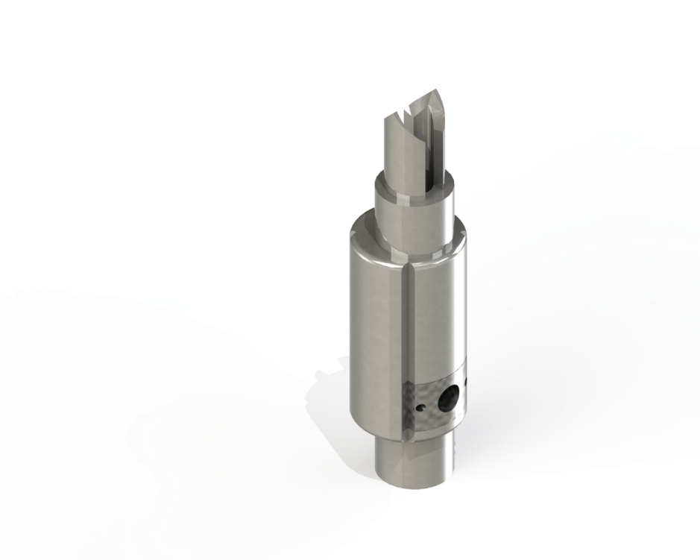
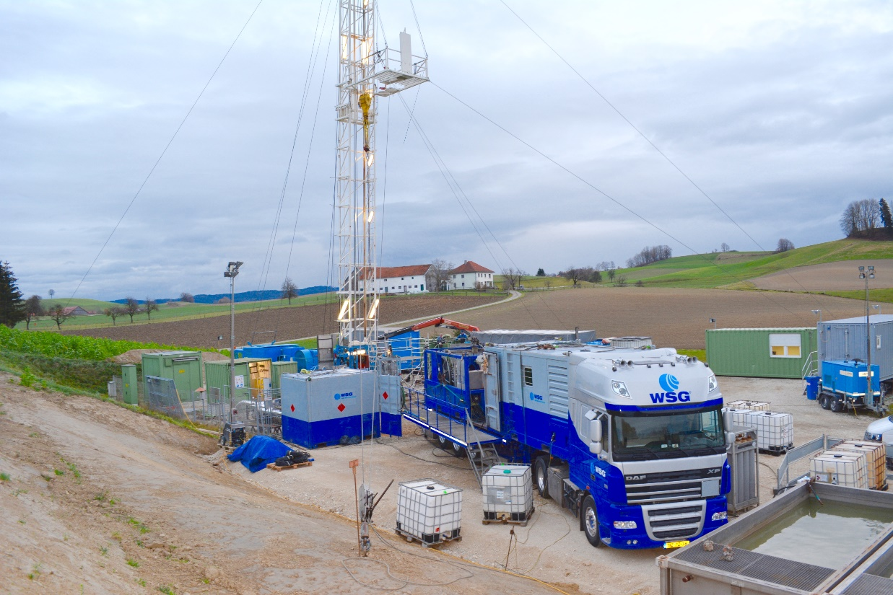
Conventional procedure
How does it work?
Workover rig pulls the completion and sets a deflector shoe on a workover tubing

Slide 5
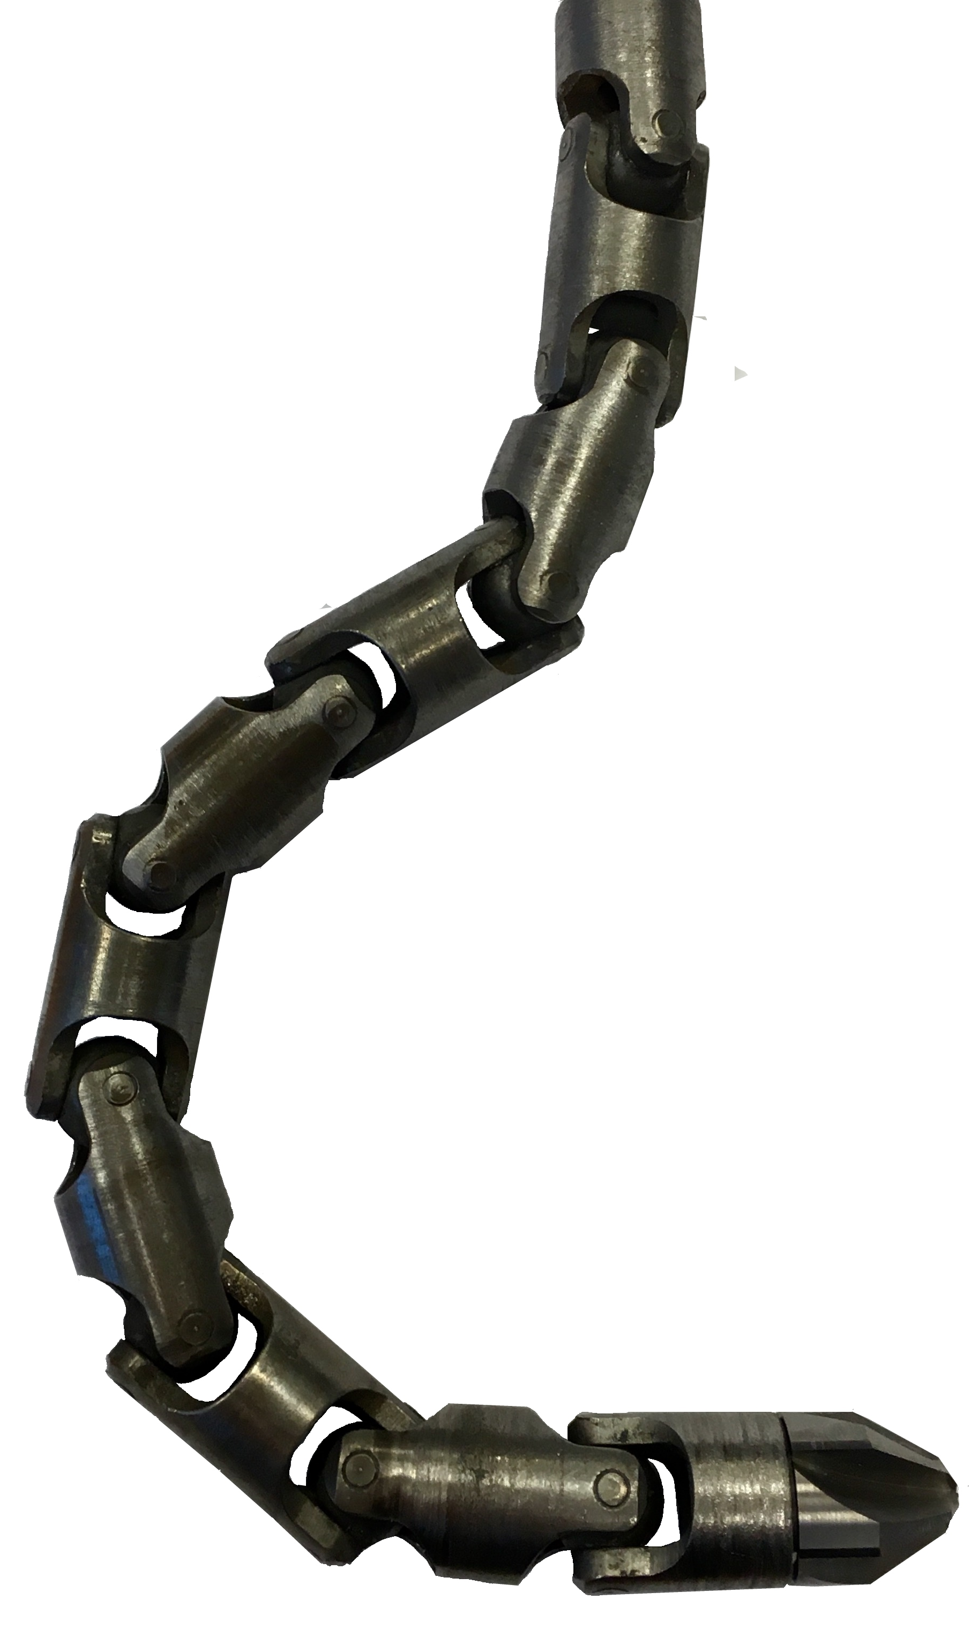
Conventional procedure
How does it work?
Workover rig pulls the completion and sets a deflector shoe on a workover tubing
Gyro orientation of the deflector shoe opening (optional)
RIH with ½“ Mini Coil to mill a hole into the casing

Slide 6
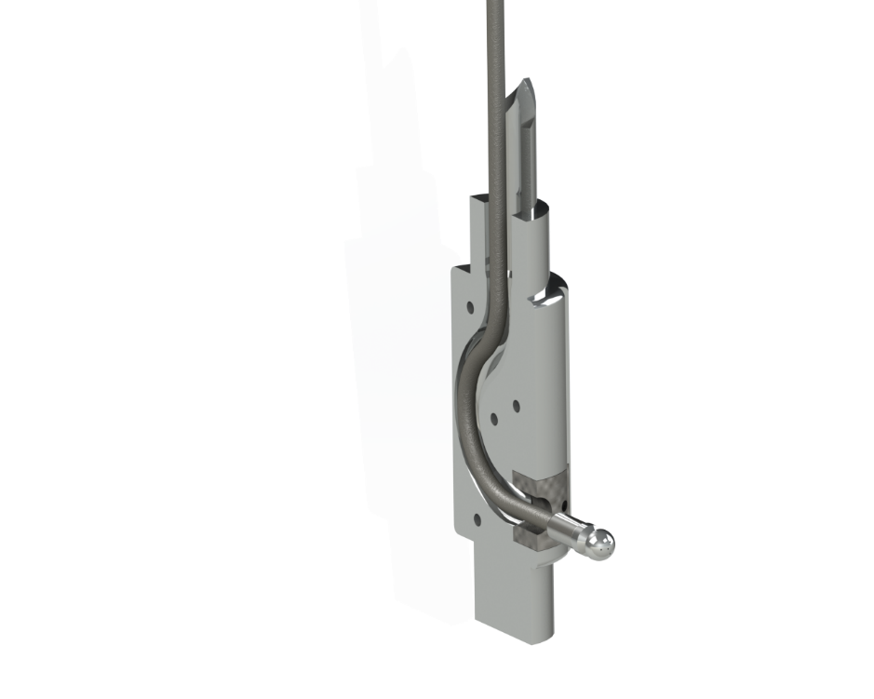
Conventional procedure
How does it work?
Workover rig pulls the completion and sets a deflector shoe on a workover tubing
Gyro orientation of the deflector shoe opening (optional)
RIH with ½“ Mini Coil to mill a hole into the casing
RIH with ½“ Mini Coil to jet into the reservoir
Mechanism of Penetration
Surface Erosion
Poroelastic tensile failure
    Cavitation

Slide 7
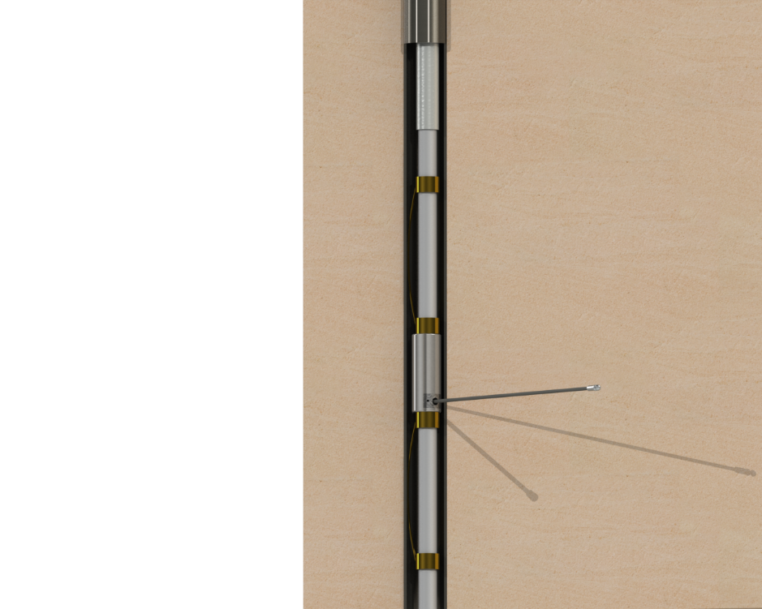
Conventional procedure
≥ 4-1/2” Casing
Downhole Assembly
Casing: 4 ½“ Inch and larger
Work-over tubing: 2-7/8“ to 2-1/8“
Decentralizers assure the deflector is pushed against the casing
Deflector shoe guiding the milling and jetting assembly
2-7/8” WO tubing
2-3/8” WO Tubing
De-Centralizers
How does it work?
Workover rig pulls the completion and sets a deflector shoe on a workover tubing
Gyro orientation of the deflector shoe opening (optional)
RIH with ½“ Mini Coil to mill a hole into the casing
RIH with ½“ Mini Coil to jet into the reservoir
Deflector Shoe
Jetting hose with Nozzle
De-Centralizers

Slide 8
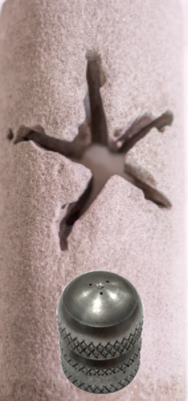
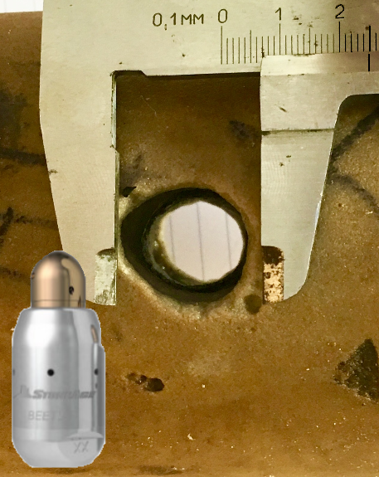
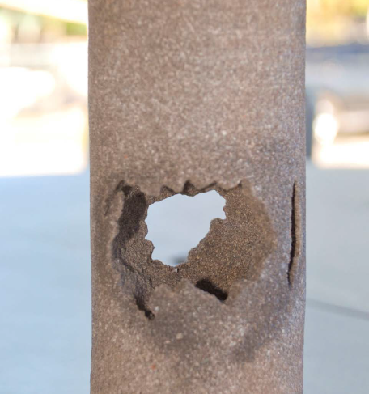
Lateral dimensions
Approximately 2”in diameter and up to 100m long
Static
Rotary
Acid Stimulation

Slide 9
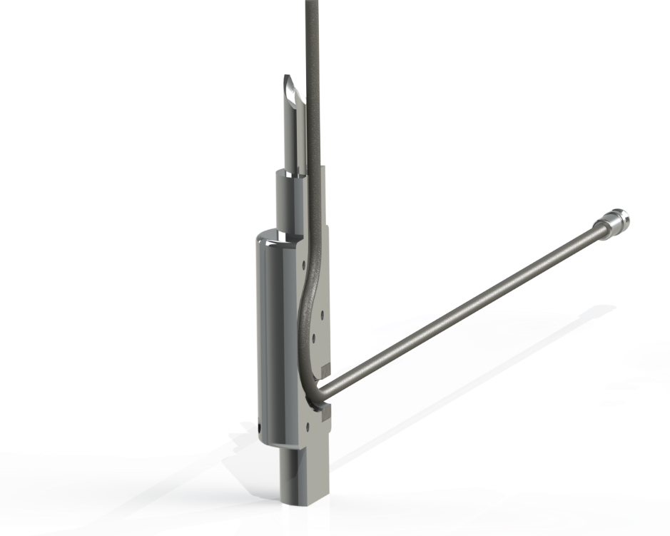
Acid Stimulation
How does Jetting with acid work?
The hose is RIH with fresh water. When the target depth is reached, start pumping a 15% HCl blend with inhibitors.
Acid Jetting benefits
For calcite cemented formation the rate of penetration increases
For carbonate formations acid increases the ability to penetrate the formation, making radial jetting applicable to almost every formation
Possibility to perform an extended punctual acid squeeze

Slide 10
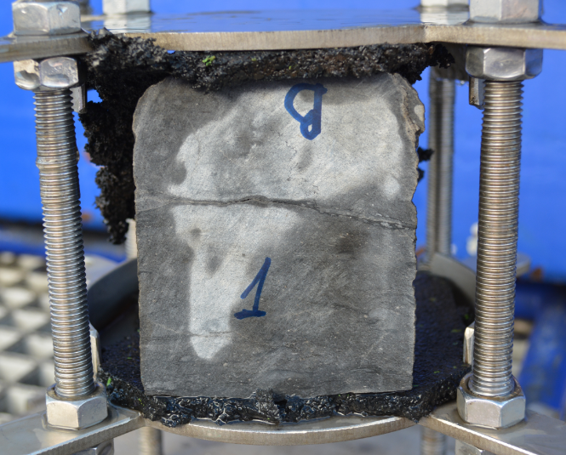
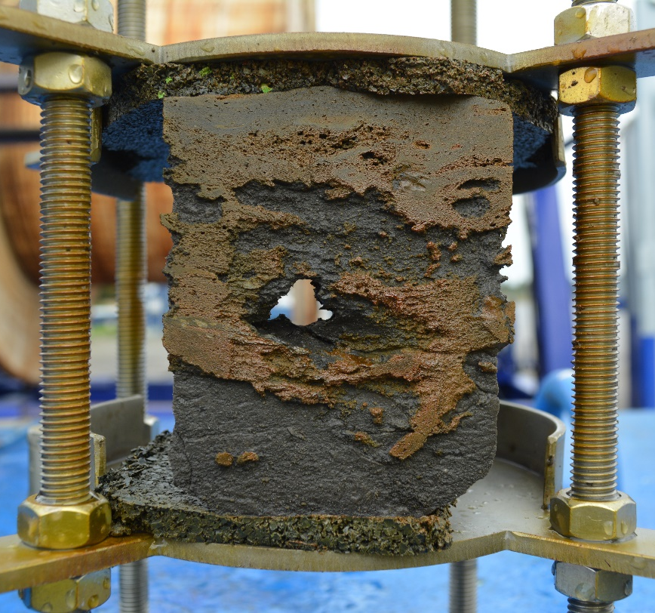
Core test examples
Limestone (low permeability, low porosity) – test with a static nozzle
No Penetration possible with water
Immediate penetration with acid

Slide 11
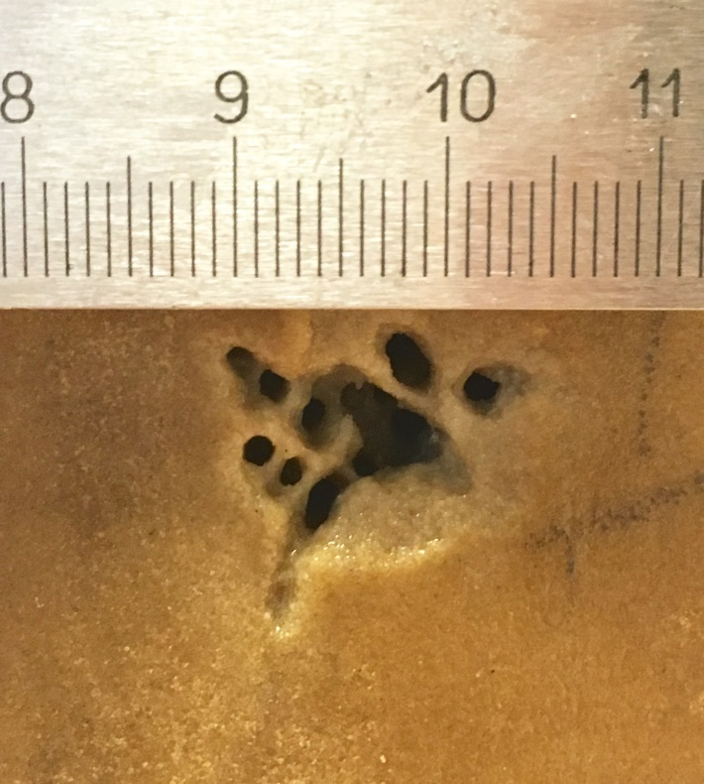
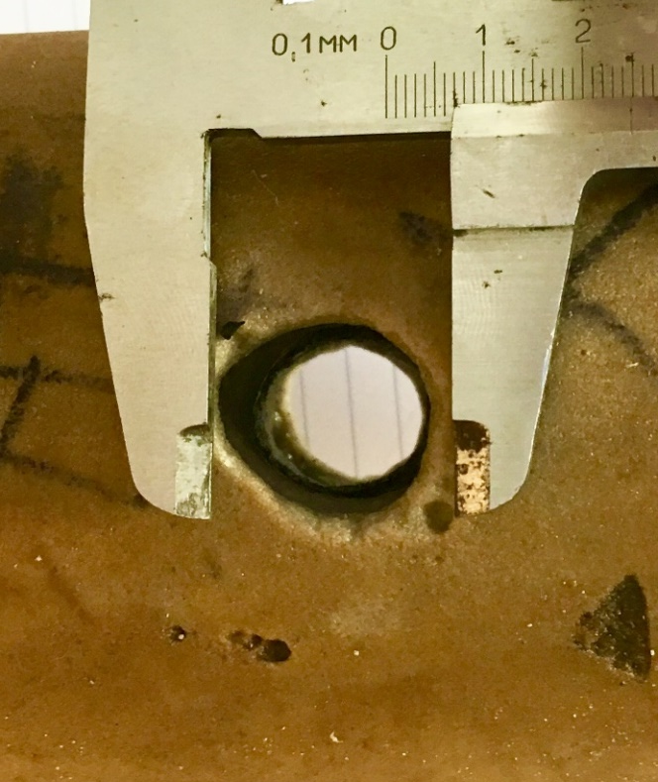
Core test examples
Sandstone (low permeability, low porosity) – Static vs Rotary nozzle
Slight Penetration with Static nozzle
Full Penetration with Rotary Nozzle

Slide 12
Fluid requirements
Running in hole 500 L (assuming a depth of 2000m)
Milling 1500 L
Pulling out of hole 500 L
Running in hole 1000 L
Jetting 1000 L
Pulling out of hole 500 L
Total consumption 5000 L per Lateral

Slide 13
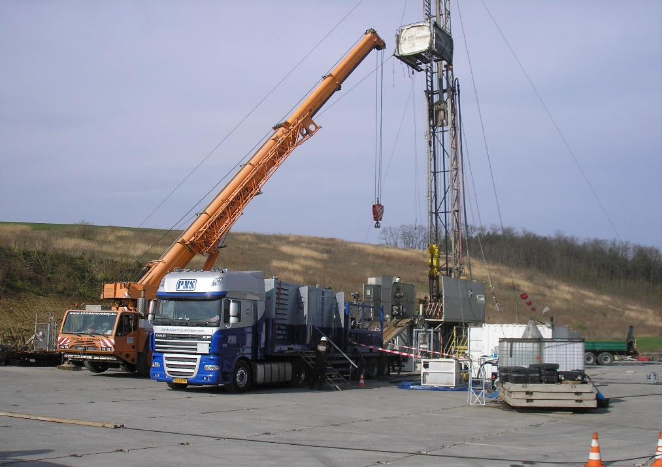
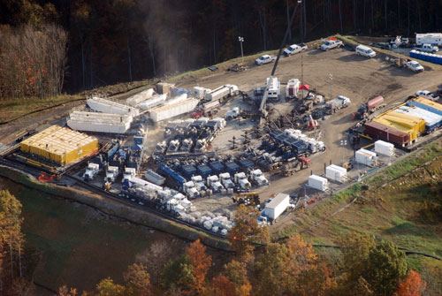
Operation Setup
Radial Jetting
Hydraulic Fracturing

Slide 14
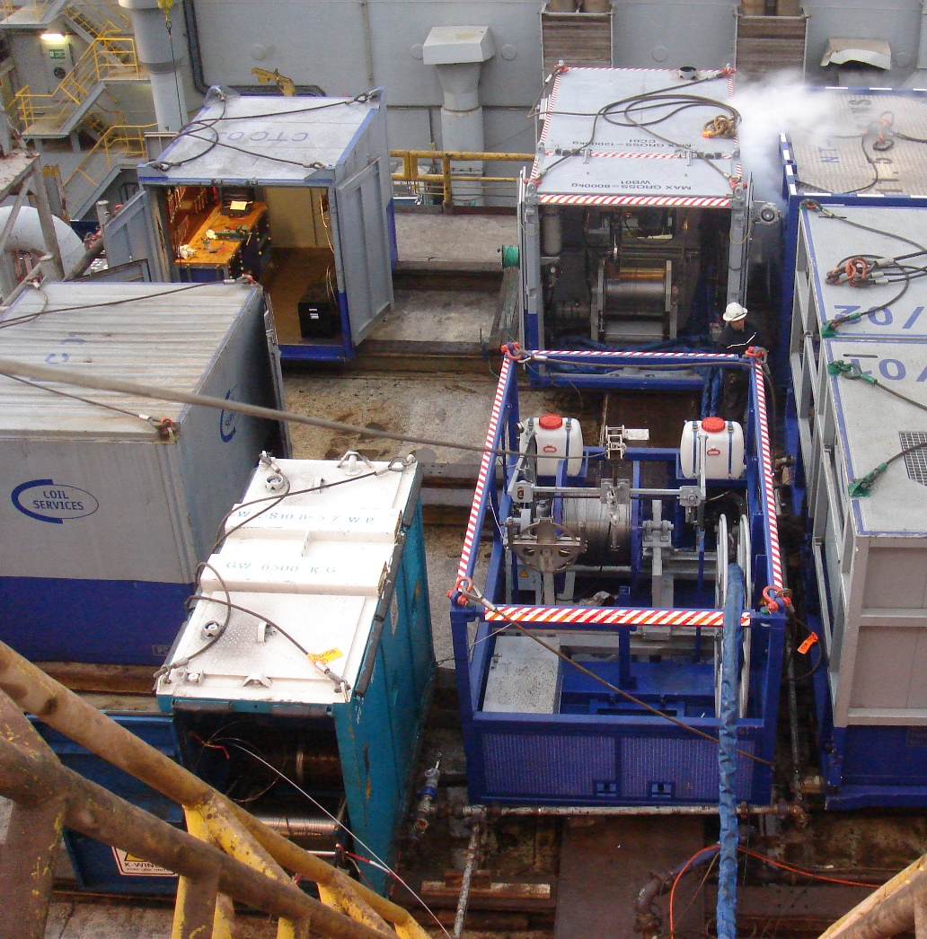
Radial Jetting offshore
10ft Tool container
3.1m x 2.45m
MGW 10.4t
Mini Coil Control Unit
CC01 3.7m x 2.45m
MGW 12t
Mini Coil Spooling Frame
CTF01 4m x 2.45m
MGW 12t
Pump
3.1m x 2.45m
MGW 10.4t

Slide 15
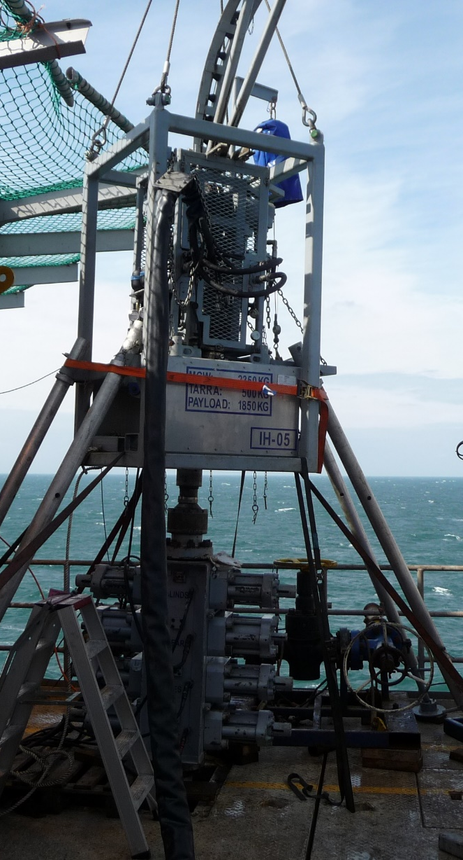
Radial Jetting offshore
Mini Coil injector
BOP
Workover tubing

Slide 16
Radial Jetting limitations
Orientation
  Initial azimuth is determined by a gyro orientation
  Lateral proceeds perpendicular and straight
  No later orienation possible
Depth
Most work was shallower than 3000m MD
Equipment is available to reach up to 5000m MD

Slide 17
Radial Jetting limitations - 2
Inclination
Reaching horizontal targets is possible, see next section
ID
Working in a 4 ½“ liner is possible

Slide 18
Statistics
78% of all laterals ever attempted to jet were created until their designed length

Slide 19
Statistics
86.7% of the cumulated requested lateral length was successfully jetted

Slide 20
Horizontal wellbores
Horizontal wellbore sections can be reached:
For milling:
-> Depending on the max. set down force of the mini coil
-> Generally possible, depending on the actual survey

Slide 21
Horizontal wellbores
Horizontal wellbore sections can be reached:
For jetting:
-> Depending on sufficient force to straighten the hose
-> Above 53°incl., gravity has to be assisted by pumping into the MC–tubing annulus

Slide 22
Calculatory Results

Slide 23

Lukoil
“
91 operations were carried out, giving average daily growth of oil flow by 6 tonnes. Additional production of oil as a result of application of the method was 67,000 tonnes, which is 3 times more than in 2007.
“
Lukoil 2008 annual report

Slide 24

OMV
Jaap Huijskes
                >>OMV VP E&P<<
  „Radial Jetting is an important technique for the development of marginal fields“

Slide 25
MND
„Daily production increased by 100% and the gas volume is at lower levels“
MND Report 4/2014

Slide 26

European Commission
The further improvement of radial jetting is funded by the EU within the Project SURE
„Novel Productivity Enhancement Concept for a Sustainable Utilization of a Geothermal Resource“
as grant agreement 654662 of the EU´s Horizon 2020 research and innovation programme.

Slide 27

Questions?

Slide 28

Thank you for your attention
Sidney van den Berg
SvandenBerg@wellservices-group.com
Tel: +31 591 668 155
Tel: +31 625 645 266

