Slide 1
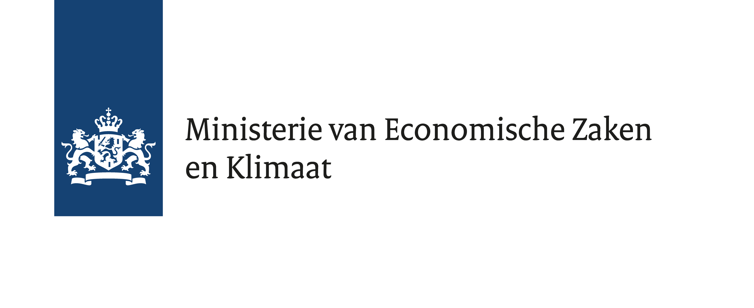
DAP symposium 2019, March 12th
Upscaling Geothermal Heat: Synthetic Models Advising Field Development
Alexandros Daniilidis, Hamid Nick, David Bruhn
Research Funded by:
Steering committee

Slide 2
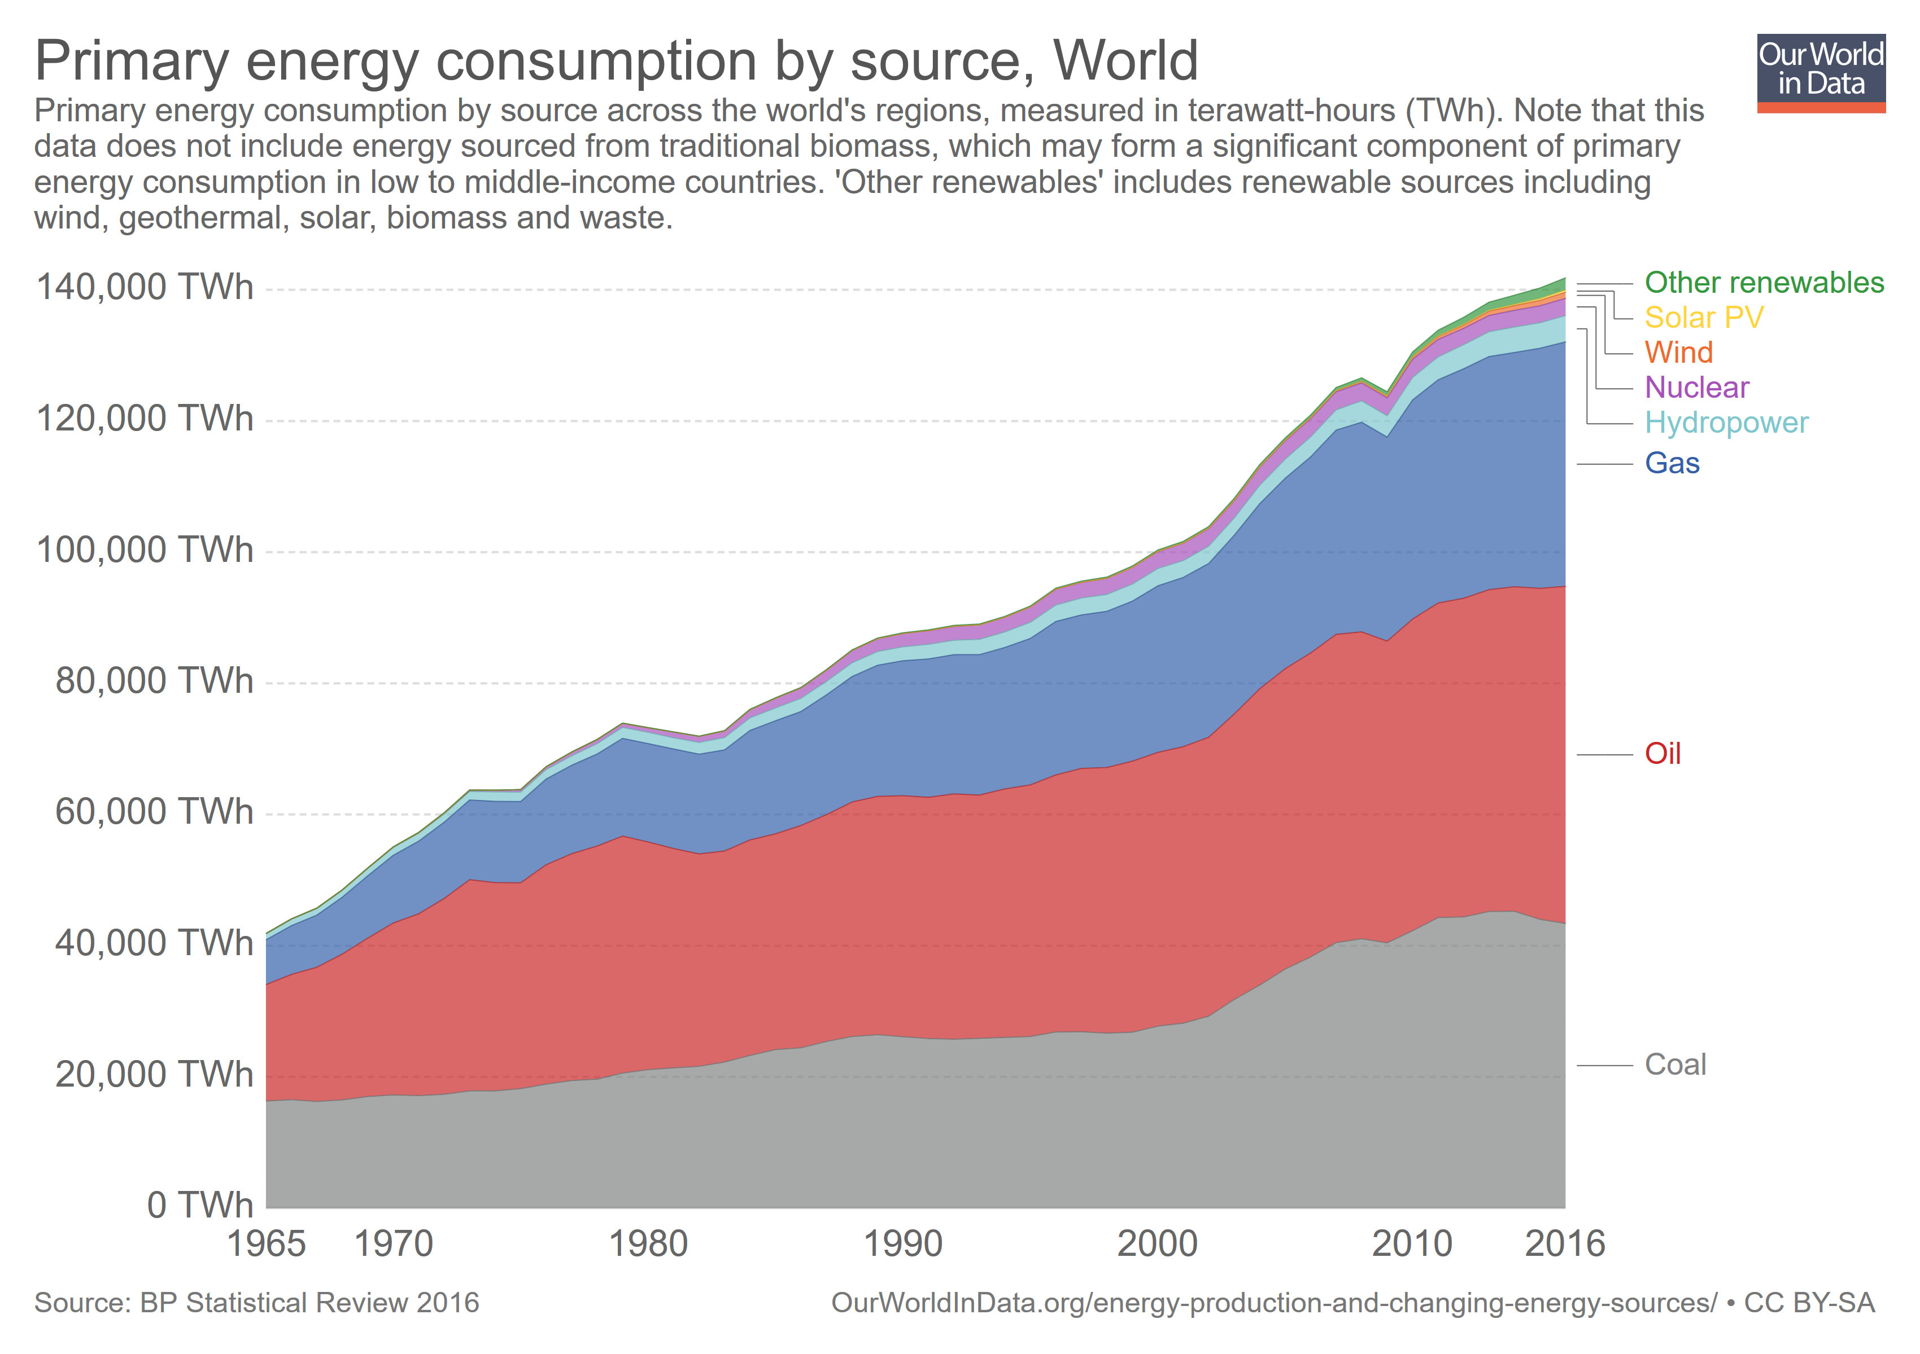
Motivation
CO₂
_{<2°C}

Slide 3
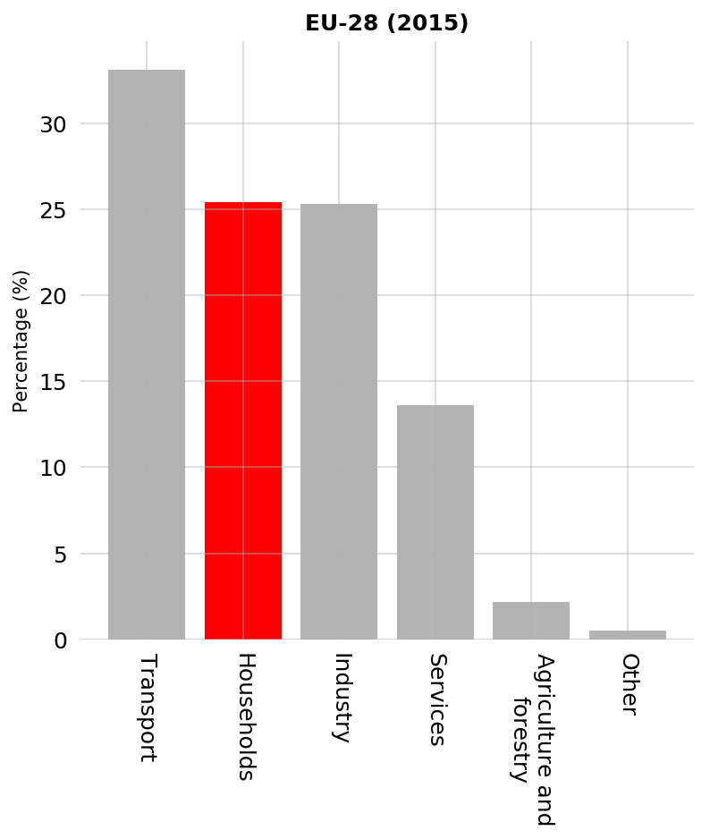
Motivation

Slide 4
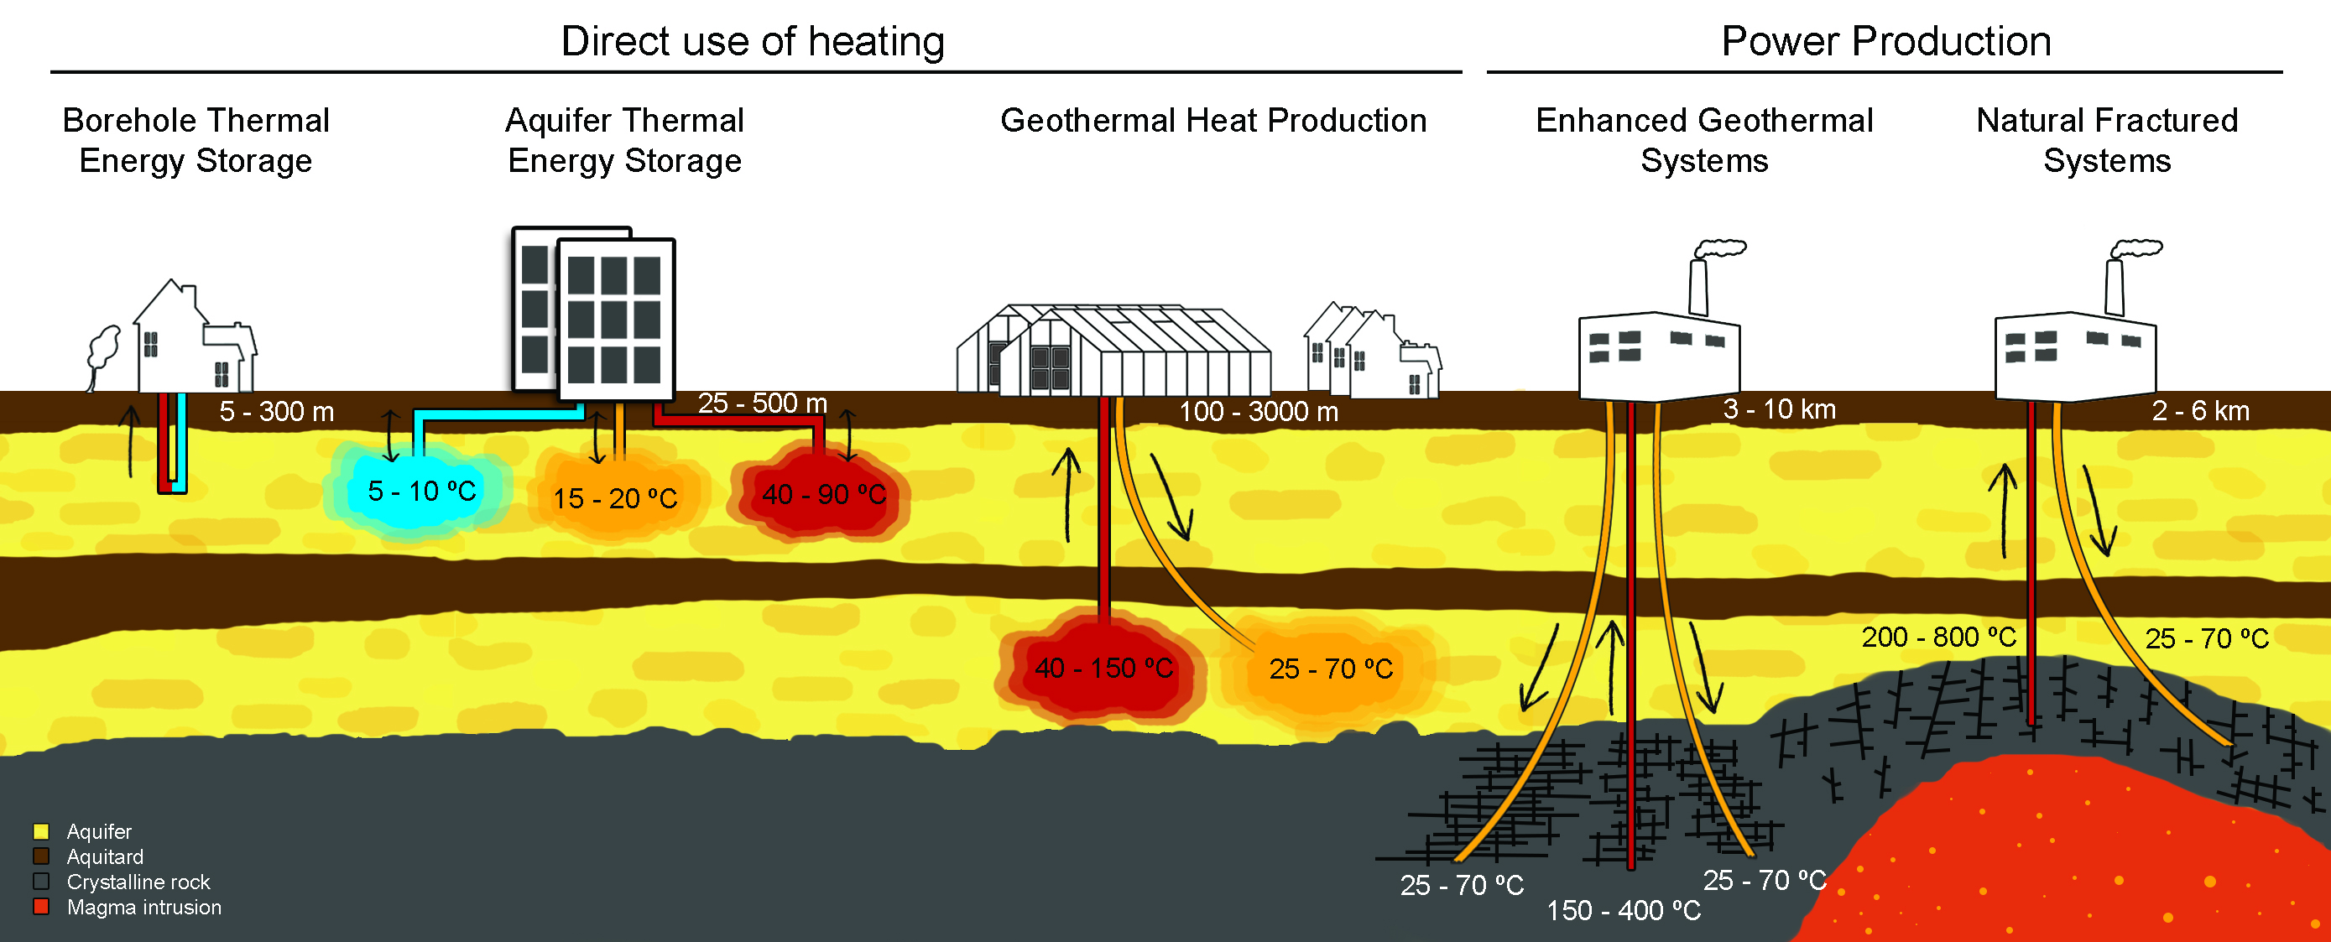
Geothermal systems

Slide 5
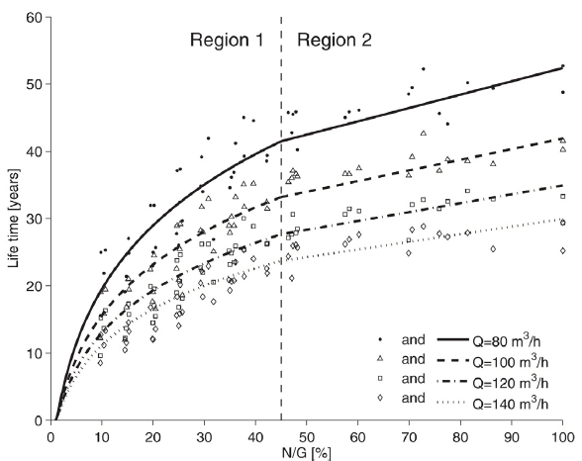
Background
Three types of reservoir models
Crooijmans et.al. 2016

Slide 6
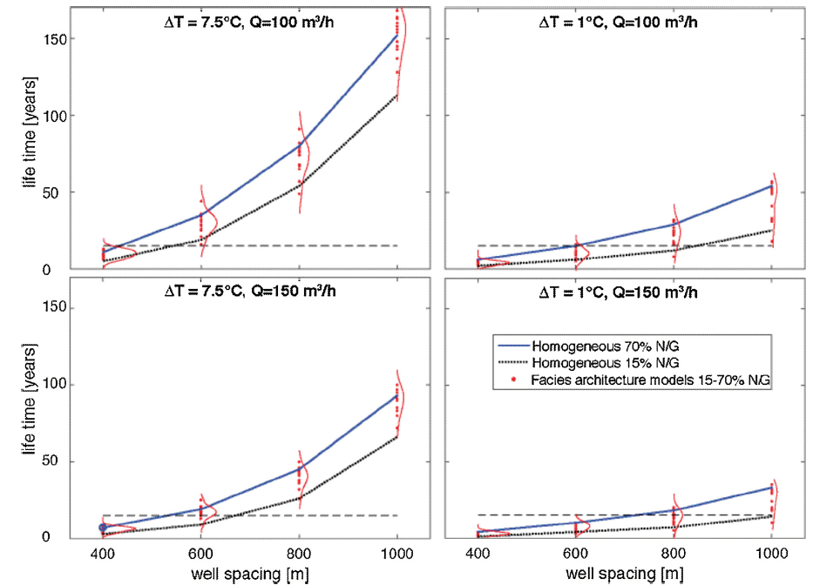
Background
Well spacing
Willems et.al. 2017
Notes:
From Willems we know that the lifetime of a systems with facies architecture can be reasonalby captured with a homogeneous model with comparative N/G

Slide 7
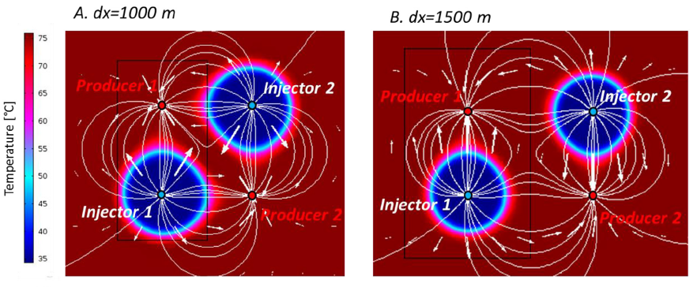
Background
Interference – two doublets
Willems et.al. 2017
Notes:
Positive interference for equal well spacing
production rate issues with regards to spacing and pressence of geological features that can alter the pressure field such as a fault
NPV should be looked at for longer than 15 years (beyond subsidy duration)

Slide 8
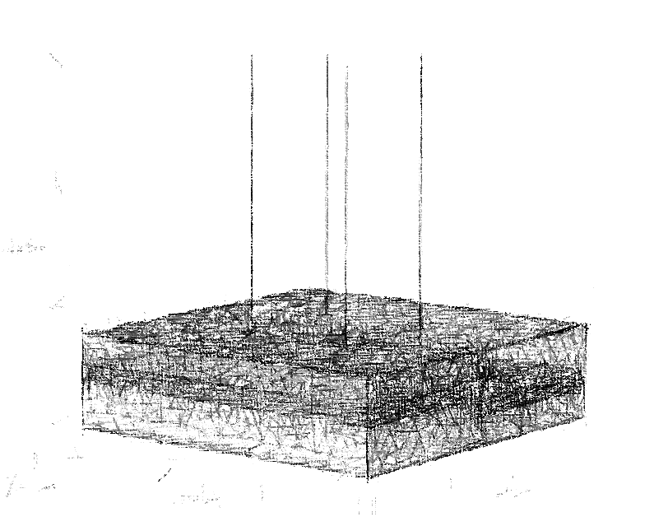
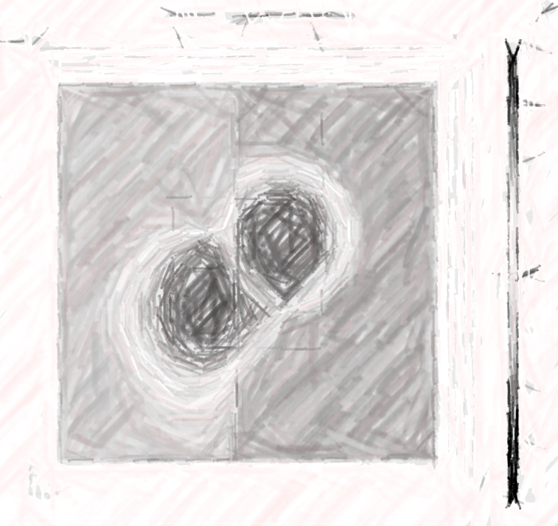
Underlying idea
“Simple” synthetic model
X1000s realization
Analyze results
Devise strategy
Capture uncertainty
Consider scenarios
Obtain generalizable conclusions
“Upscale” findings to field scale
Notes:
Positive interference for equal well spacing
production rate issues with regards to spacing and pressence of geological features that can alter the pressure field
NPV should be looked at for longer than 15 years (beyond subsidy duration)

Slide 9
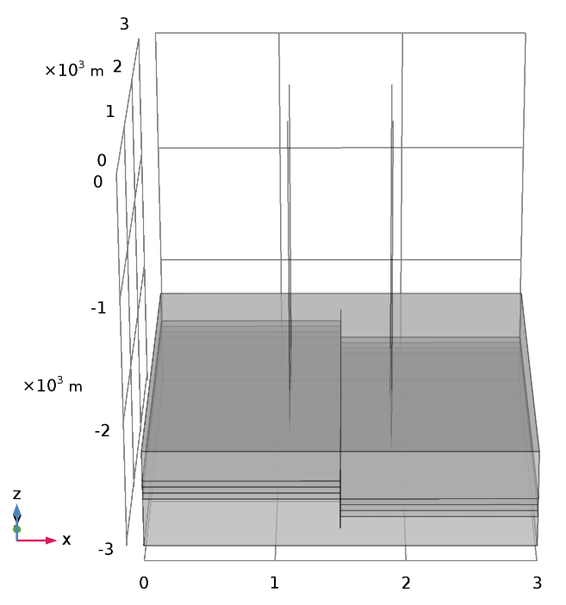
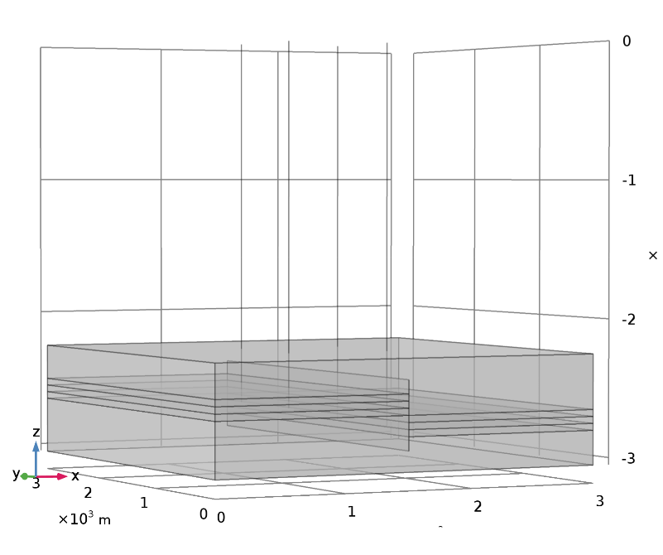
Synthetic model
2 doublets separated by one fault
Notes:
Hydraulic Thermal model
Reservoir: 3 layers of 50m, homogeneous flow properties
Over and underburden 250m thickness, really low permeability
Simulate the system for 50 years

Slide 10
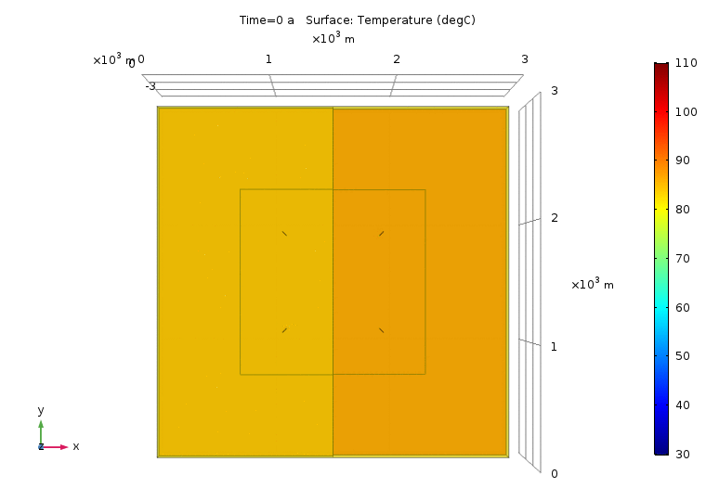
Example simulation
Top view
Notes:
Displacement 150m, fault distance center, 800m spacing
Two ways to see this, different operators of west and east doublet, or single operator

Slide 11
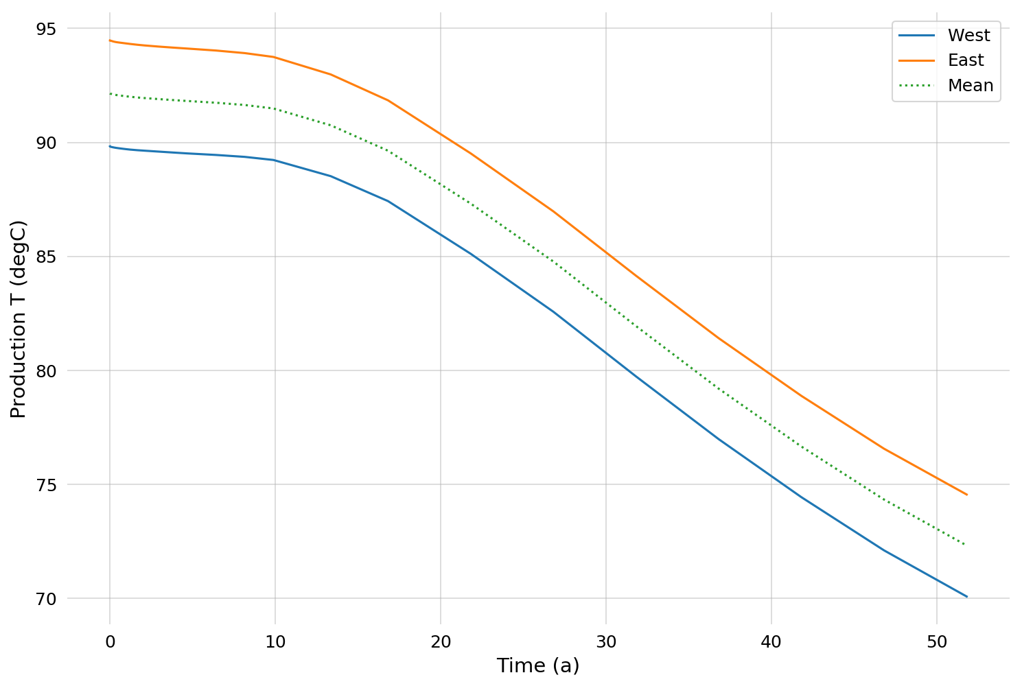
System lifetime
Temperature drop
Notes:
East doublet, higher temperature due to increased depth. Pattern similar for all three cases

Slide 12
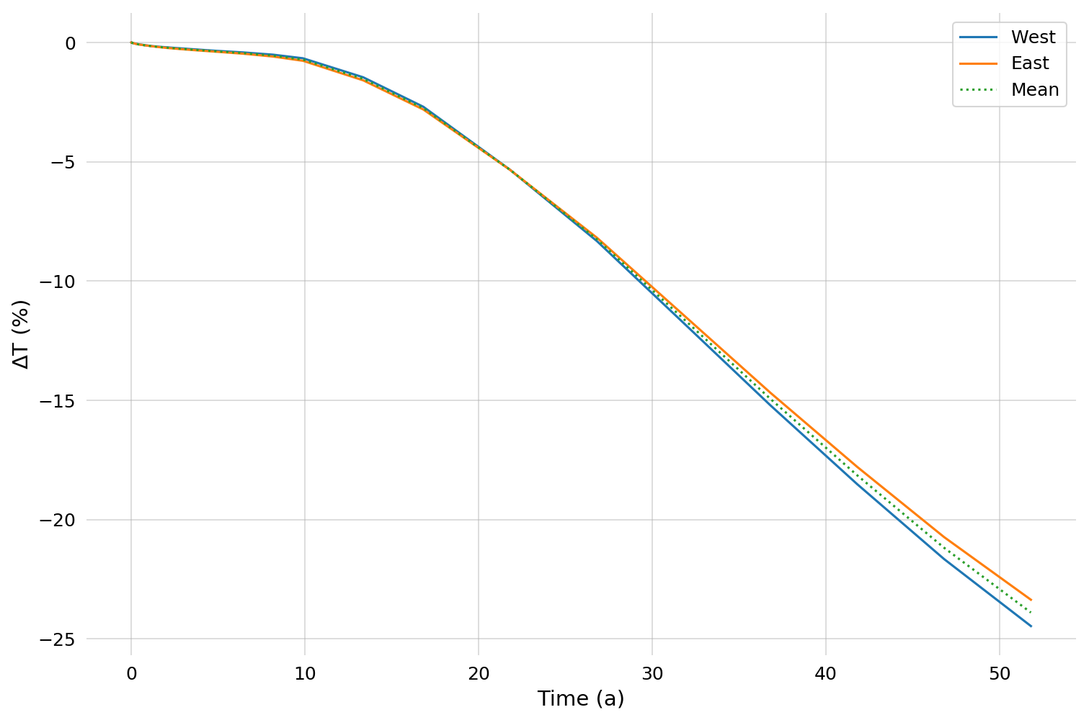
System lifetime
Percentage drop T≤95%T_{t=0}
Notes:
Normalizing to initial temperature shows small differences

Slide 13
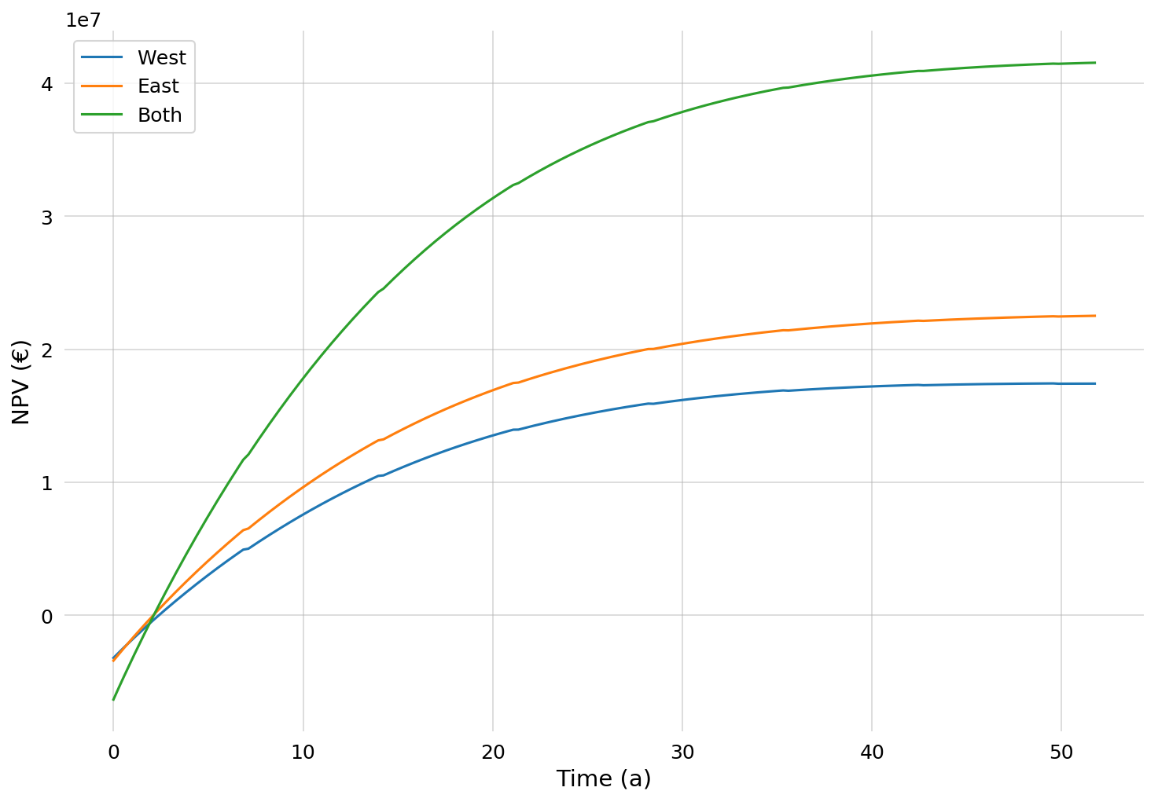
NPV
At system lifetime
Notes:
Assumes 60euro/MWh price for heat
NPV still positive and increasing but, my main process is not satisfied, beyond the lifetime point
From an NPV perspective we could produce more, if our process could accept lower temperature input.

Slide 14
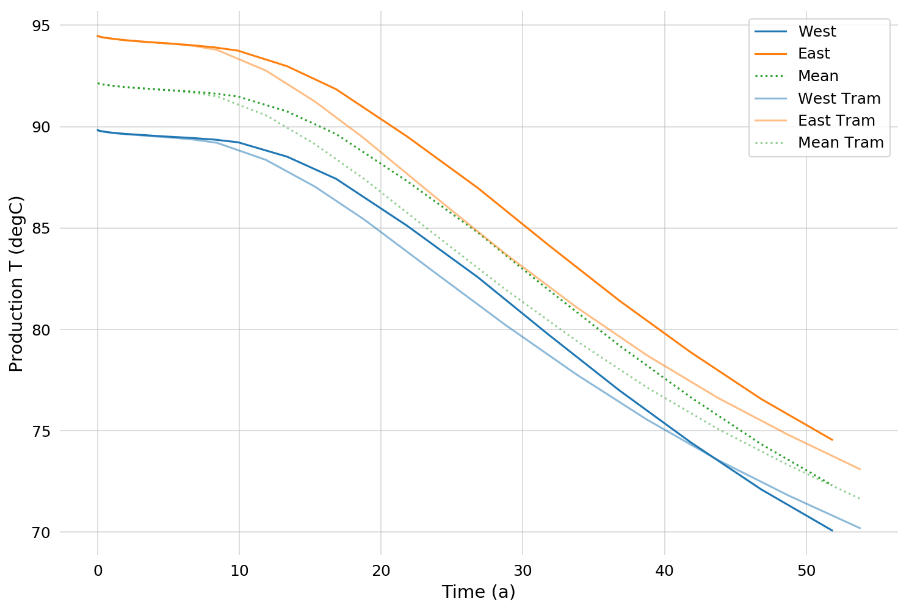
System lifetime
Well configuration

Slide 15
Example simulation
Top view
Uncertainty:
Reservoir layer properties
Fault distance
Fault properties
….
Scenario:
Well spacing
Well arrangement
Flow rate
….
Notes:
Displacement 150m, fault distance 200m from West doublet

Slide 16
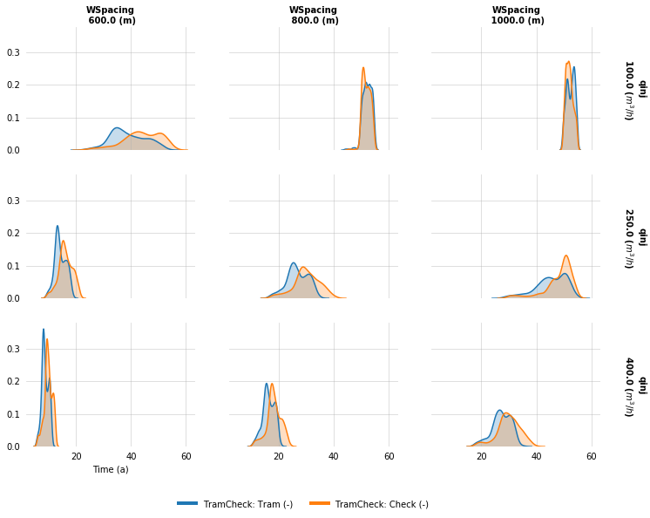
System lifetime
Well configurations T ≤ 95% T_{t0}
Notes:
Checherboard configuration always preferable
~20 years of lifetime even at 400m3/hr with 1000m spacing
~20 years of lifetime even at 250m3/hr with 800m spacing

Slide 17
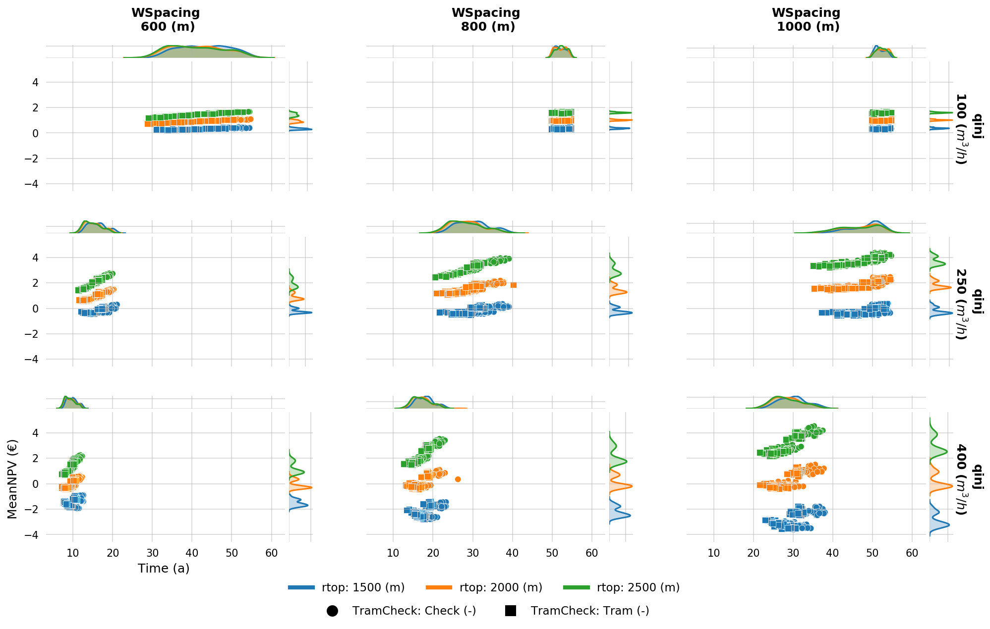
Systematic Overview
T≤95% T_{t0}

Slide 18
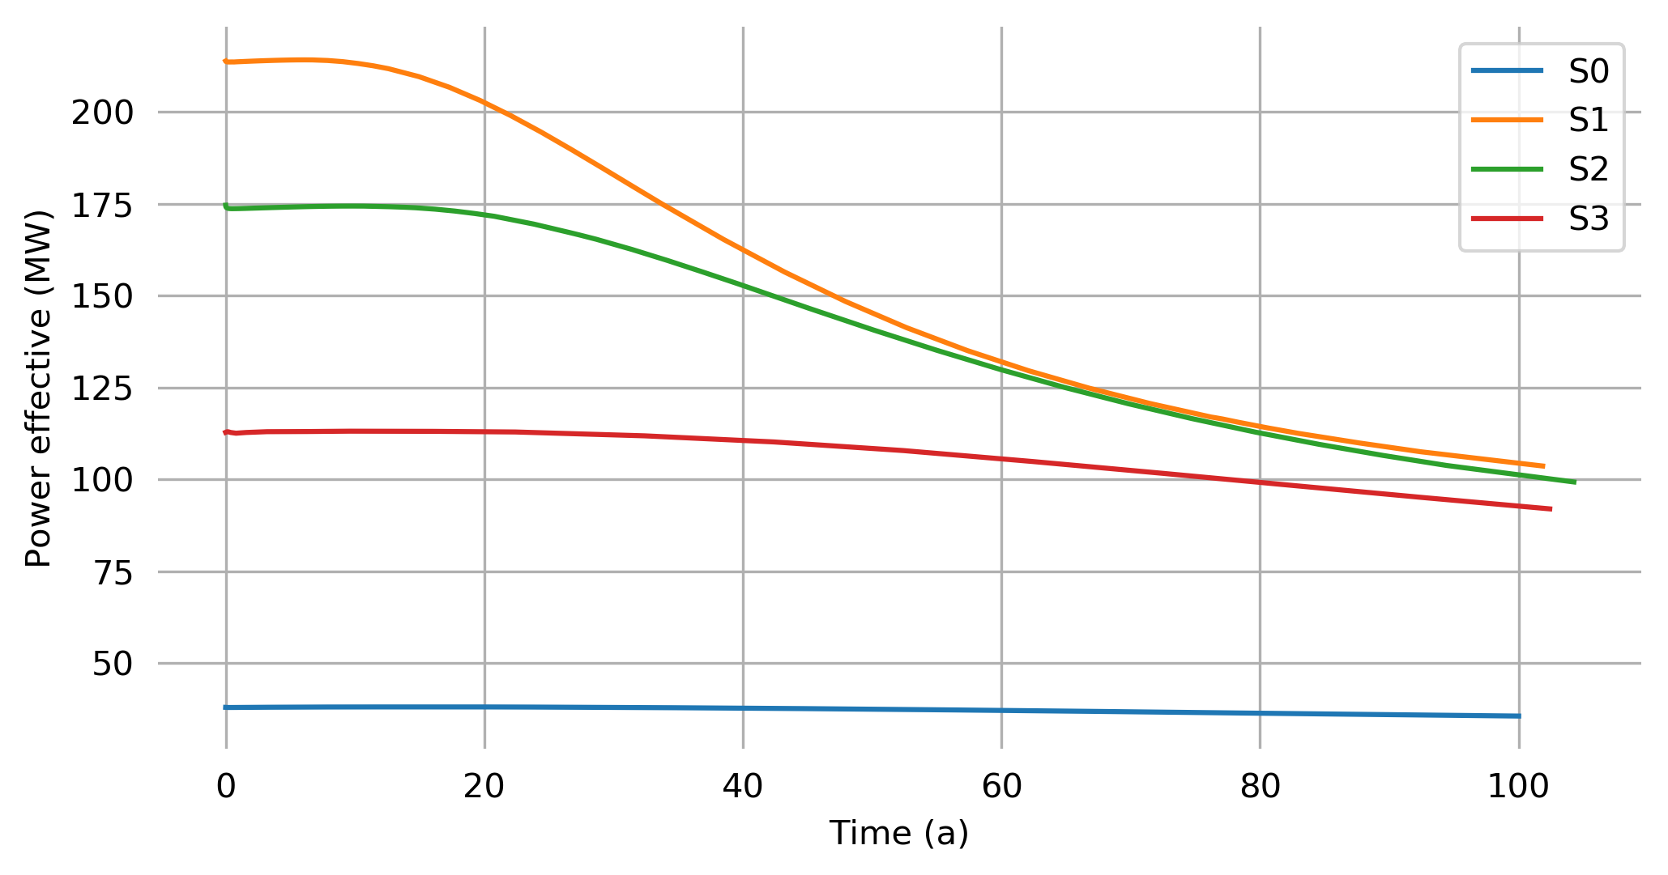
Field scale
Notes:
Increasing the number of wells, decreasing the well spacing
At field scale with geomodelled flow properties

Slide 19
Overview
“Simple” synthetic model
X1000s realization
Analyze results
Devise strategy
Capture uncertainty
Consider scenarios
Obtain generalizable conclusions
“Upscale” findings to field scale
Notes:
Positive interference for equal well spacing
production rate issues with regards to spacing and pressence of geological features that can alter the pressure field
NPV should be looked at for longer than 15 years (beyond subsidy duration)

Slide 20
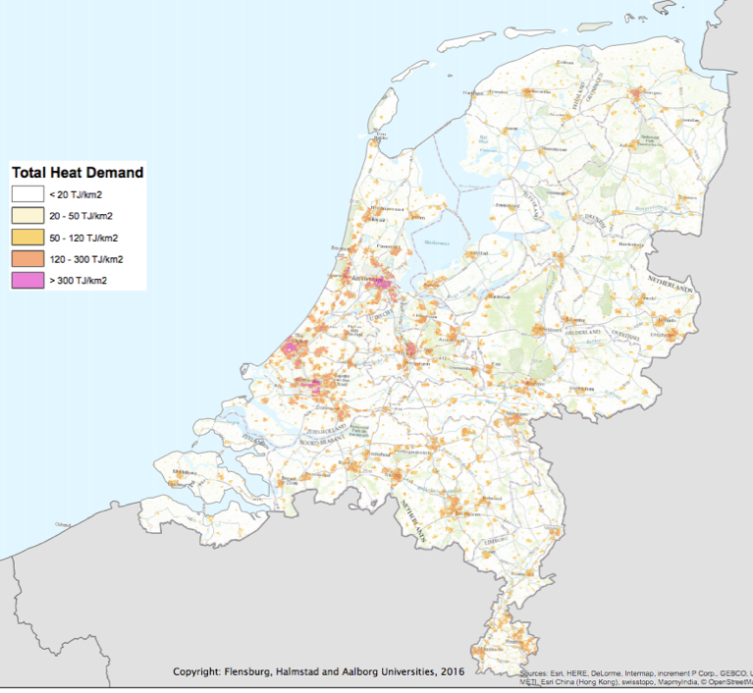
Relevance
Source: Heat Roadmap Europe 2013
Notes:
To supply a larger part of the high demand, we need coordinated development of geothermal systems.
A development strategy at the regional scale can signifficantly improve the output per license area and also per finite subsurface space.
Results are already apparent with two doublets and become more relevant as their number increases further.

Slide 21
Contact:
A.Daniilidis@tudelft.nl

